Slide 1

BP Energy Outlook

Slide 2


Slide 3
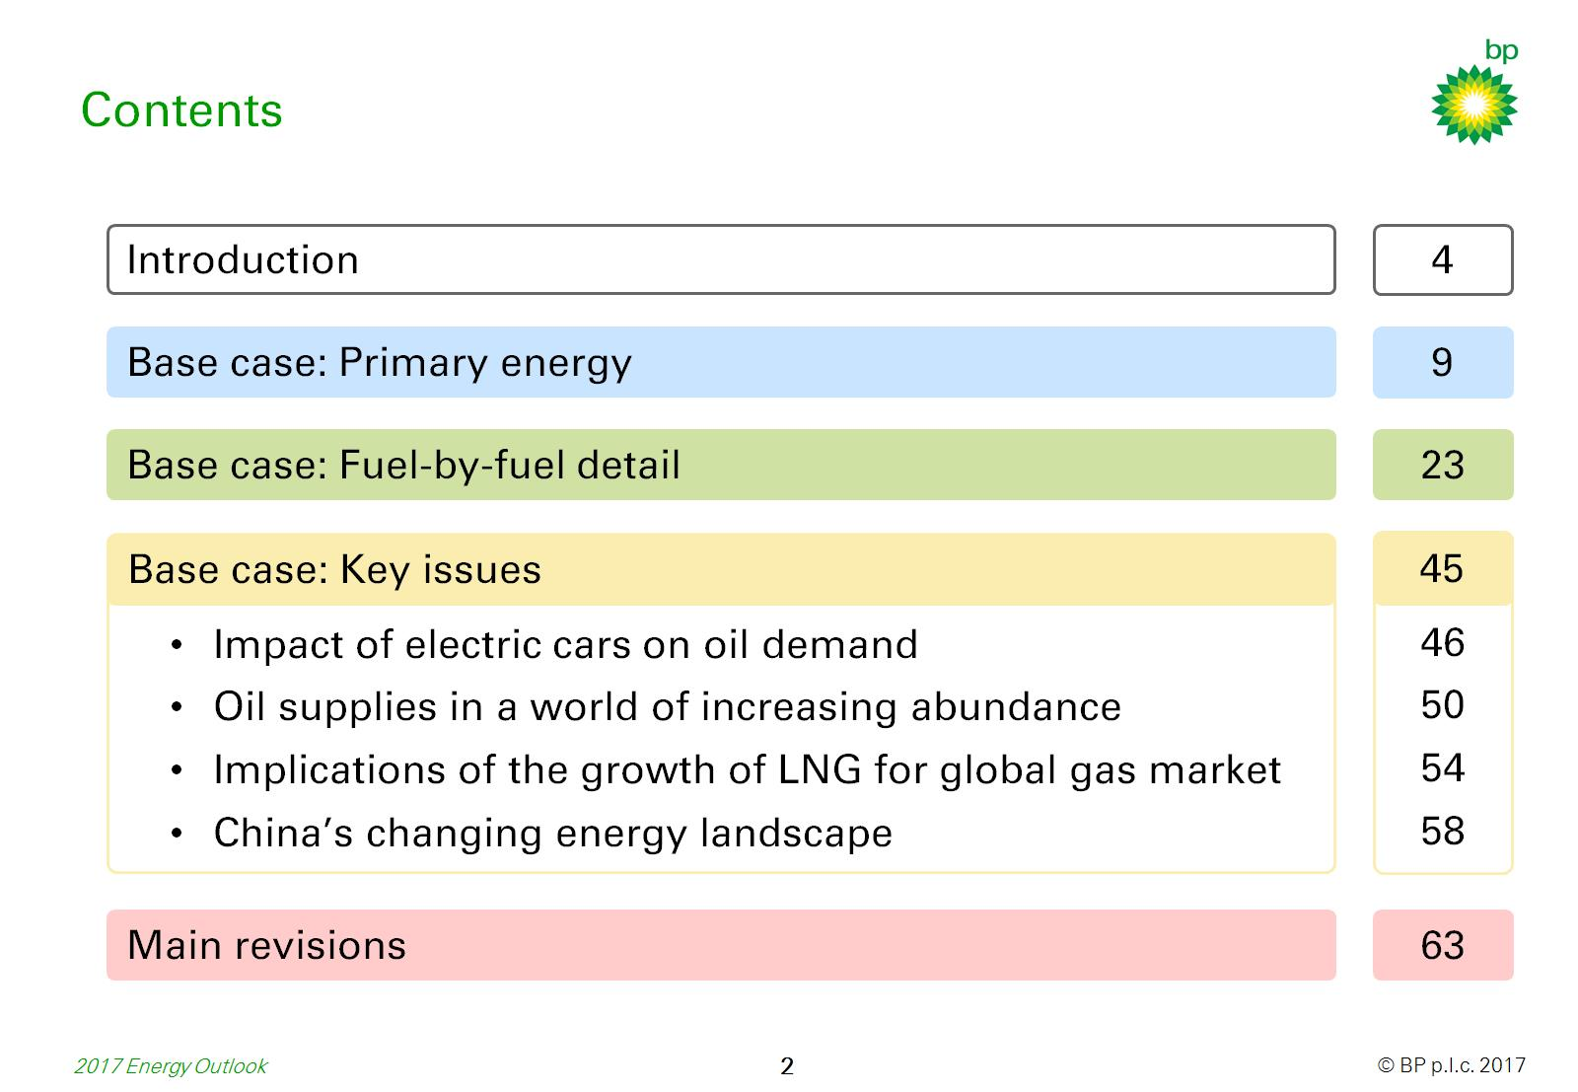
Contents

Slide 4
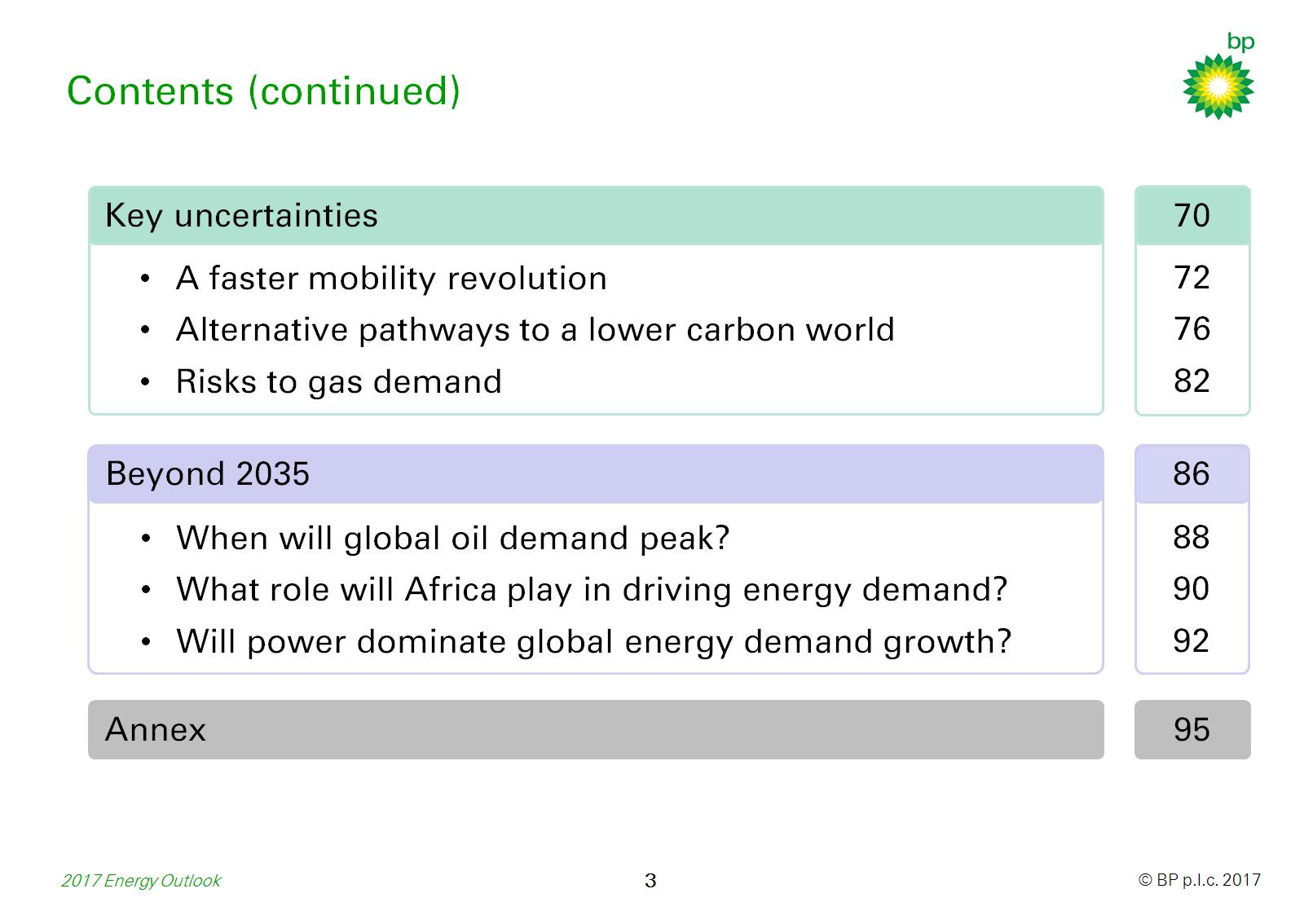
Contents (continued)

Slide 5
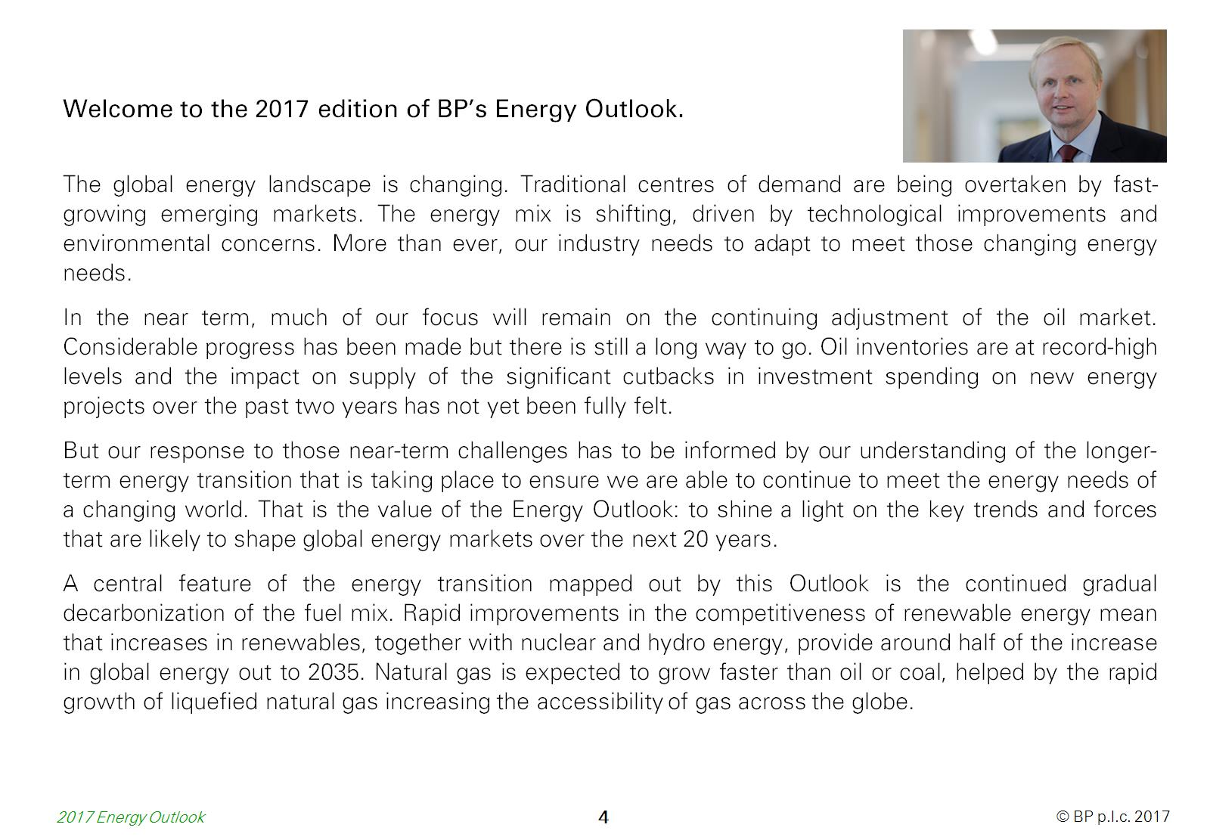

Slide 6
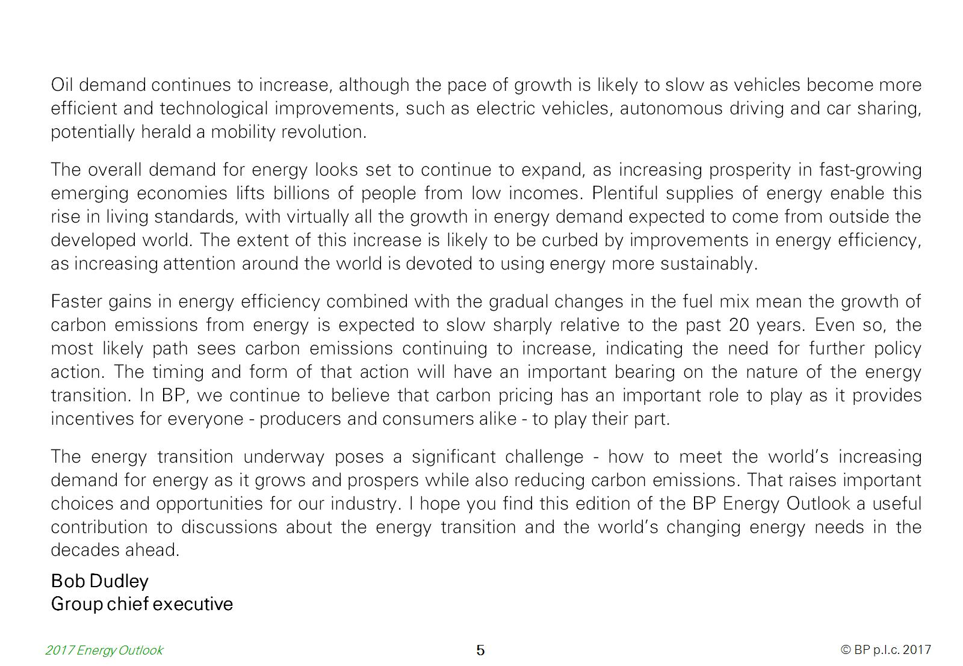

Slide 7
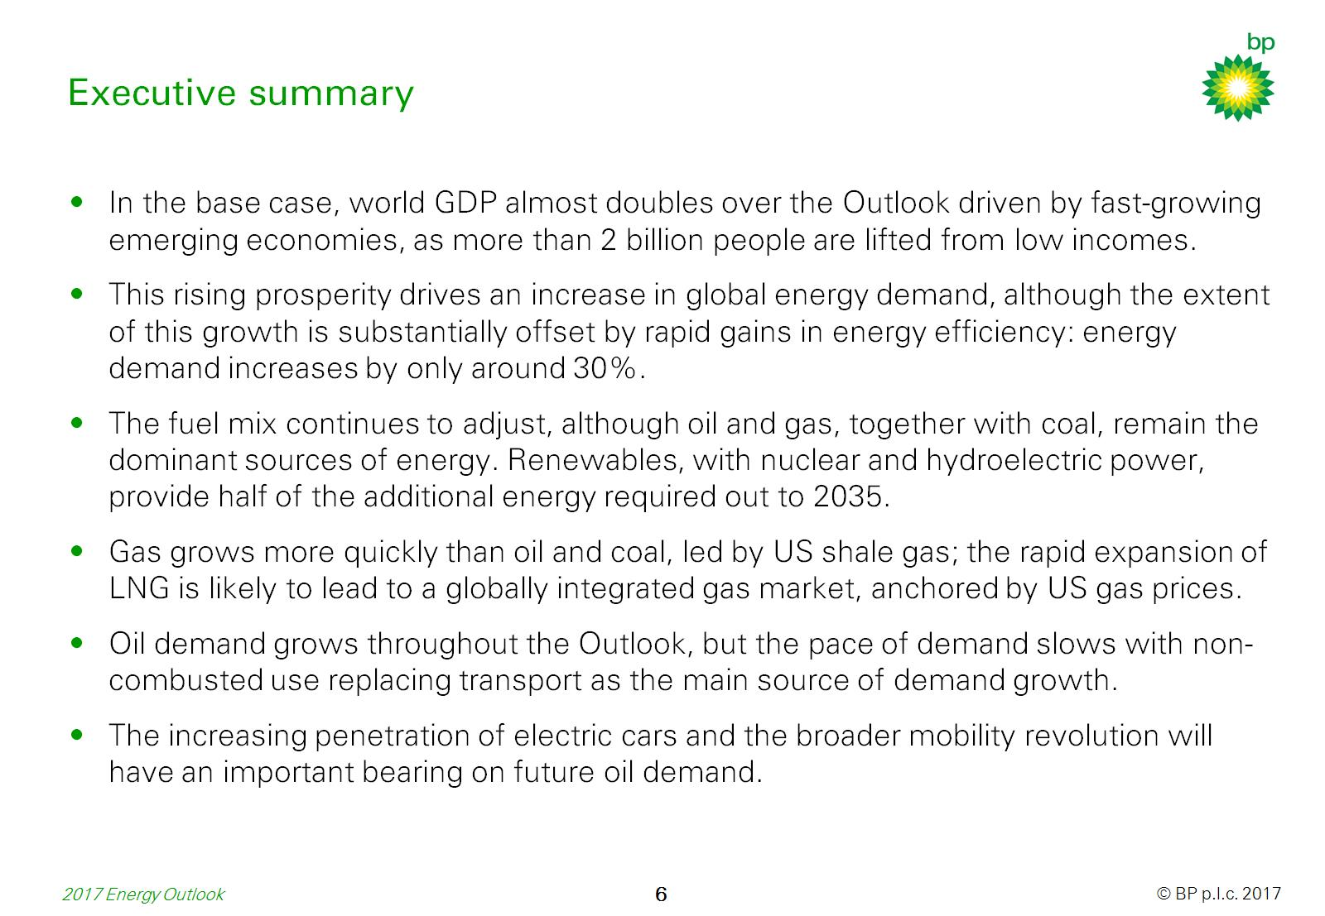
Executive summary

Slide 8
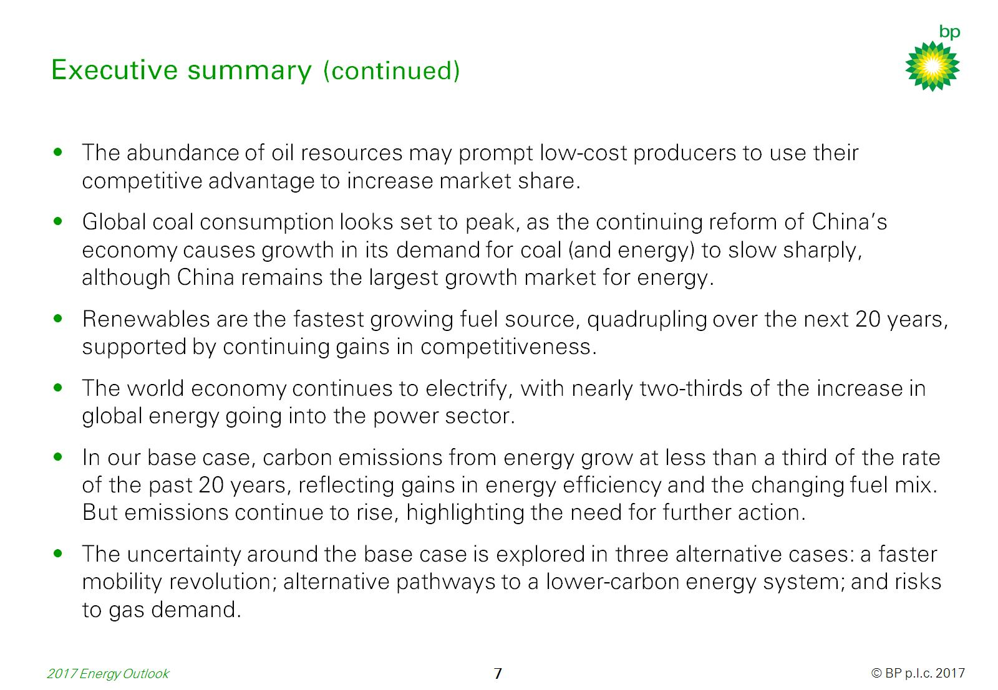
Executive summary (continued)

Slide 9
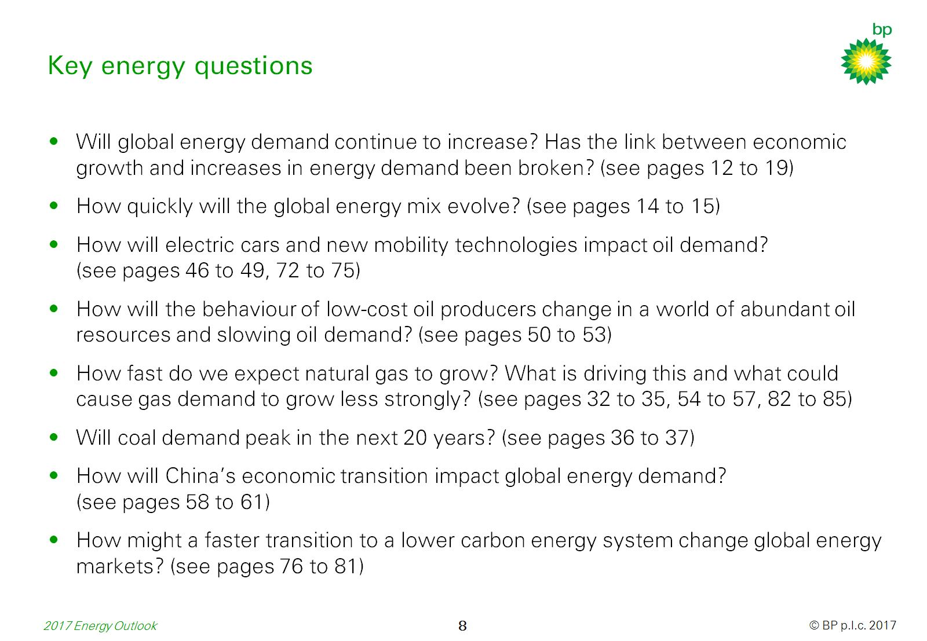

Slide 10
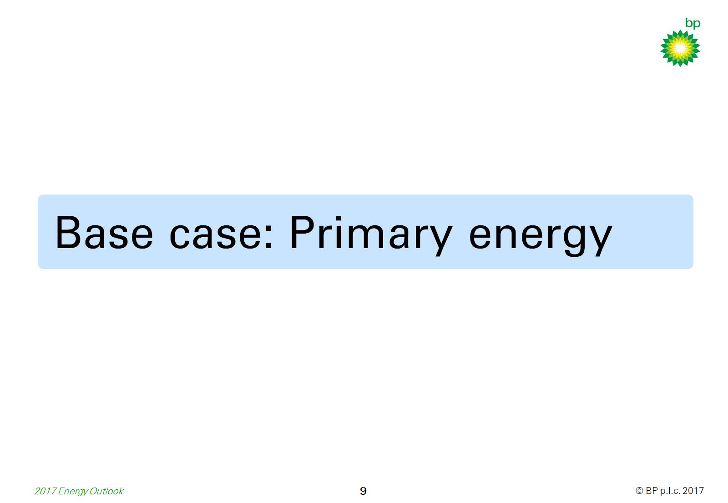

Slide 11
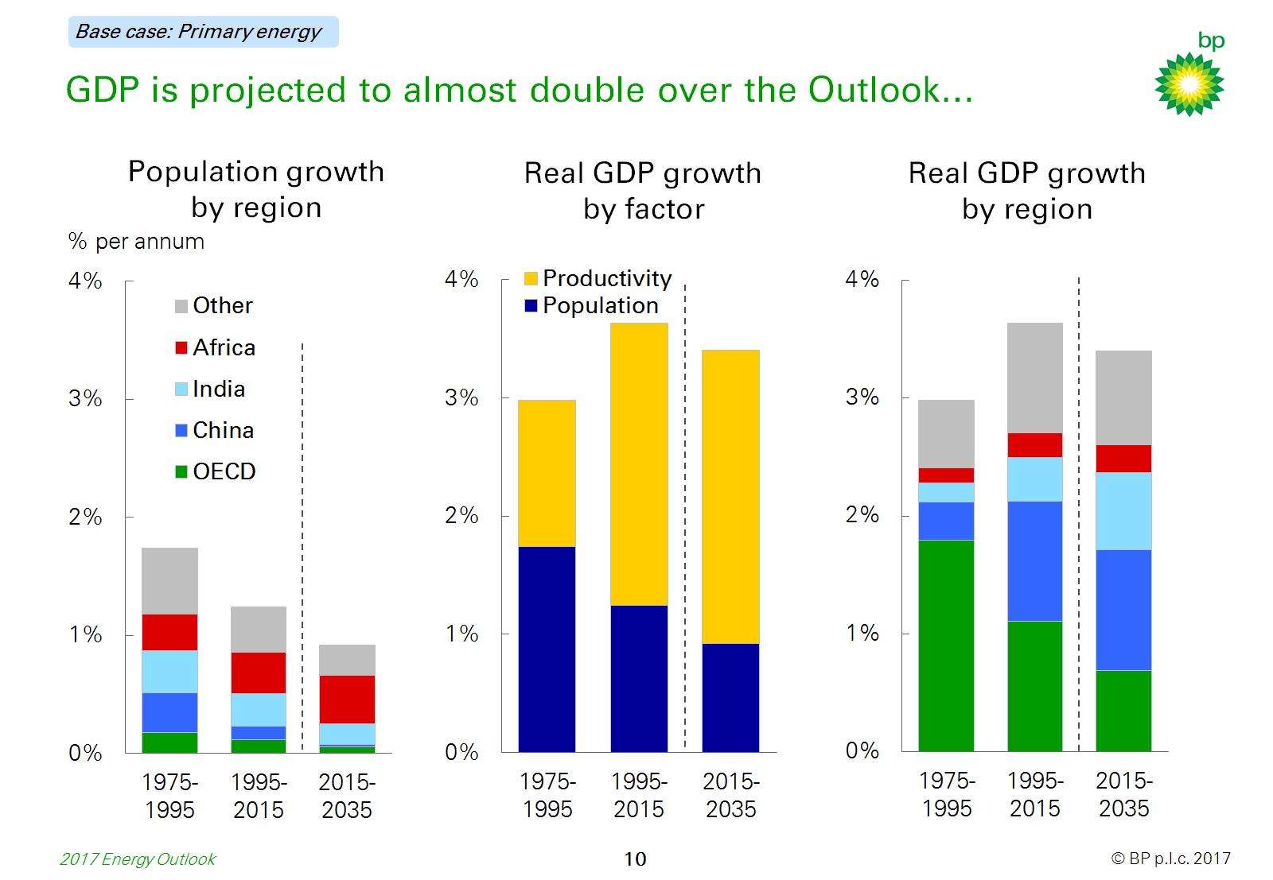
GDP is projected to almost double over the Outlook…

Slide 12
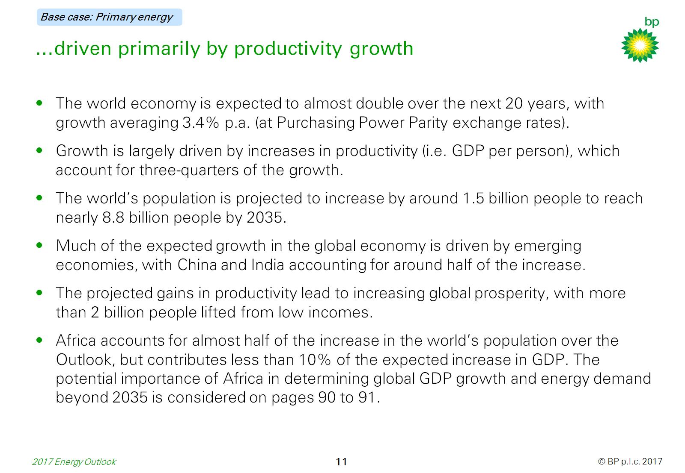
…driven primarily by productivity growth

Slide 13
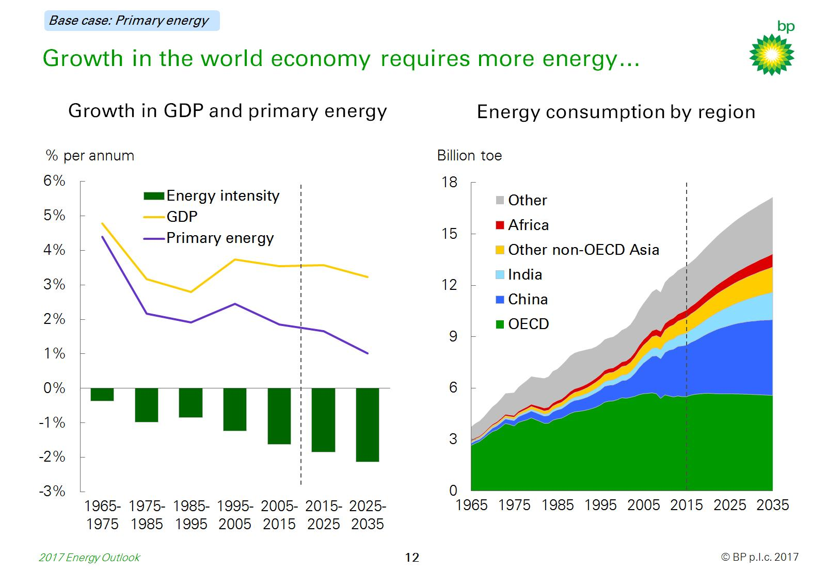
Growth in the world economy requires more energy…

Slide 14
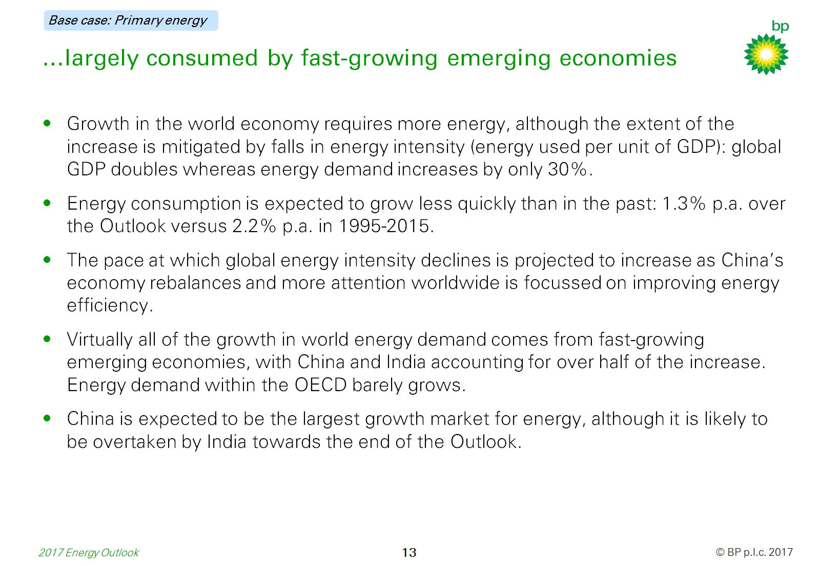
…largely consumed by fast-growing emerging economies

Slide 15
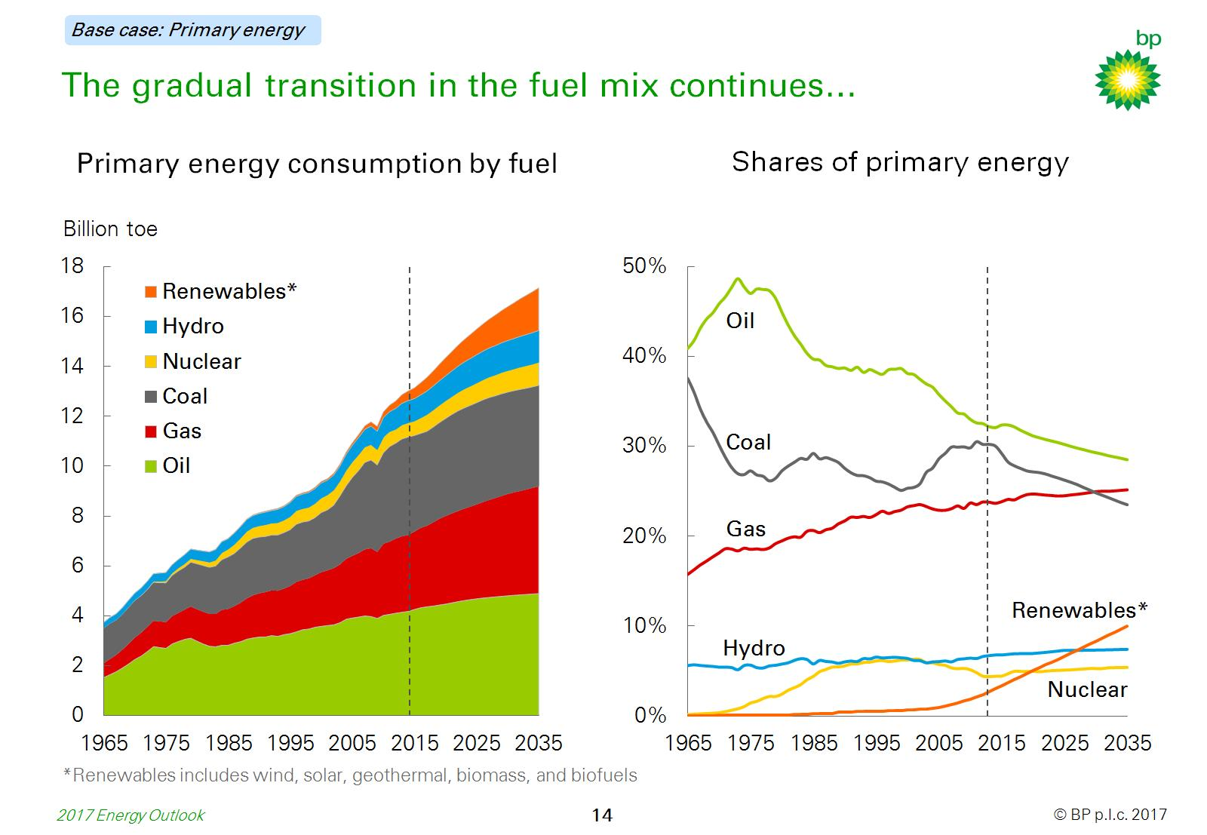
The gradual transition in the fuel mix continues…

Slide 16
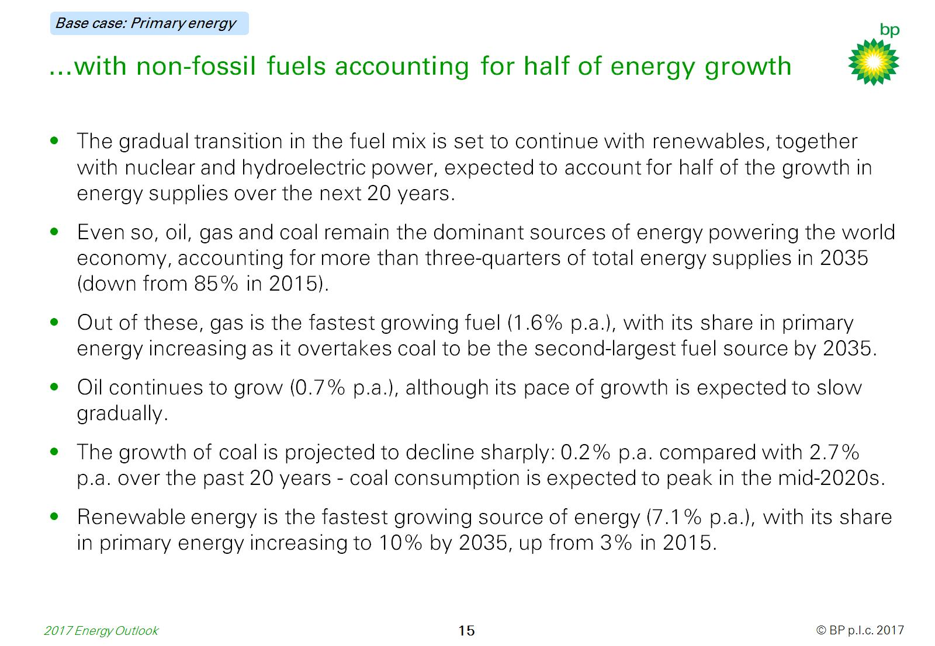
…with non-fossil fuels accounting for half of energy growth

Slide 17
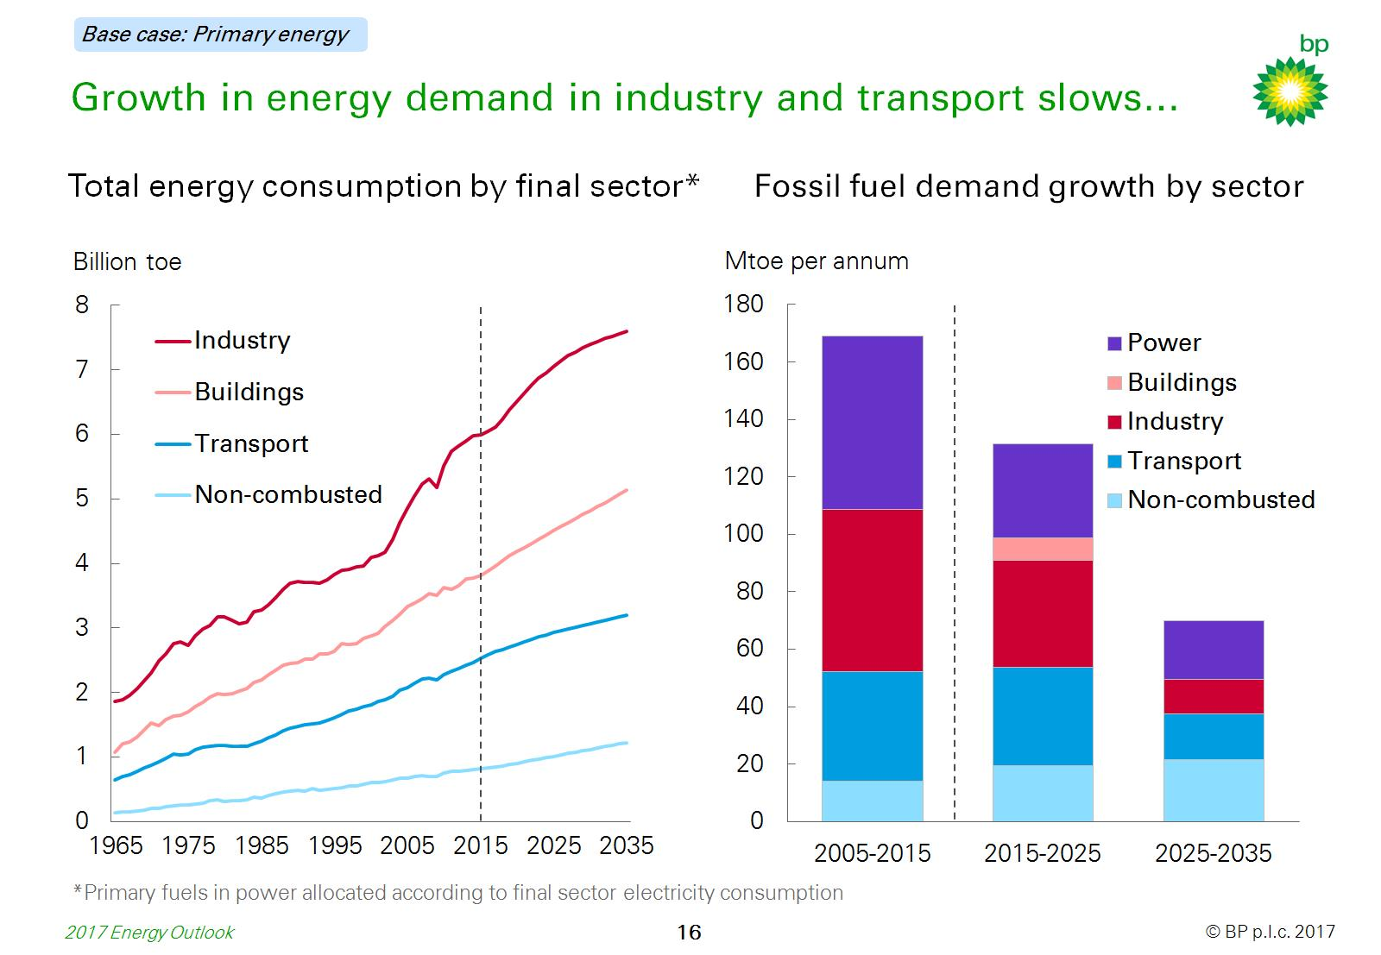
Growth in energy demand in industry and transport slows…

Slide 18
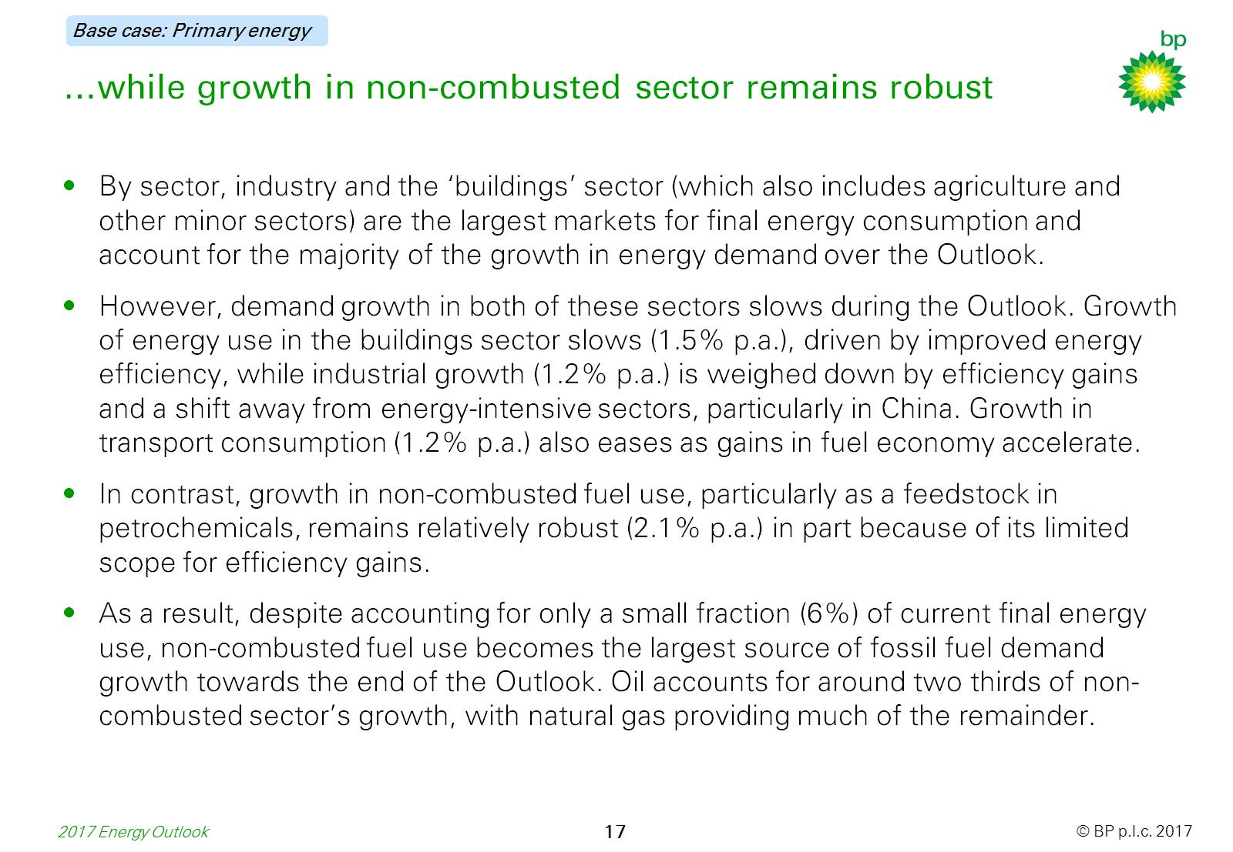
…while growth in non-combusted sector remains robust

Slide 19
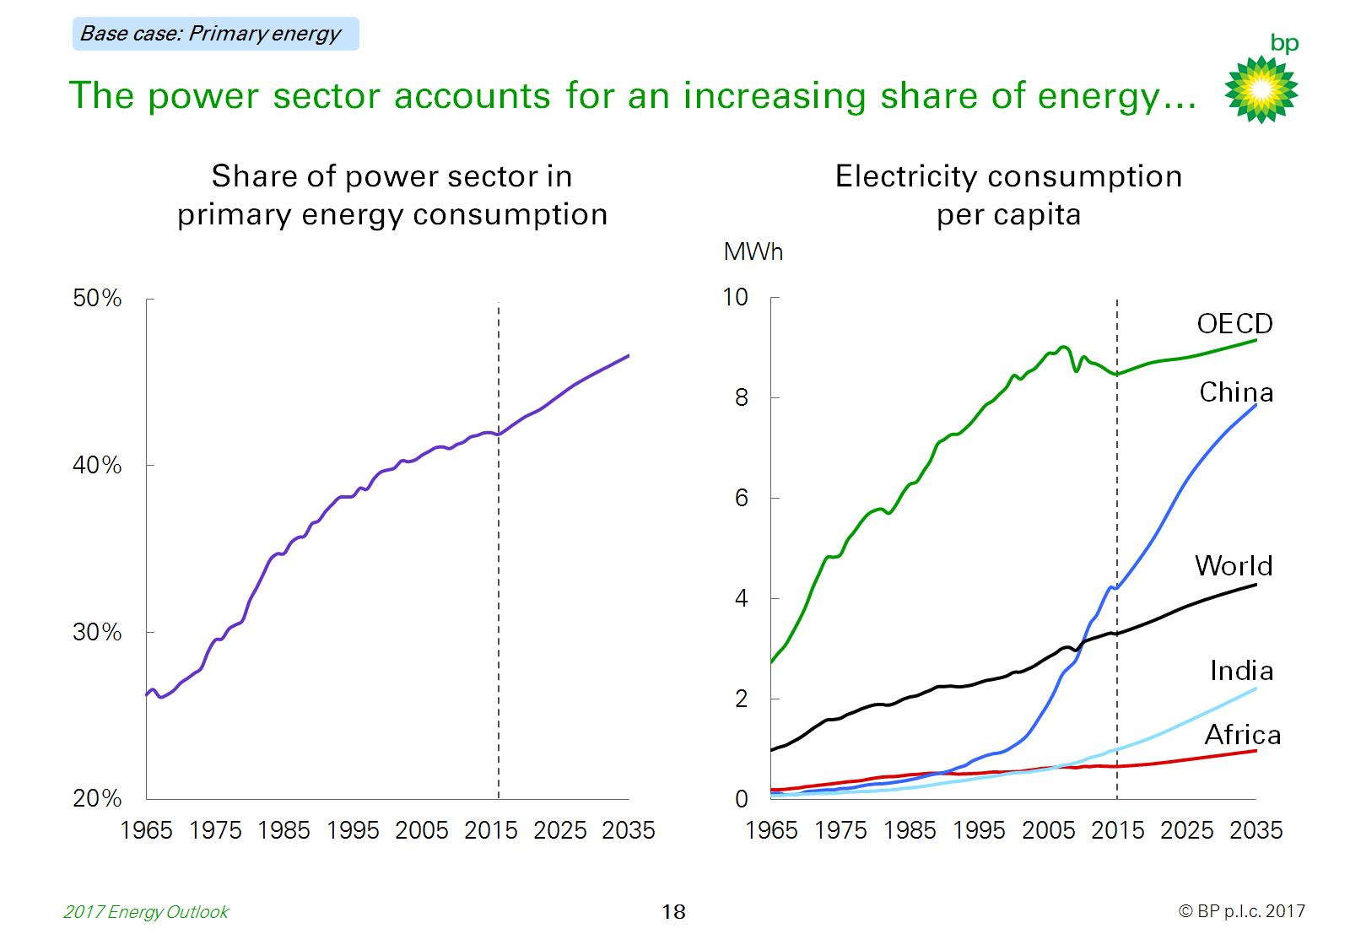
The power sector accounts for an increasing share of energy…

Slide 20
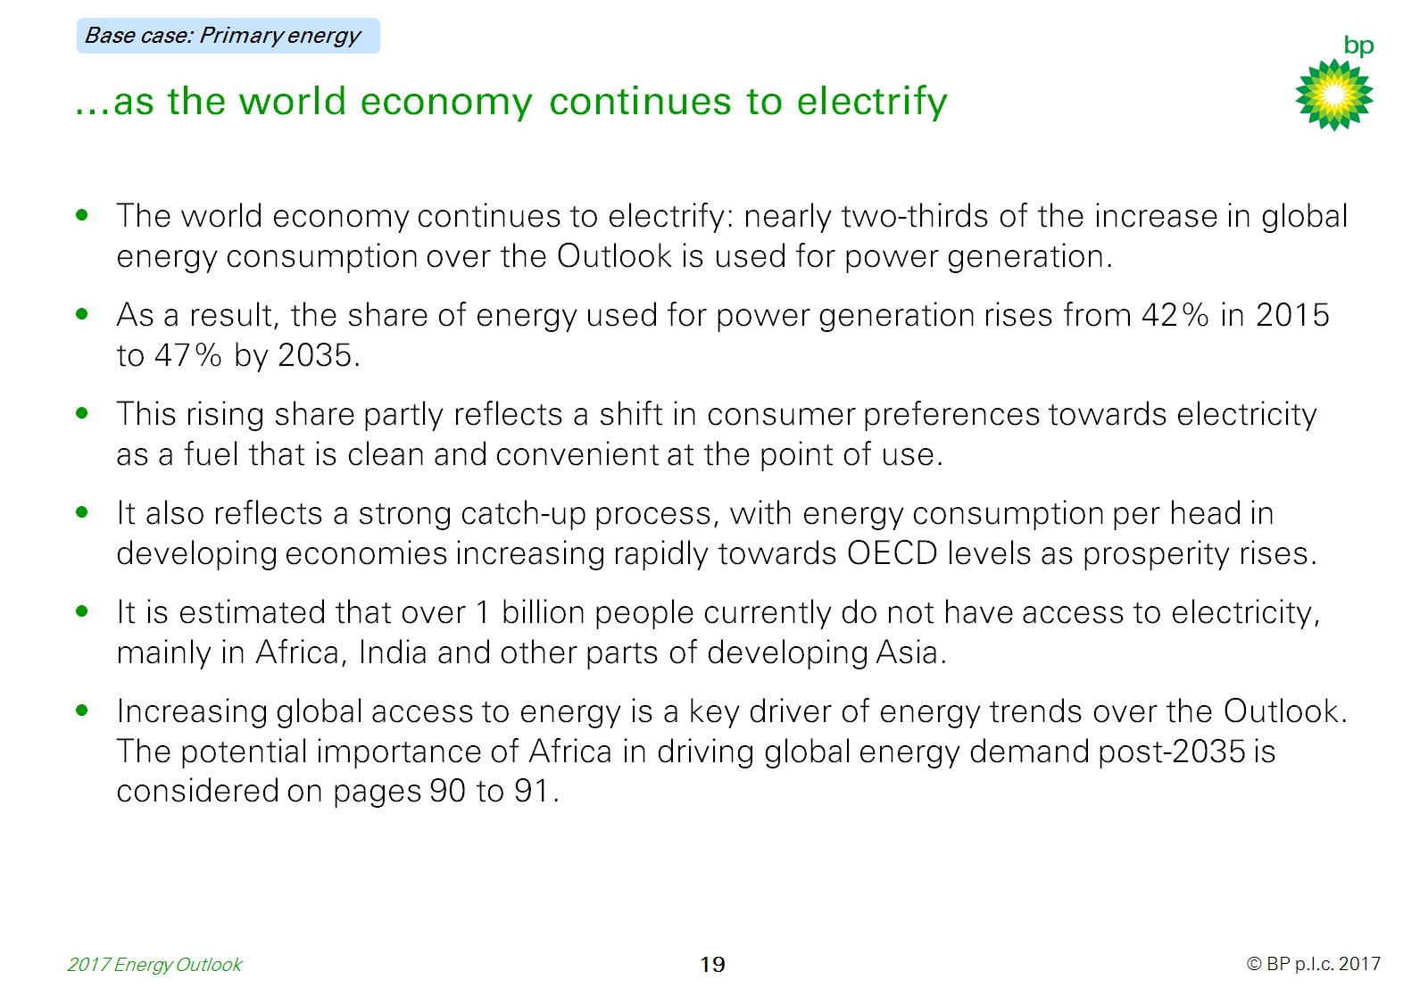
…as the world economy continues to electrify

Slide 21
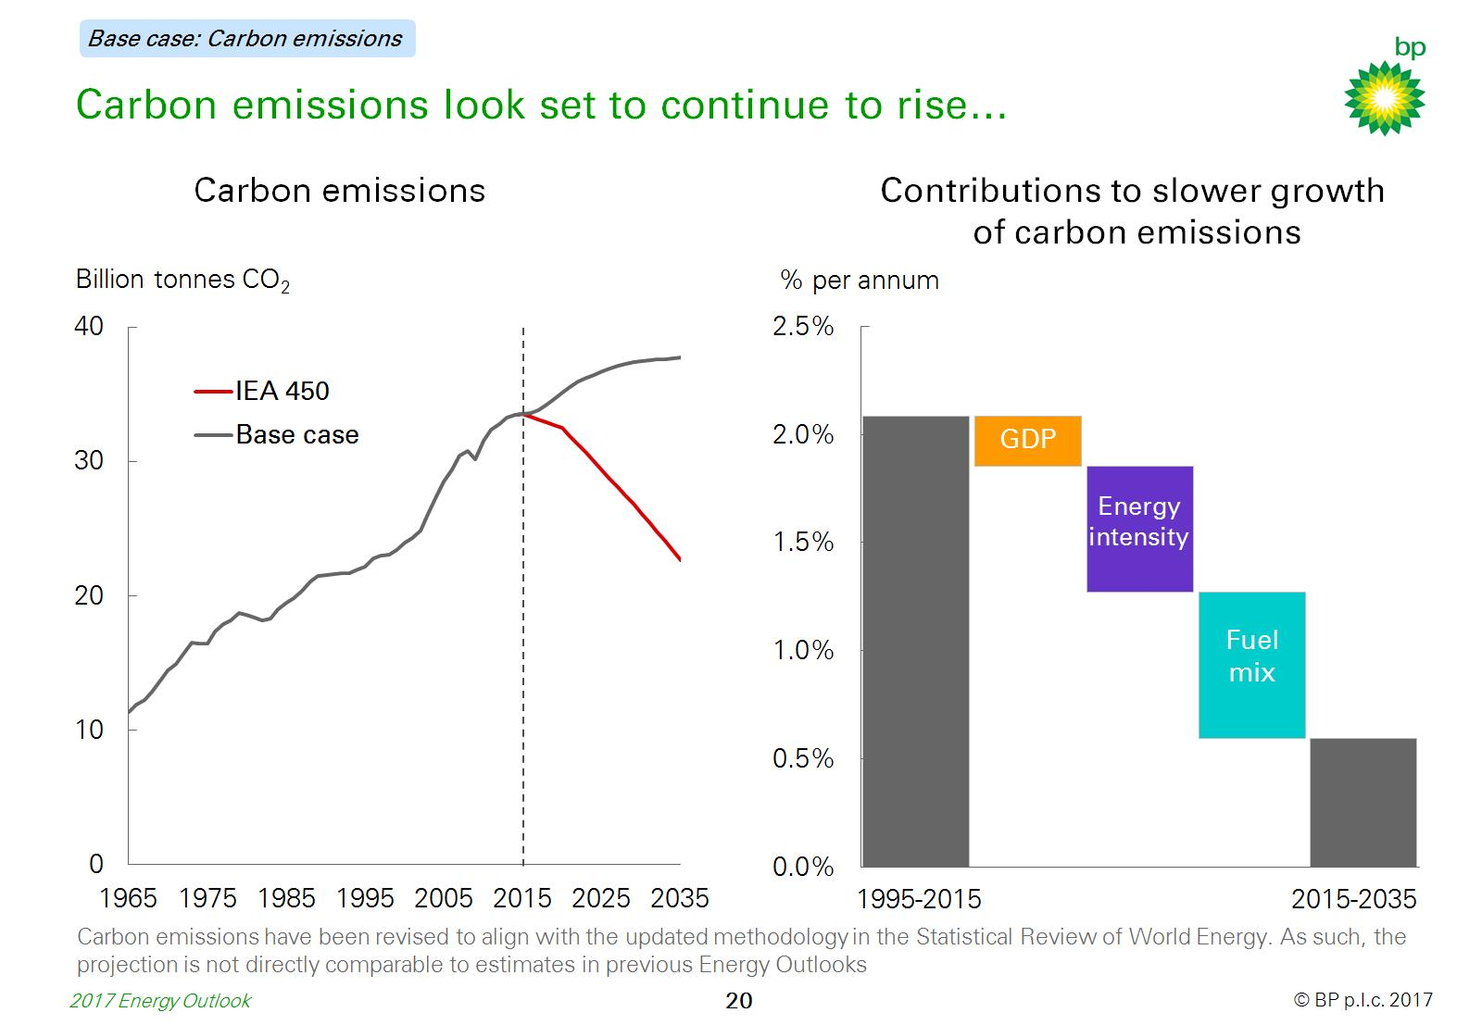
Carbon emissions look set to continue to rise…

Slide 22
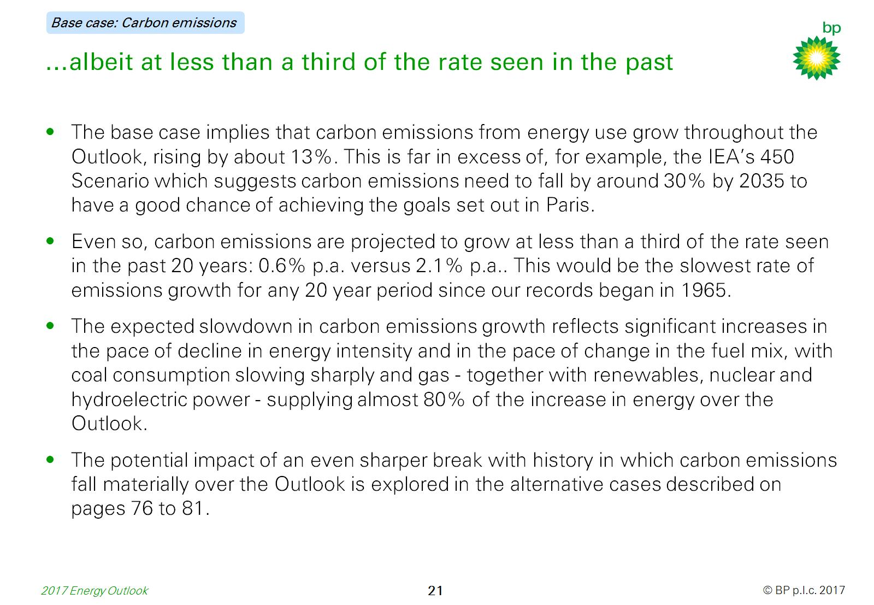
…albeit at less than a third of the rate seen in the past

Slide 23


Slide 24
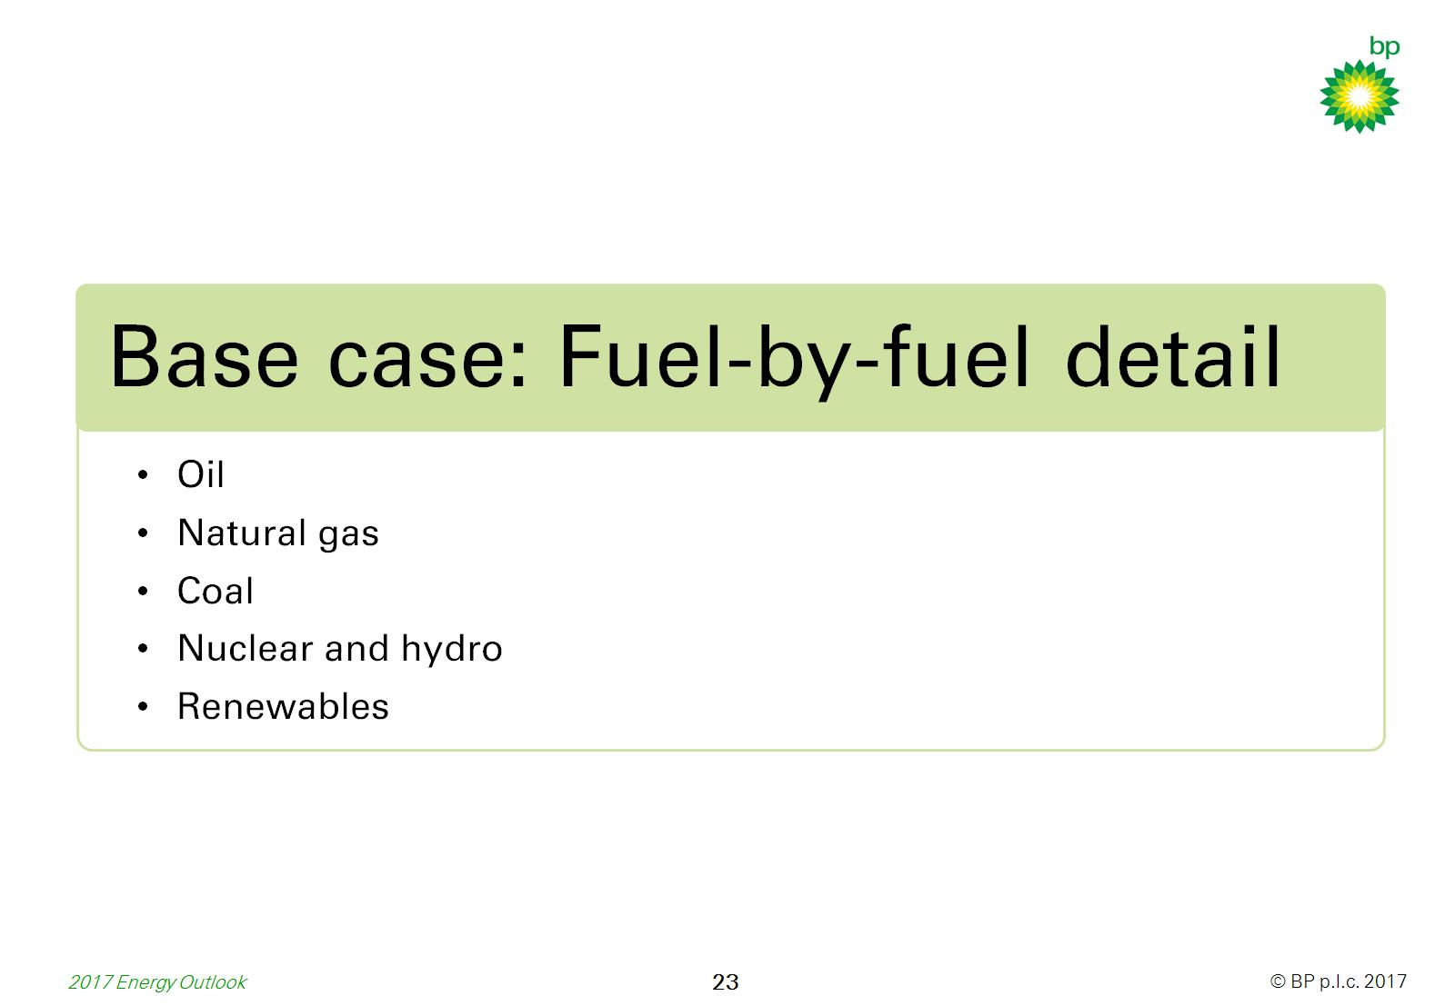

Slide 25
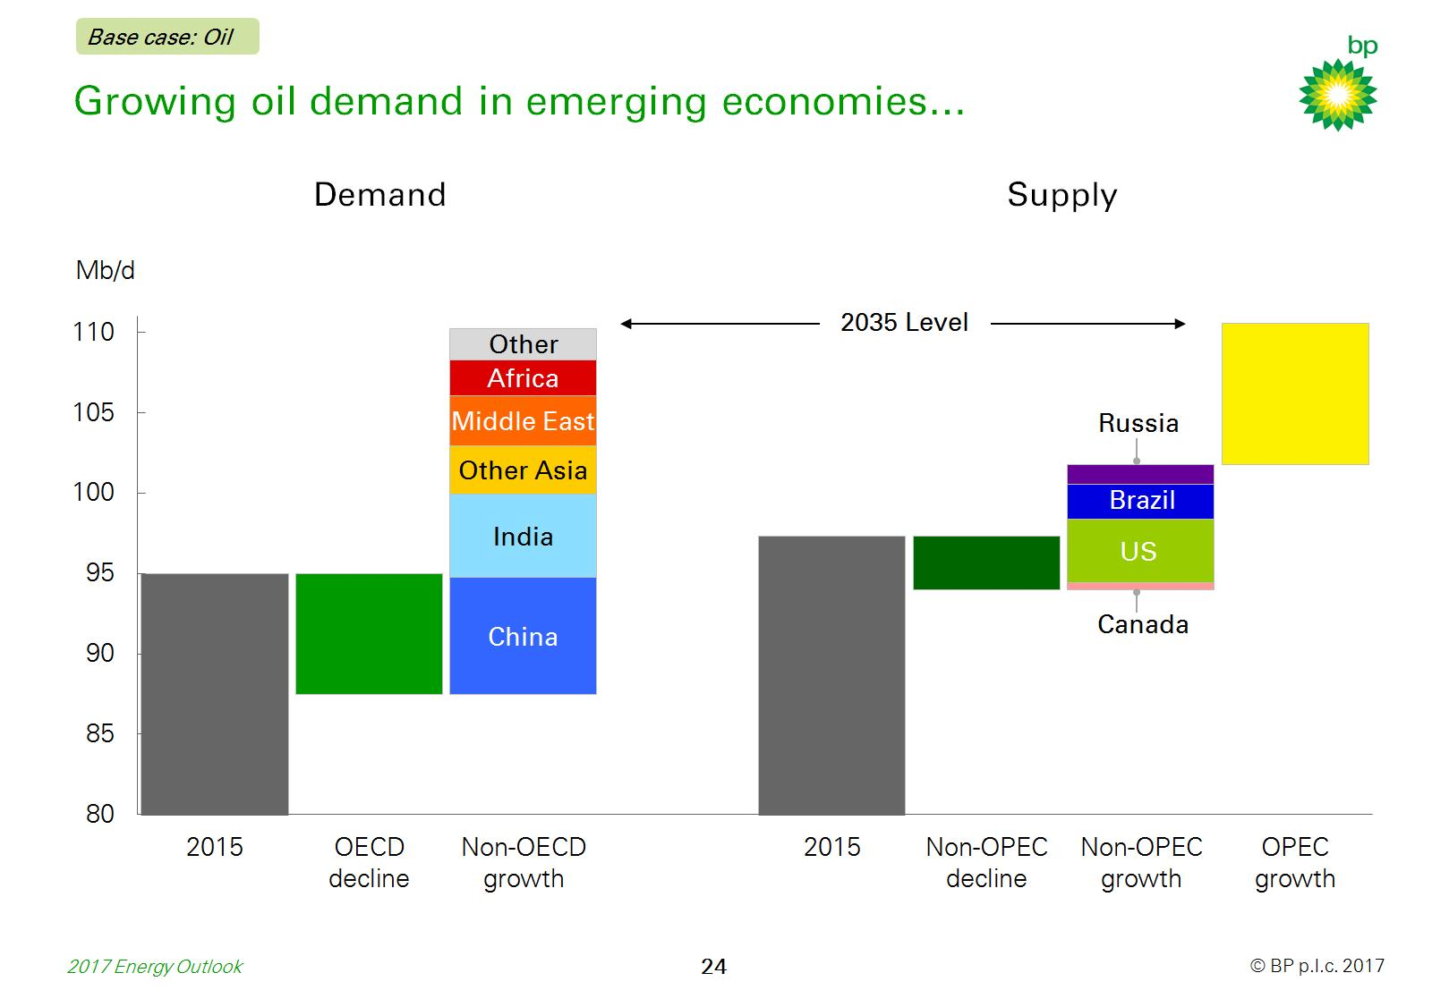
Growing oil demand in emerging economies…

Slide 26
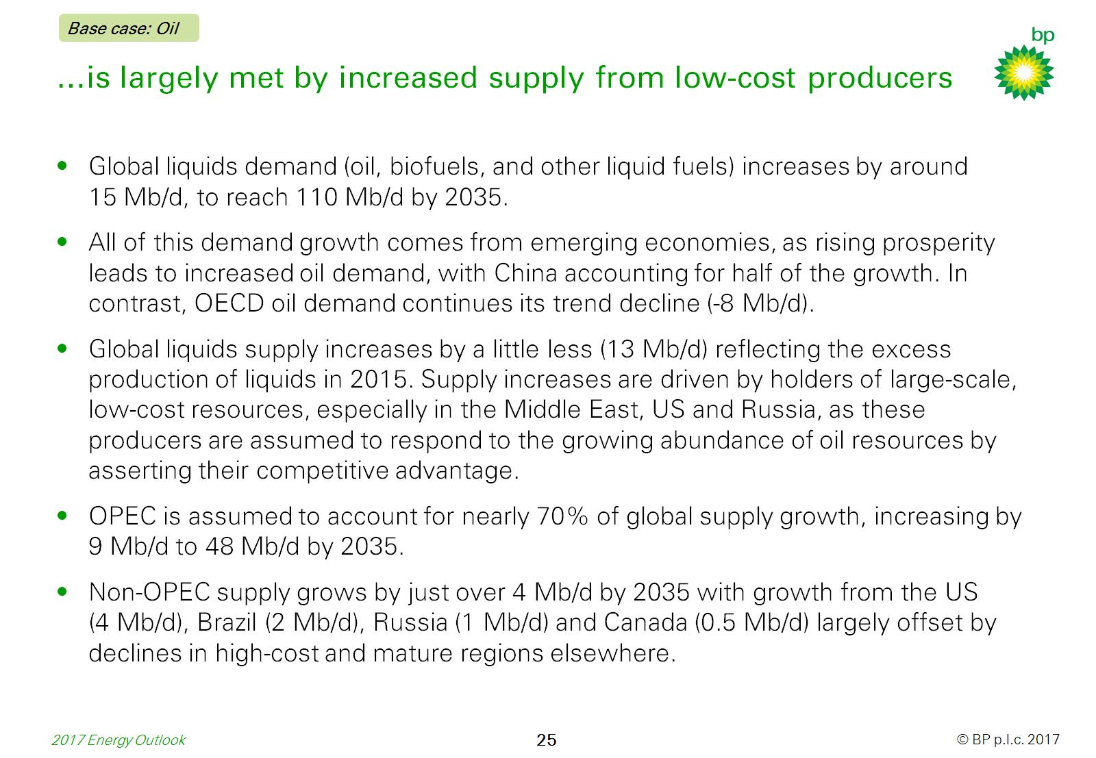
…is largely met by increased supply from low-cost producers

Slide 27
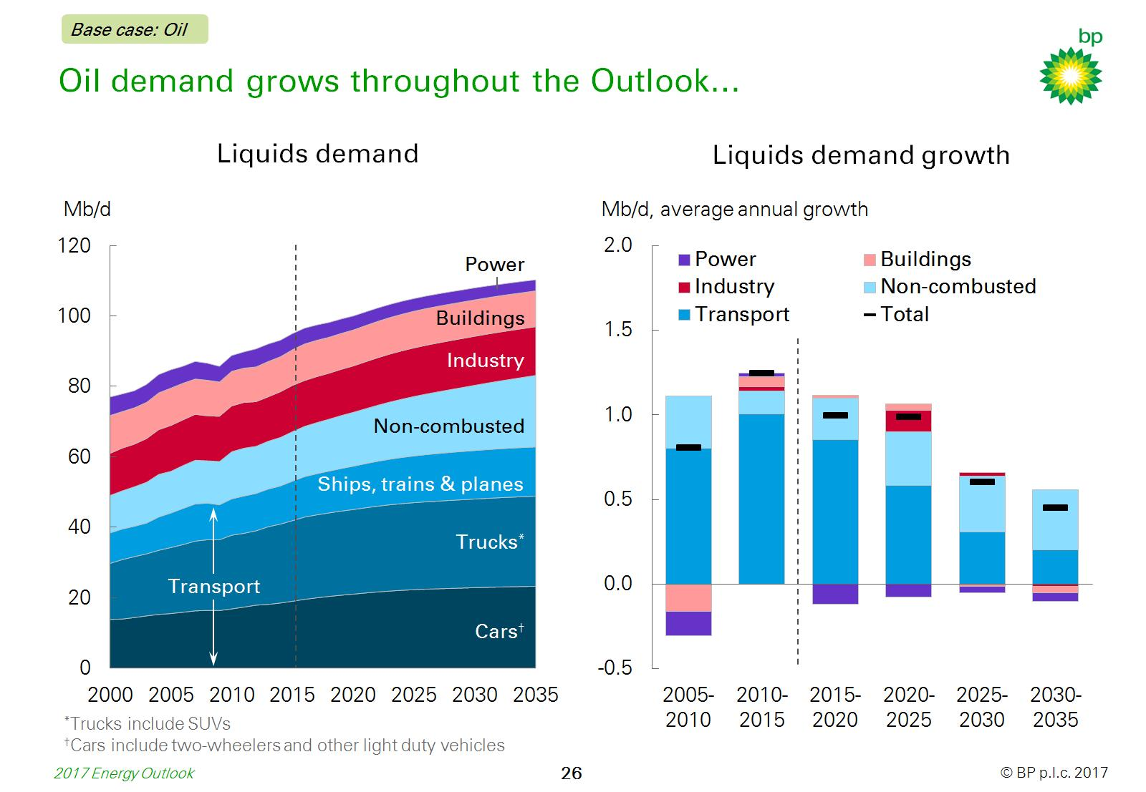
Oil demand grows throughout the Outlook…

Slide 28
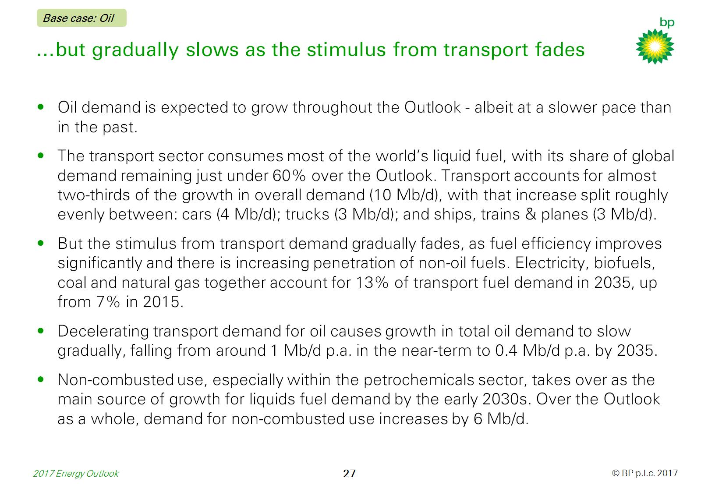
…but gradually slows as the stimulus from transport fades

Slide 29
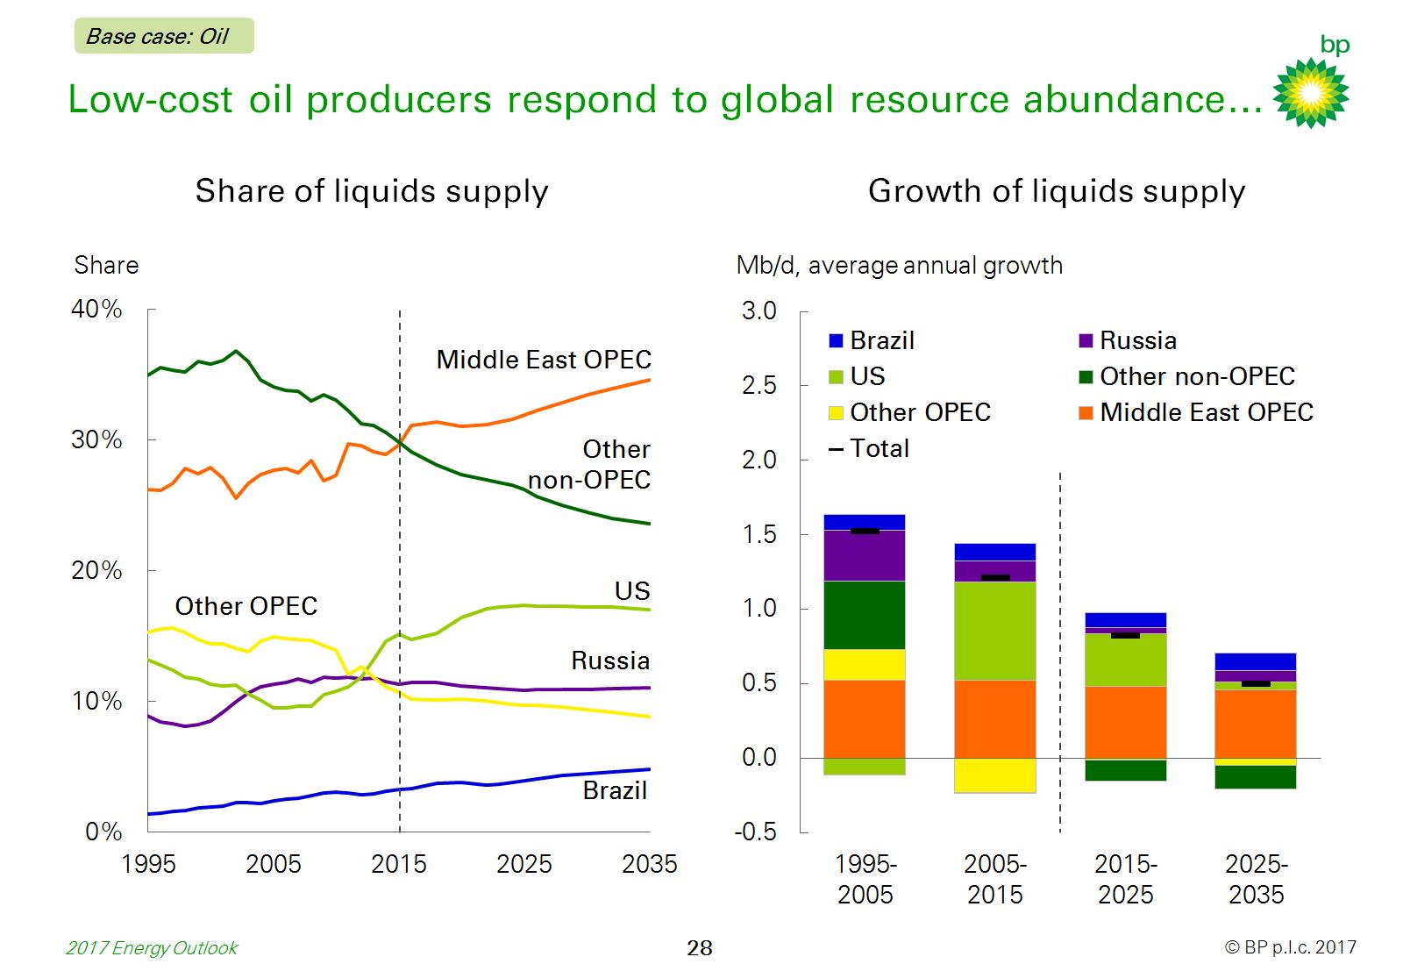
Low-cost oil producers respond to global resource abundance…

Slide 30
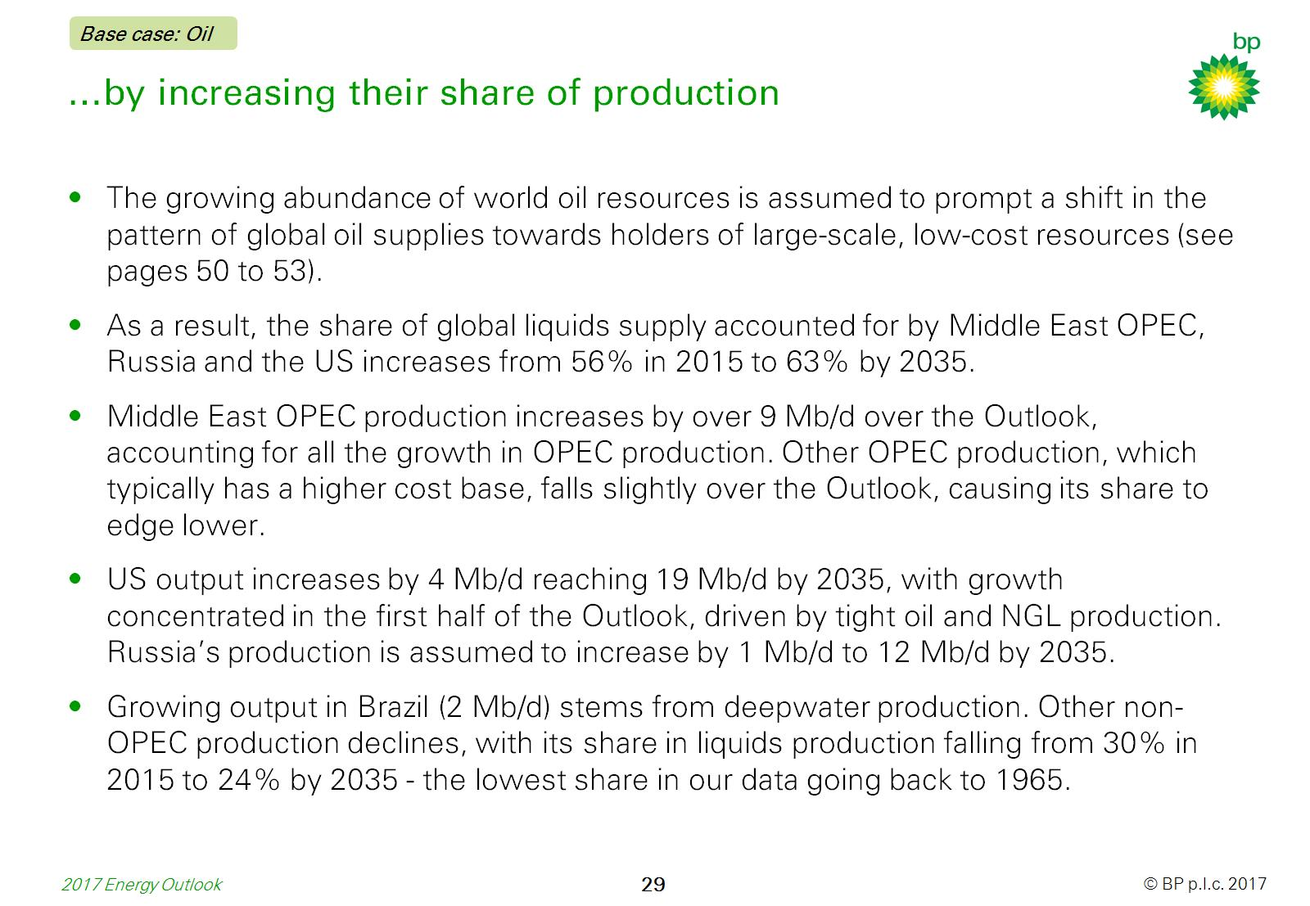
…by increasing their share of production

Slide 31
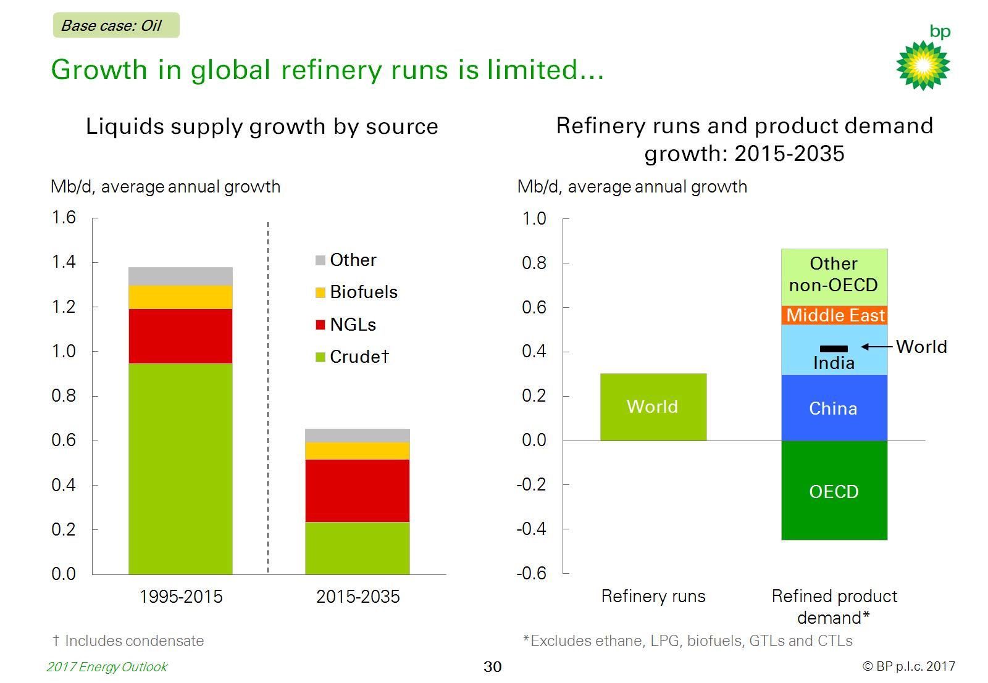
Growth in global refinery runs is limited…

Slide 32
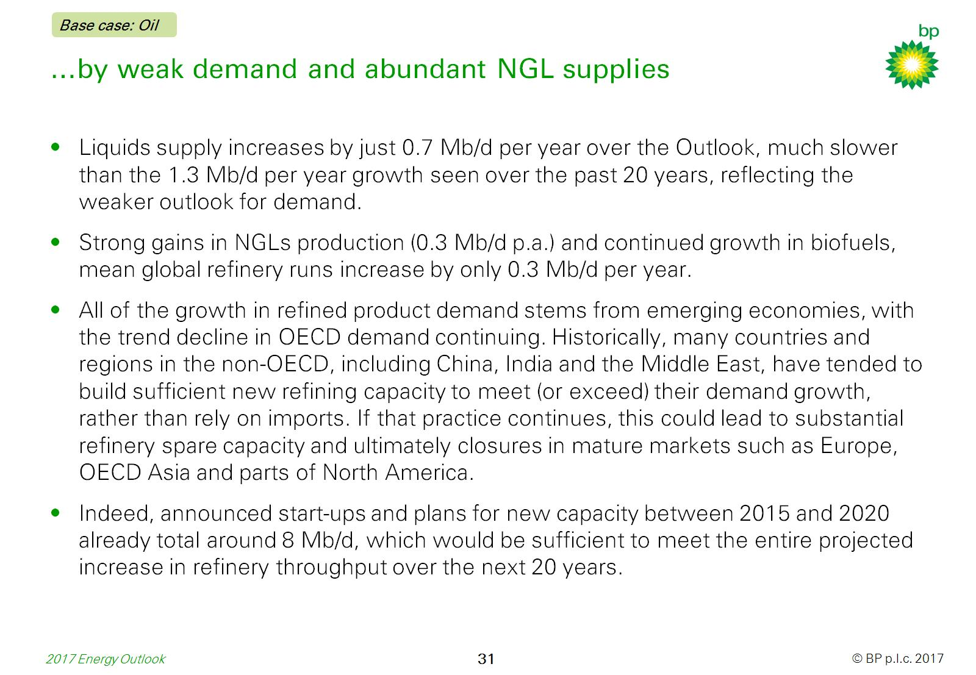
…by weak demand and abundant NGL supplies

Slide 33
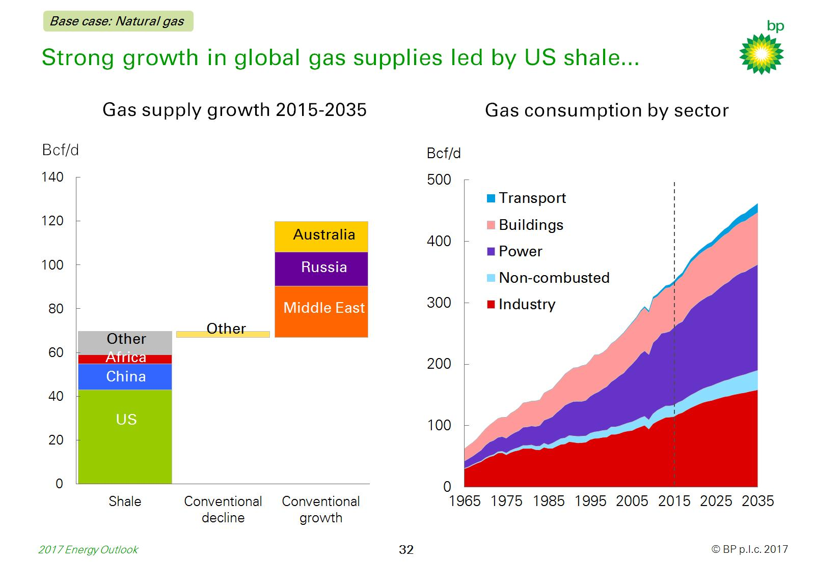
Strong growth in global gas supplies led by US shale...

Slide 34
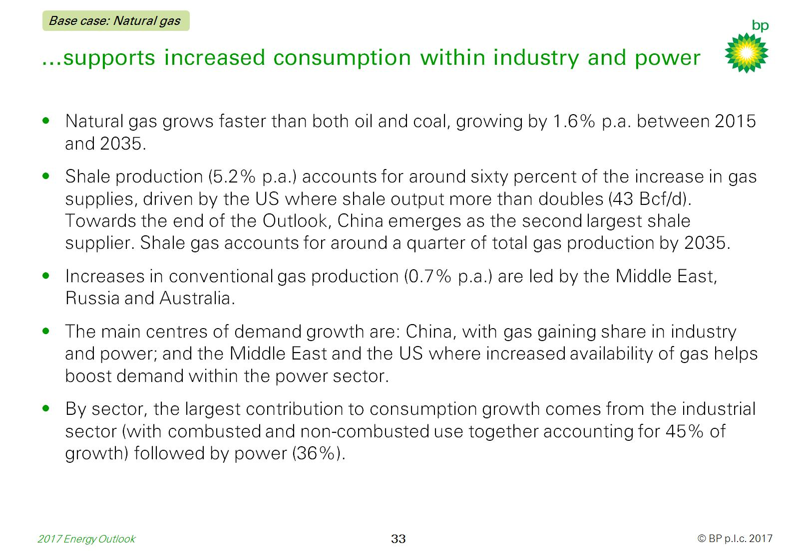
…supports increased consumption within industry and power

Slide 35
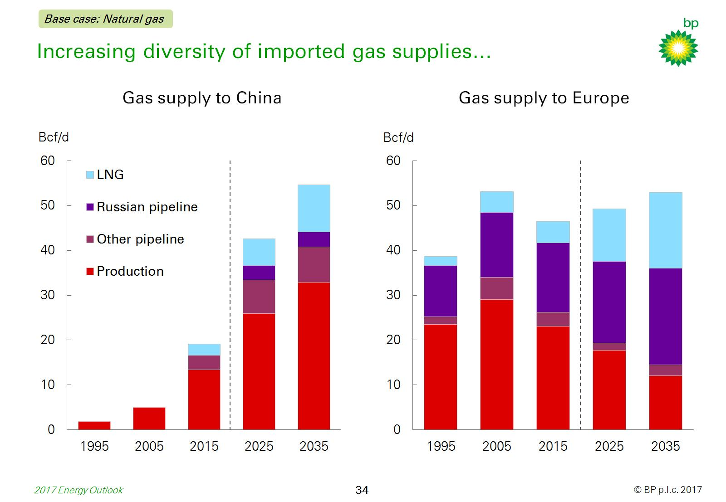
Increasing diversity of imported gas supplies…

Slide 36
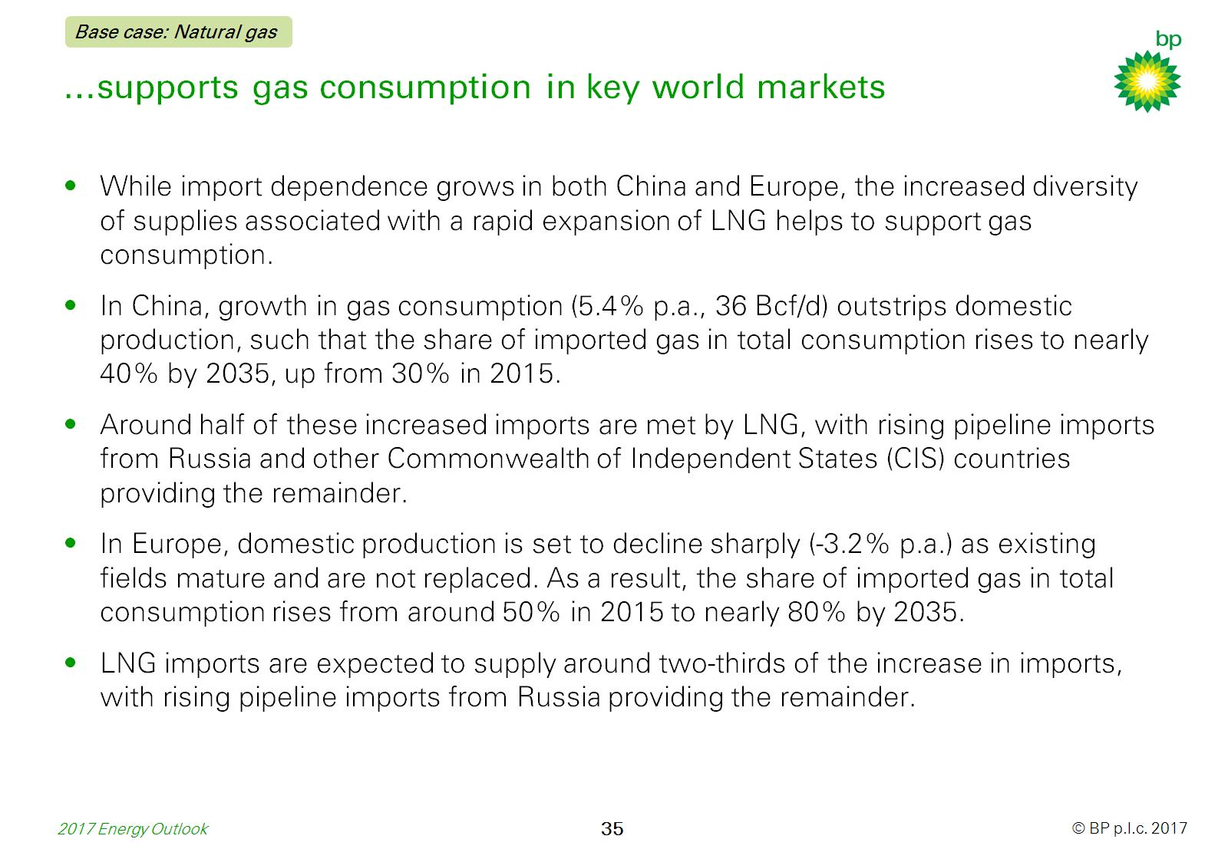
…supports gas consumption in key world markets

Slide 37
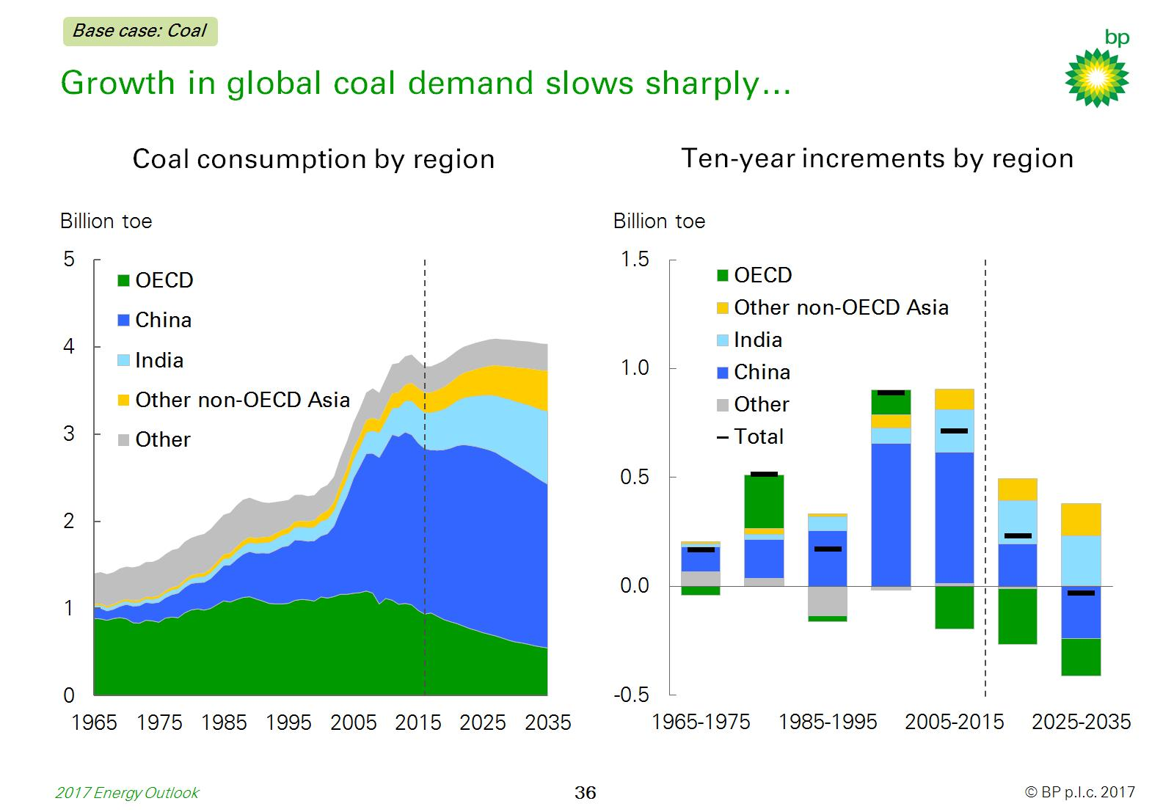
Growth in global coal demand slows sharply…

Slide 38
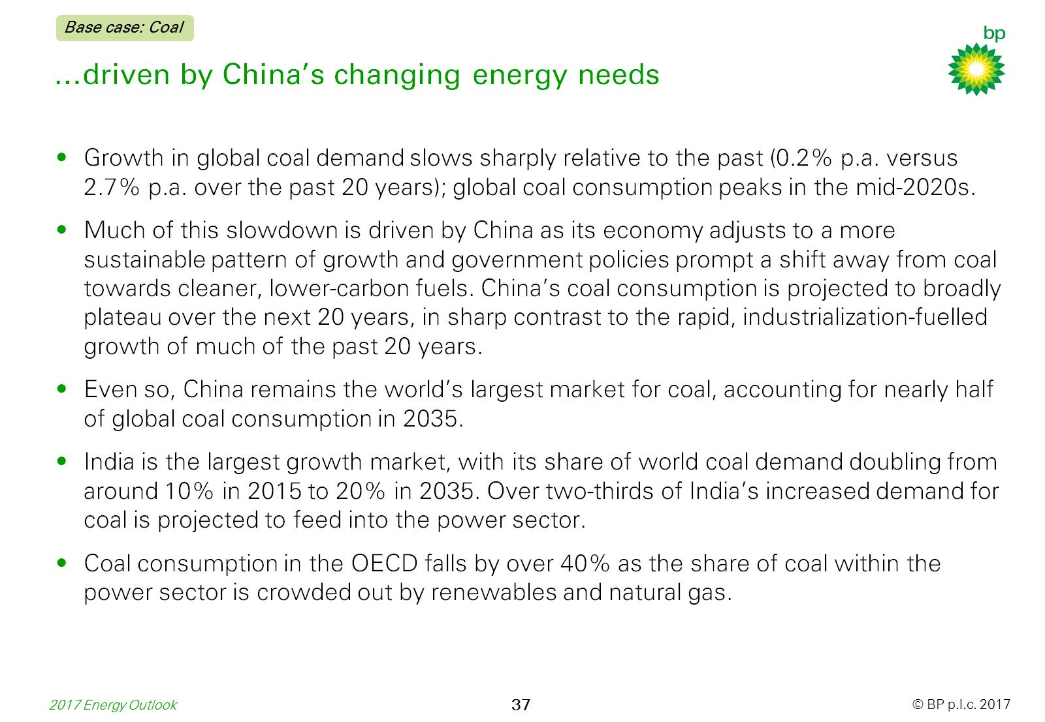
…driven by China’s changing energy needs

Slide 39
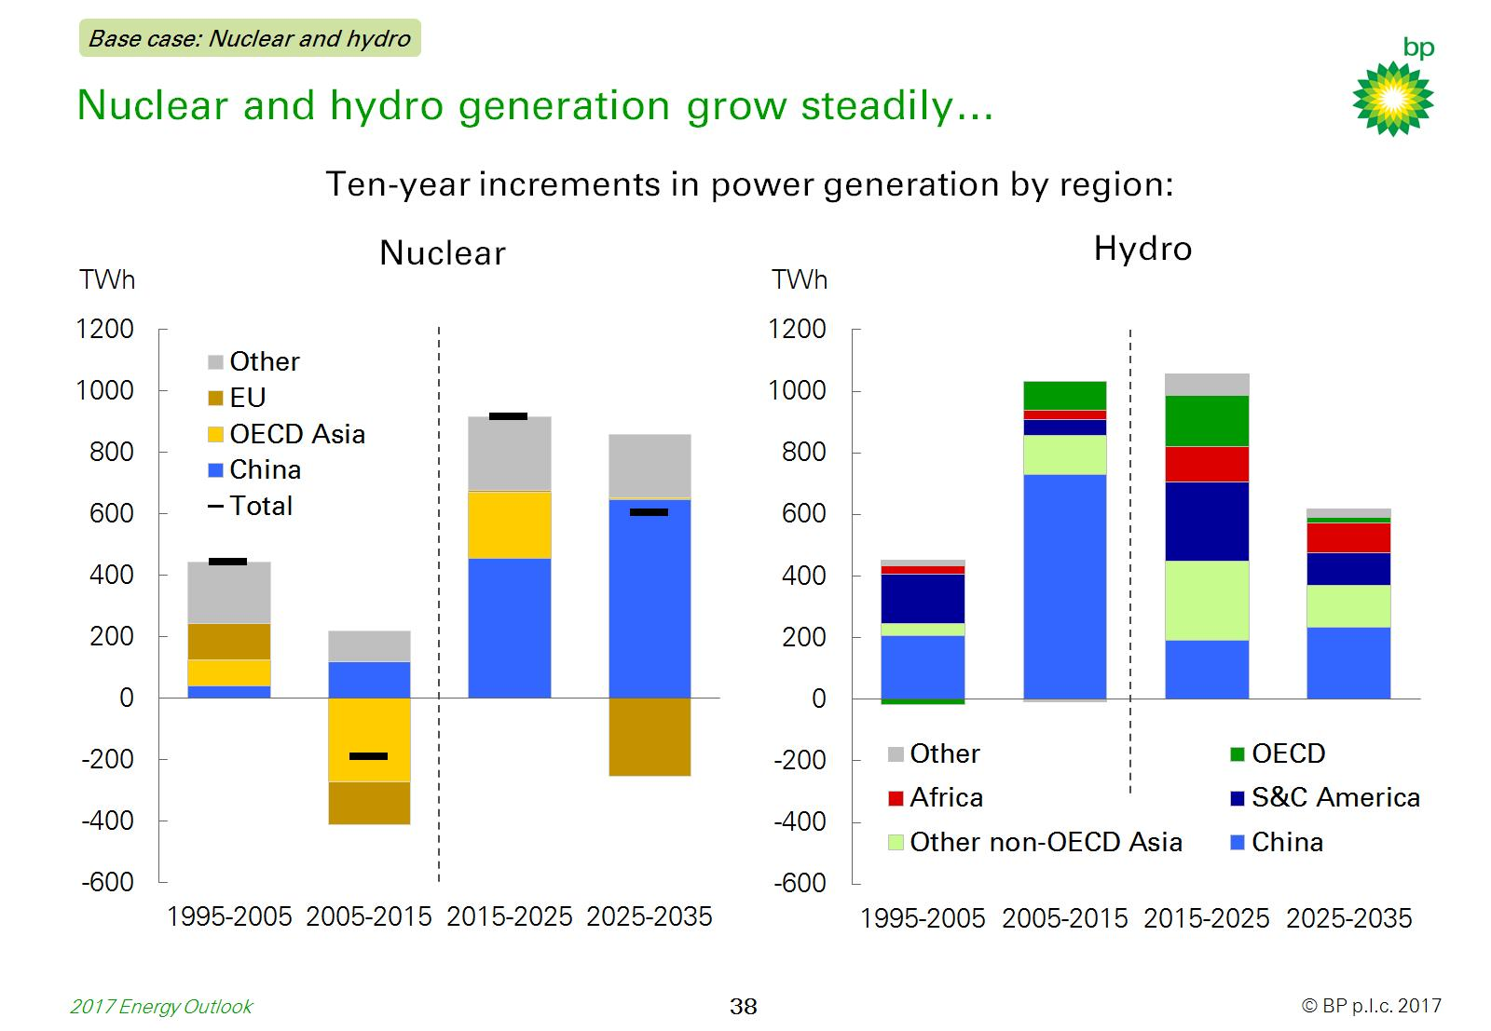
Nuclear and hydro generation grow steadily…

Slide 40
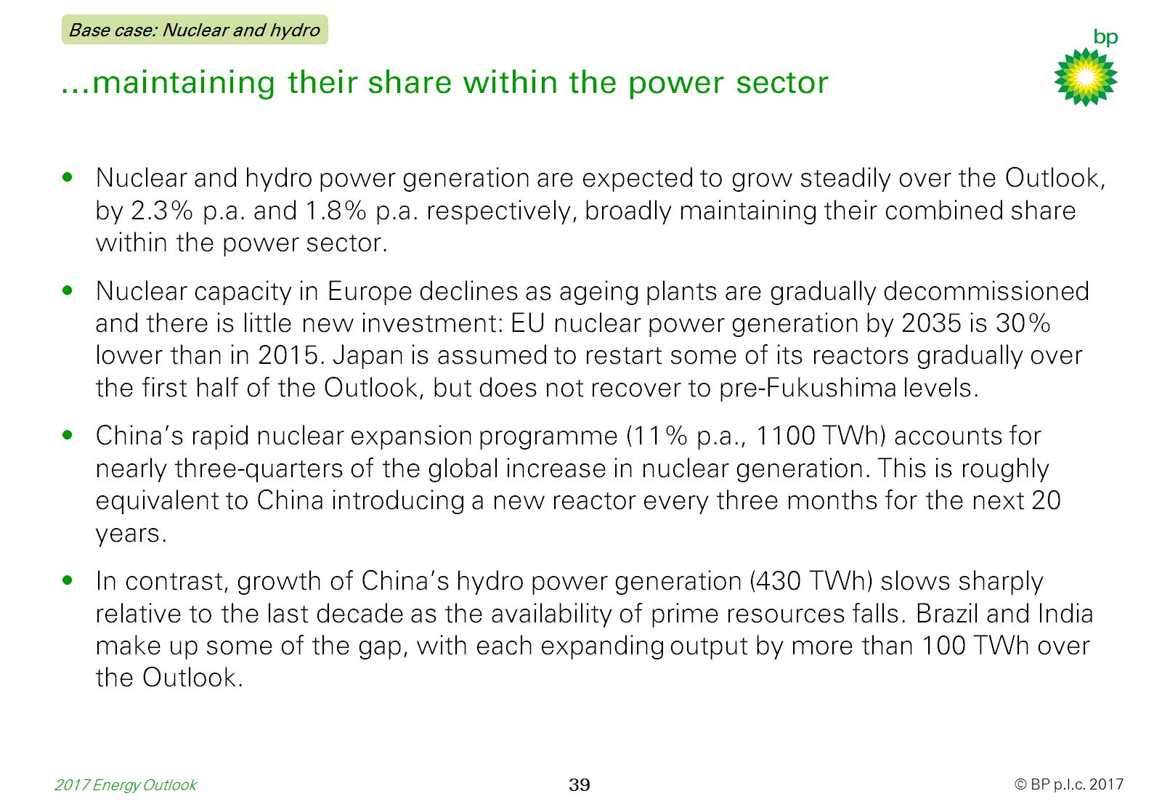
…maintaining their share within the power sector

Slide 41
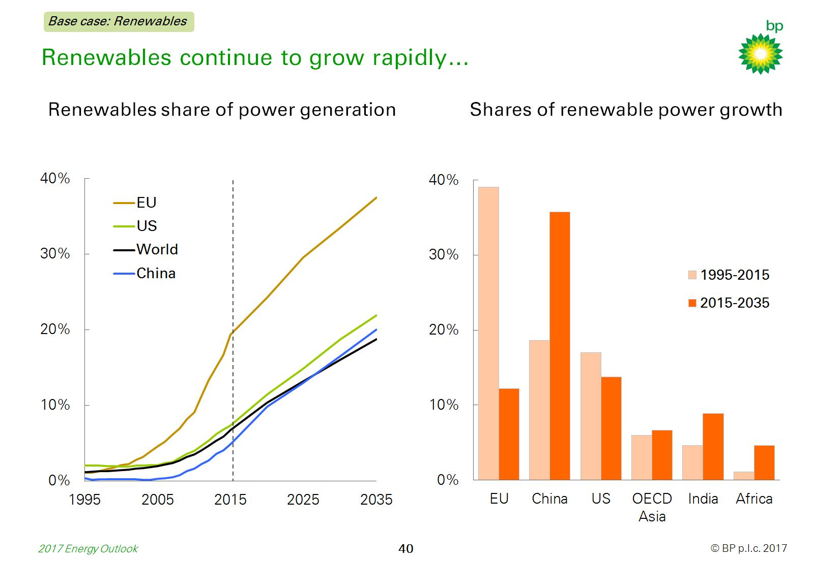
Renewables continue to grow rapidly…

Slide 42
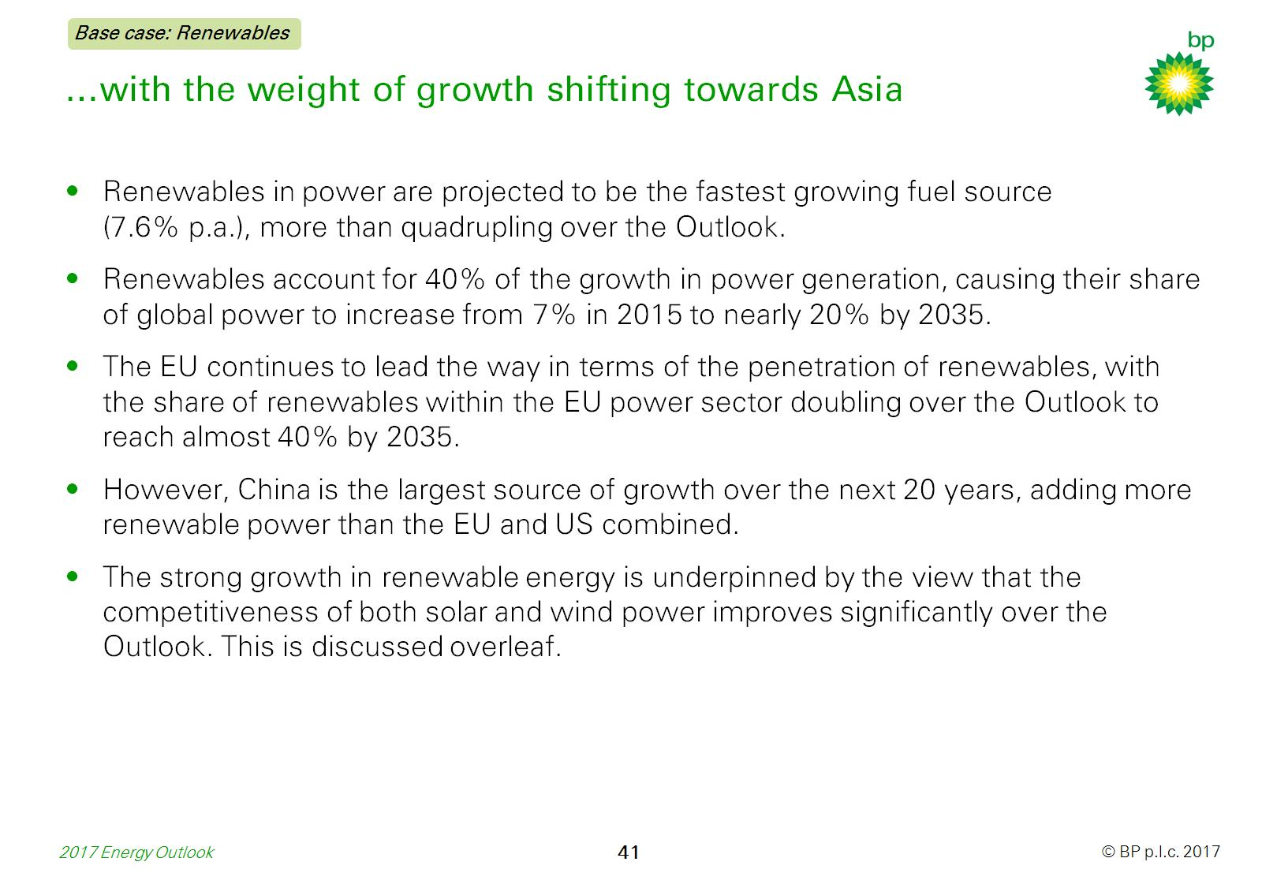
…with the weight of growth shifting towards Asia

Slide 43
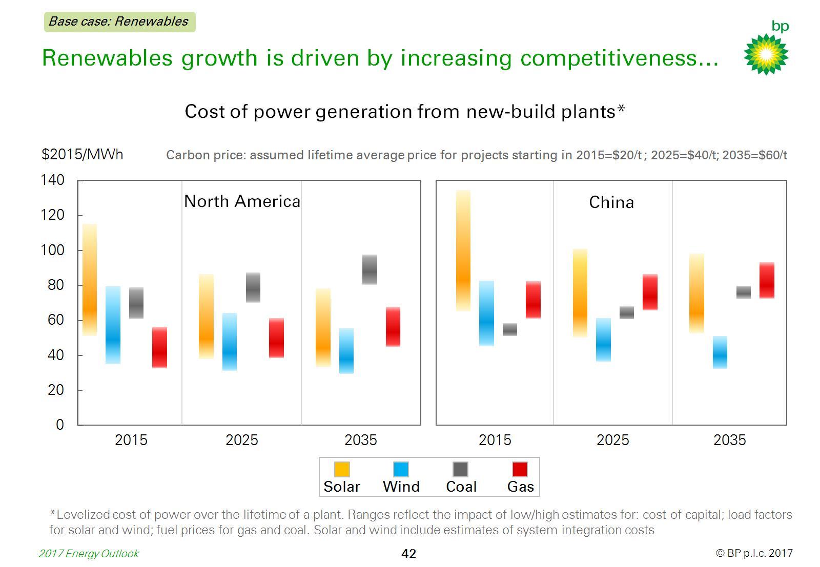
Renewables growth is driven by increasing competitiveness…

Slide 44
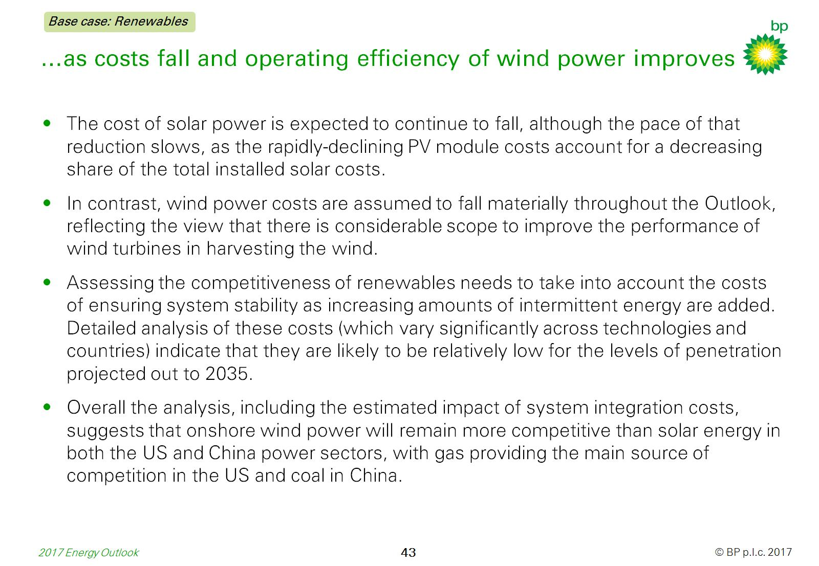
…as costs fall and operating efficiency of wind power improves

Slide 45


Slide 46
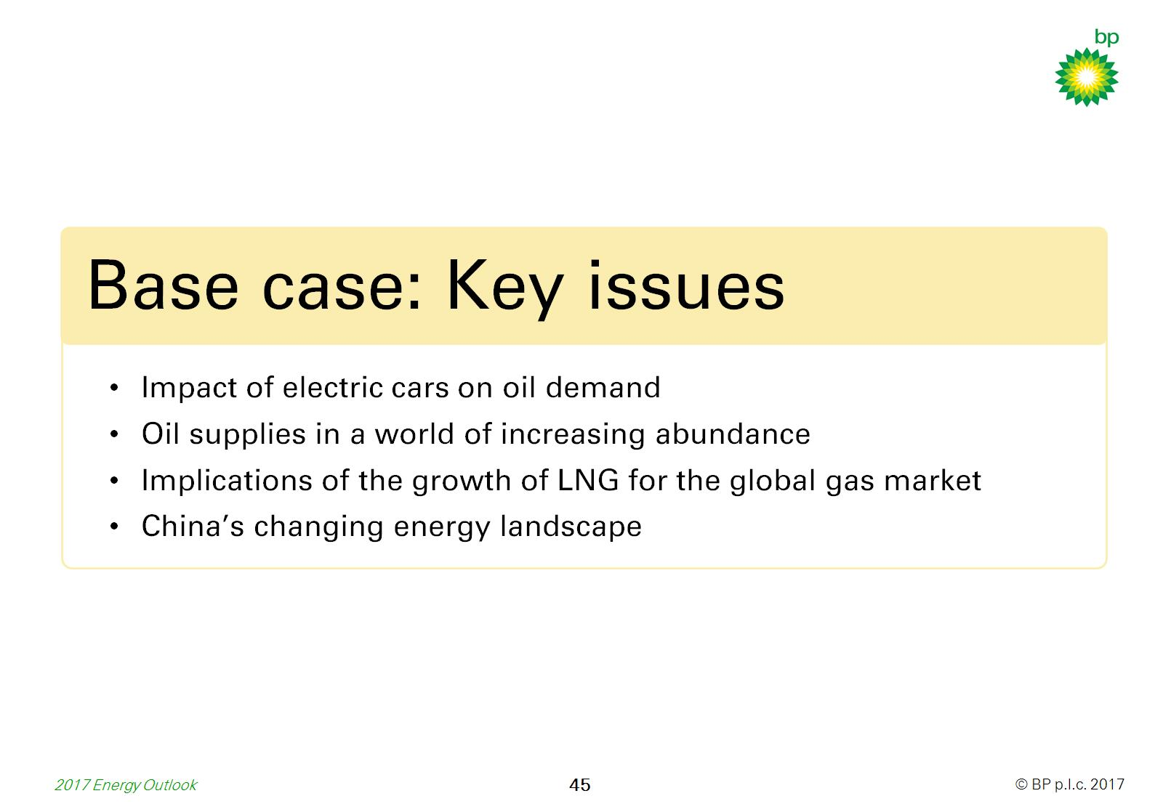

Slide 47
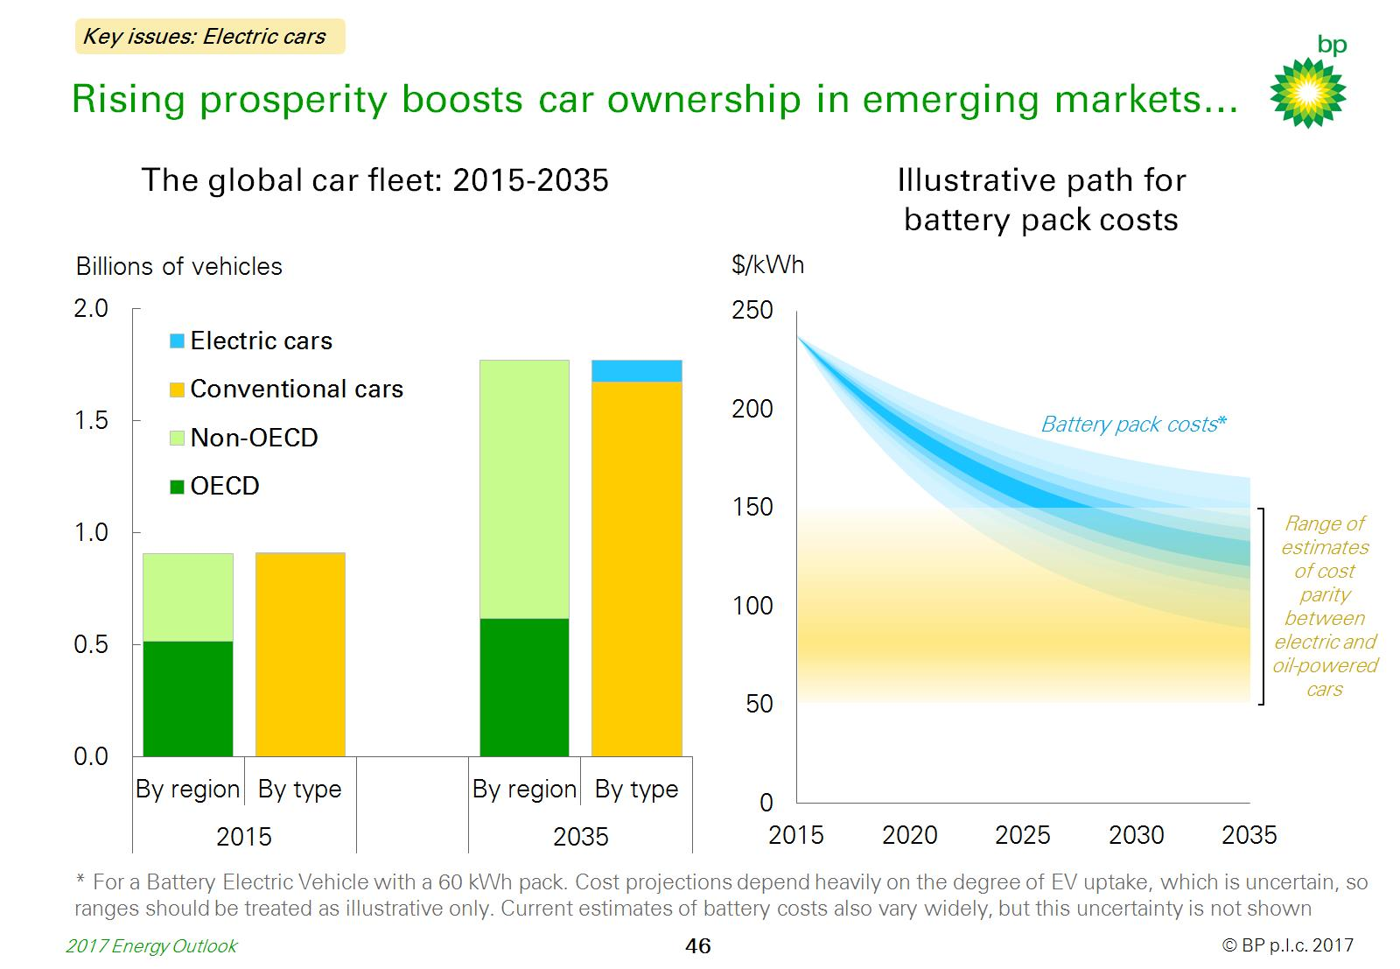
Rising prosperity boosts car ownership in emerging markets…

Slide 48
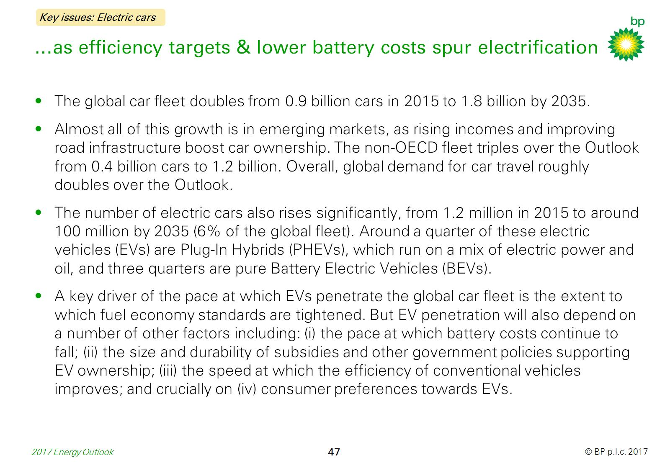
…as efficiency targets & lower battery costs spur electrification

Slide 49
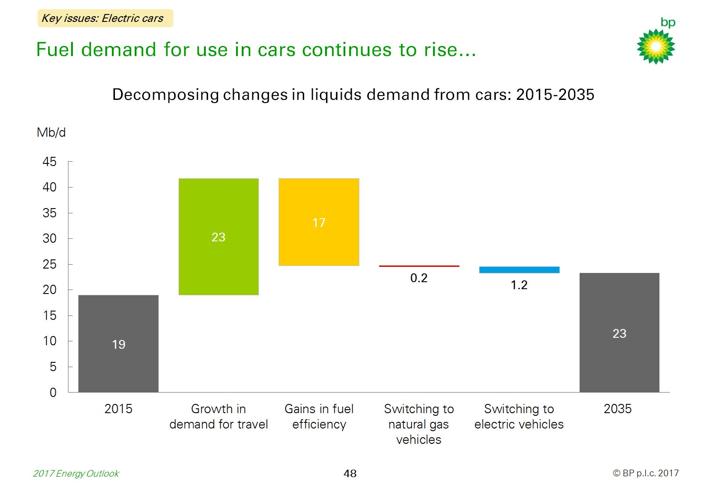
Fuel demand for use in cars continues to rise…

Slide 50
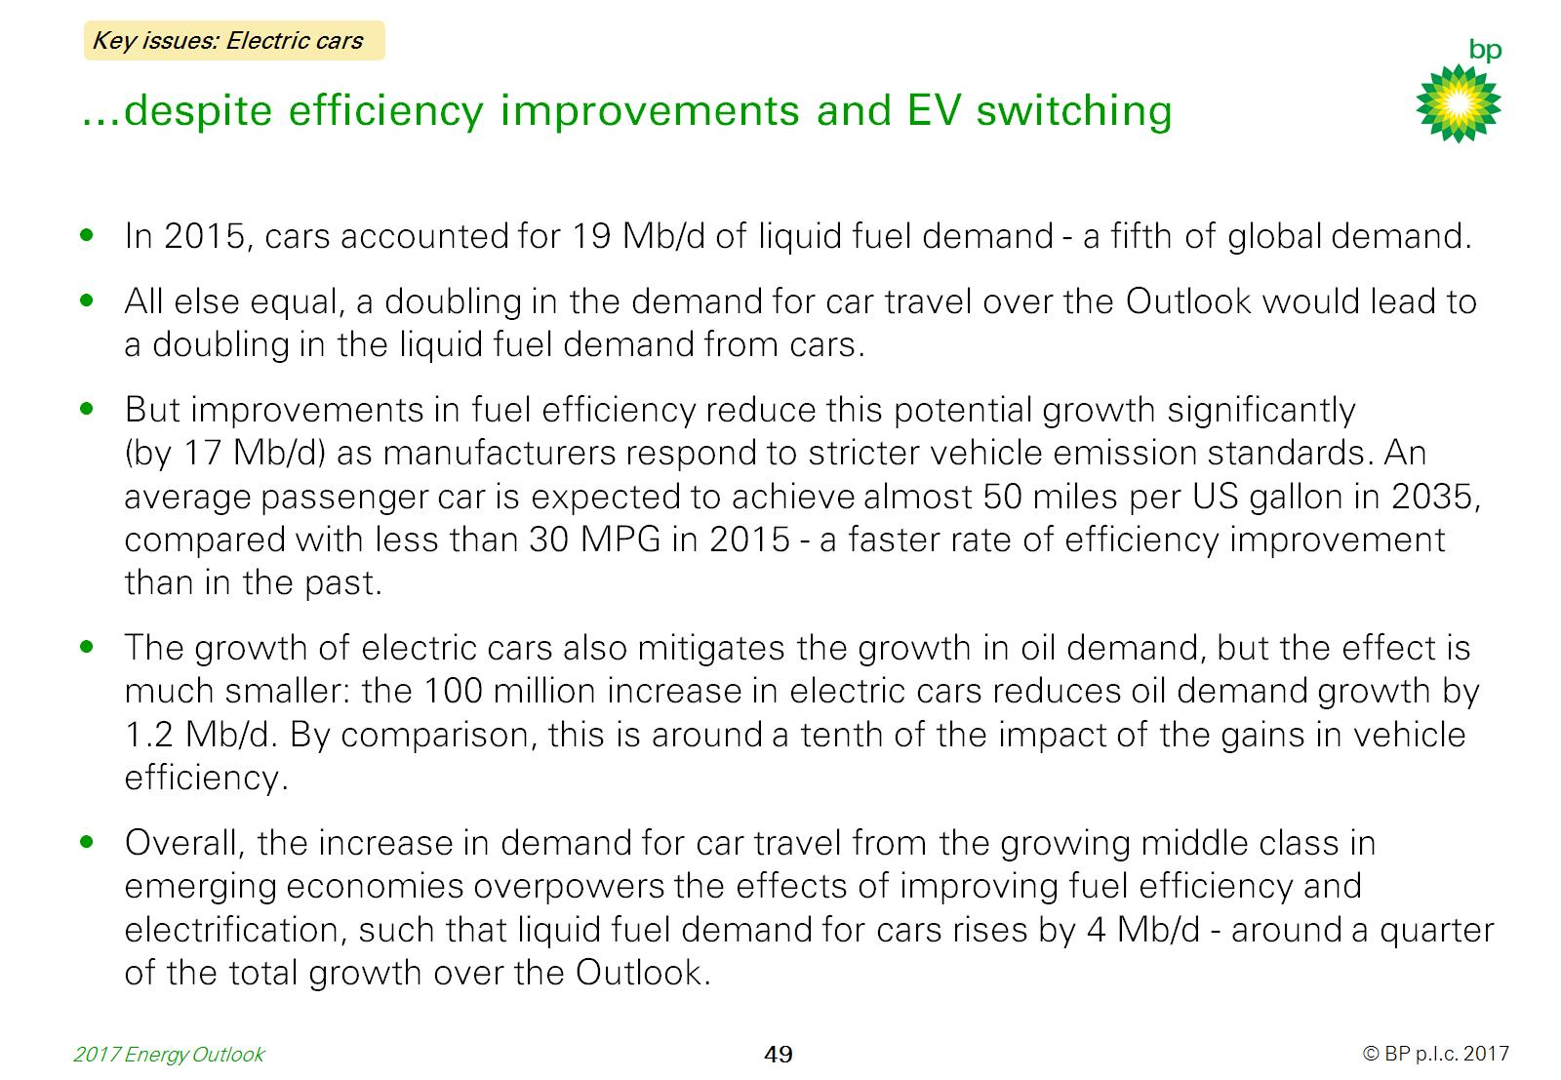
…despite efficiency improvements and EV switching

Slide 51
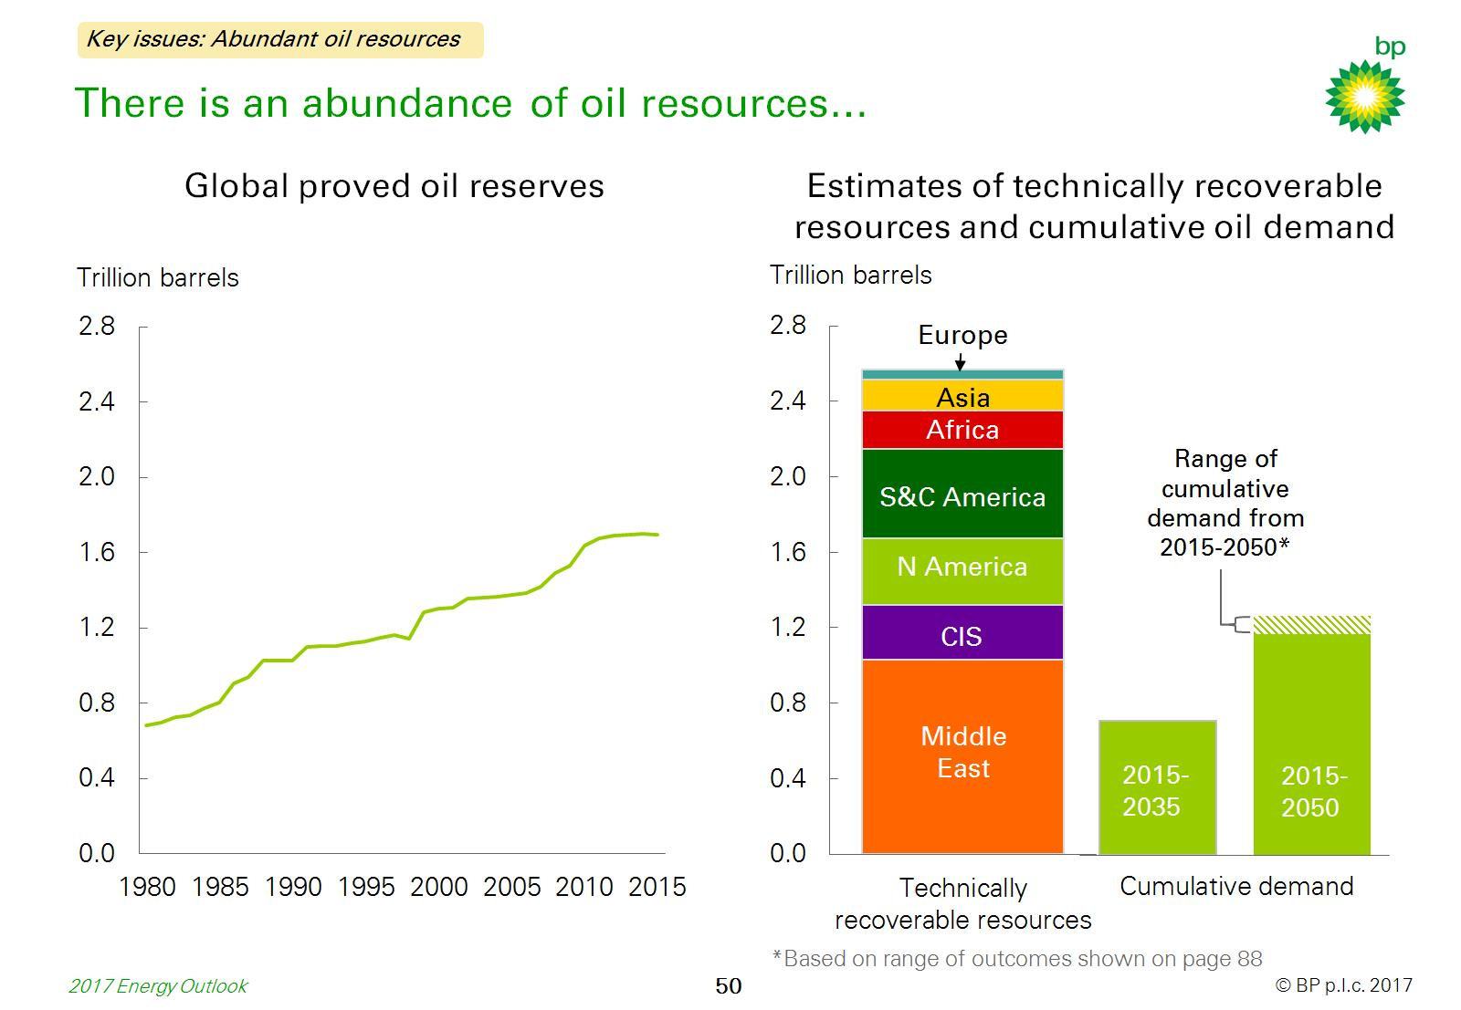
There is an abundance of oil resources…

Slide 52
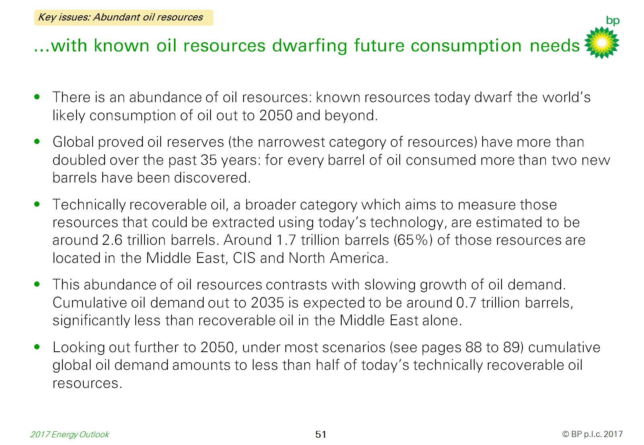
…with known oil resources dwarfing future consumption needs

Slide 53
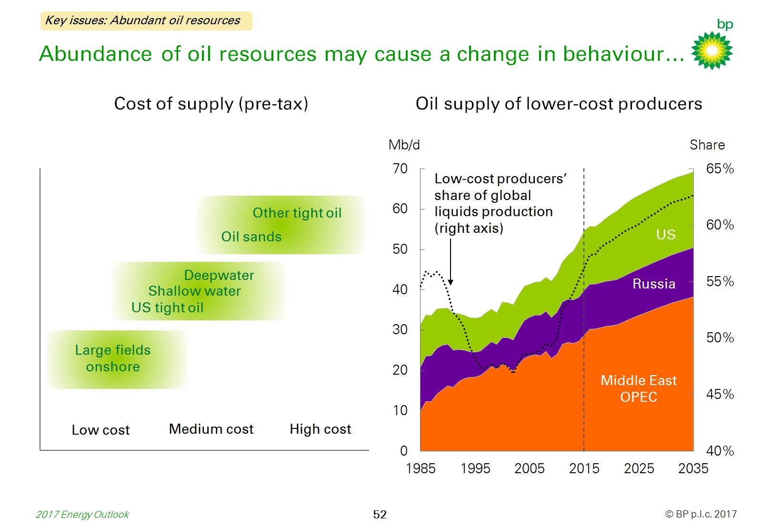
Abundance of oil resources may cause a change in behaviour…

Slide 54
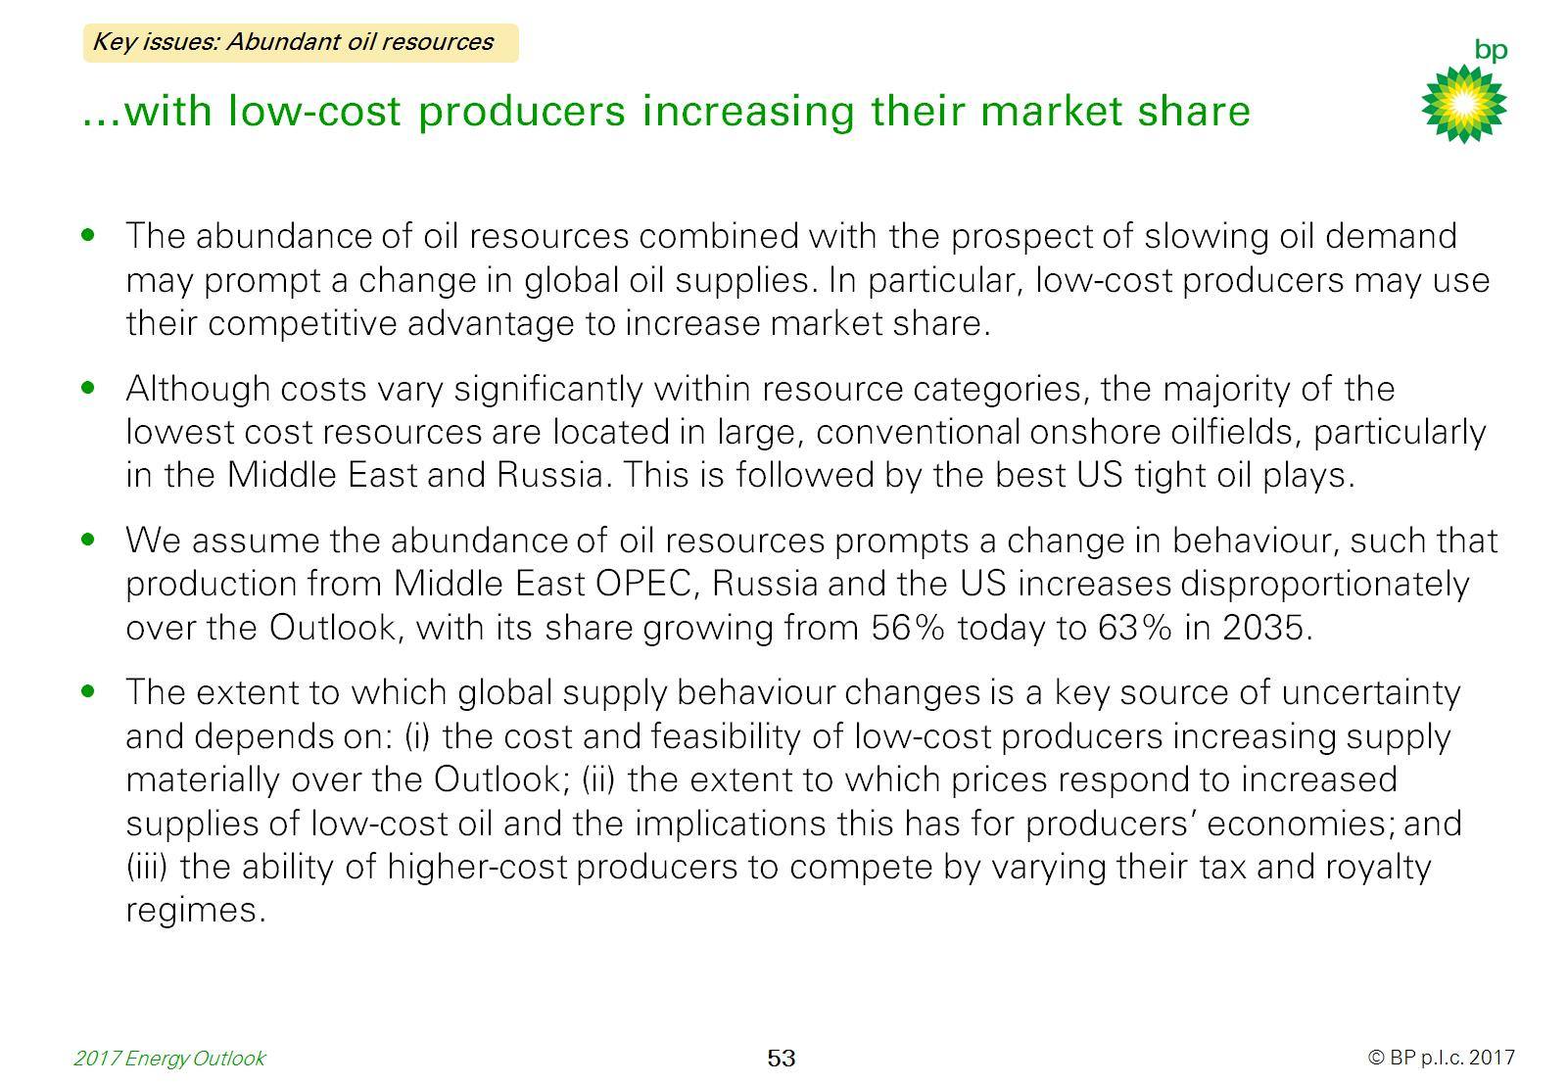
…with low-cost producers increasing their market share

Slide 55

LNG supplies grow strongly led by US and Australia…

Slide 56

…with demand remaining concentrated in Asia

Slide 57

LNG’s share in traded gas increases sharply…

Slide 58

…leading to increasing integration across gas markets

Slide 59

China’s energy needs are changing…

Slide 60

…as it adjusts to a more sustainable growth path

Slide 61

China is also shifting towards a lower-carbon energy mix...

Slide 62

…with coal being displaced by lower carbon alternatives

Slide 63


Slide 64


Slide 65

Energy demand in 2035 has been revised down…

Slide 66

…with a further shift in the fuel mix towards renewables

Slide 67

Chinese energy demand has been revised down…

Slide 68

…offset by stronger growth in other parts of emerging Asia

Slide 69

Renewables in US and EU power mix have been revised up…

Slide 70

…but offsetting revisions to gas and coal differ markedly

Slide 71


Slide 72


Slide 73

A faster mobility revolution could disrupt oil demand…

Slide 74

…but the size and direction depends on its form

Slide 75

Two illustrative scenarios highlight how oil demand…

Slide 76

…might vary depending on the nature of the revolution

Slide 77

The speed of transition to a lower-carbon energy economy…

Slide 78

…is a major uncertainty in the outlook for energy

Slide 79

The speed of transition has a significant impact…

Slide 80

…on the growth of energy and its composition

Slide 81

Comparison with other low carbon scenarios…

Slide 82

…reveals similarities and differences

Slide 83

Gas demand growth could be slower…

Slide 84

…if less priority is attached to moving away from coal

Slide 85

The strength of natural gas demand could be challenged…

Slide 86

…from both stronger and weaker environmental policies

Slide 87


Slide 88


Slide 89

The point at which global oil demand will peak…

Slide 90

…depends on GDP growth, efficiency trends and climate policy

Slide 91

The role Africa will play in driving global energy demand…

Slide 92

…depends on productivity growth and industrial structure

Slide 93

The power sector consumes a growing share of energy…

Slide 94

…and by 2050 could account for all growth in primary energy

Slide 95


Slide 96


Slide 97

Key figures: Energy

Slide 98

Key figures: Macro, energy intensity and CO₂ emissions

Slide 99

Digital revolution mobility scenario: assumptions

Slide 100

Electric revolution mobility scenario: assumptions

Slide 101

Comparison with other energy outlooks

Slide 102

Notes on comparisons

Slide 103

Comparison and other key data sources

Slide 104

Disclaimer

