Slide 1


Slide 2
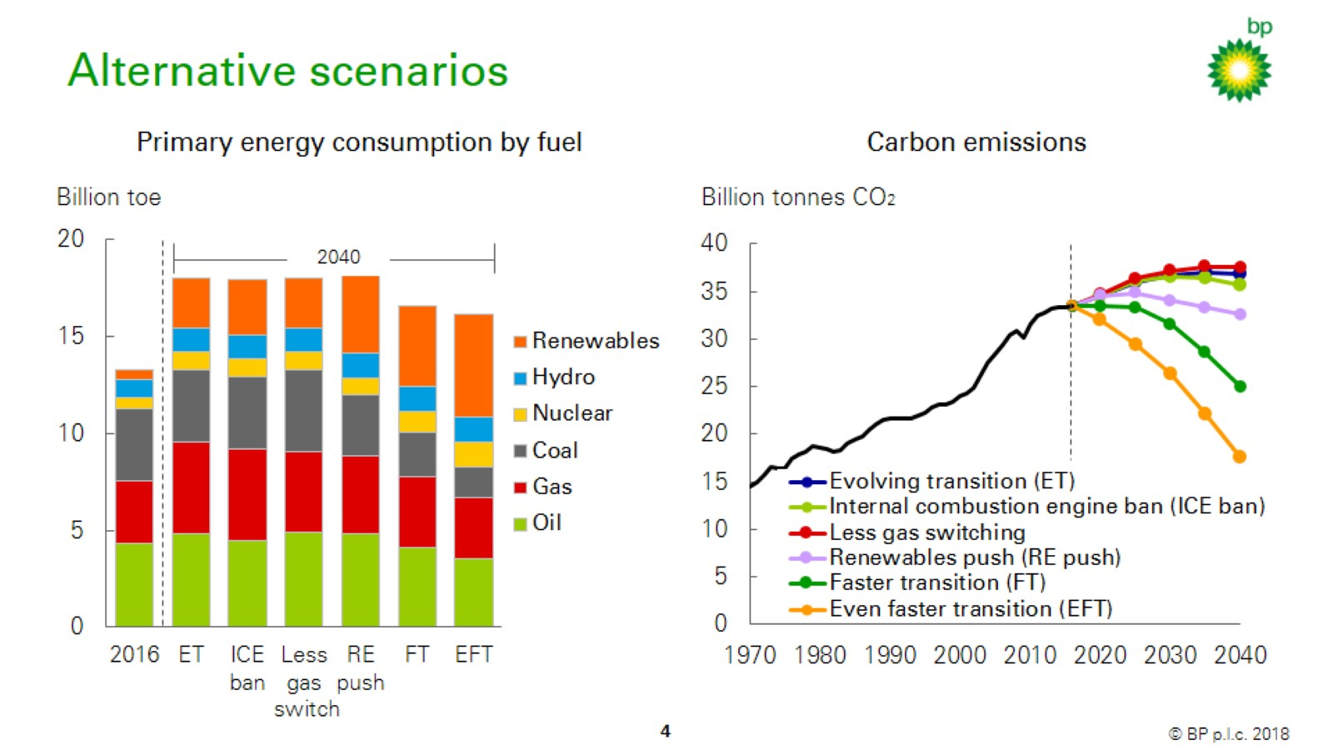
Alternative scenarios

Slide 3

Alternative scenarios

Slide 4
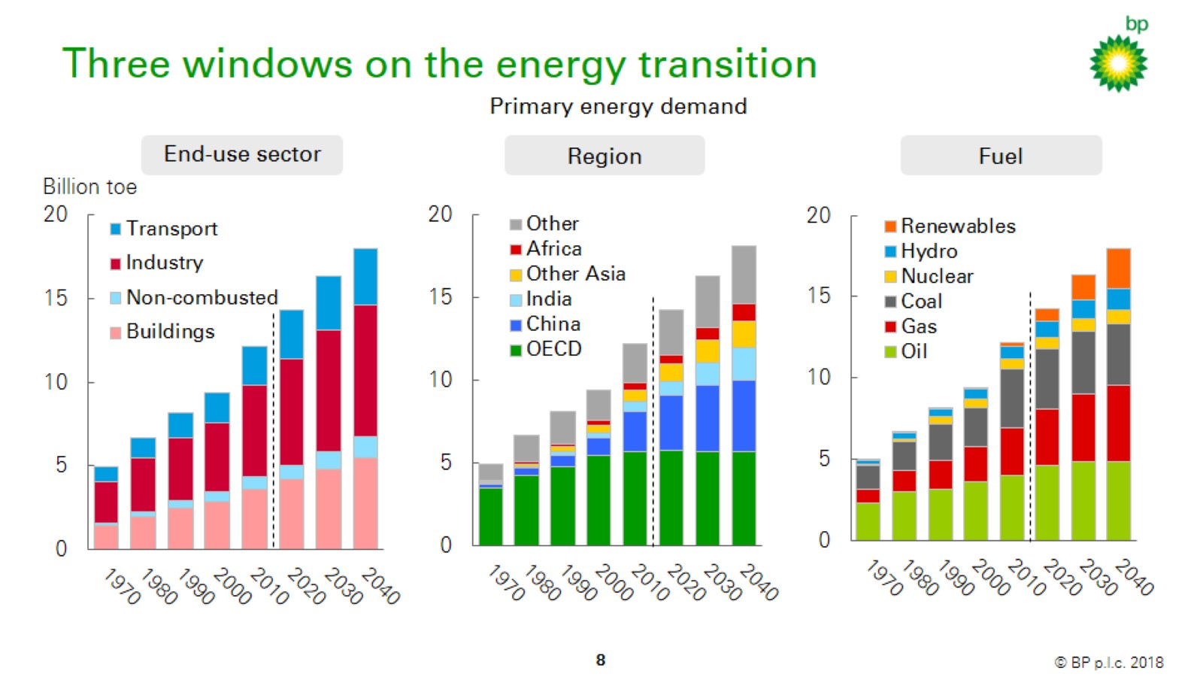
Three windows on the energy transition

Slide 5
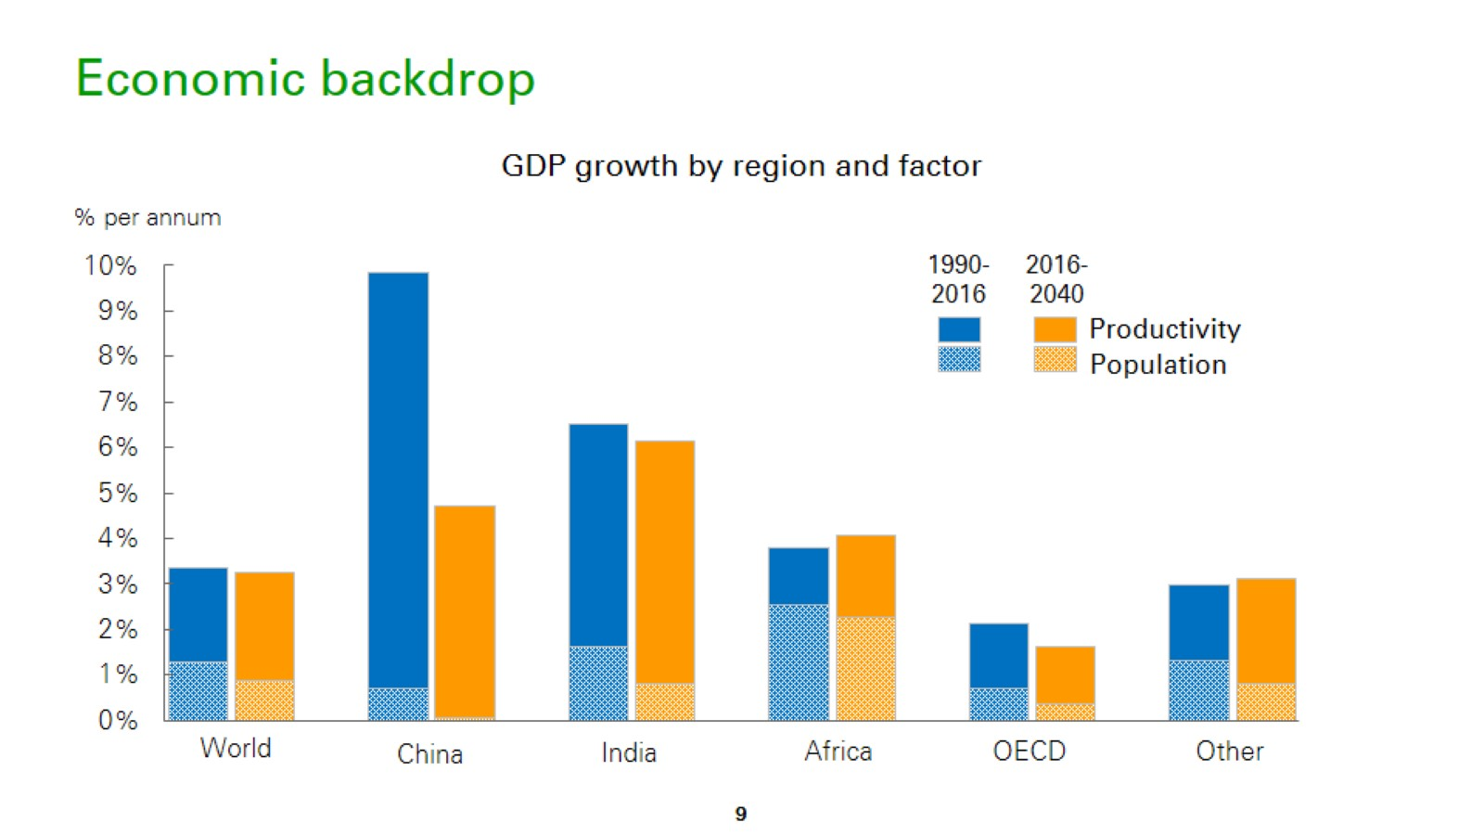
Economic backdrop

Slide 6

Three windows on the energy transition

Slide 7
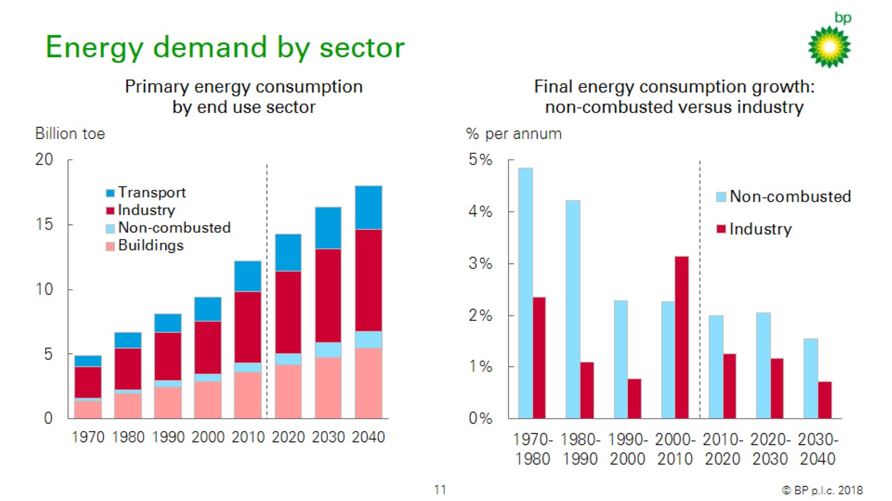
Energy demand by sector

Slide 8
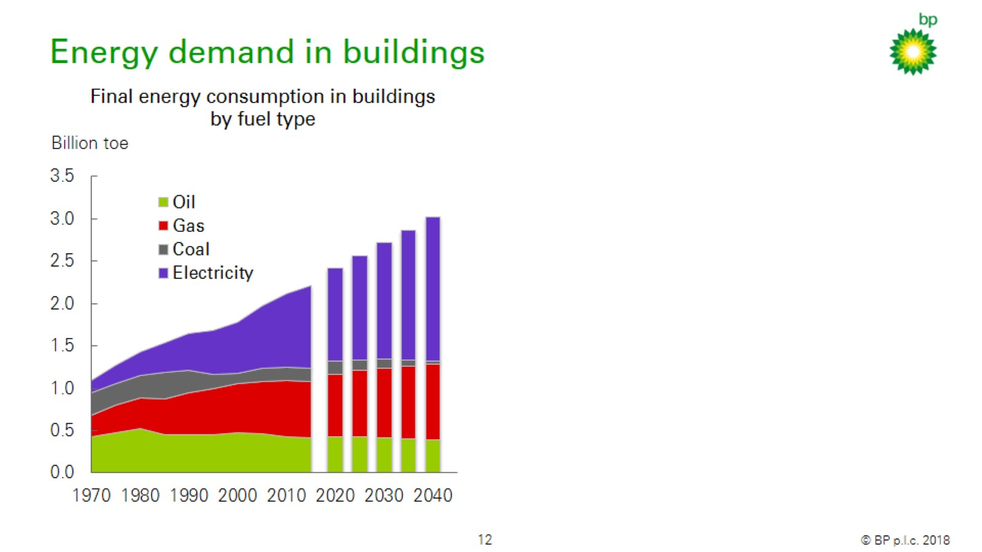
Energy demand in buildings

Slide 9
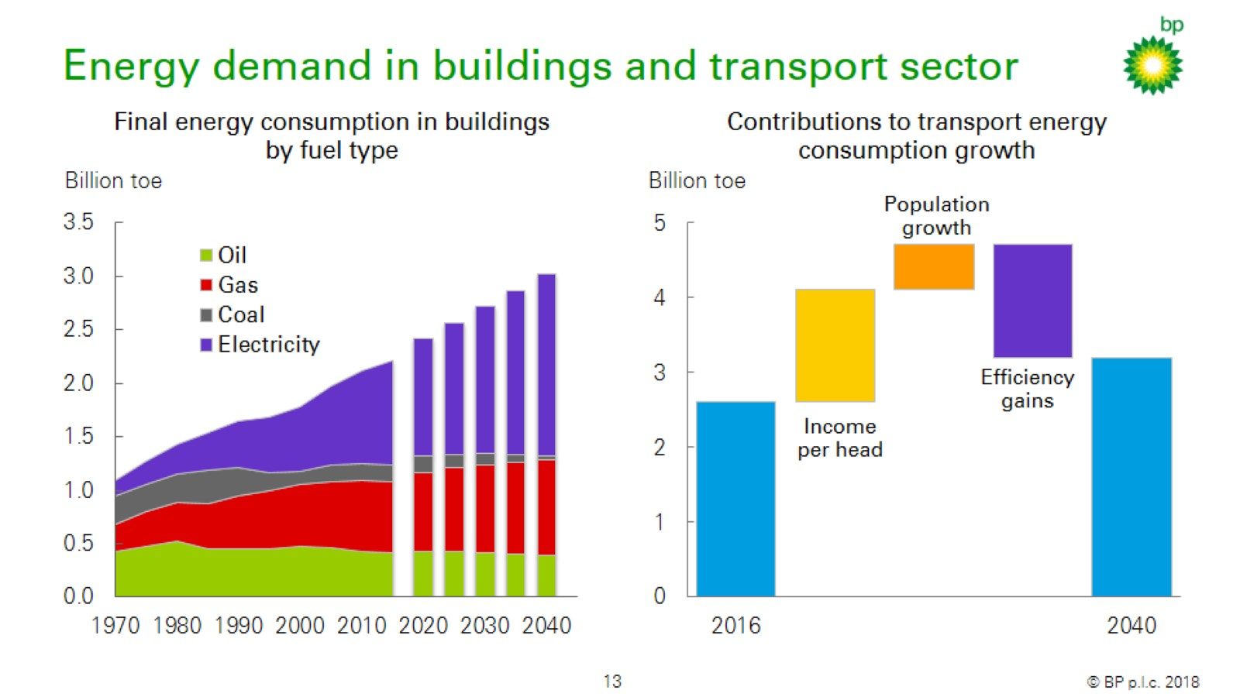
Energy demand in buildings and transport sector

Slide 10

Three windows on the energy transition

Slide 11
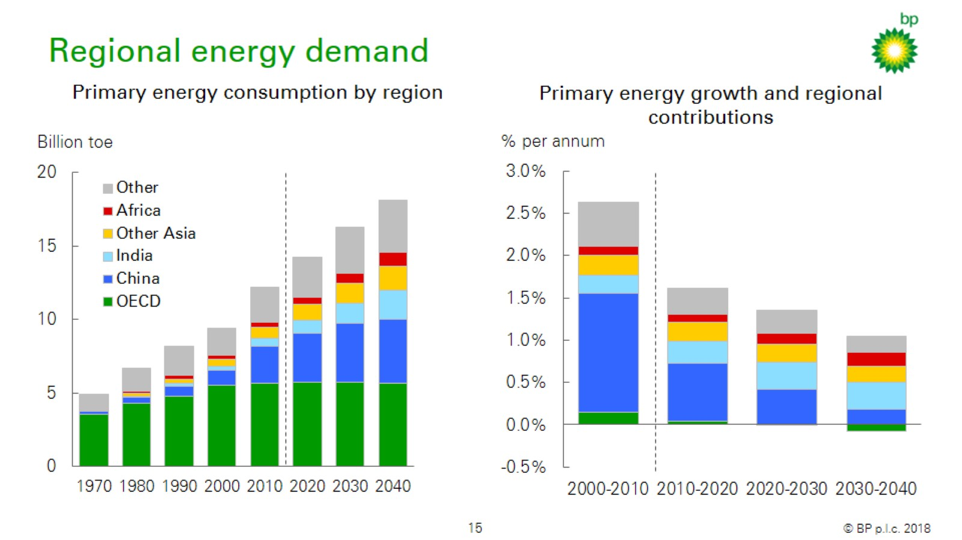
Regional energy demand

Slide 12
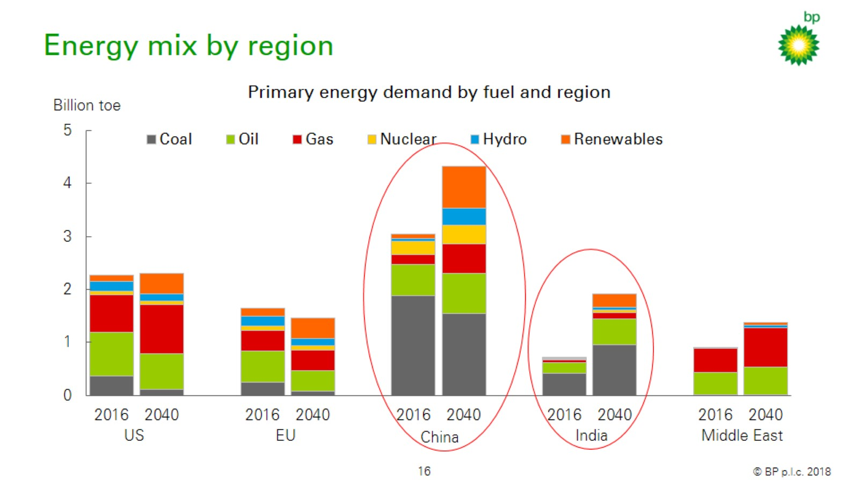
Energy mix by region

Slide 13

Three windows on the energy transition

Slide 14
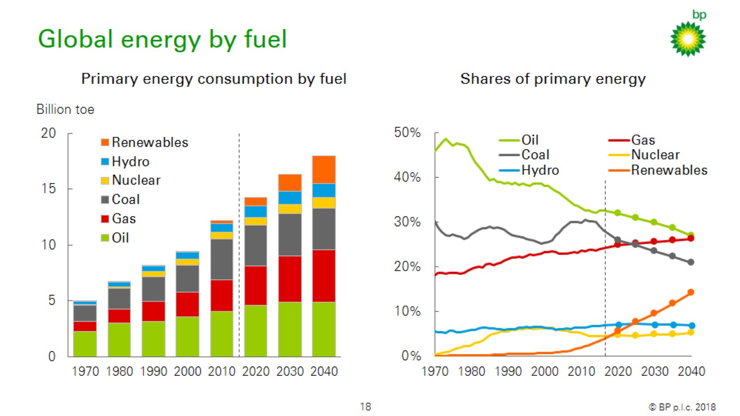
Global energy by fuel

Slide 15
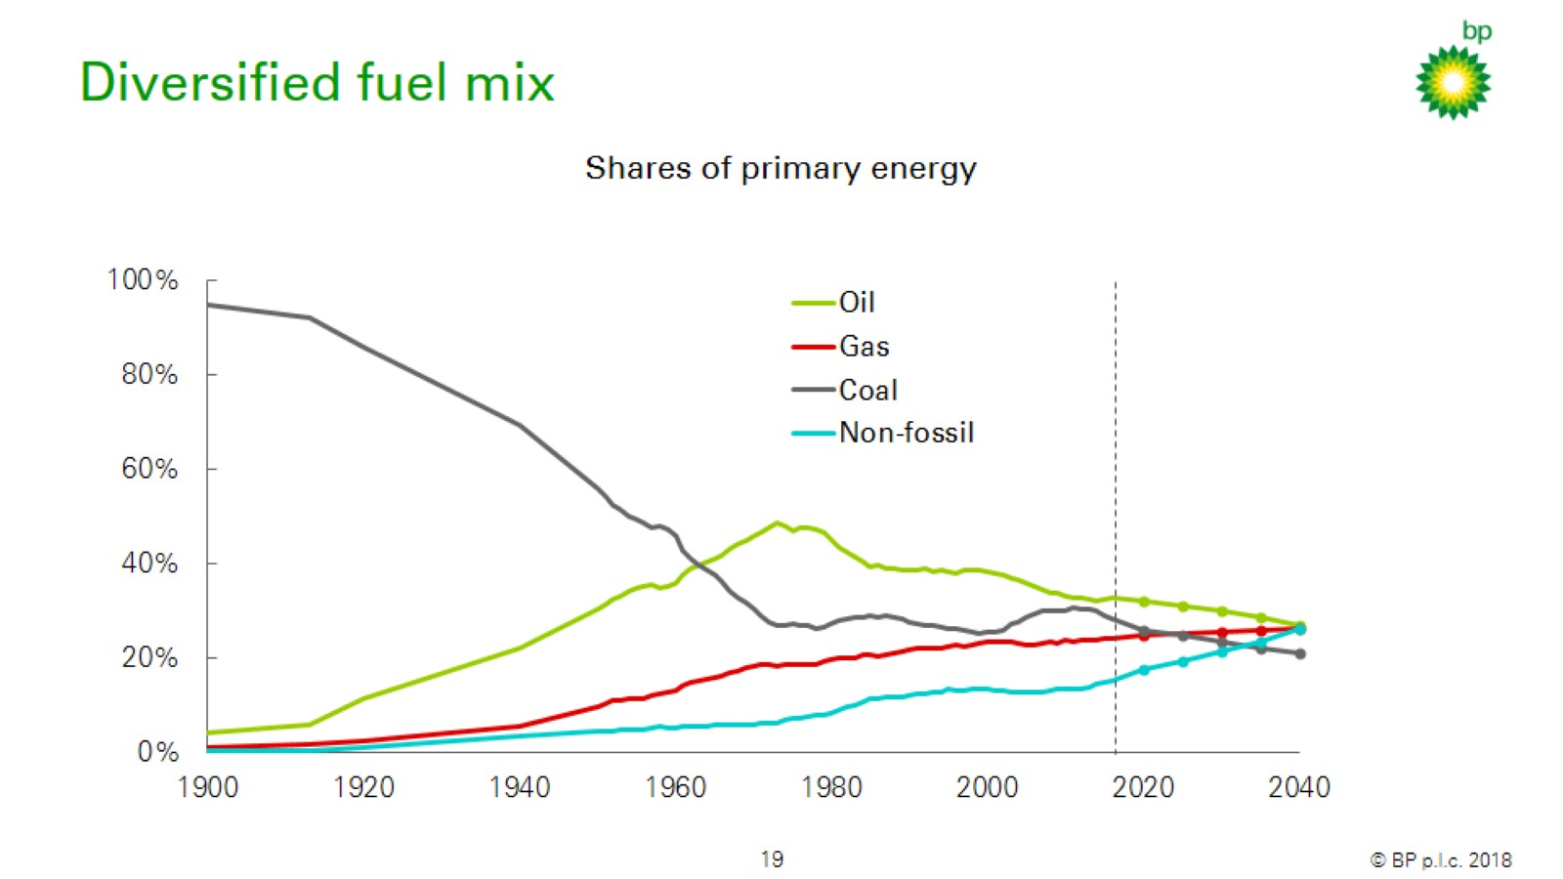
Diversified fuel mix

Slide 16

Three windows on the energy transition

Slide 17
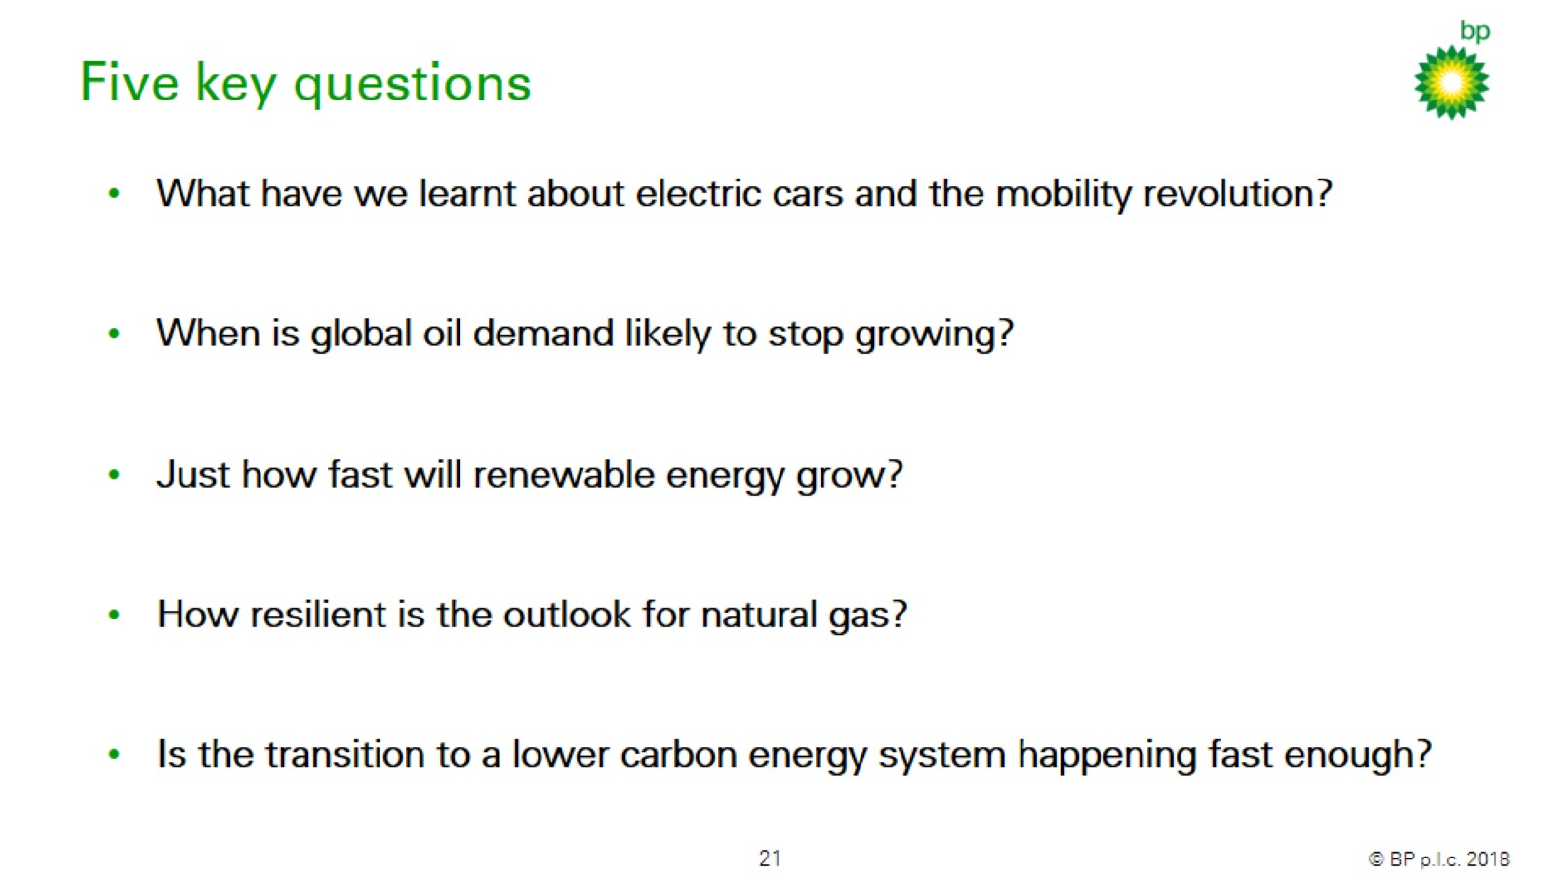
Five key questions

Slide 18
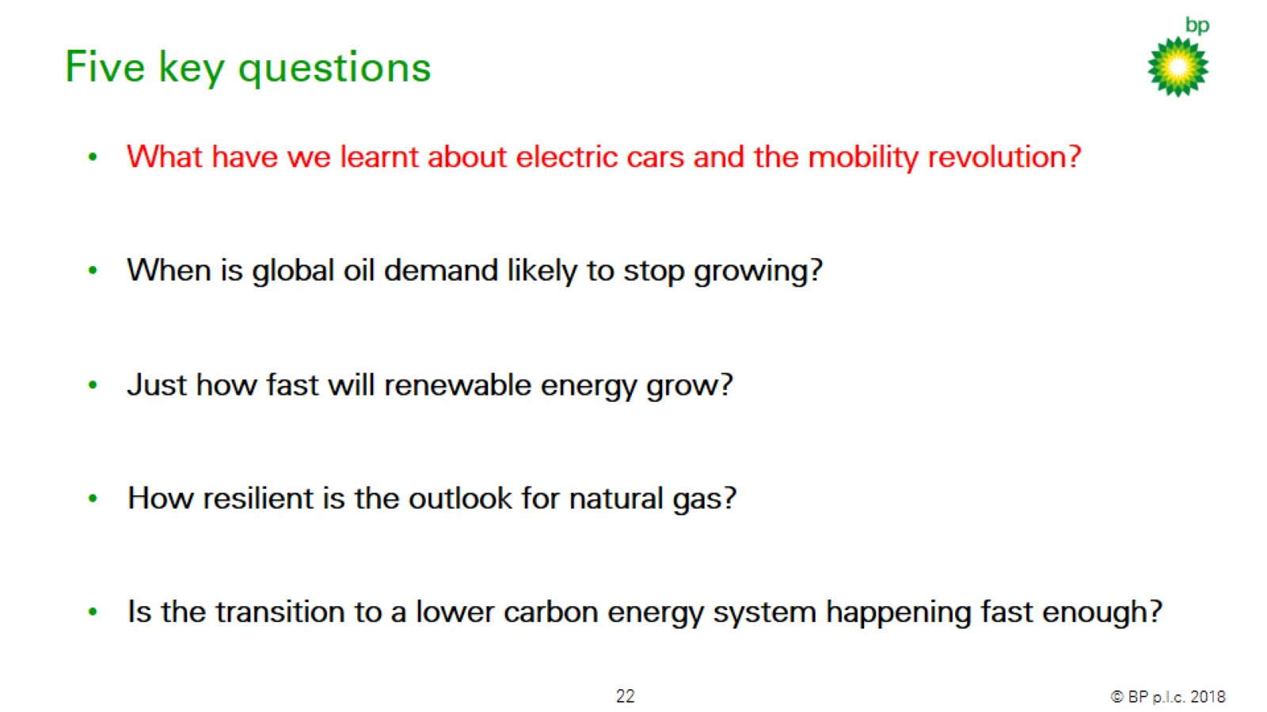
Five key questions

Slide 19
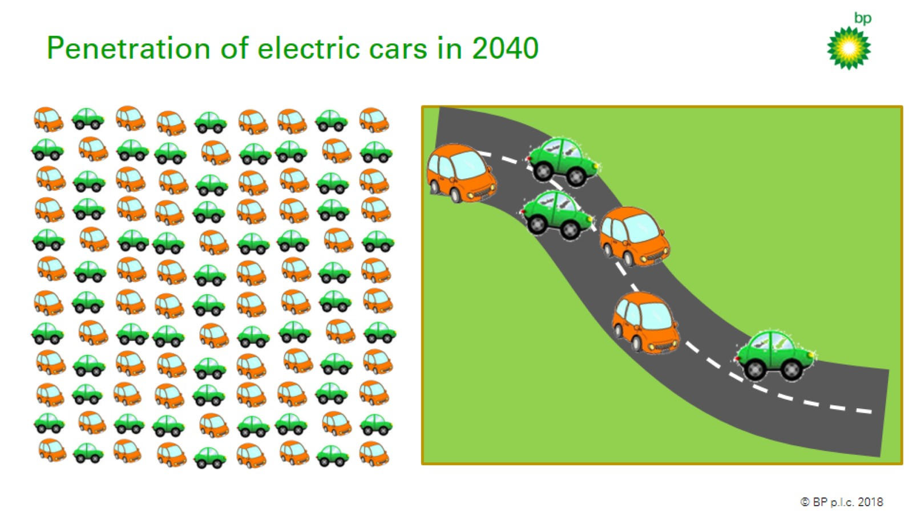
Penetration of electric cars in 2040

Slide 20
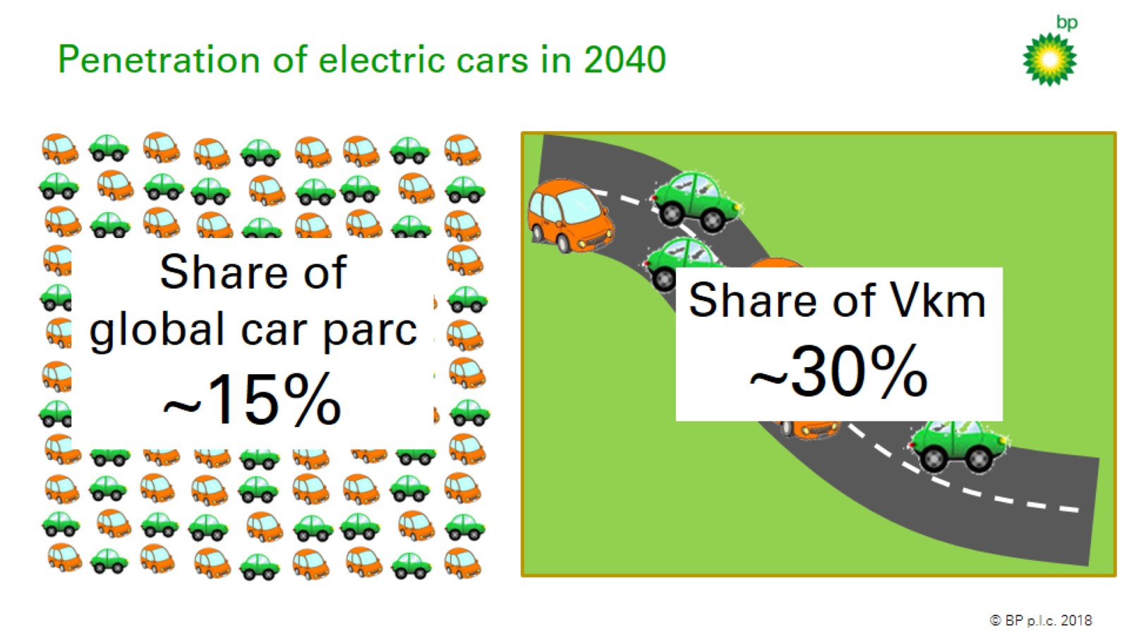
Penetration of electric cars in 2040

Slide 21
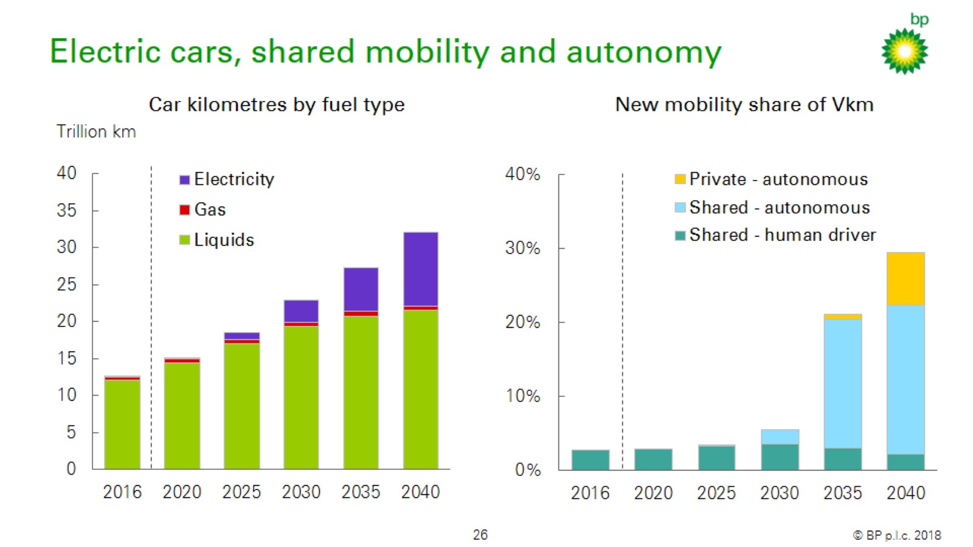
Electric cars, shared mobility and autonomy

Slide 22
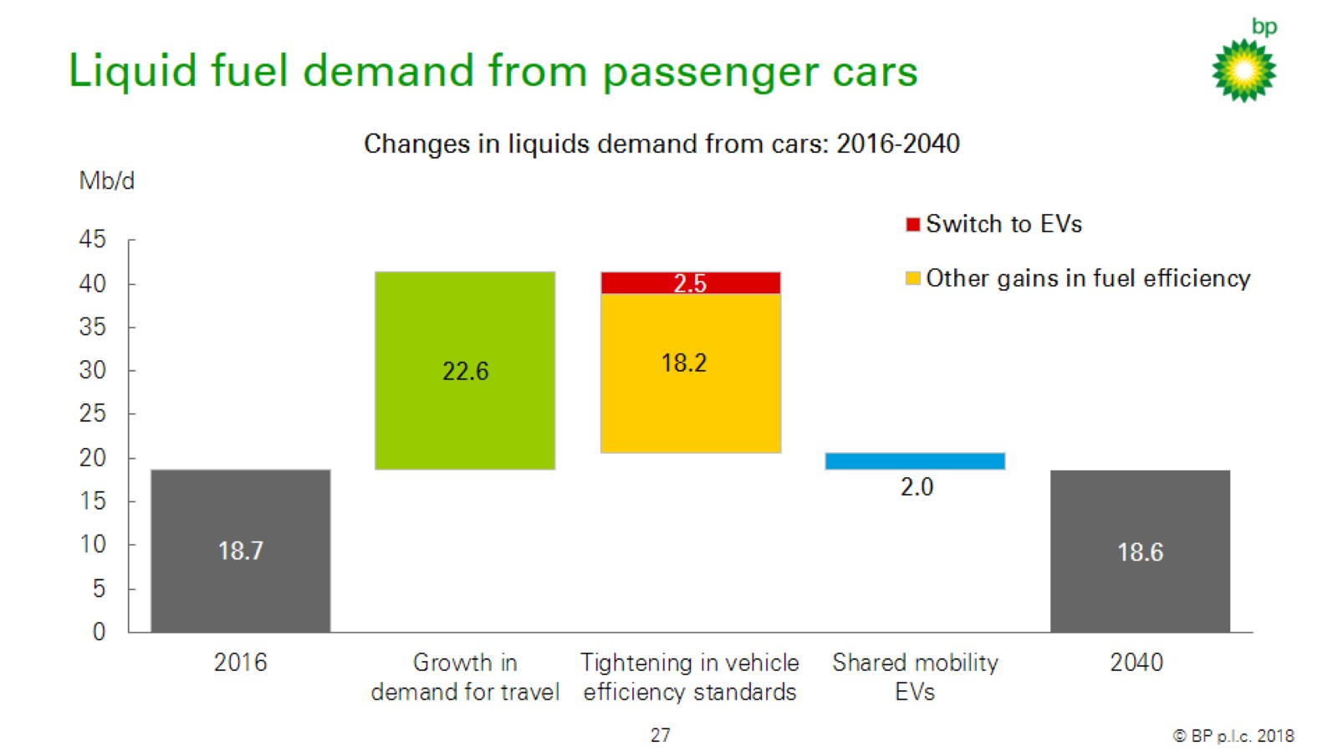
Liquid fuel demand from passenger cars

Slide 23
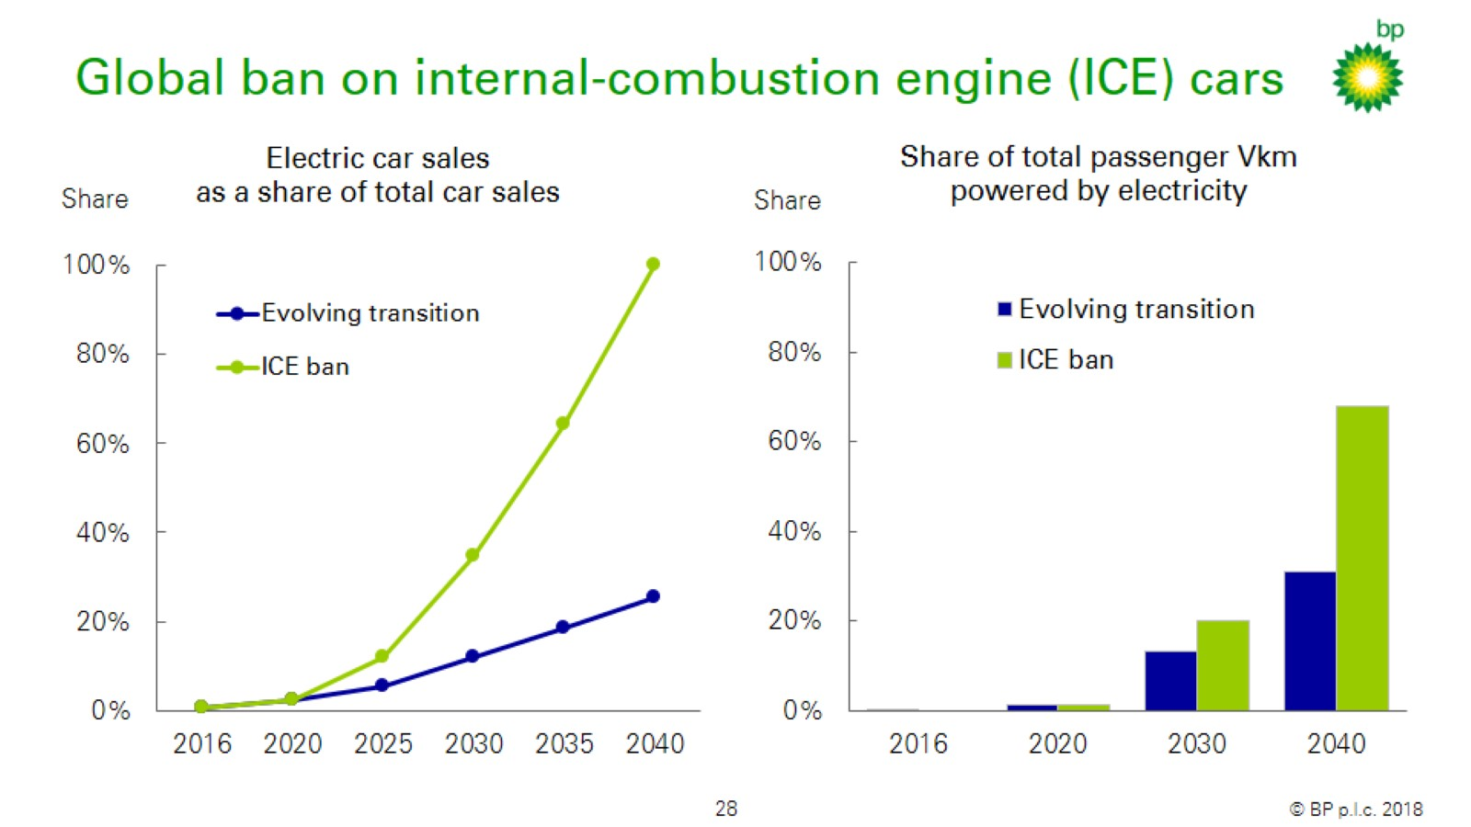
Global ban on internal-combustion engine (ICE) cars

Slide 24
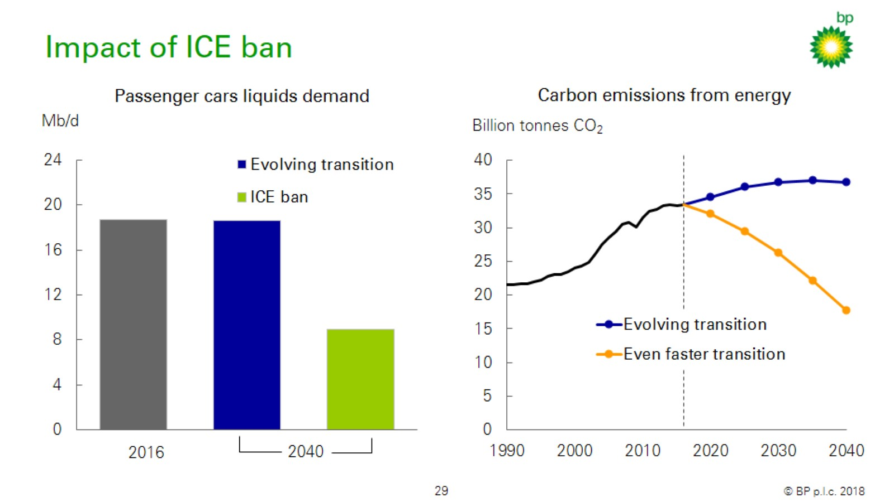
Impact of ICE ban

Slide 25
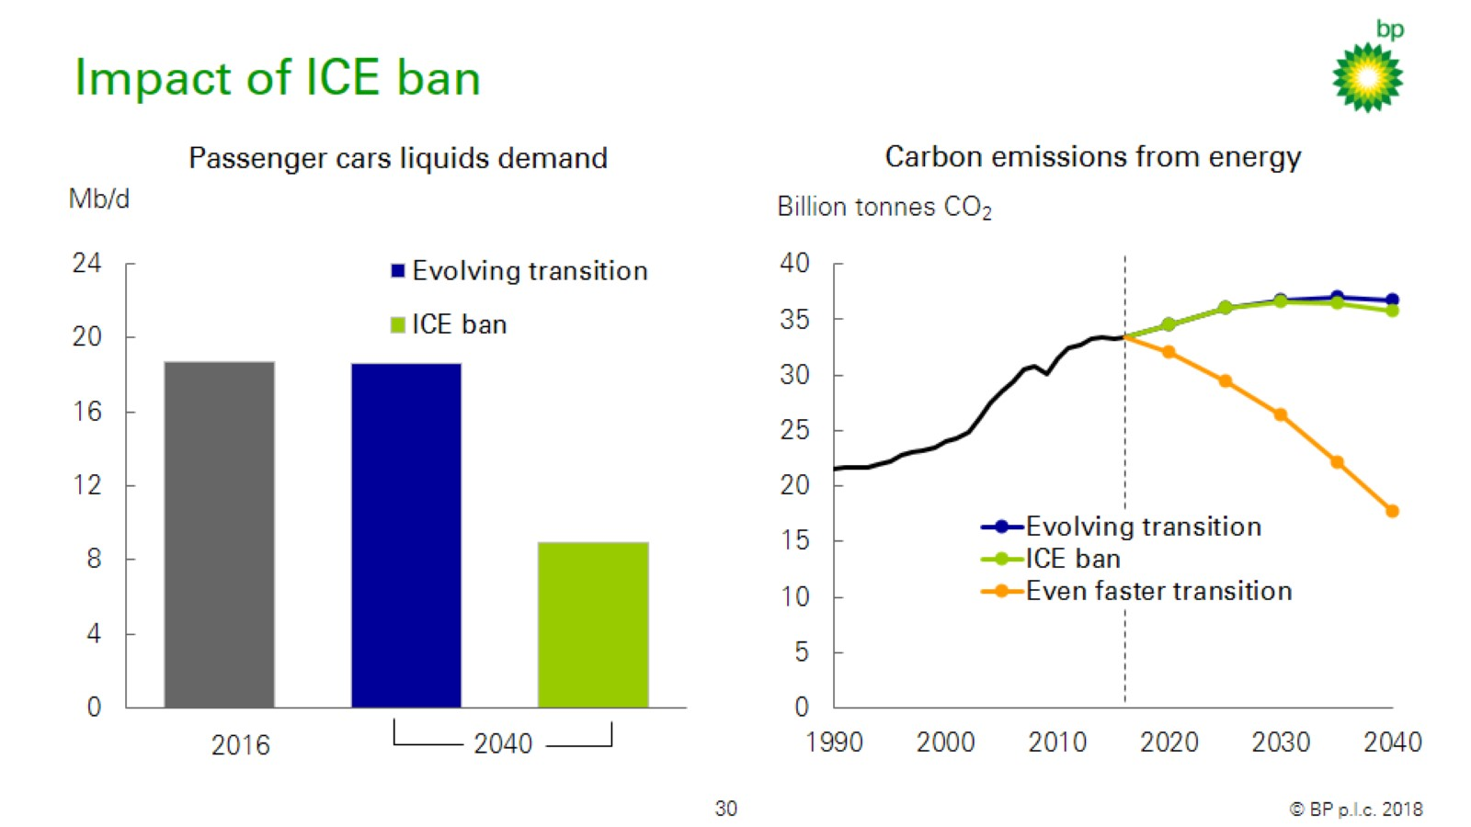
Impact of ICE ban

Slide 26
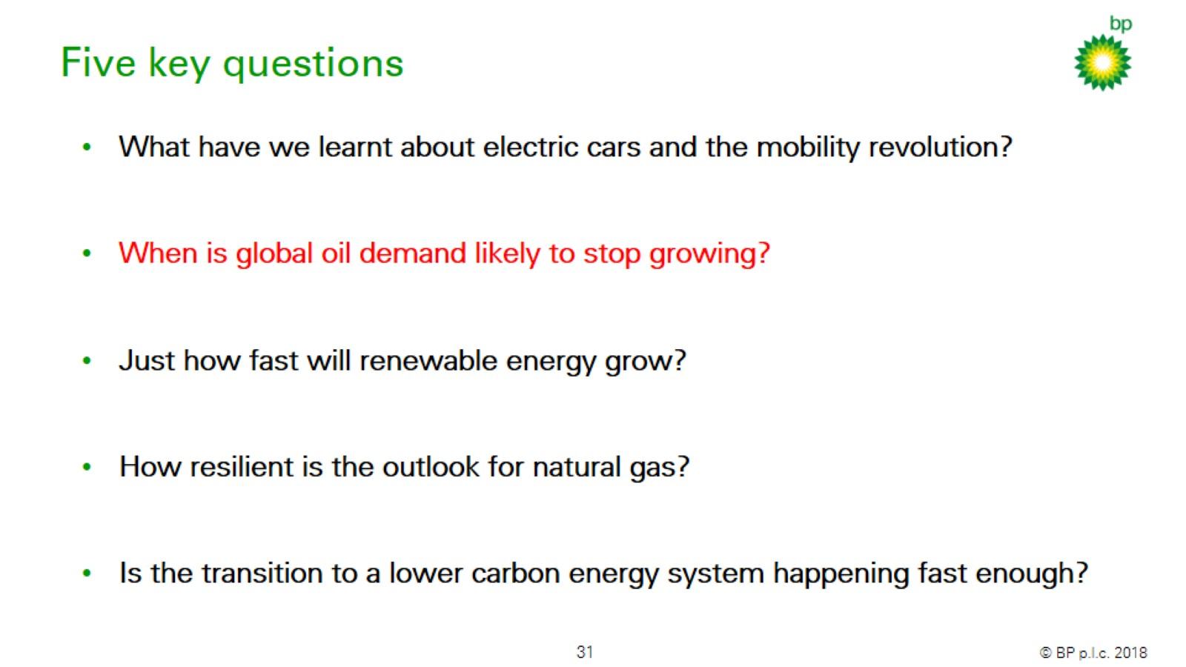
Five key questions

Slide 27
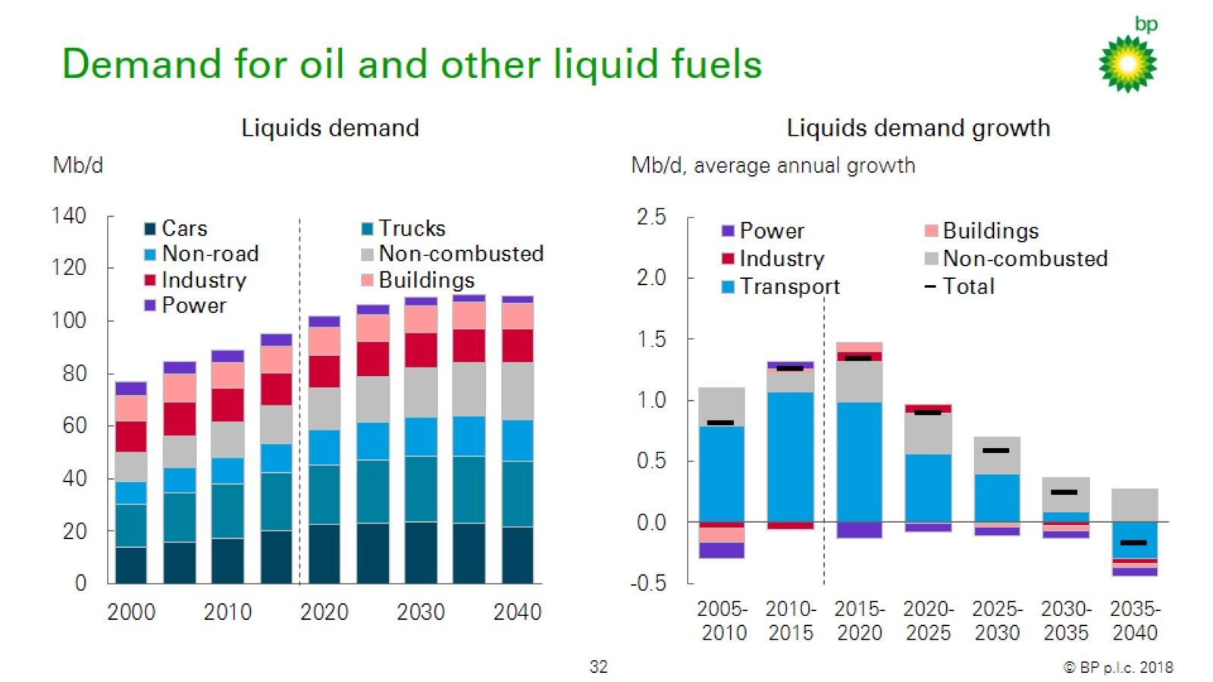
Demand for oil and other liquid fuels

Slide 28
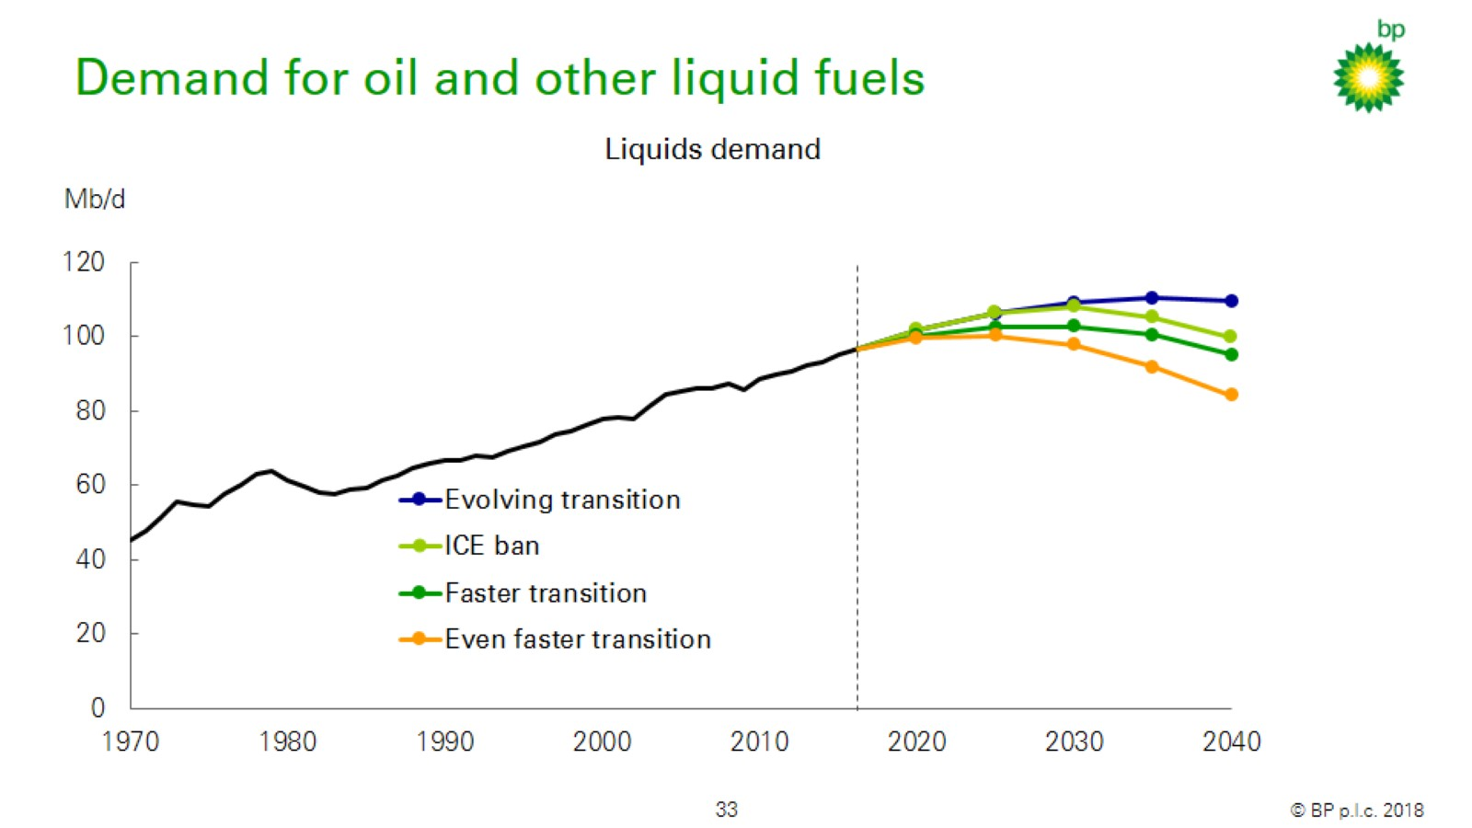
Demand for oil and other liquid fuels

Slide 29
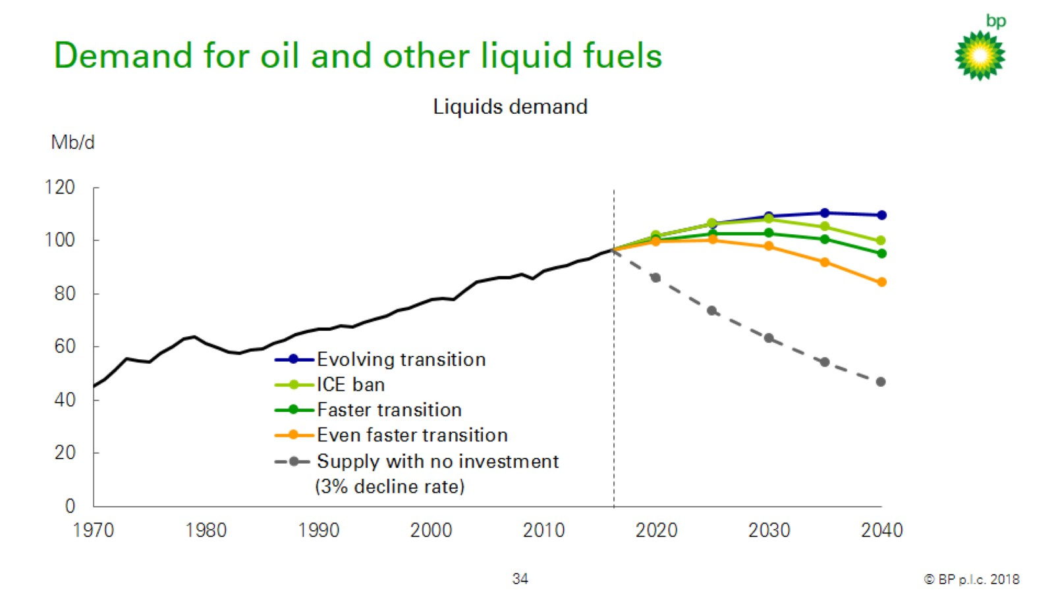
Demand for oil and other liquid fuels

Slide 30
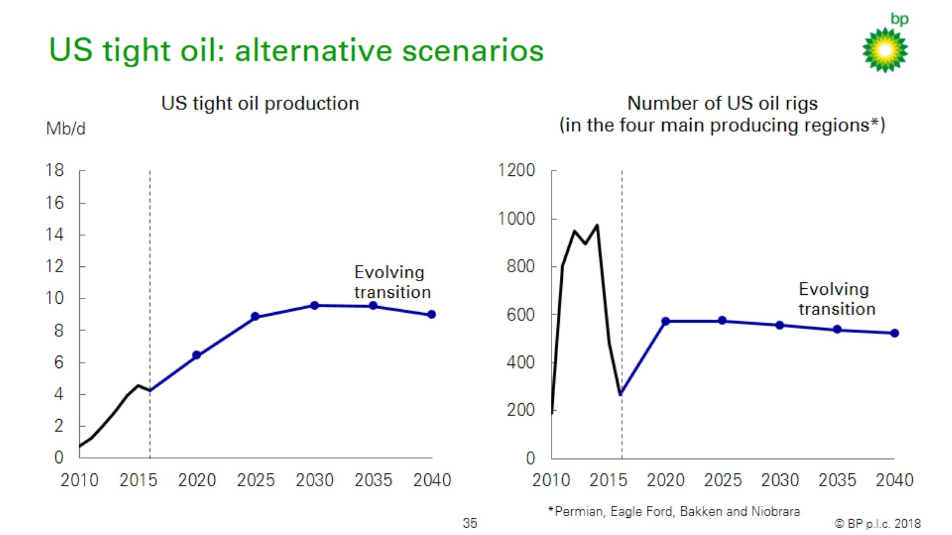
US tight oil: alternative scenarios

Slide 31
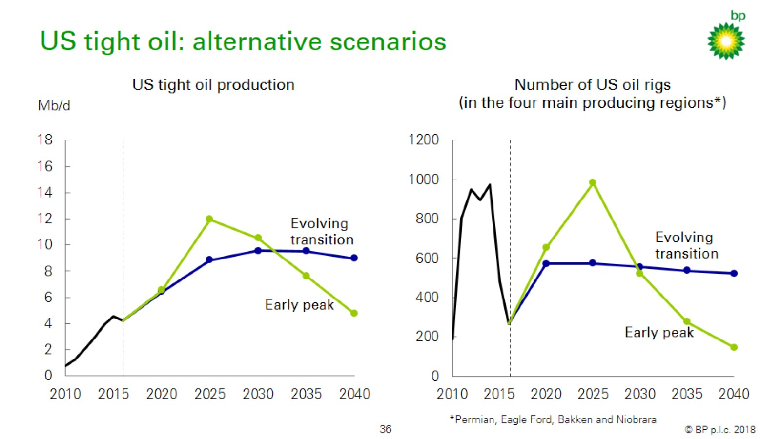
US tight oil: alternative scenarios

Slide 32
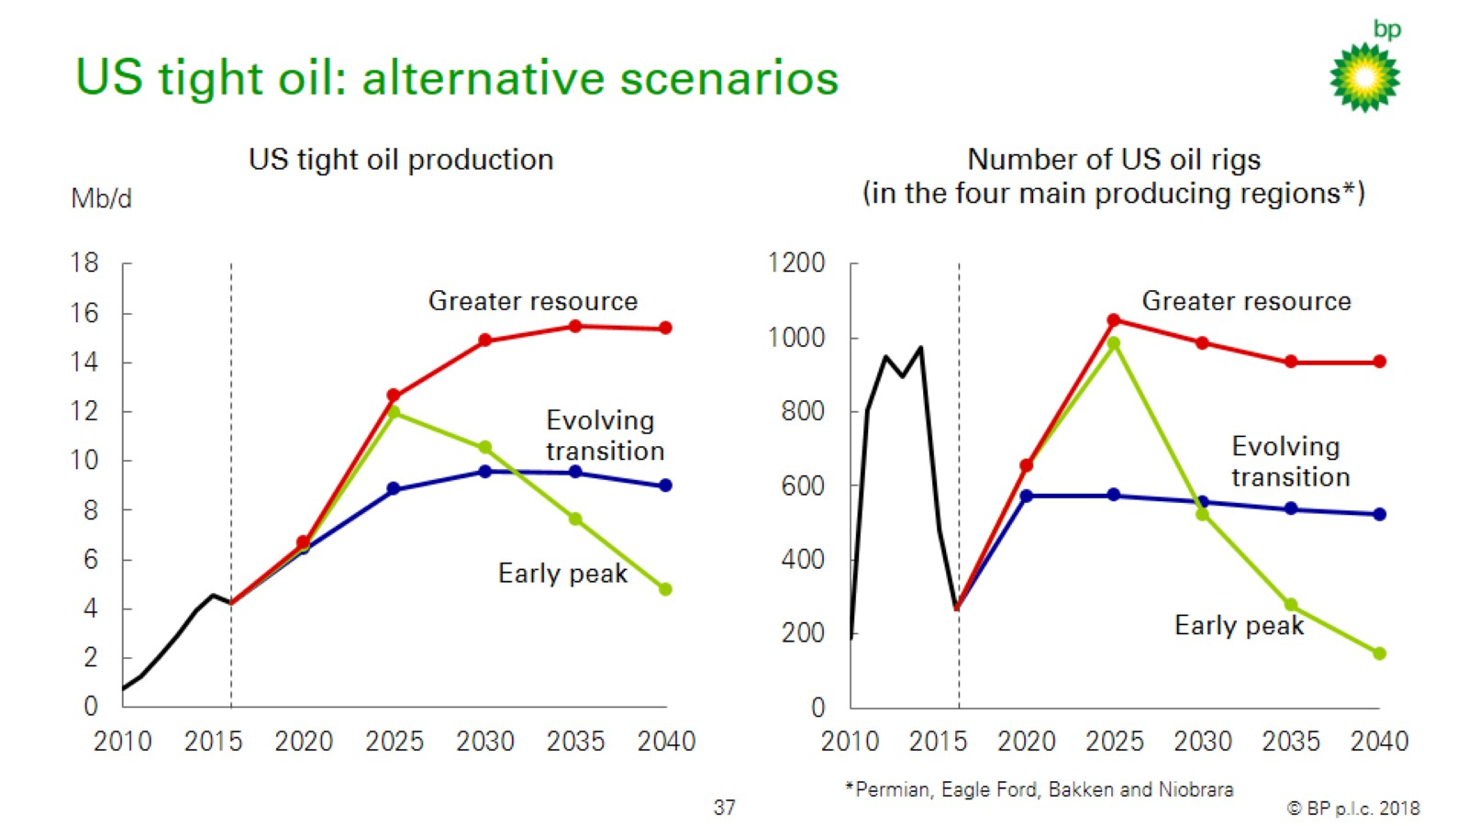
US tight oil: alternative scenarios

Slide 33
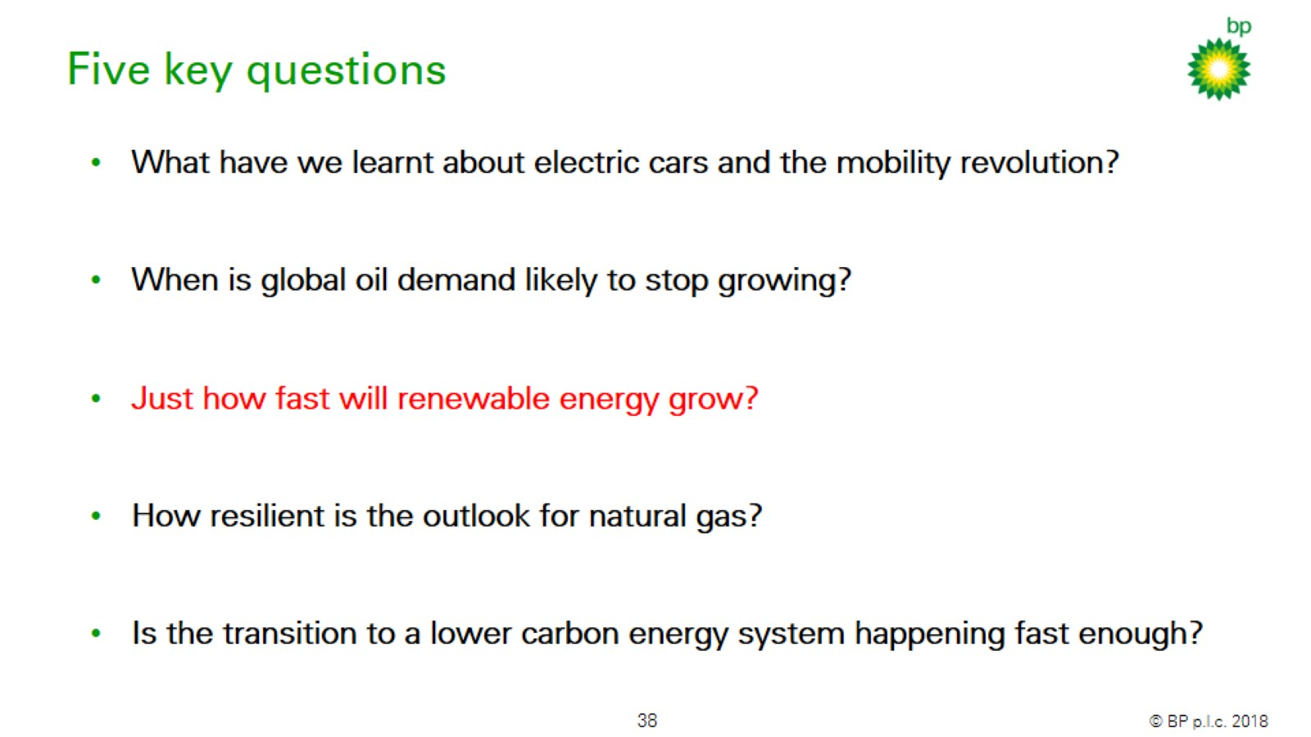
Five key questions

Slide 34
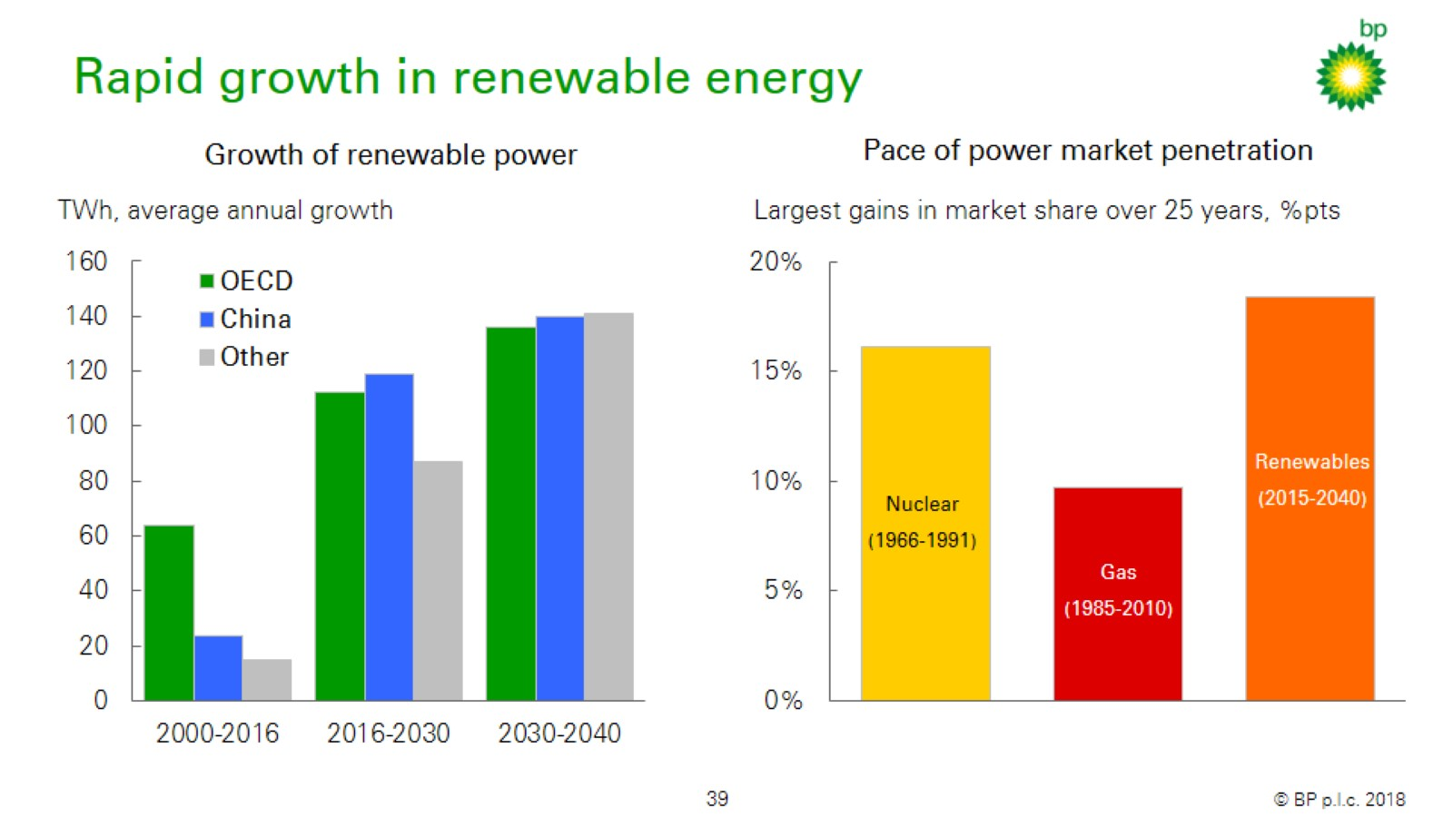
Rapid growth in renewable energy

Slide 35
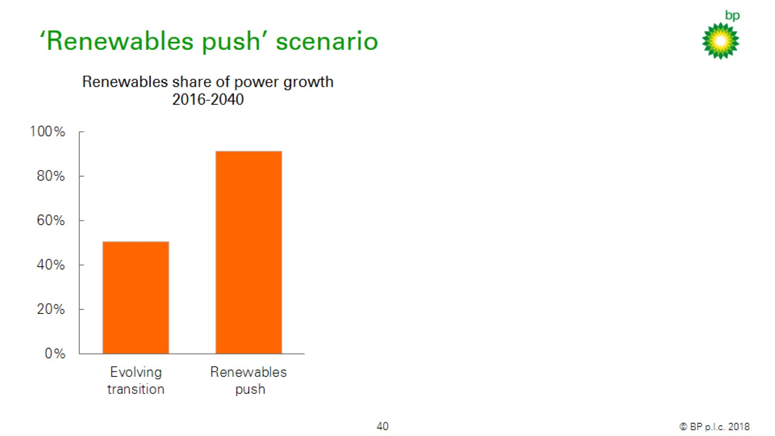
‘Renewables push’ scenario

Slide 36
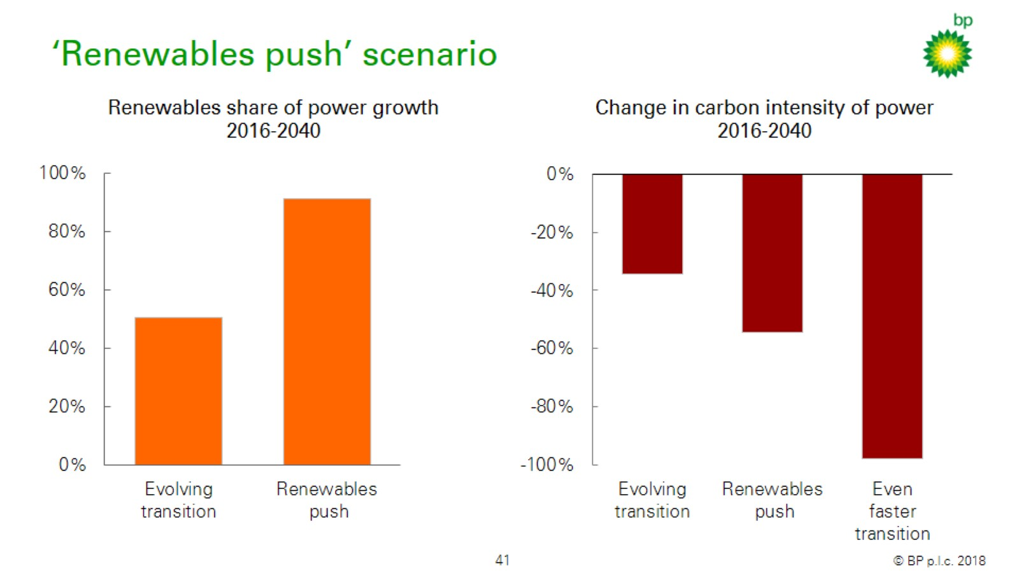
‘Renewables push’ scenario

Slide 37
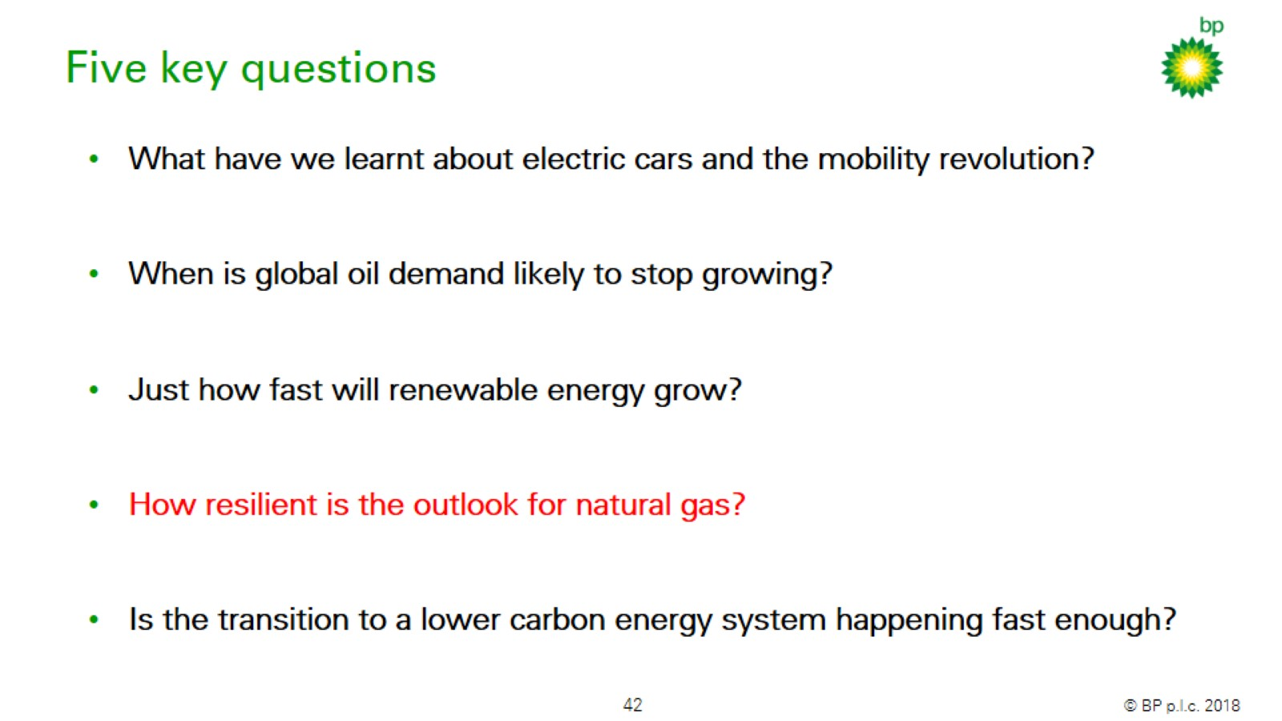
Five key questions

Slide 38
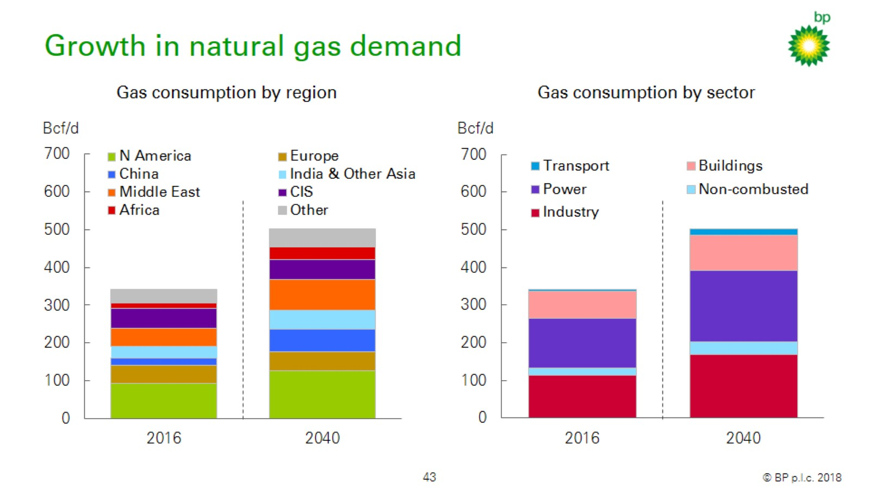
Growth in natural gas demand

Slide 39
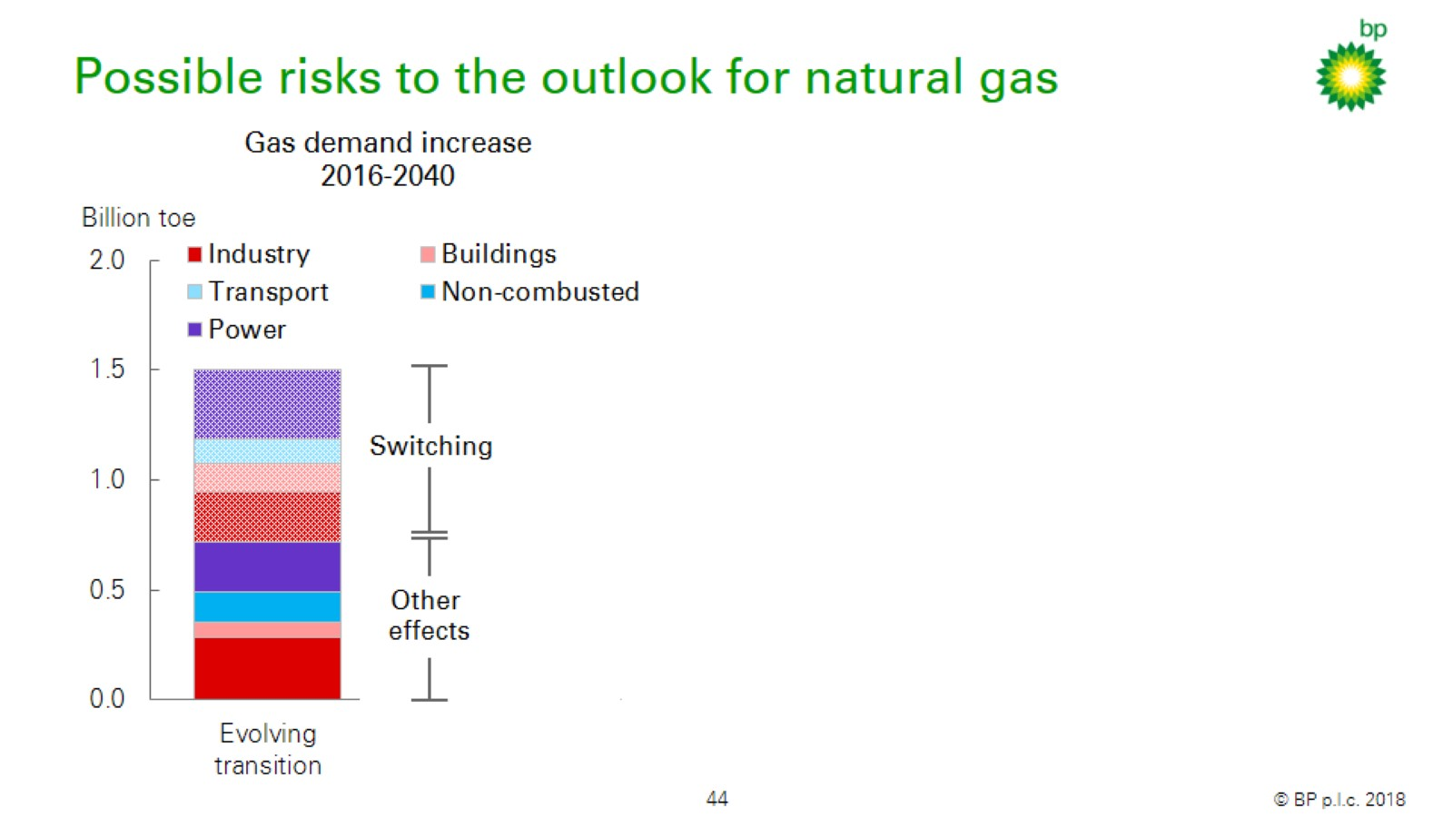
Possible risks to the outlook for natural gas

Slide 40
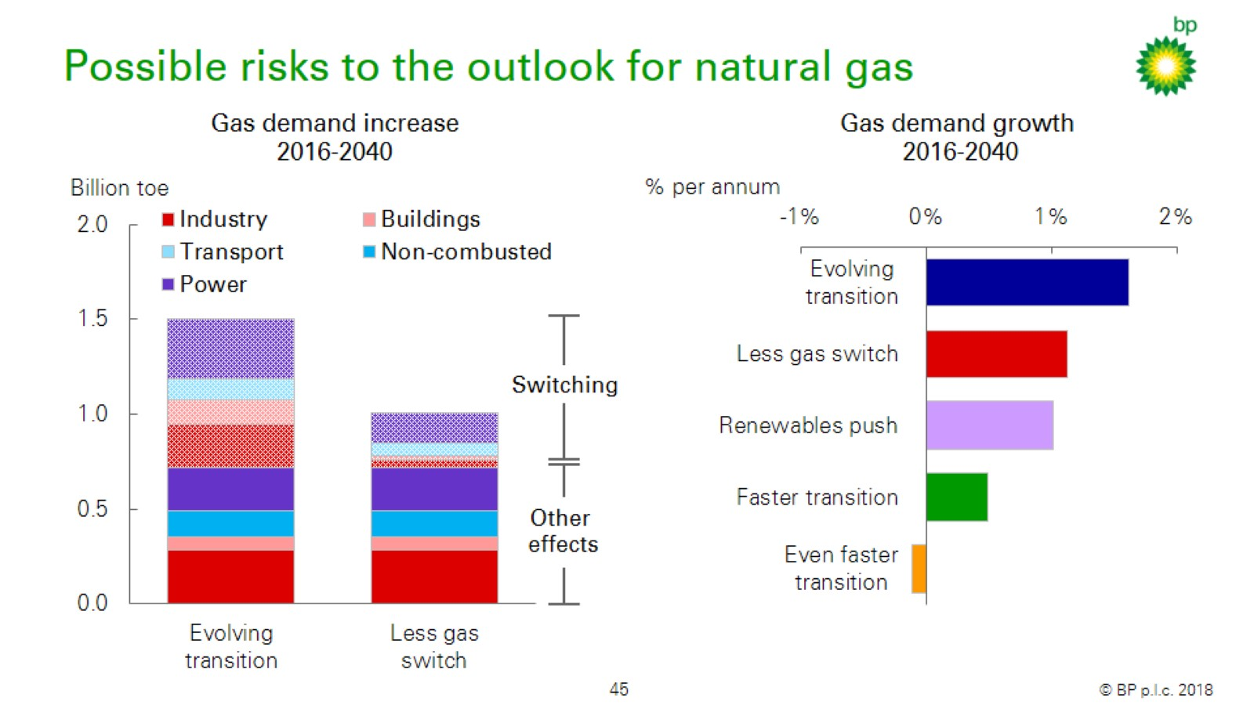
Possible risks to the outlook for natural gas

Slide 41
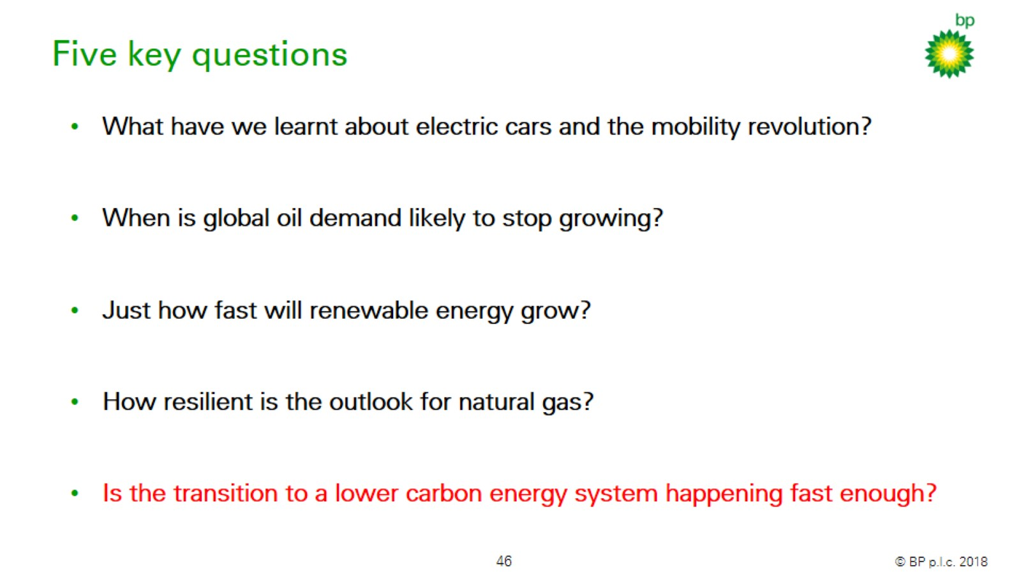
Five key questions

Slide 42
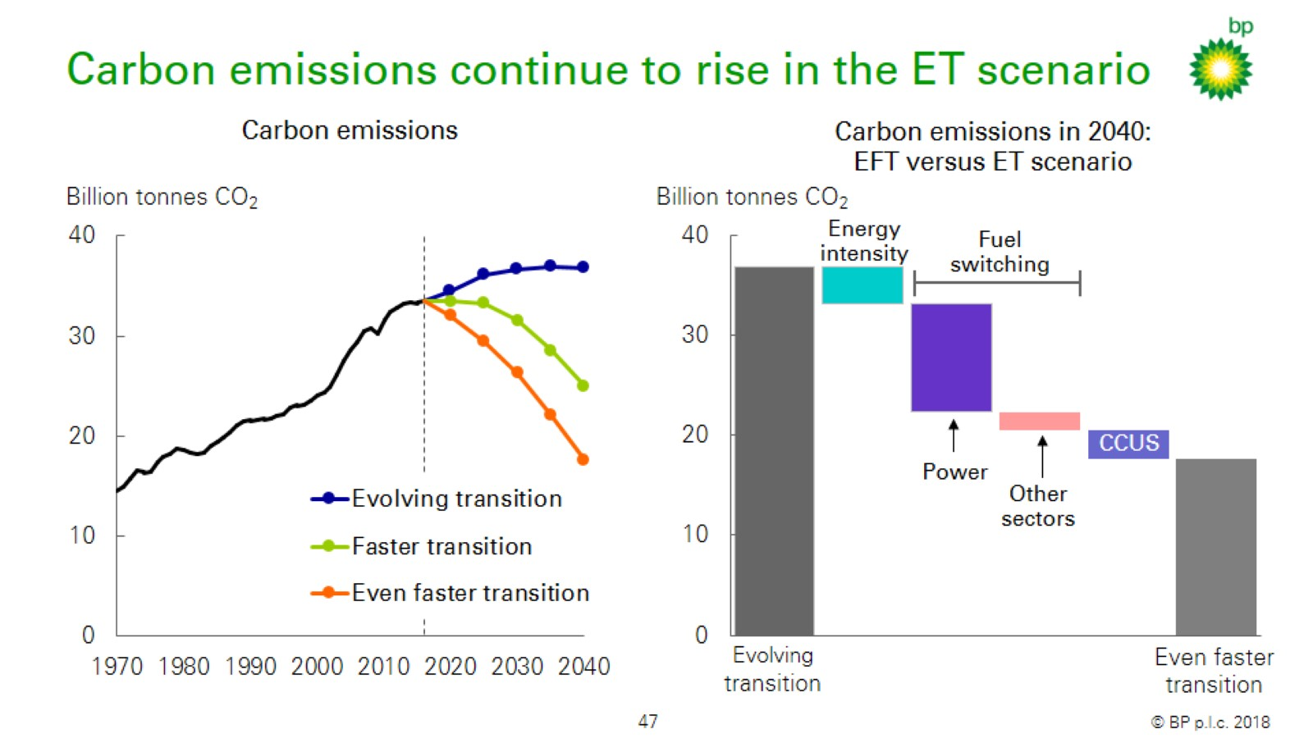
Carbon emissions continue to rise in the ET scenario

Slide 43
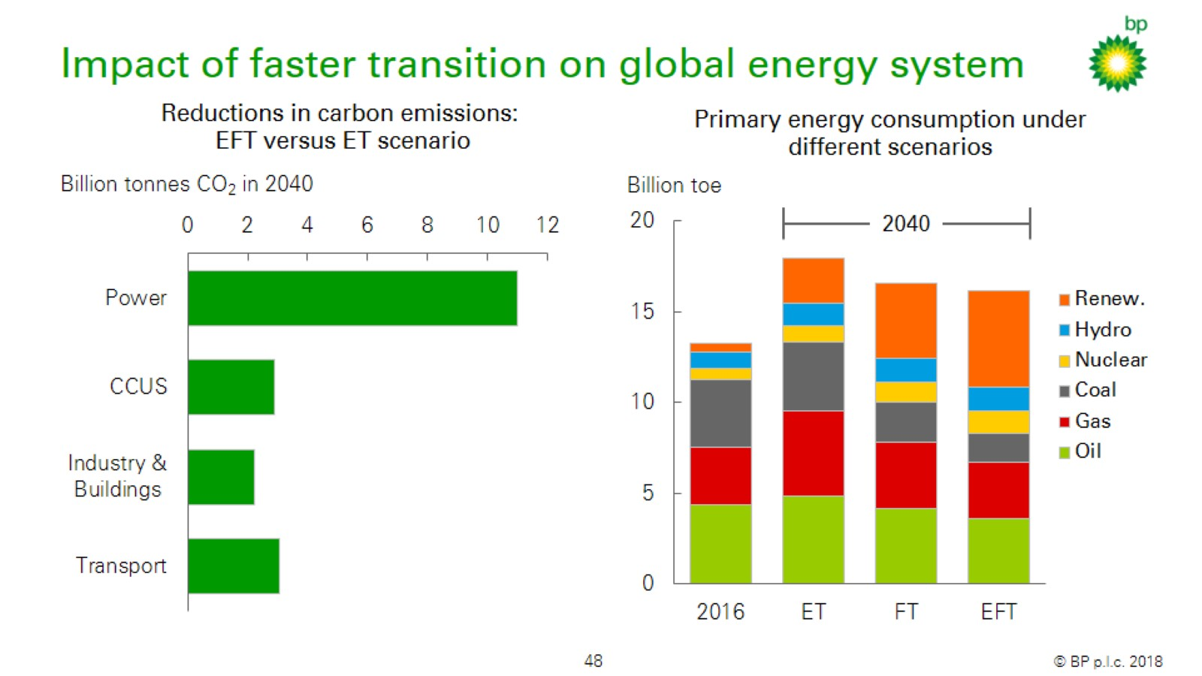
Impact of faster transition on global energy system

Slide 44
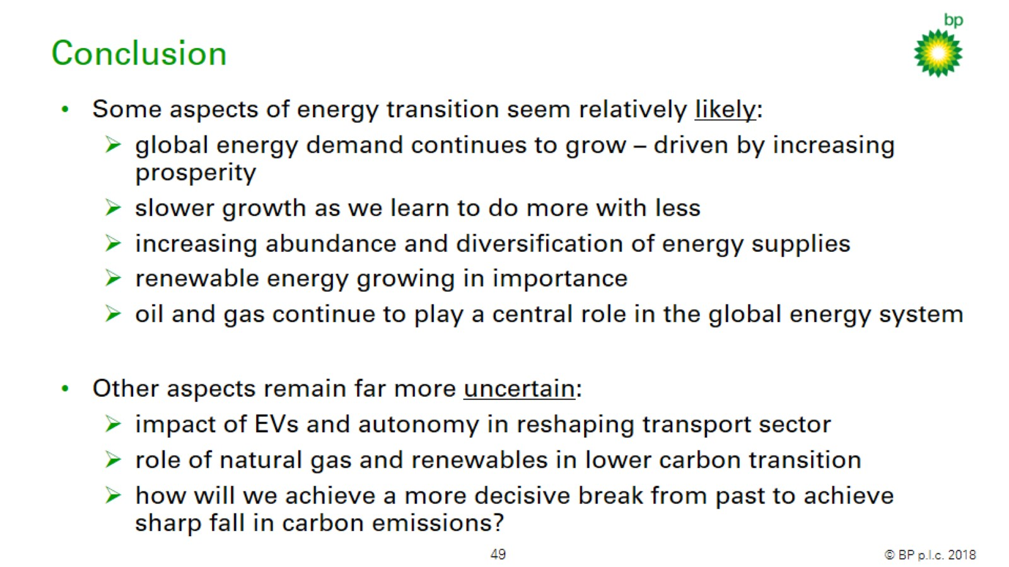
Conclusion

Slide 45


