Slide 1
Spencer Dale
Group chief economist

Slide 2
Energy Outlook scenarios
Primary energy consumption by fuel
CO₂ emissions
Gt of CO₂
Billion toe
25
50
2040
Evolving transition (ET)
More energy (ME) Less globalization (LG)
20
Renew.*
Hydro Nuclear Coal Gas
Oil
40
Rapid transition (RT)
15
30
10
20
5
10
0
0
2017 ET ME LG RT
1970
1980 1990 2000 2010
2020 2030 2040
2019 BP Energy Outlook
*Renewables includes wind, solar, geothermal, biomass and biofuels
© BP p.l.c. 2019

Slide 3



Three windows on the energy transition
Primary energy demand
End-use sector Region
Billion toe
Fuel
20 20
Other Africa
Other Asia India
20
Renewables Hydro
Transport Industry
Non-combusted
Nuclear
15
15
15
Coal Gas Oil
Buildings
China OECD
10
10
10
5
5
5
0
0
0

Slide 4
Energy demand by sector
Primary energy consumption by end-use sector
Billion toe
Annual demand growth and sector contributions
% per annum
20
Transport Industry
Non-combusted
2.5%
2.0%
15
Buildings
10
1.5%
1.0%
5
0.5%
0
1970 1980 1990 2000 2010 2020 2030 2040
0.0%
1995-2017
2017-2040

Slide 5
Regional energy demand
Primary energy consumption by region
Billion toe
Primary energy growth and regional contributions
% per annum
20
Other Other Asia Africa India
3.0%
2.5%
15
2.0%
China
OECD
1.5%
10
1.0%
0.5%
5
0.0%
0
-0.5%
1990 2000
2010 2020 2030
2040
1990-
2000
2000-
2010
2010-
2020
2020-
2030
2030-
2040

Slide 6
Increase in primary energy demand
Increase in primary energy demand, 2017-2040
Billion toe
Income per head
Energy efficiency
30
25
20
World
population
15
10
5
0
2017
2040

Slide 7
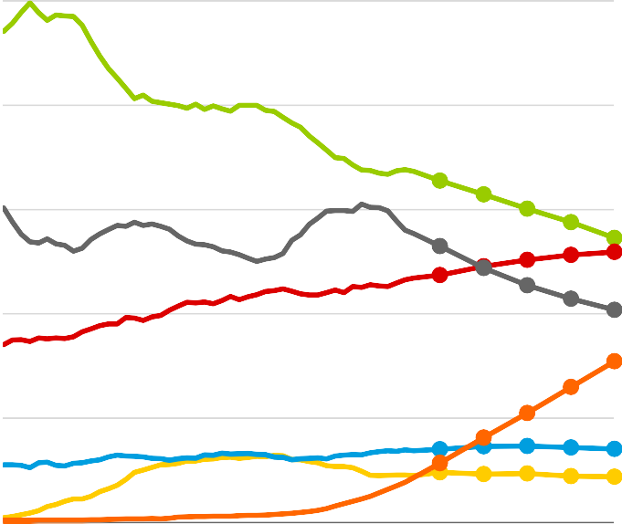
Global energy by fuel type
Primary energy consumption by fuel
Billion toe
Shares of primary energy
20
Renewables Hydro Nuclear
50%
40%
15
Coal Gas
30%
10
Oil
20%
5
10%
0
1970 1980 1990 2000 2010 2020 2030 2040
0%
1970 1980 1990 2000 2010 2020 2030 2040

Slide 8
Three windows on the energy transition
Primary energy demand
End-use sector Region
Billion toe
Fuel
20 20
Other Africa
Other Asia India
20
Renewables Hydro
Transport Industry
Non-combusted
Nuclear
15
15
15
Coal Gas Oil
Buildings
China OECD
10
10
10
5
5
5
0
0
0

Slide 9
Five key questions and uncertainties
◆ How much ‘more energy’ does the world need?
◆ How important are plastics for the future of oil demand?
◆ What might happen if the trade disputes escalate?
◆ How quickly could renewables grow?
◆ A low-carbon energy system: what more needs to be done?

Slide 10
Five key questions and uncertainties
◆ How much ‘more energy’ does the world need?
◆ How important are plastics for the future of oil demand?
◆ What might happen if the trade disputes escalate?
◆ How quickly could renewables grow?
◆ A low-carbon energy system: what more needs to be done?

Slide 11
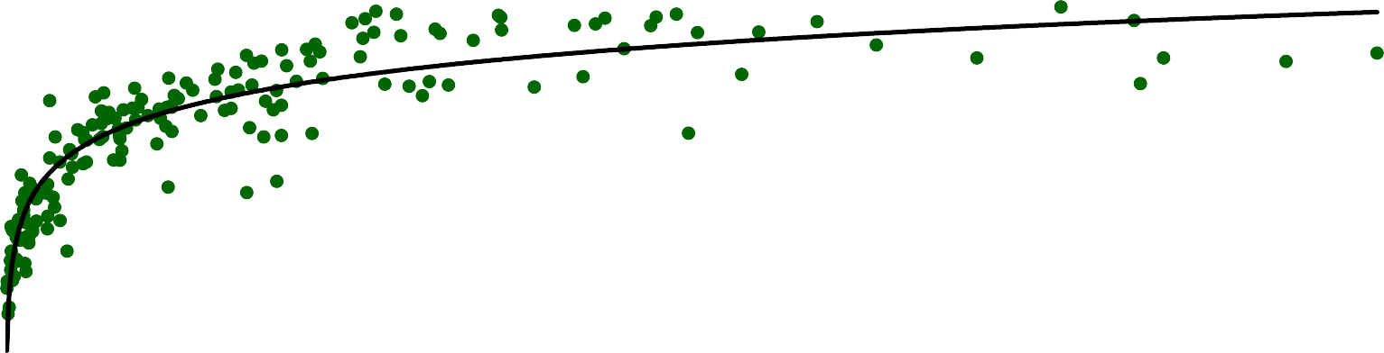
Human development and energy consumption
UN Human Development Index and energy consumption, 2017
HDI
1.0
Line of best fit
0.8
Sample of countries
0.6
0.4
80% of population
0.2
0.0
0
100
200
300
400
500
Gigajoules/head

Slide 12
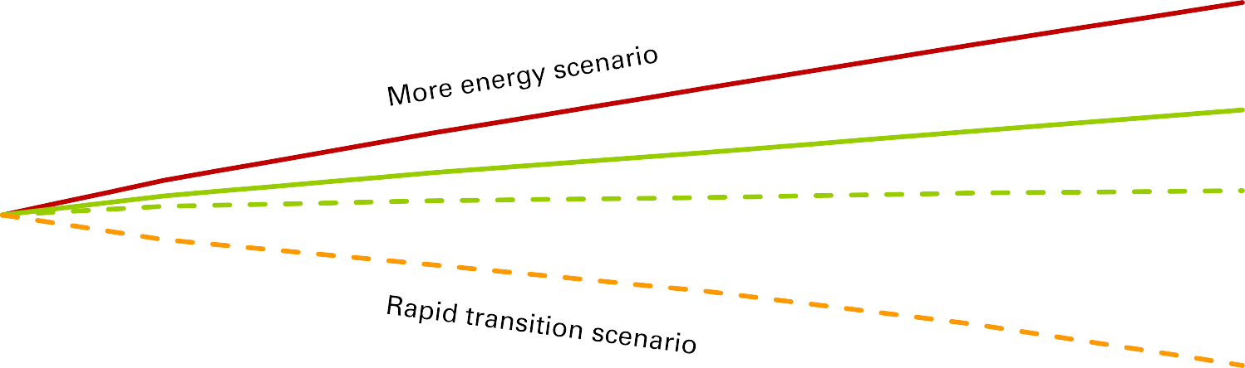
Dual challenge: more energy, less carbon
Primary energy demand and carbon emissions
Cumulative growth rate
70%
50%
Primary
energy
more energy
30%
10%
-10%
less carbon
CO₂
-30%
-50%
-70%
2017 2020
Primary energy
CO₂
2023 2026
Evolving transition scenario
2029
2032
2035
2038
2019 BP Energy Outlook
© BP p.l.c. 2019

Slide 13
Five key questions and uncertainties
◆ How much ‘more energy’ does the world need?
◆ How important are plastics for the future of oil demand?
◆ What might happen if the trade disputes escalate?
◆ How quickly could renewables grow?
◆ A low-carbon energy system: what more needs to be done?
2019 BP Energy Outlook
© BP p.l.c. 2019
13

Slide 14
Demand for oil and other liquid fuels
Liquids demand
Liquids demand growth
Mb/d
140
Mb/d, average annual growth
2.0
Power Buildings Industry
Non-combusted Transport
Total
Power
Industry
Non-road Cars
Buildings
Non-combusted Trucks
120
1.5
100
80
1.0
60
0.5
40
Transport
0.0
20
0
-0.5
2010 2015 2020 2025 2030 2035 2040
2005- 2010- 2015- 2020- 2025- 2030- 2035-
2010 2015 2020 2025 2030 2035 2040

Slide 15


Demand for liquid fuels and plastics
Demand for non-combusted liquid fuels
Liquid feedstocks for single-use plastics
Mb/d
Mb/d
30
7
25
Impact of tighter plastics regulations in ET scenario
6
5
20
Impact of single use plastics ban
4
15
3
10
2
5
1
0
0
2017
2040
1990
2000
2010
2020
2030
2040

Slide 16
Demand and supply of oil
Mb/d 140
More energy
Evolving transition Single-use plastics ban Greater reform
Less globalization Rapid transition
Supply with no investments in new fields
120
100
80
Trillions of $s
60
40
20
0
1970
1980
1990
2000
2010
2020
2030
2040

Slide 17
Five key questions and uncertainties
◆ How much ‘more energy’ does the world need?
◆ How important are plastics for the future of oil demand?
◆ What might happen if the trade disputes escalate?
◆ How quickly could renewables grow?
◆ A low-carbon energy system: what more needs to be done?

Slide 18
Less globalization scenario
◆ Reduced openness and trade leads to slight reduction in trend global GDP growth
◆ Concerns about energy security adds a small risk premium (10%) to imported energy

Slide 19
Alternative scenario: Less globalization
Difference relative to ET scenario in 2040: Net exports (oil & gas)
Global GDP and energy
Mtoe
0
GDP Energy
1%
0%
-1%
-2%
-3%
-4%
-5%
-6%
-7%
China
ET
-300
 |  | Renewables Coal Gas Oil
Less globalization
-600
-900
2000
2010
2020
2030
2040
600
300
0
-300
-600
-900
US
Total
2000
2010
2020
2030
2040

Slide 20
Five key questions and uncertainties
◆ How much ‘more energy’ does the world need?
◆ How important are plastics for the future of oil demand?
◆ What might happen if the trade disputes escalate?
◆ How quickly could renewables grow?
◆ A low-carbon energy system: what more needs to be done?

Slide 21
Renewable energy
Renewables share of power generation
Fuel shares in power
30%
50%
Gas
Geothermal and biomass
Coal Renewables Hydro & Nuclear
25%
40%
Solar
20%
Wind
30%
15%
20%
10%
5%
10%
0%
0%
1995
2010
2025
2040
2000
2010
2020
2030
2040

Slide 22


Speed of energy transition
Speed of penetration of new fuels in global energy system
Share of world energy 35%
Oil (1877)
Gas (1899)
Nuclear (1974)
Hydro (1922)
Renewables (2006)
30%
25%
20%
15%
10%
5%
0%
0
10
20
30
40
50
Years from reaching 1% share

Slide 23
Five key questions and uncertainties
◆ How much ‘more energy’ does the world need?
◆ How important are plastics for the future of oil demand?
◆ What might happen if the trade disputes escalate?
◆ How quickly could renewables grow?
◆ A low-carbon energy system: what more needs to be done?

Slide 24
CO₂ emissions in ET scenario
CO₂ emissions
Gt of CO₂
CO₂ emissions by sector
Gt of CO₂
40
40
Transport Industry Buildings Power
Evolving transition
30
30
20
20
10
10
0
0
1965
1980
1995
2010
2025
2040
1995
2017
2040

Slide 25
Rapid transition scenario: policy measures
◆ Wide range of policy measures: broadly equivalent in terms of their implied costs and effort
◆ No silver bullet: a comprehensive set of policy measures is needed
◆ Carbon prices are key, especially in the power and industrial sectors
◆ Role for targeted regulatory measures, especially until carbon prices reach
material levels

Slide 26
CO₂ emissions
CO₂ emissions
Gt of CO₂
CO₂ in 2040: ET vs RT scenario
Gt of CO₂
40
40
Evolving transition
Rapid transtion
30
30
20
20
10
10
0
0
ET 2040
Power
Industry & Buildings
Transport
RT 2040
1965
1980
1995
2010
2025
2040

Slide 27
Global energy demand and fuel mix
Primary energy consumption by fuel
Billion toe 20
Renewables
16
Hydro
12
Nuclear
Coal
8
Gas
4
Oil
0
2017
Rapid transition
Evolving transition
2040

Slide 28
Hard-to-abate carbon emissions
CO₂ emissions in RT scenario in 2040
Gt of CO₂ 20
16
12
8
4
0
Decarbonise power sector
Renewables
Gas (and coal) plus CCUS
Energy storage and demand-side-response
 |  | Buildi Indus
 |  | Trans
 |  | Powe
ngs
Other low-carbon energy sources and carriers
Hydrogen
Bioenergy
try
port
Efficiency
Circular economy
Process efficiency
r
Storage and removal of carbon
CCUS
Negative emission technologies, eg land carbon, bioenergy with CCS (BECCS)

Slide 29
Spencer Dale
Group chief economist

