Slide 1

bp.com/statisticalreview #BPstats
© BP p.I.c.2019

Slide 2
Primary energy

Slide 3
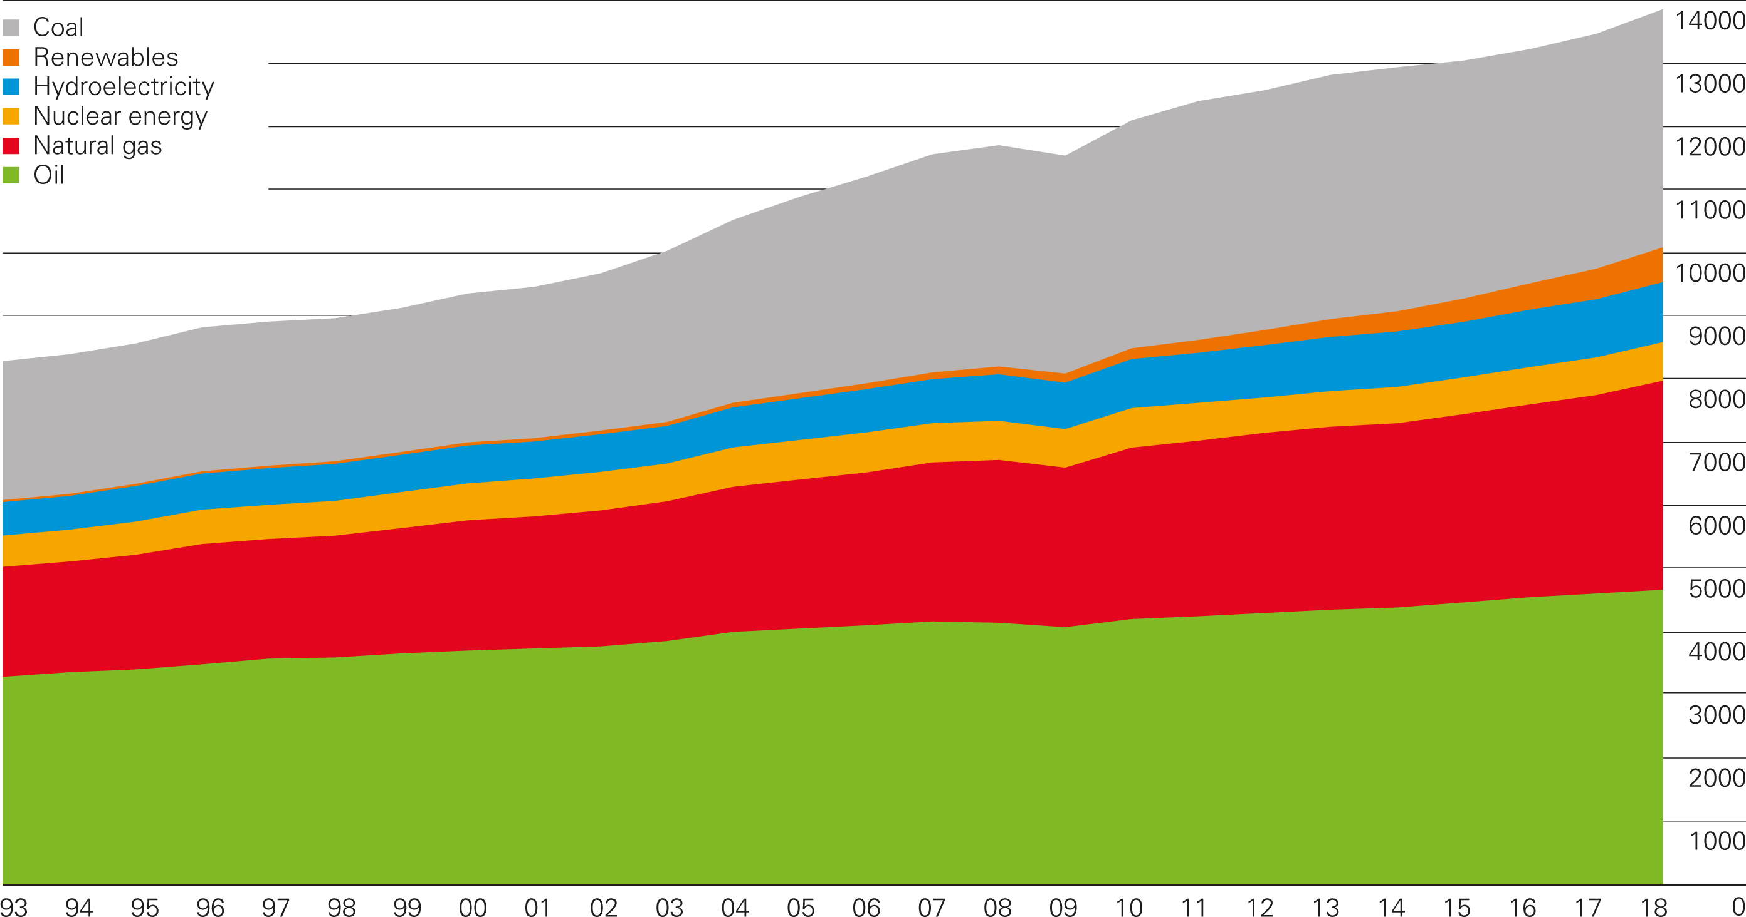
Primary energy world consumption
Million tonnes oil equivalent

Slide 4
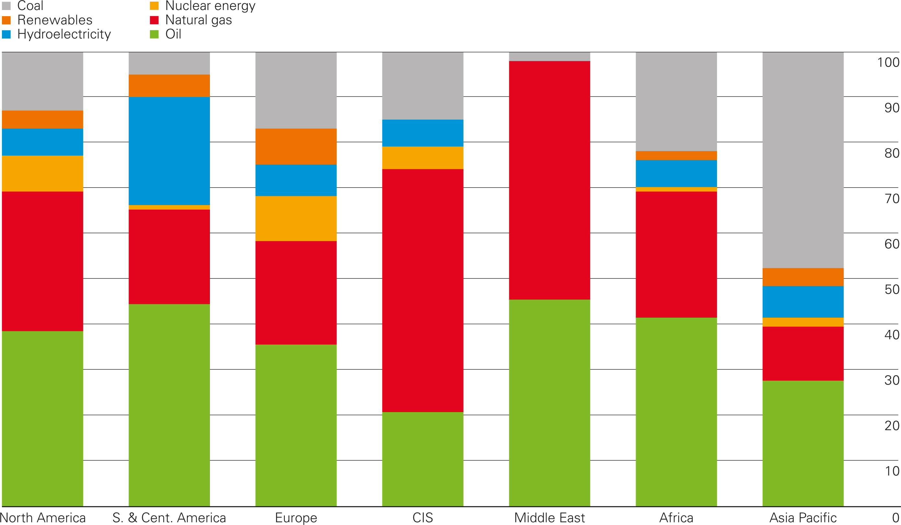
Primary energy regional consumption by fuel 2018
Percentage

Slide 5
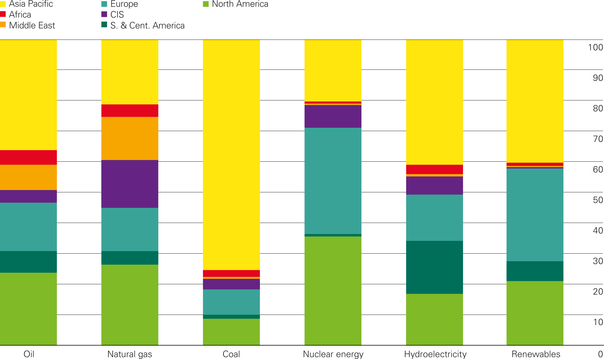
Fuel consumption by region 2018
Percentage

Slide 6
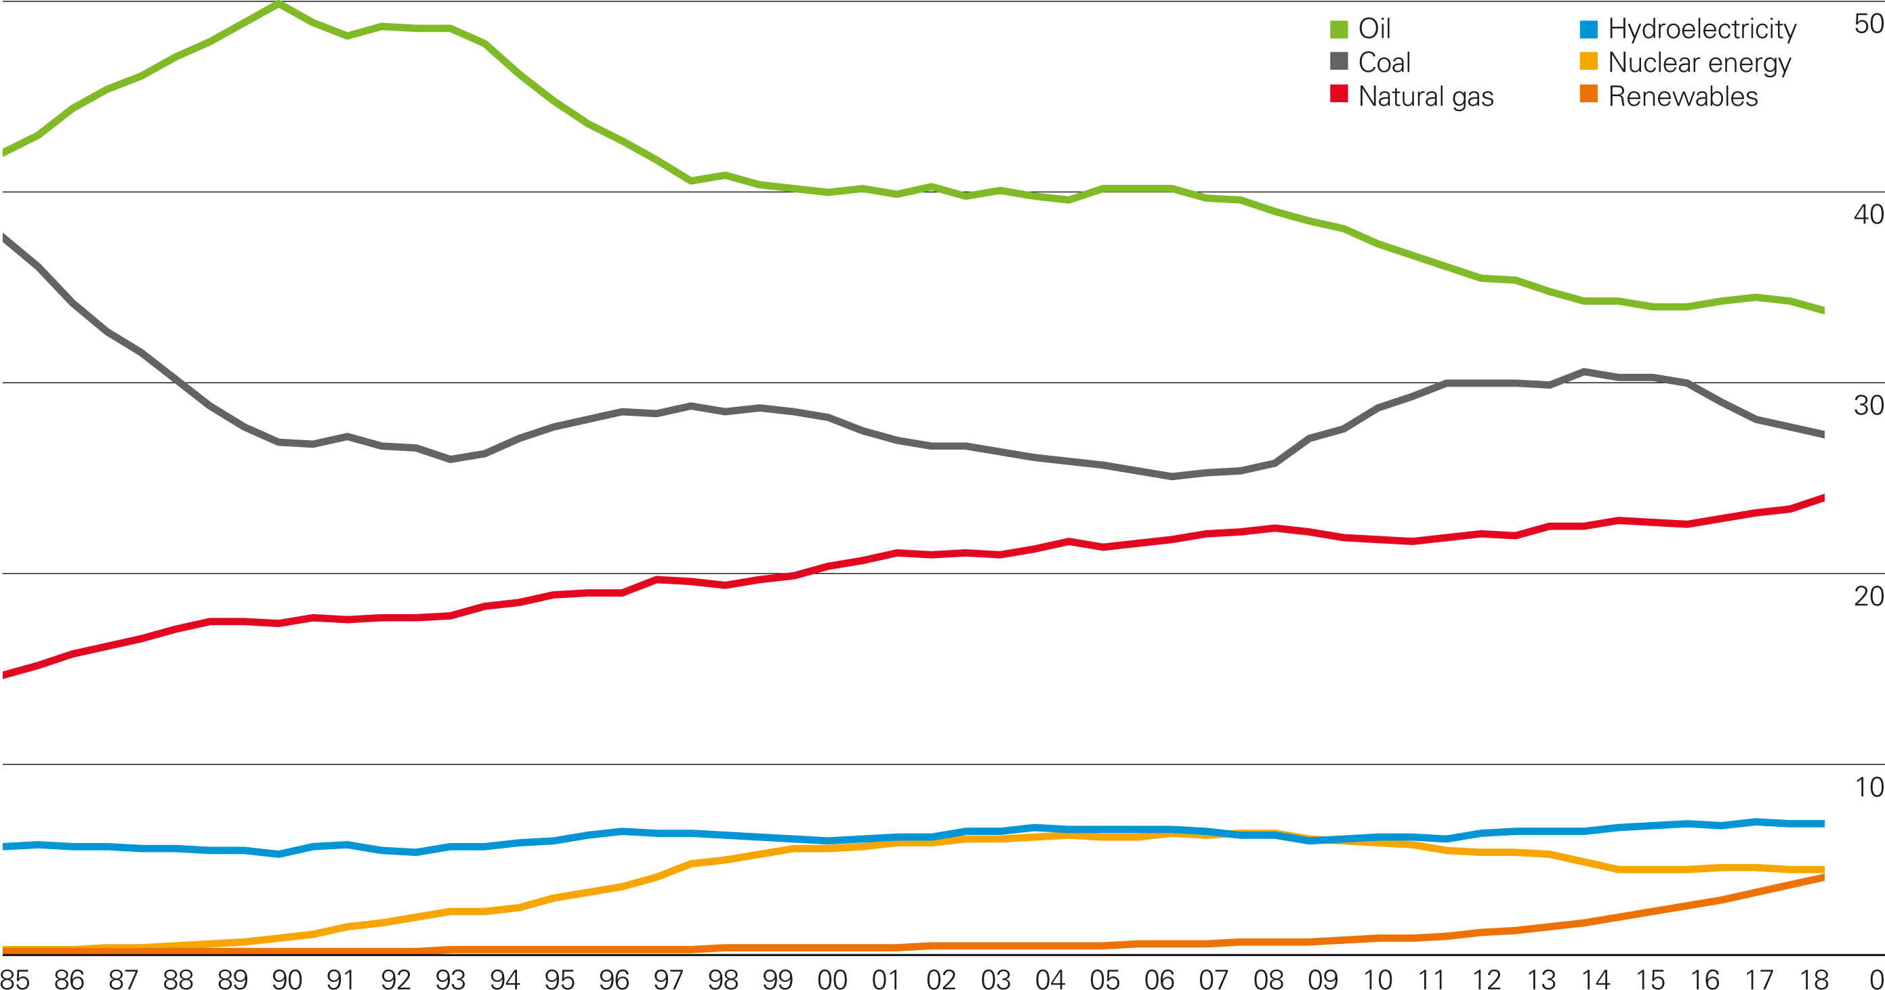
Shares of global primary energy consumption
Percentage

Slide 7
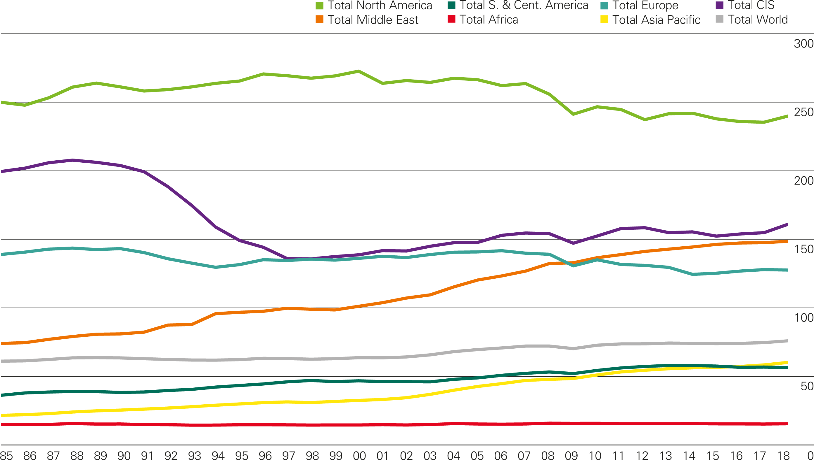
Energy per capita by region
Gigajoules per head

Slide 8
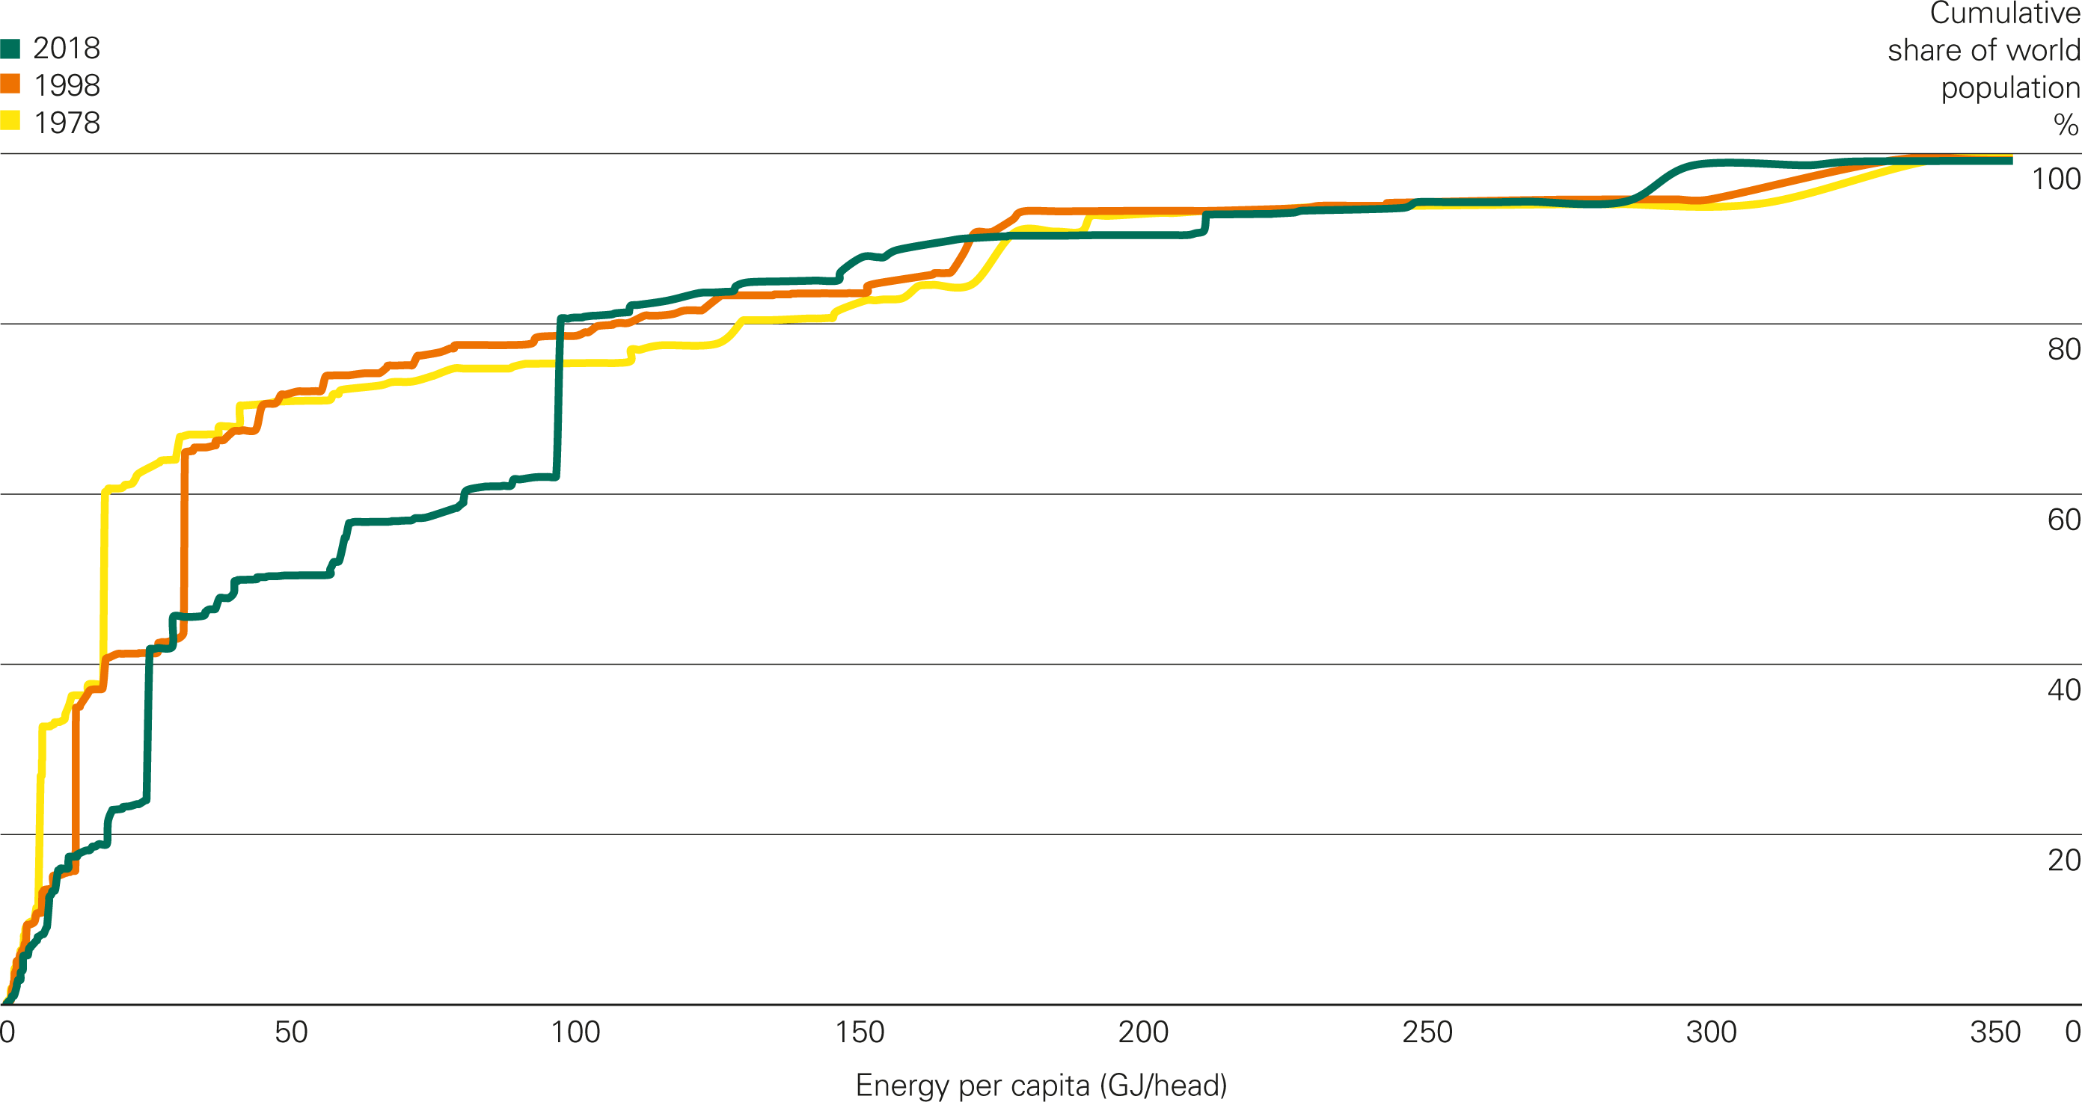
Energy per capita: distribution across countries

Slide 9
Oil

Slide 10
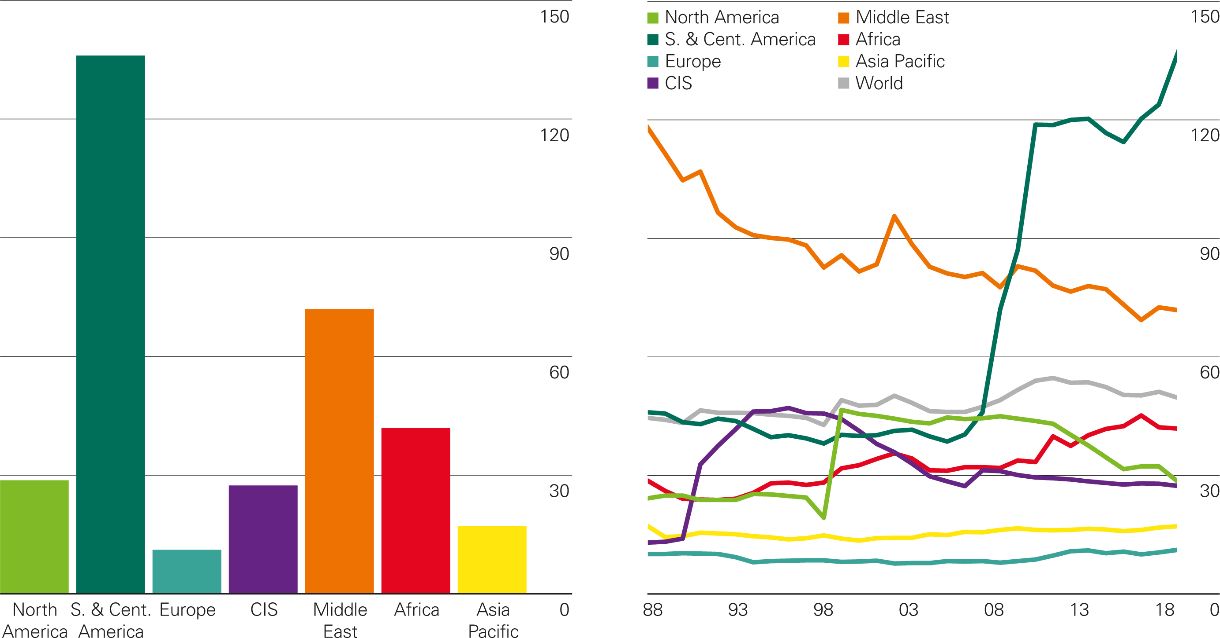
Oil reserves-to-production (R/P) ratios
Years
2018 by region
History

Slide 11
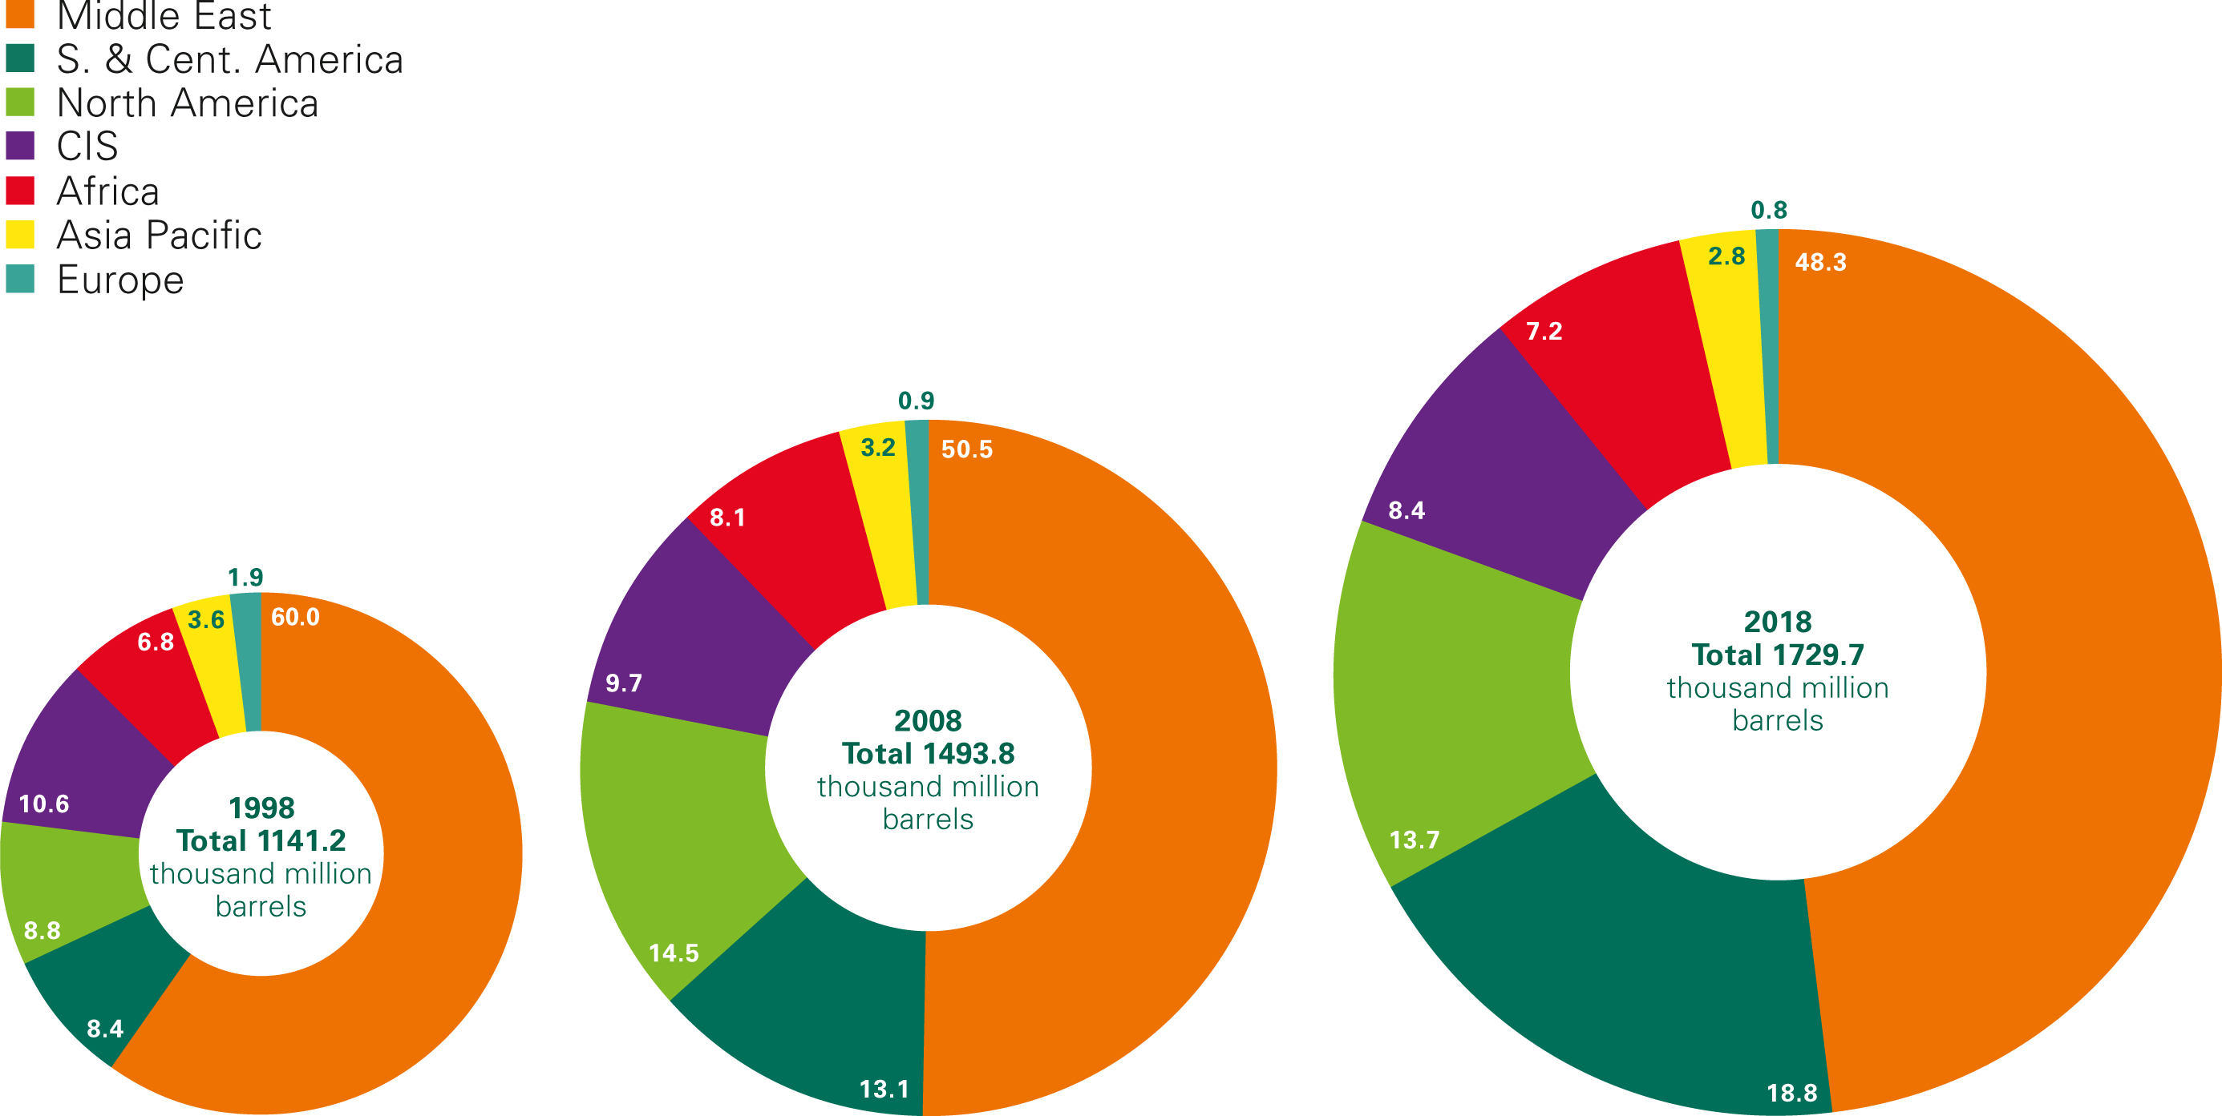
Distribution of proved oil reserves: 1997, 2007 and 2018
Percentage

Slide 12
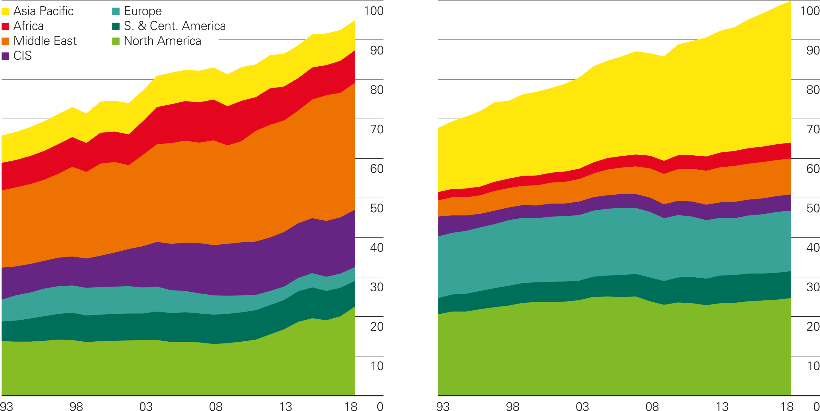
Oil production/consumption by region
Million barrels daily
Production by region
Consumption by region

Slide 13
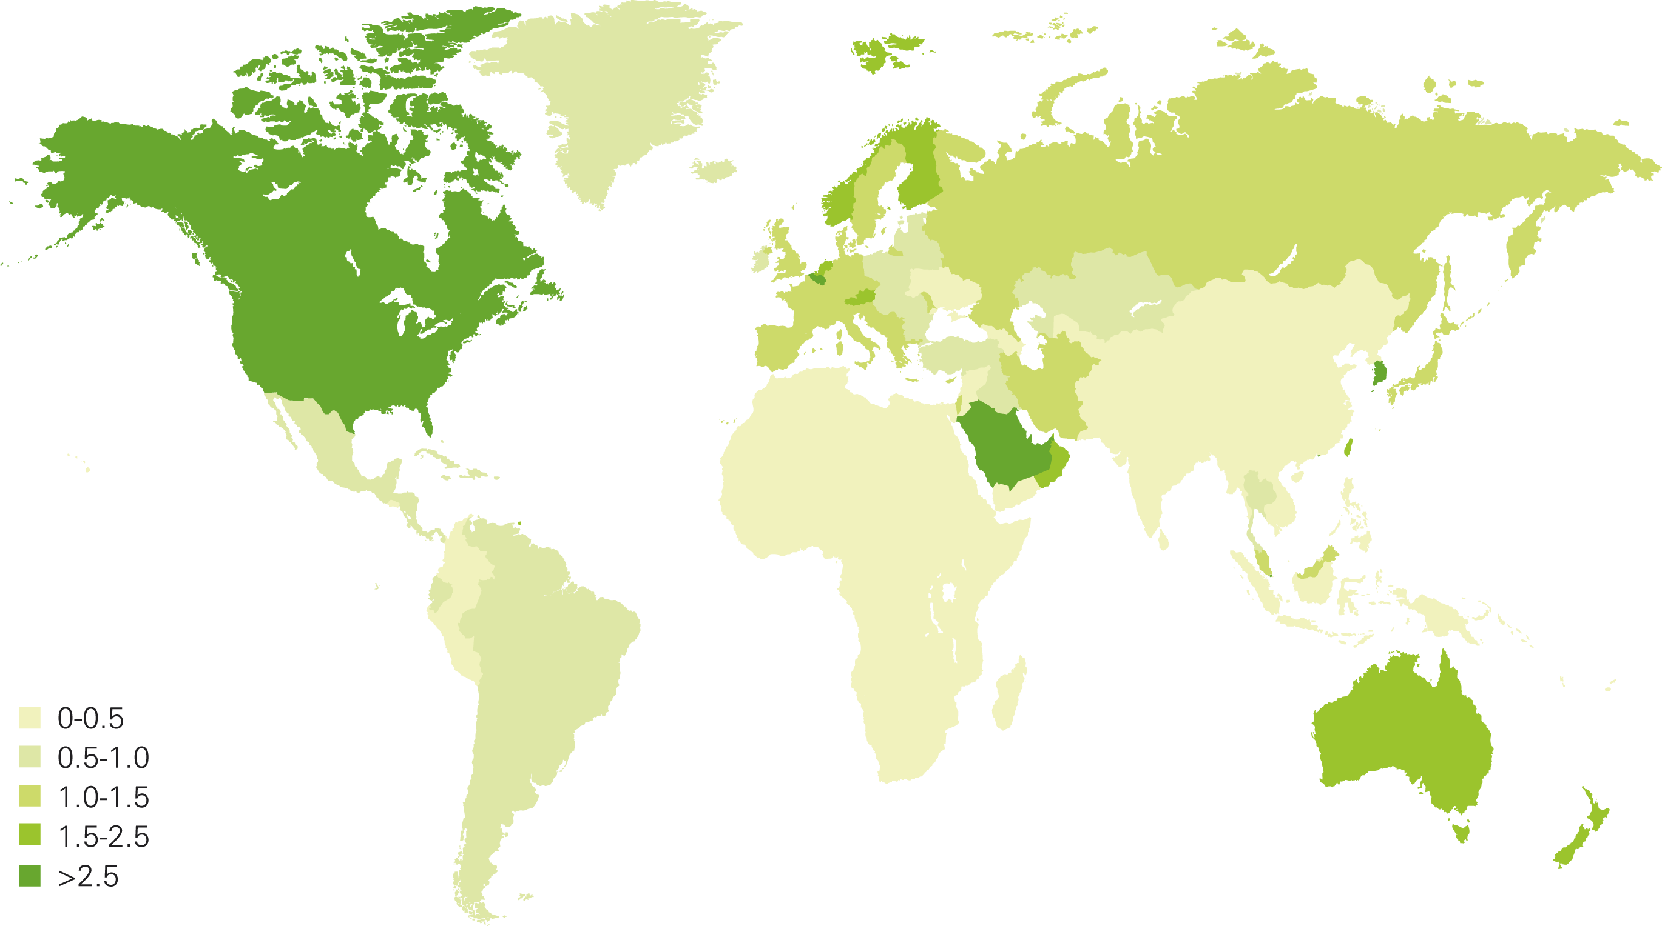
Oil consumption per capita 2018
Tonnes

Slide 14
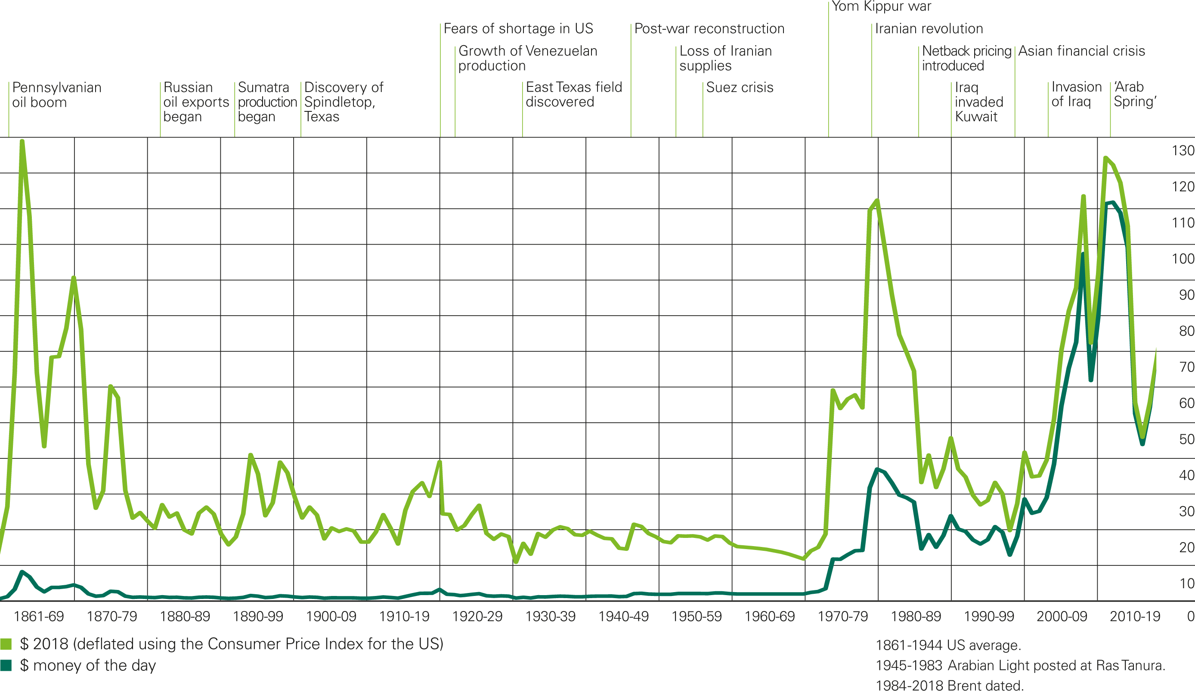
Crude oil prices 1861-2018
US dollars per barrel, world events

Slide 15
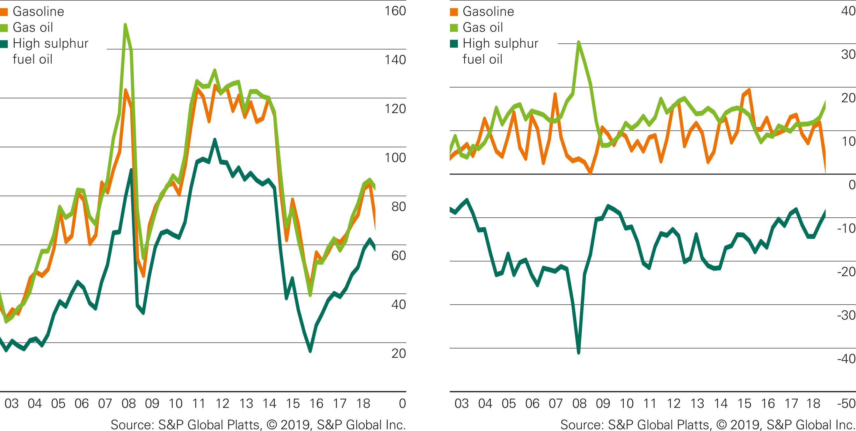
Rotterdam product prices and differentials to crude
US dollars per barrel
Oil product prices (Rotterdam)
Product differentials to crude (Rotterdam products
minus Dated Brent)
Source: S&P Global Platts, © 2018, S&P Global Inc.

Slide 16
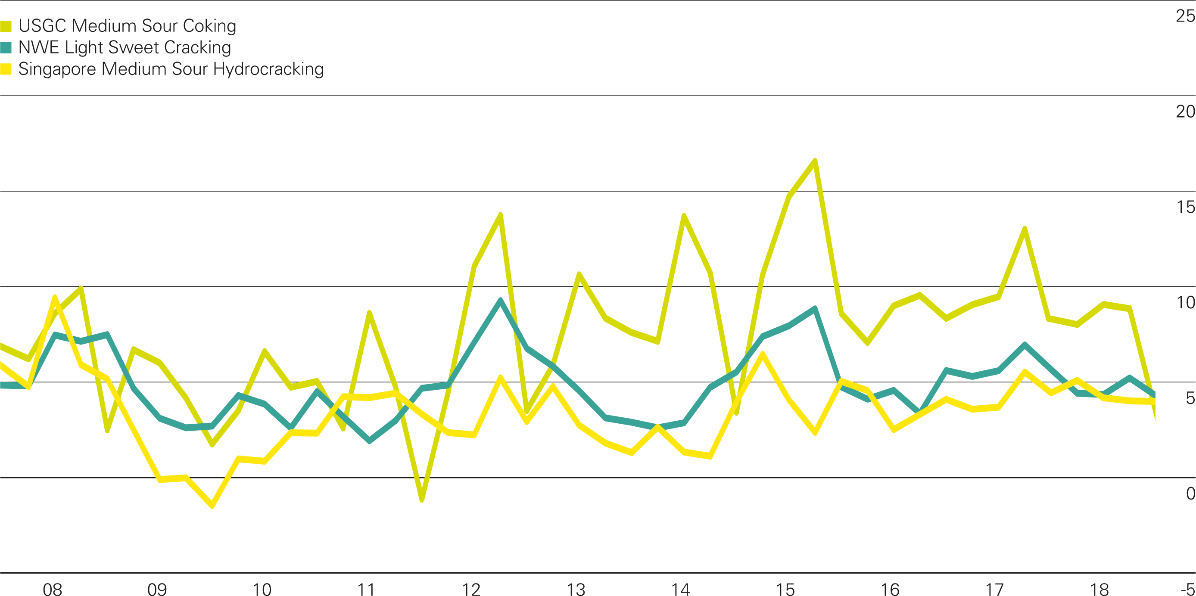
Regional refining margins
US dollars per barrel

Slide 17
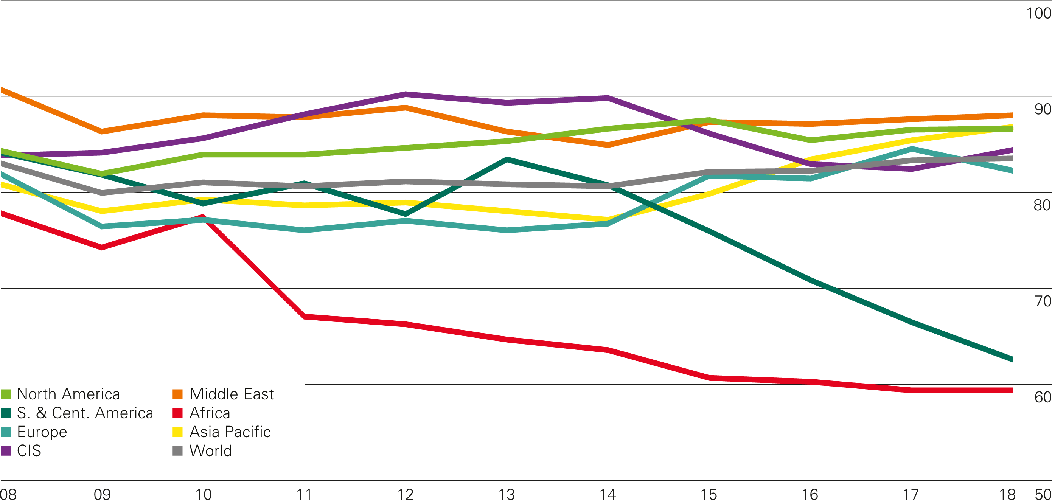
Refinery utilization
Percentage (based on average annual capacity)

Slide 18
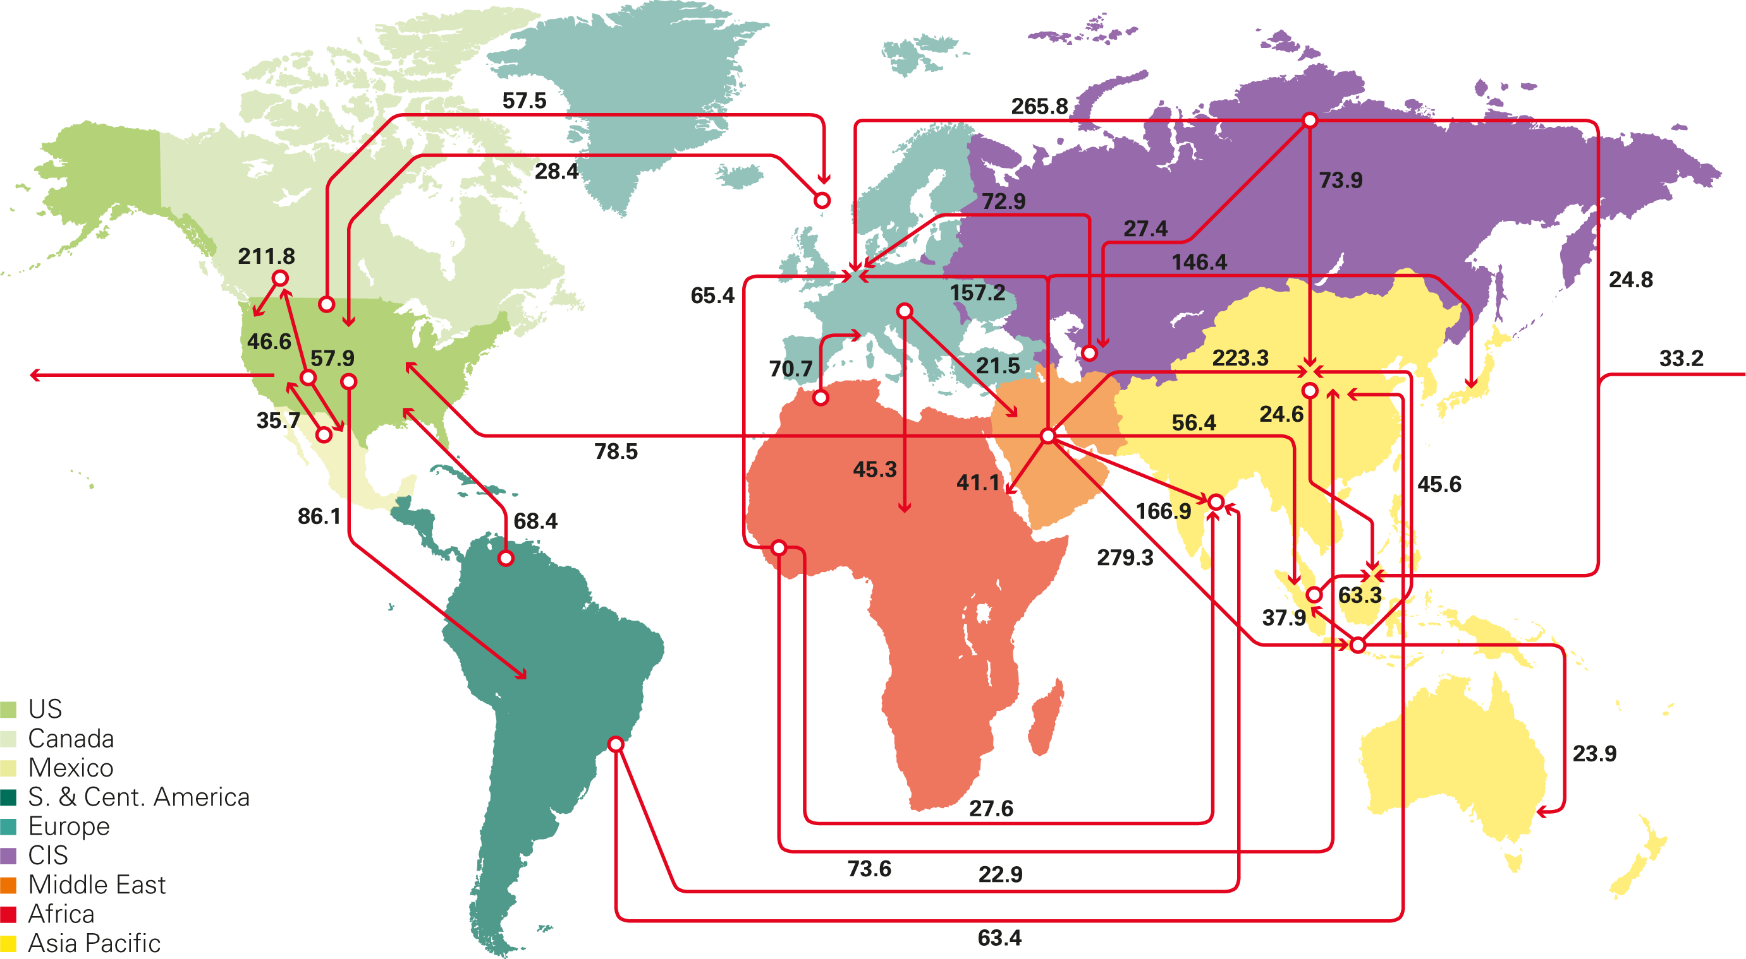
Major oil trade movements 2018
Trade flows worldwide (million tonnes)

Slide 19
Natural gas

Slide 20
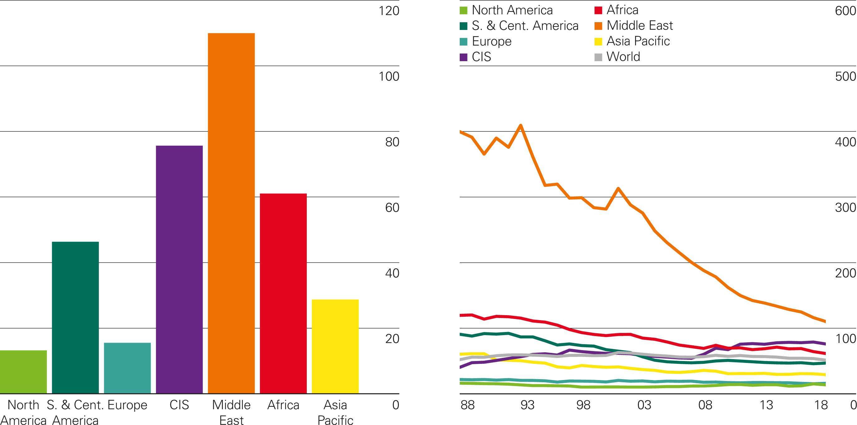
Gas reserves-to-production (R/P) ratios
Years
2018 by region
History

Slide 21
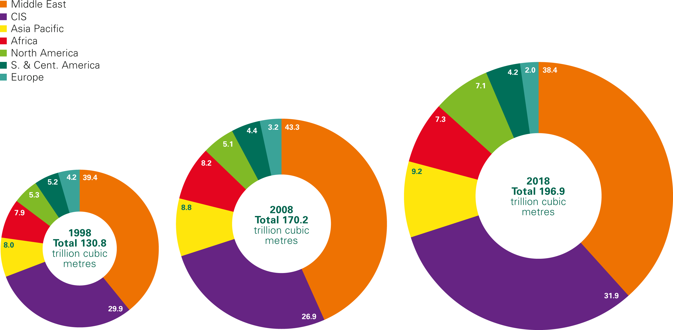
Distribution of proved gas reserves: 1998, 2008 and 2018
Percentage

Slide 22
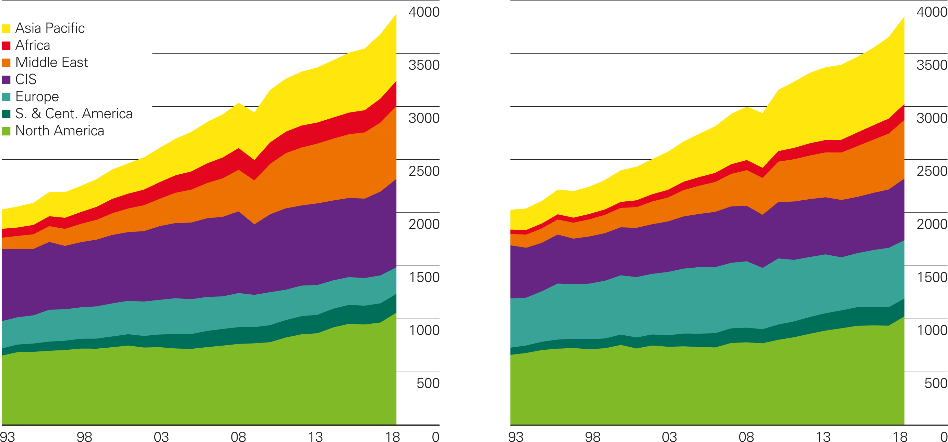
Gas production/consumption by region
Billion cubic metres
Production by region
Consumption by region

Slide 23
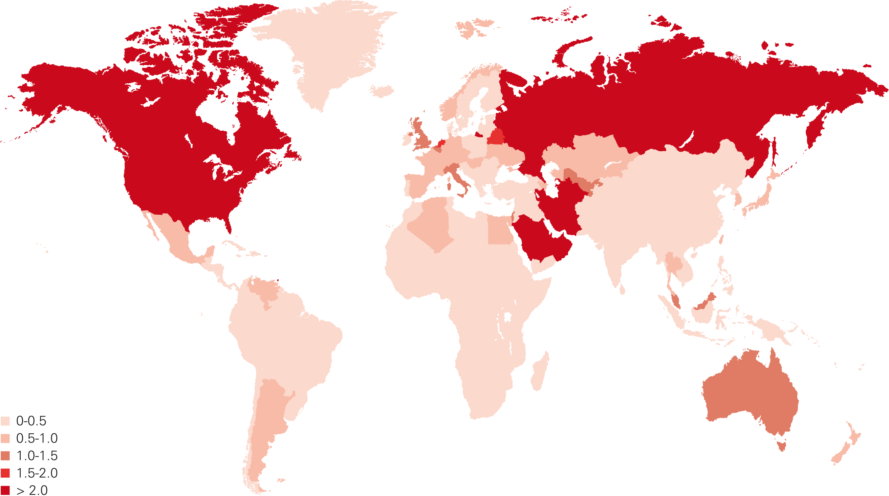
Gas consumption per capita 2018
Million tonnes oil equivalent

Slide 24
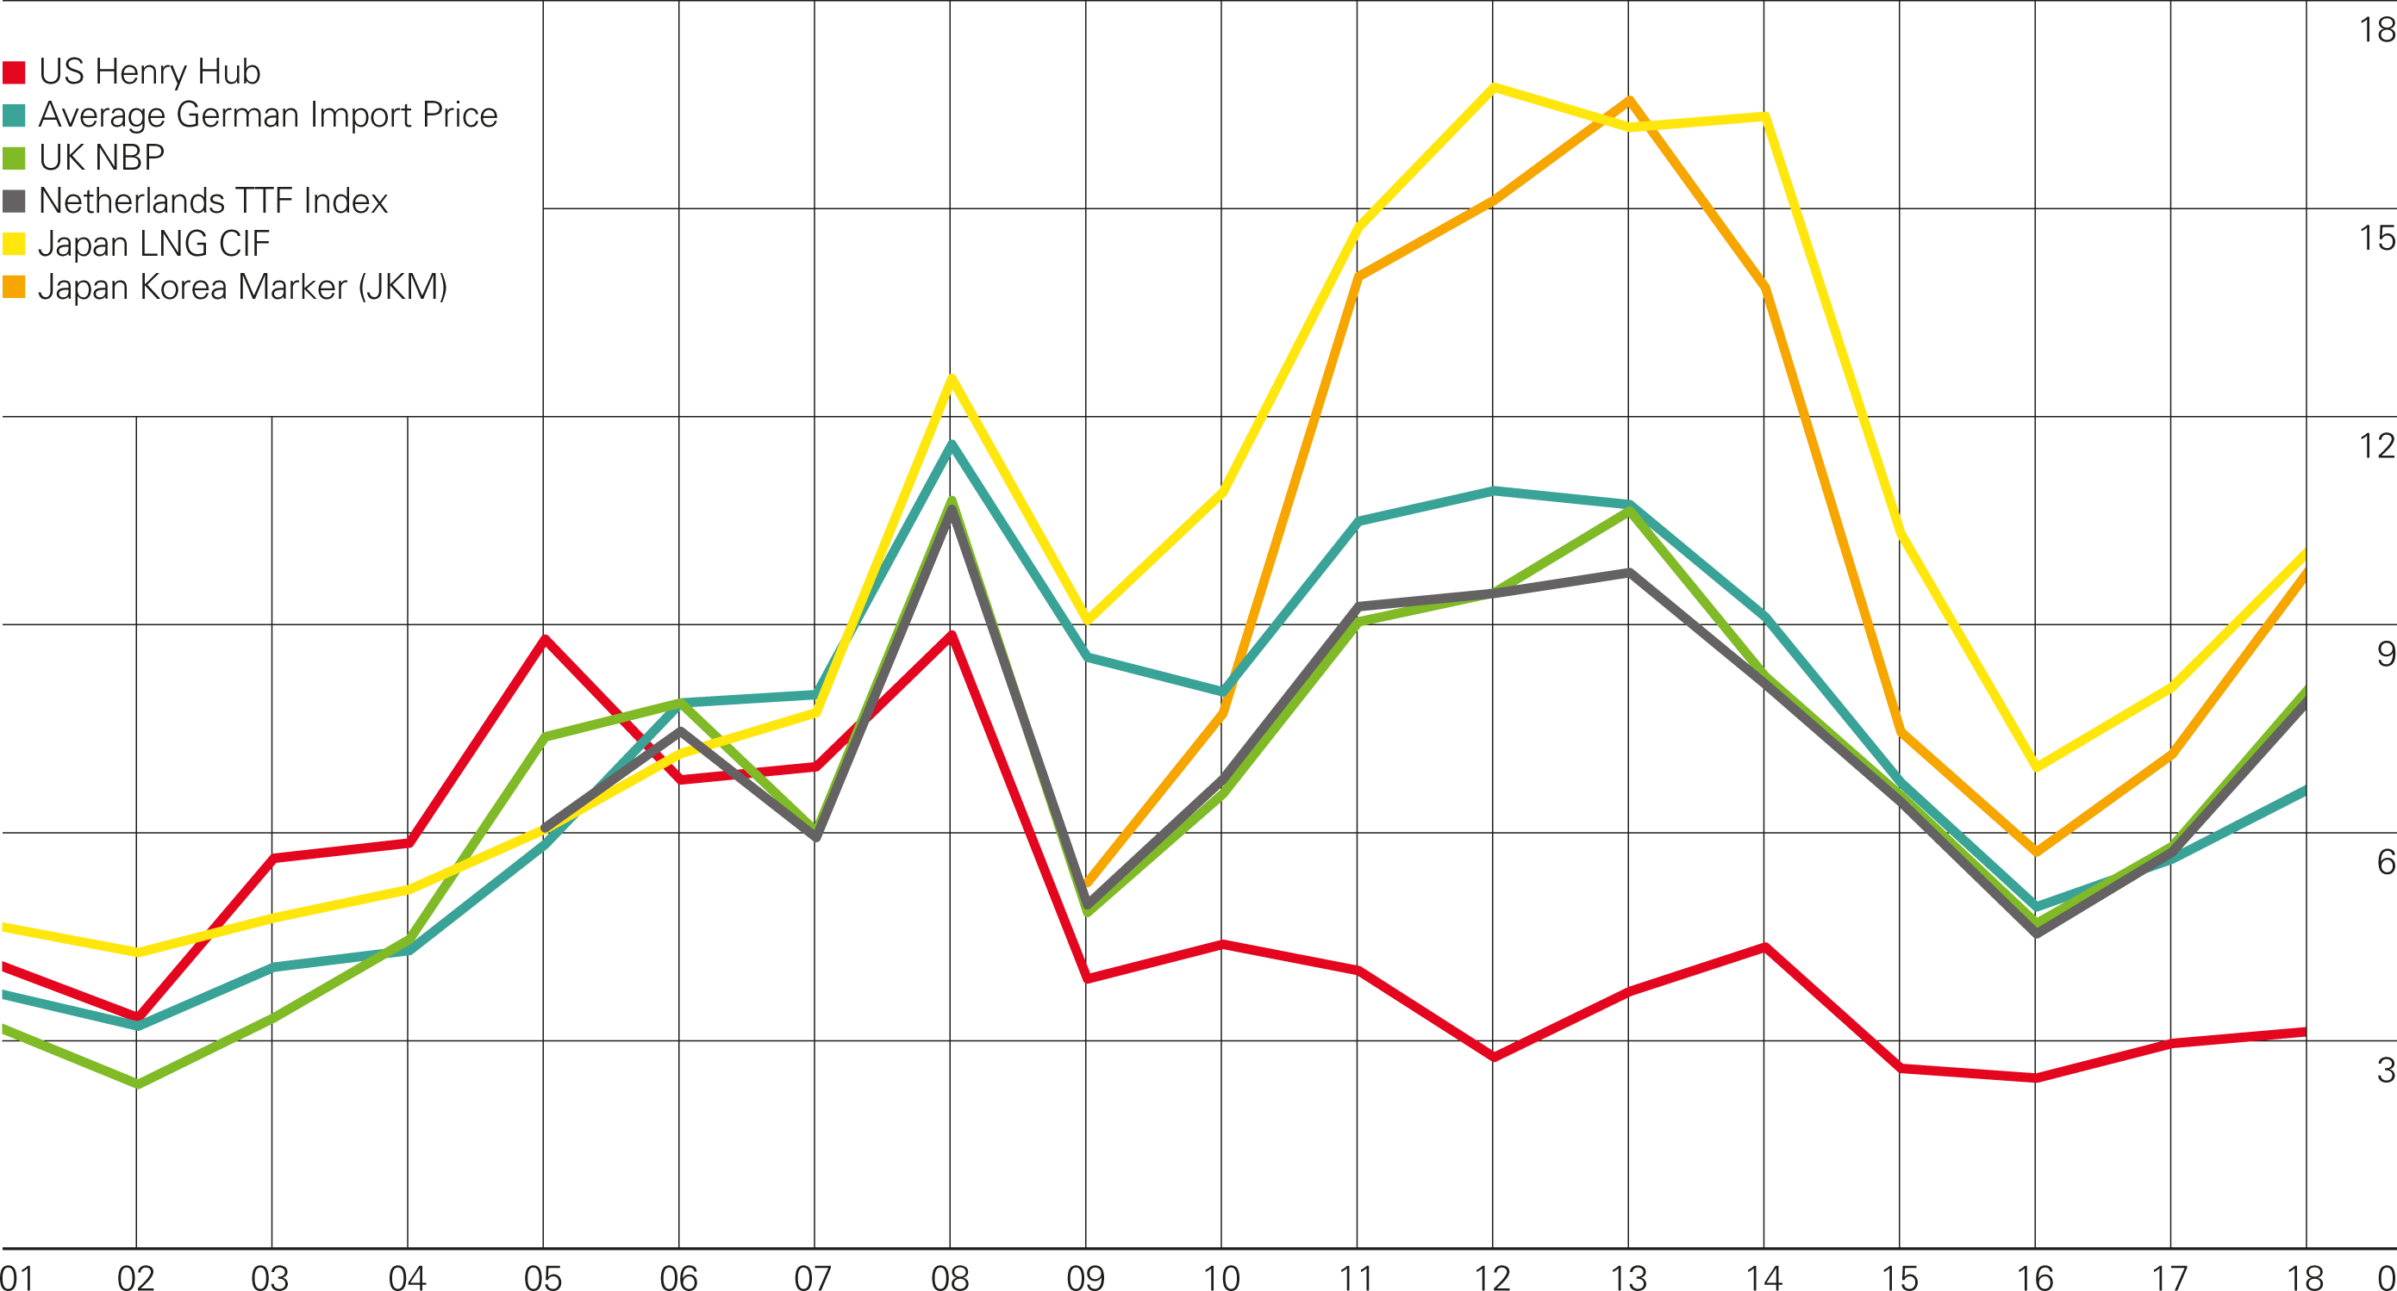
Gas prices
$/mmBtu

Slide 25
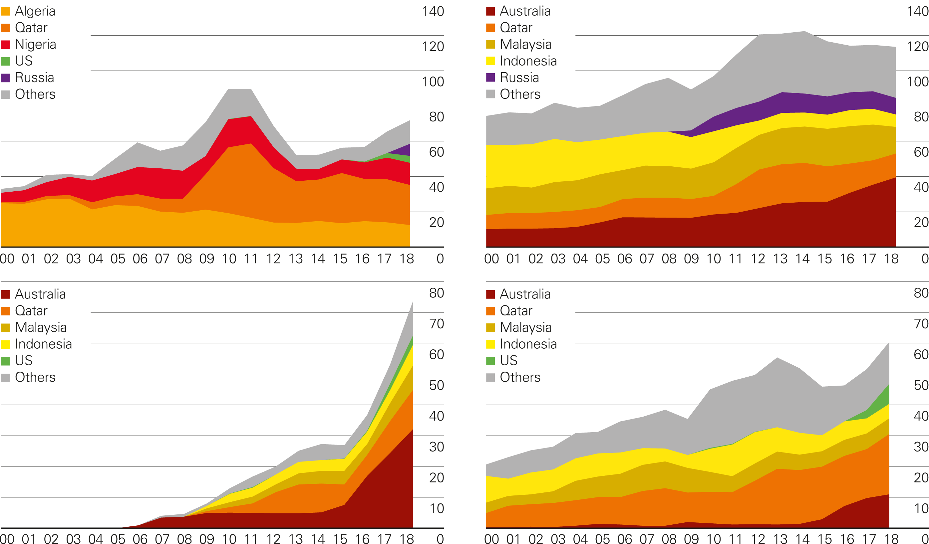
LNG imports by source
Billion cubic metres
Europe
Japan
China
South Korea

Slide 26
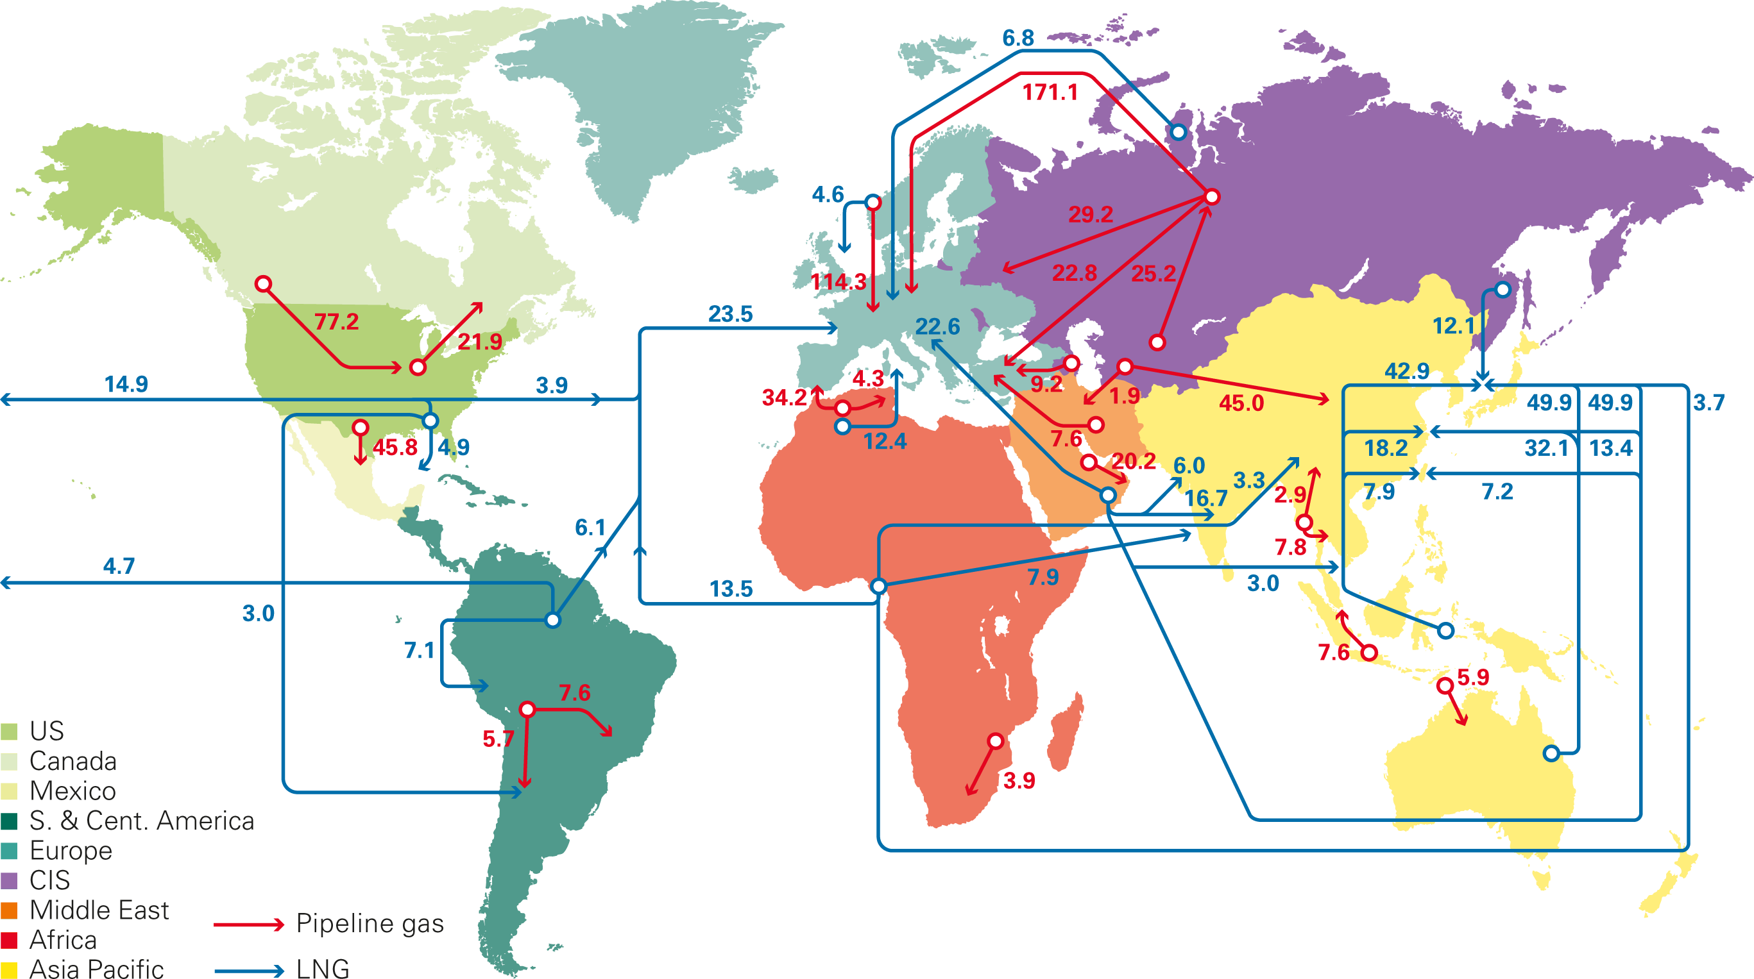
Major gas trade movements 2018
Trade flows worldwide (billion cubic metres)
Source: Includes data from FGE MENAgas service, IHS.

Slide 27
Coal

Slide 28
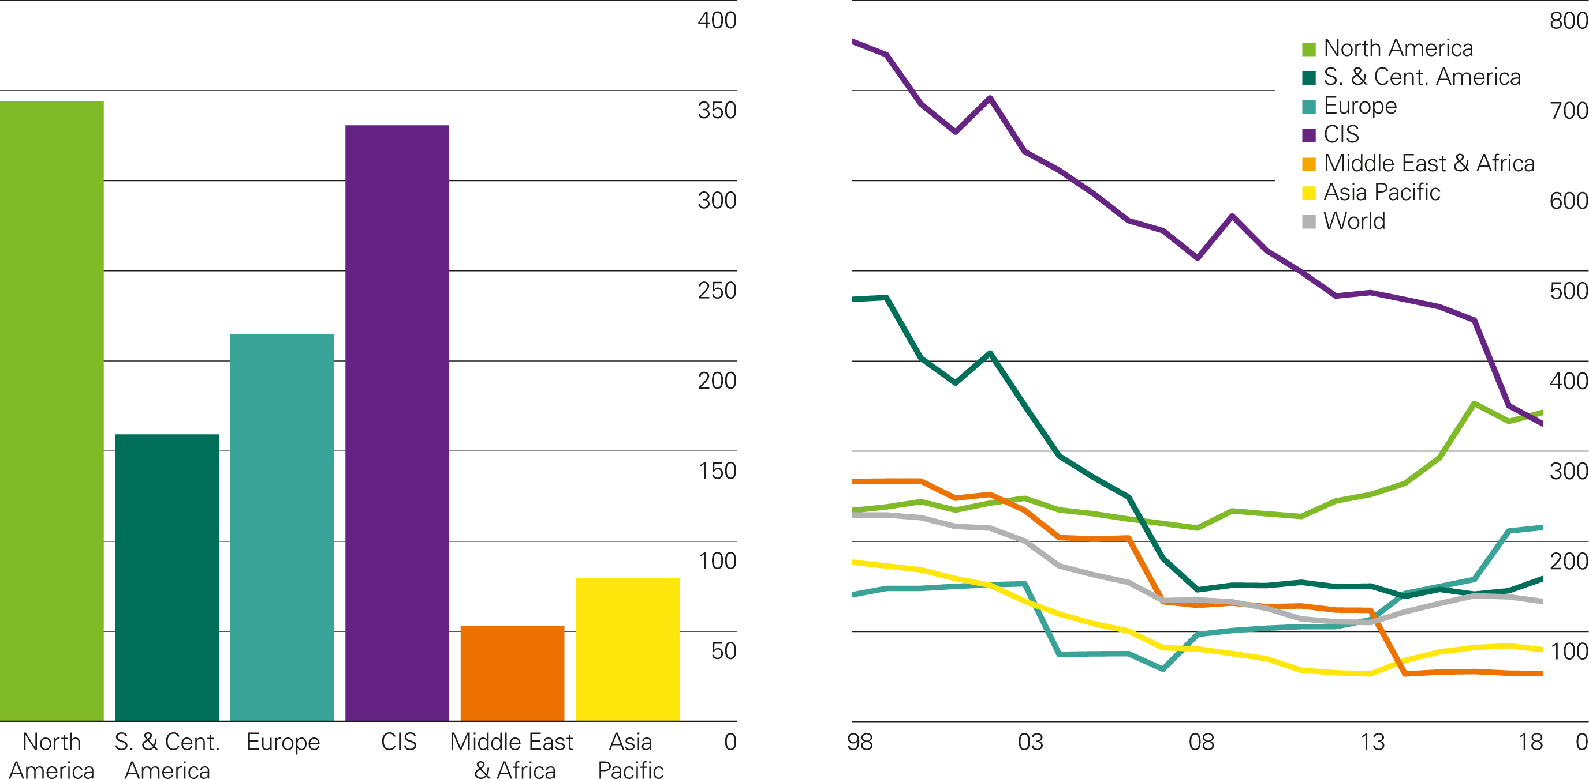
Coal reserves-to-production (R/P) ratios
Years
2018 by region
History

Slide 29
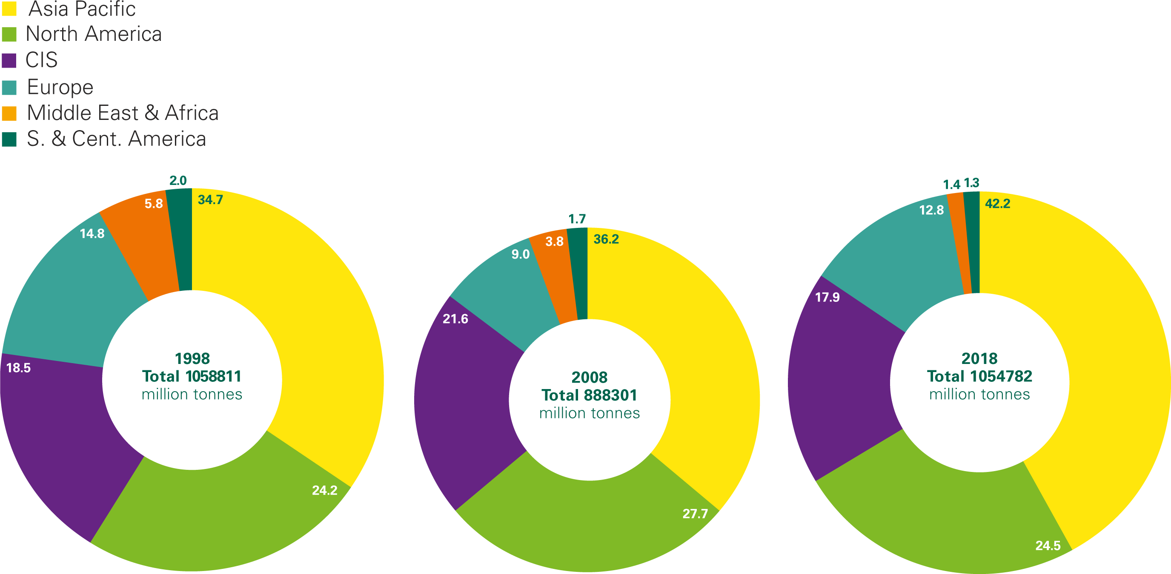
Distribution of proved coal reserves: 1998, 2008 and 2018
Percentage
Source: World Energy Resources 2013 Survey, World Energy Council.

Slide 30
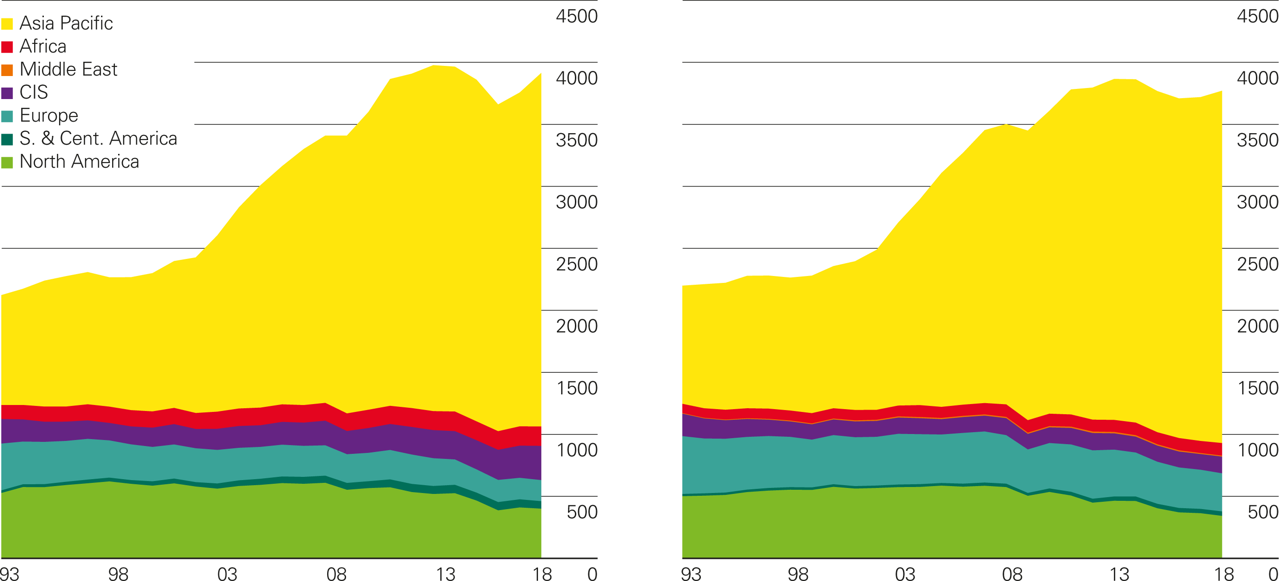
Coal production/consumption by region
Million tonnes oil equivalent
Production by region
Consumption by region

Slide 31
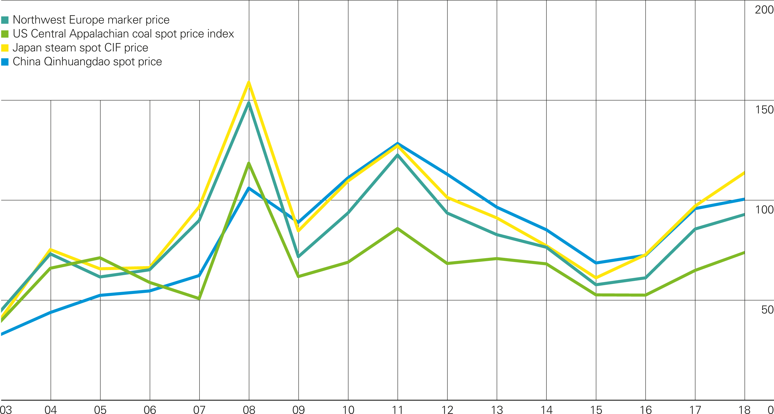
Coal prices
US dollars per tonne

Slide 32
Nuclear energy

Slide 33
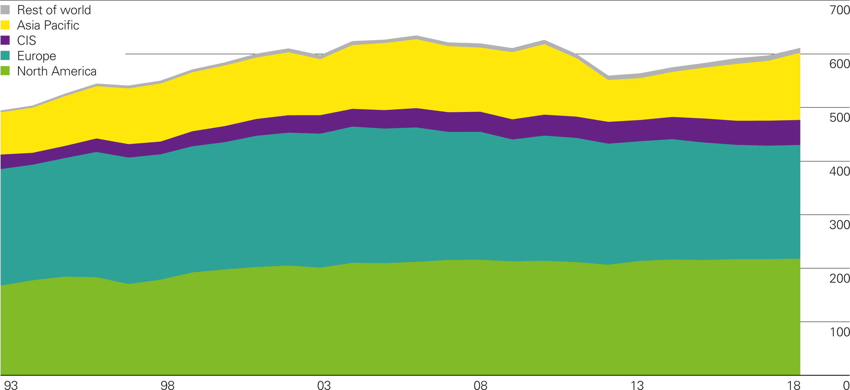
Nuclear energy consumption by region
Million tonnes oil equivalent

Slide 34
Hydroelectricity

Slide 35
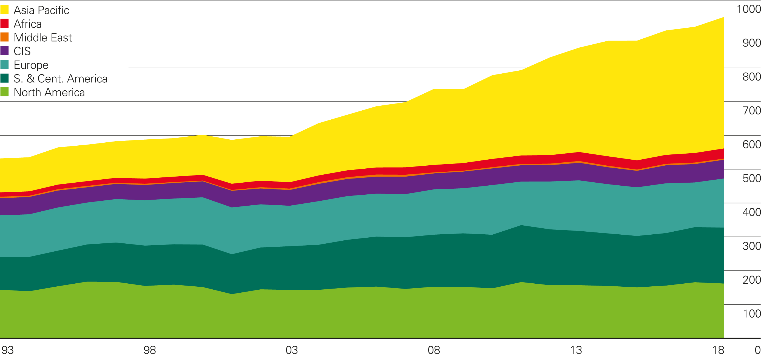
Hydroelectricity consumption by region
Million tonnes oil equivalent

Slide 36
Renewable energy

Slide 37
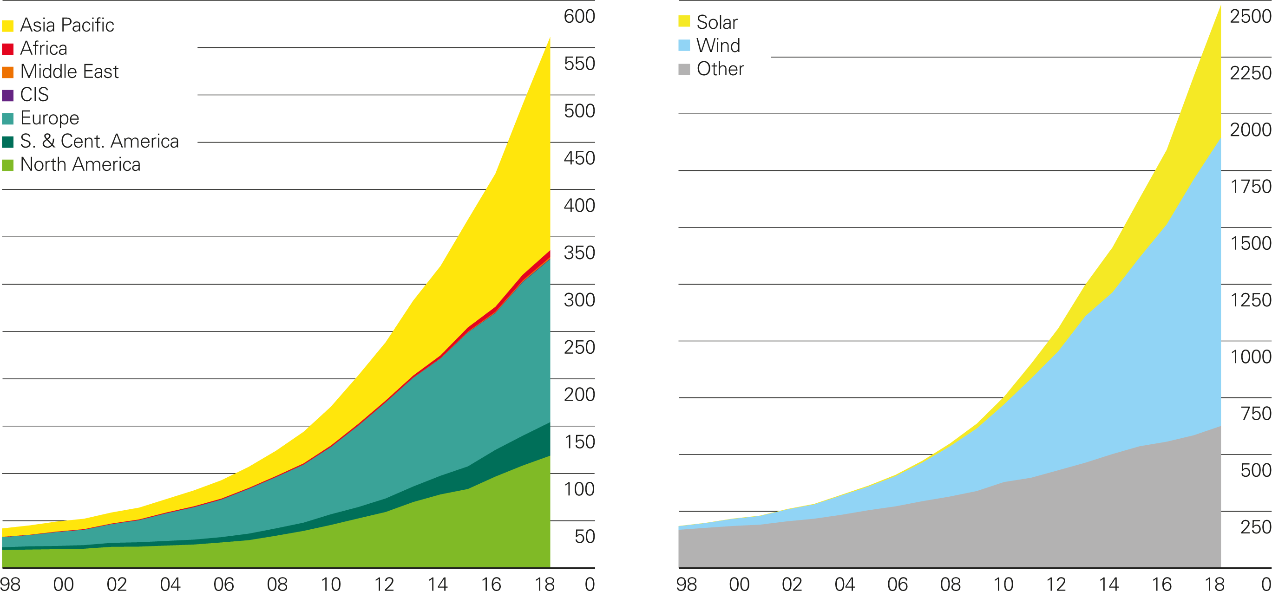
Renewable energy consumption by region/
generation by source
Renewables consumption by region
Million tonnes oil equivalent
Renewables generation by source
Terawatt-hours

Slide 38
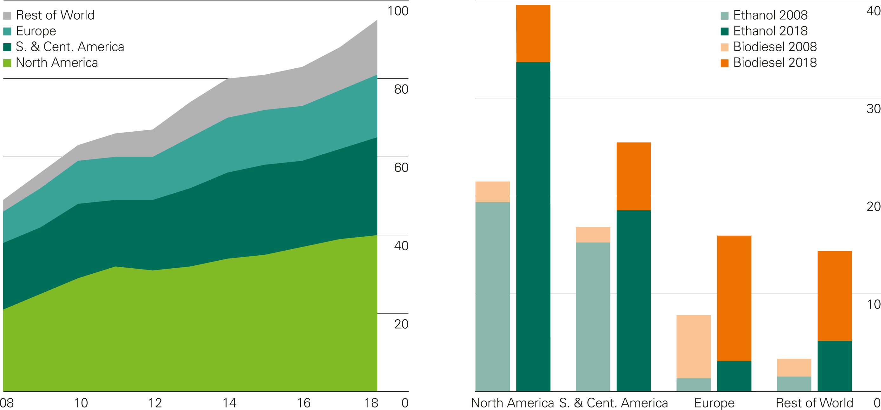
Biofuels production by region
Million tonnes oil equivalent
World biofuels production

Slide 39
Electricity

Slide 40
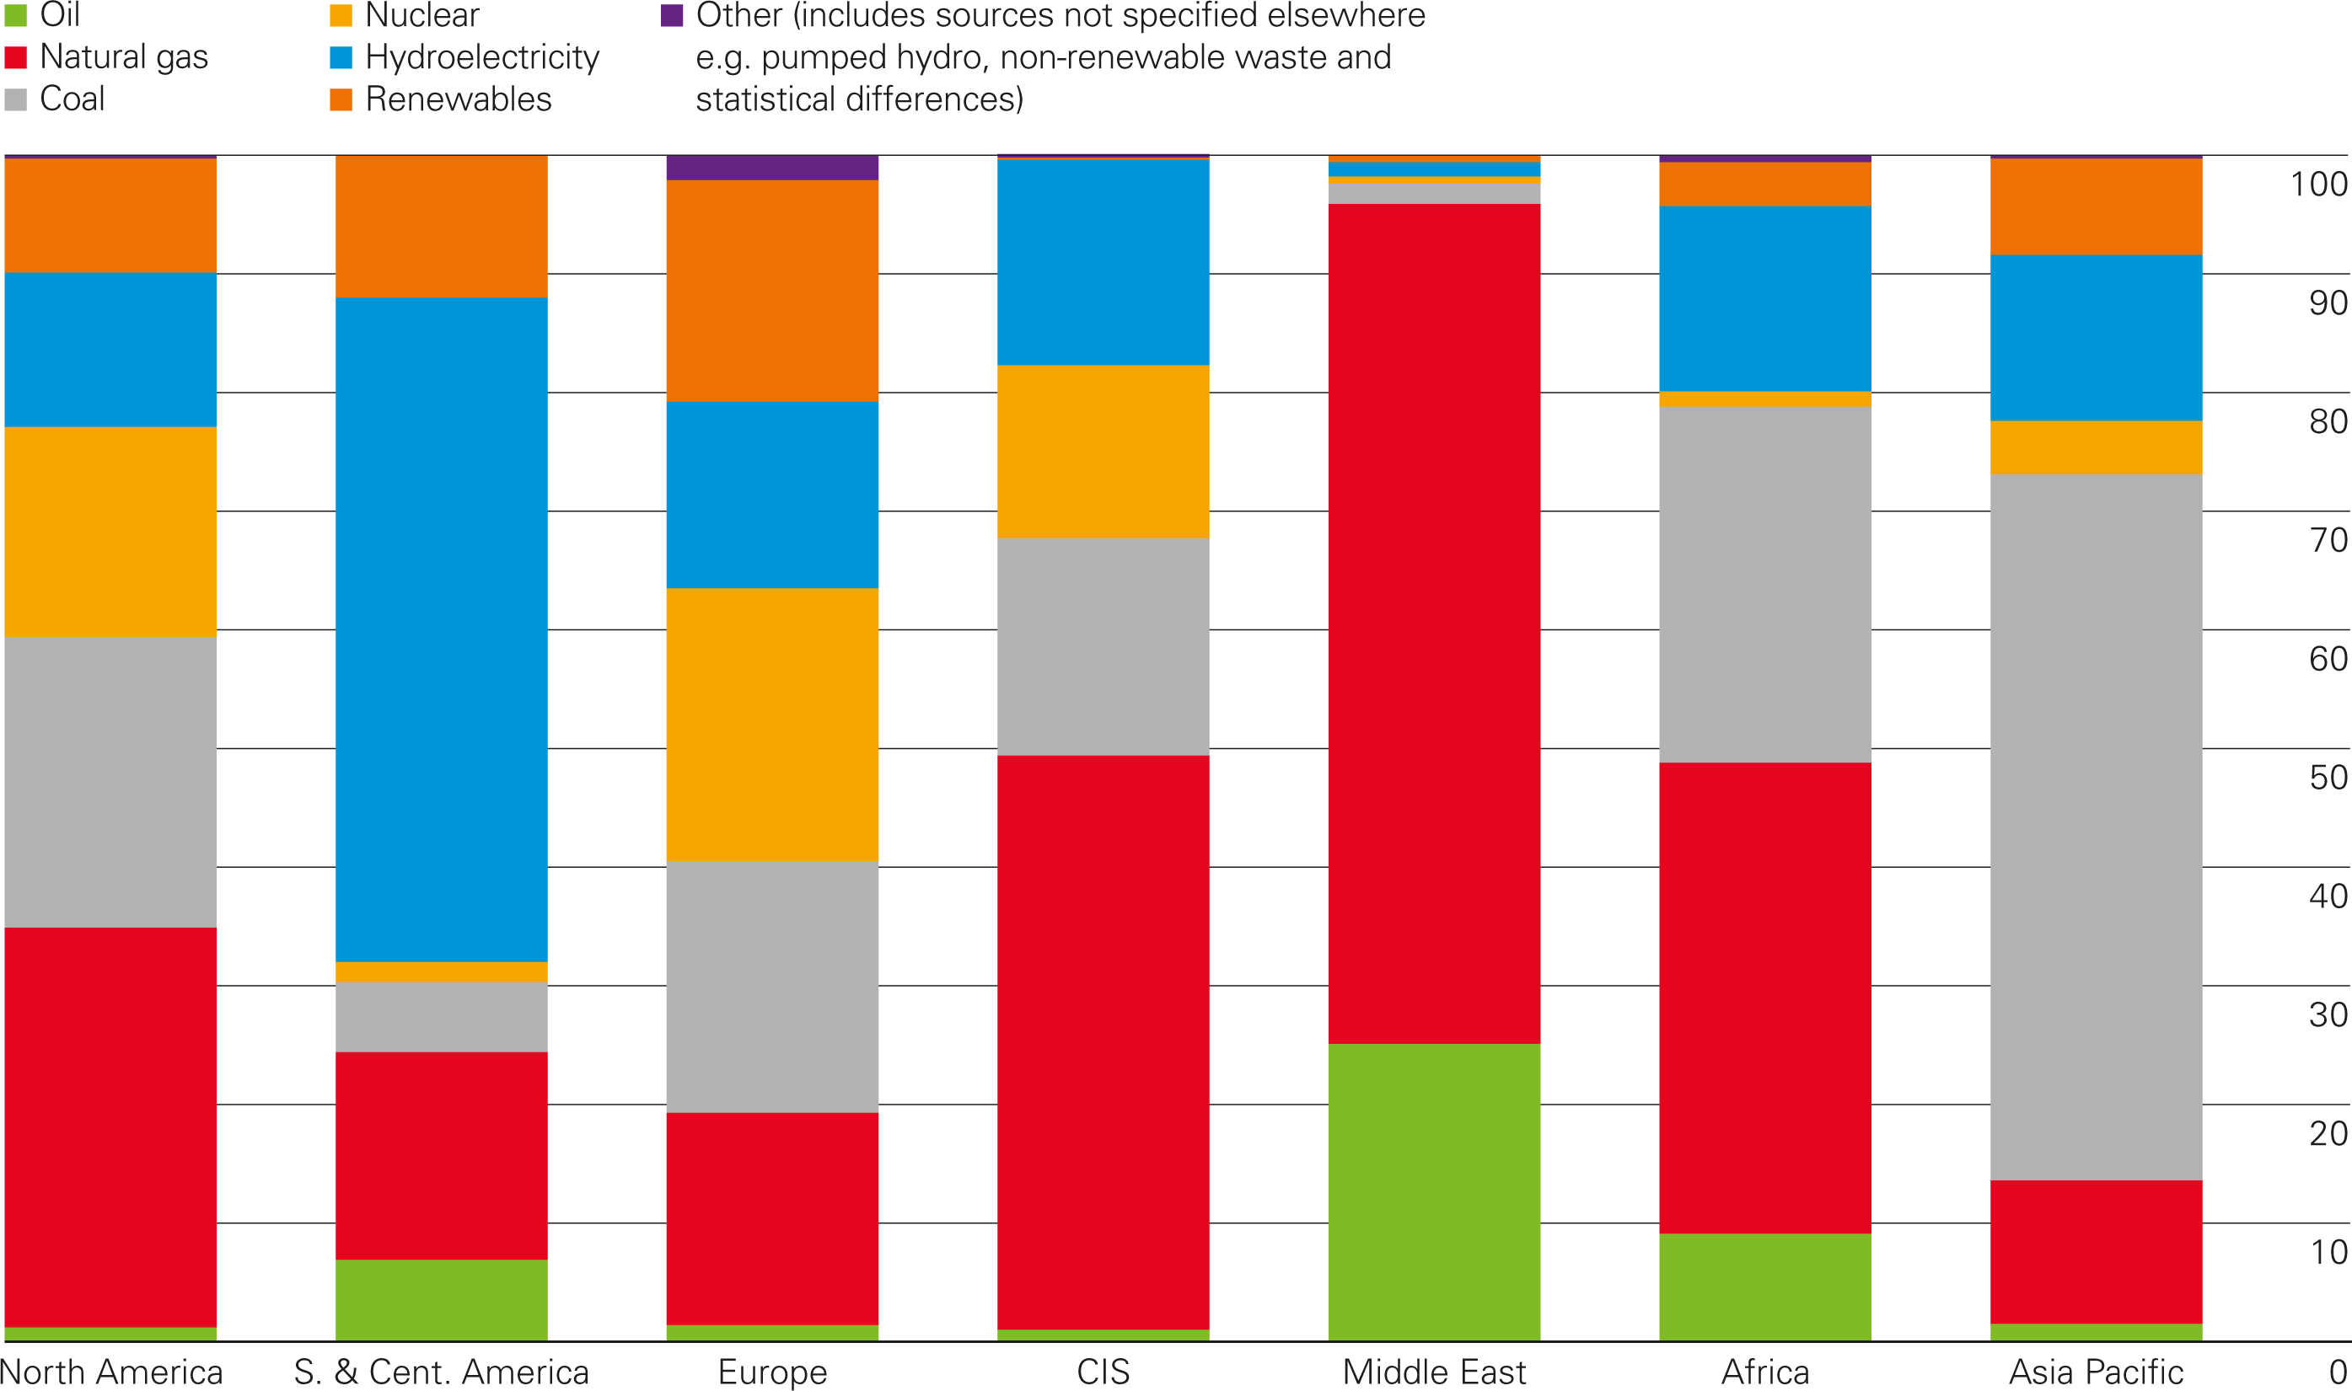
Regional electricity generation by fuel 2018
Percentage

Slide 41
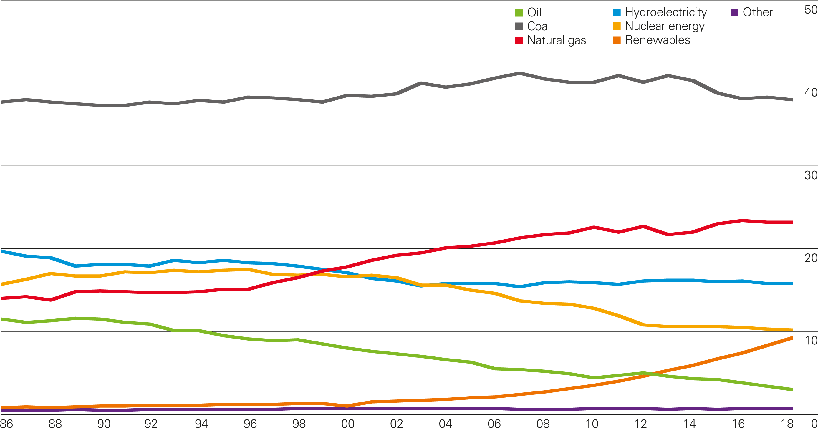
Share of global electricity generation by fuel
Percentage

Slide 42
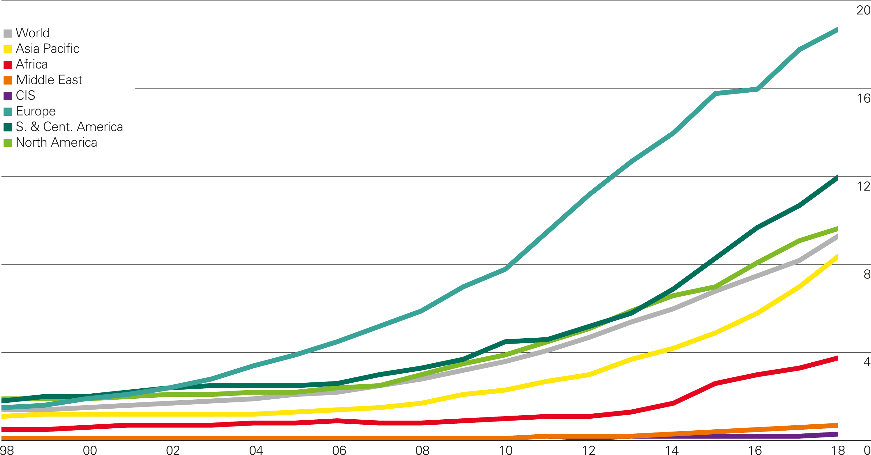
Renewables share of power generation by region
Percentage

Slide 43
Key minerals for the changing energy system

Slide 44
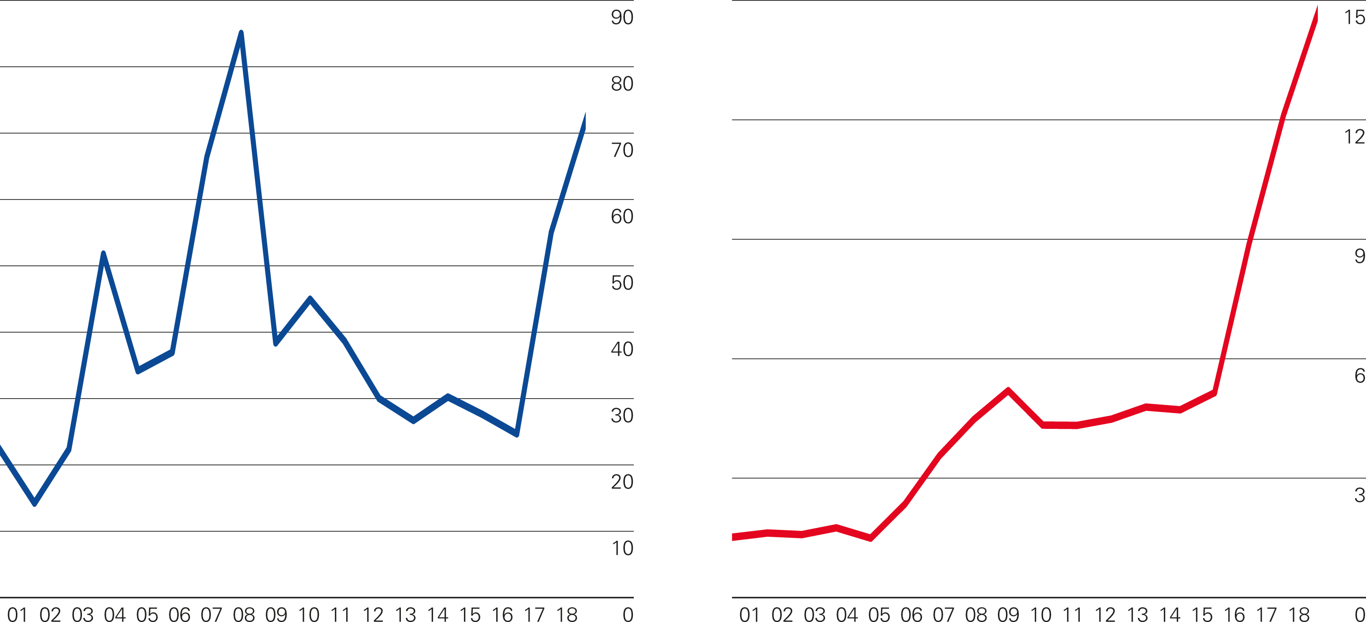
Key minerals prices
Cobalt prices
Thousands of US dollars per tonne
Lithium carbonate prices
Thousands of US dollars per tonne

