Slide 1


Slide 2


Slide 3
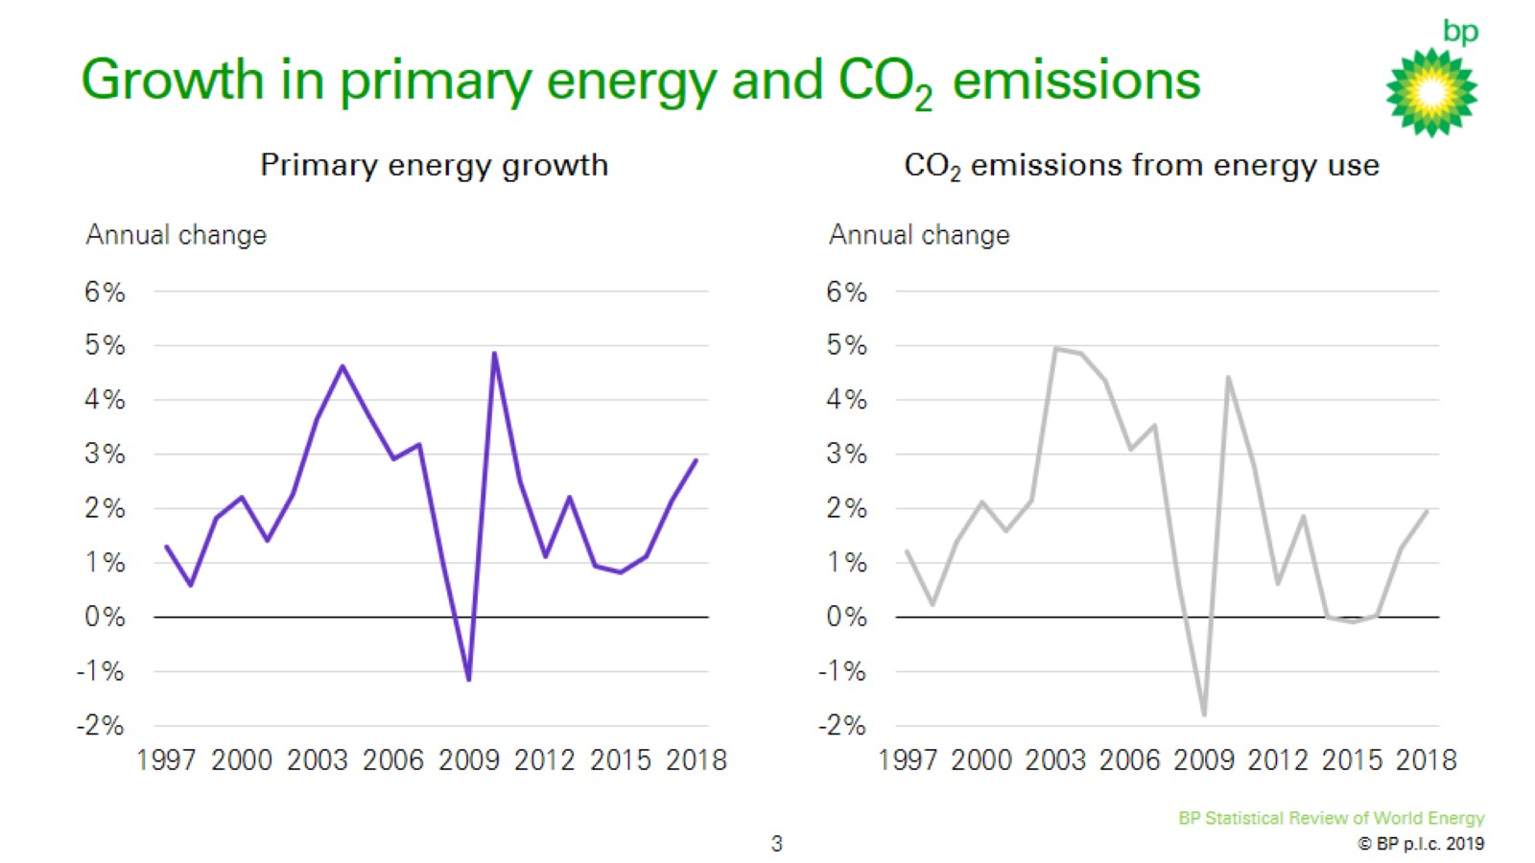
Growth in primary energy and CO₂ emissions

Slide 4
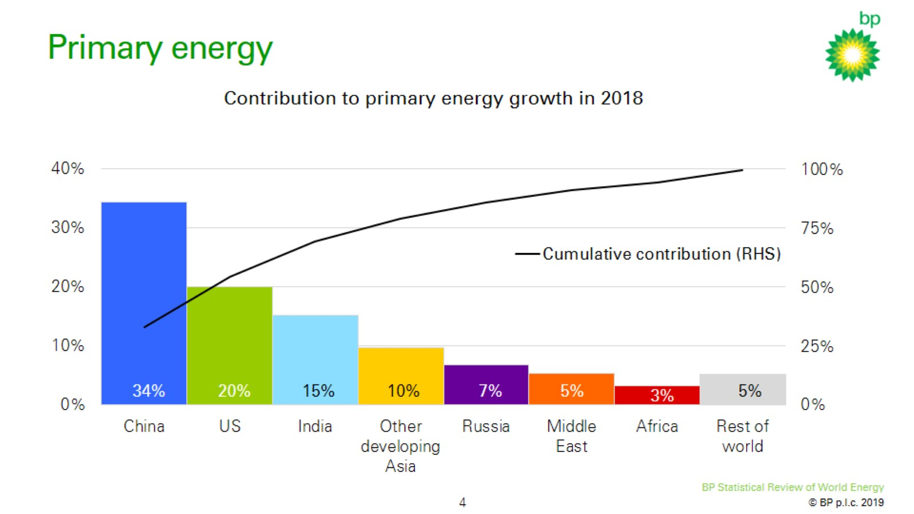
Primary energy

Slide 5
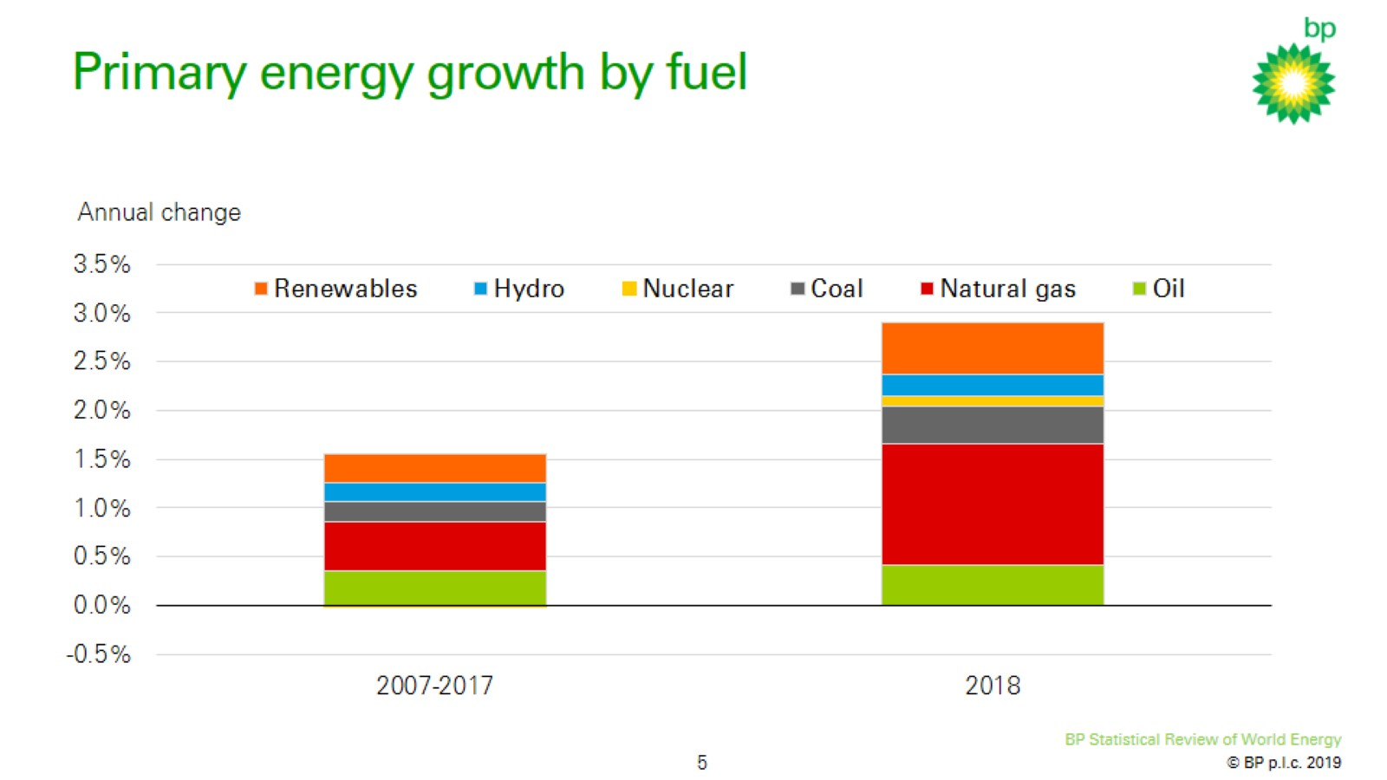
Primary energy growth by fuel

Slide 6
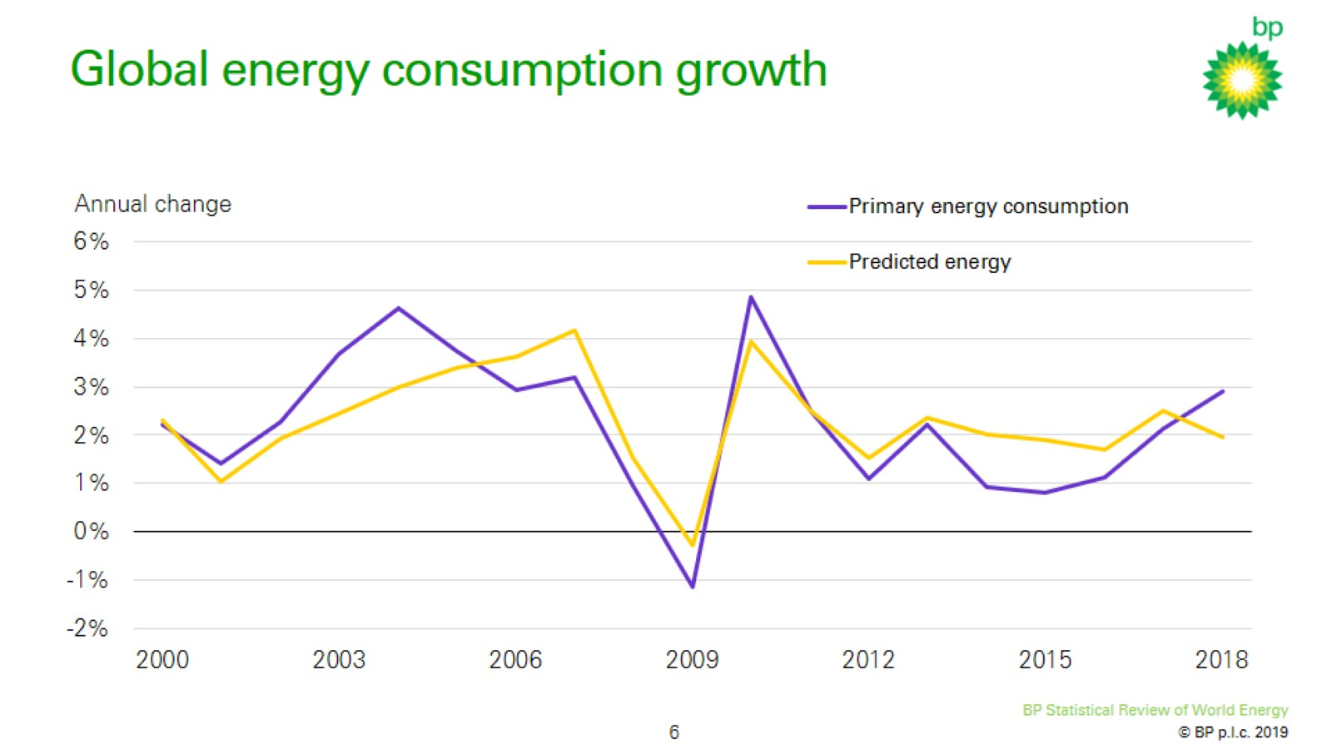
Global energy consumption growth

Slide 7
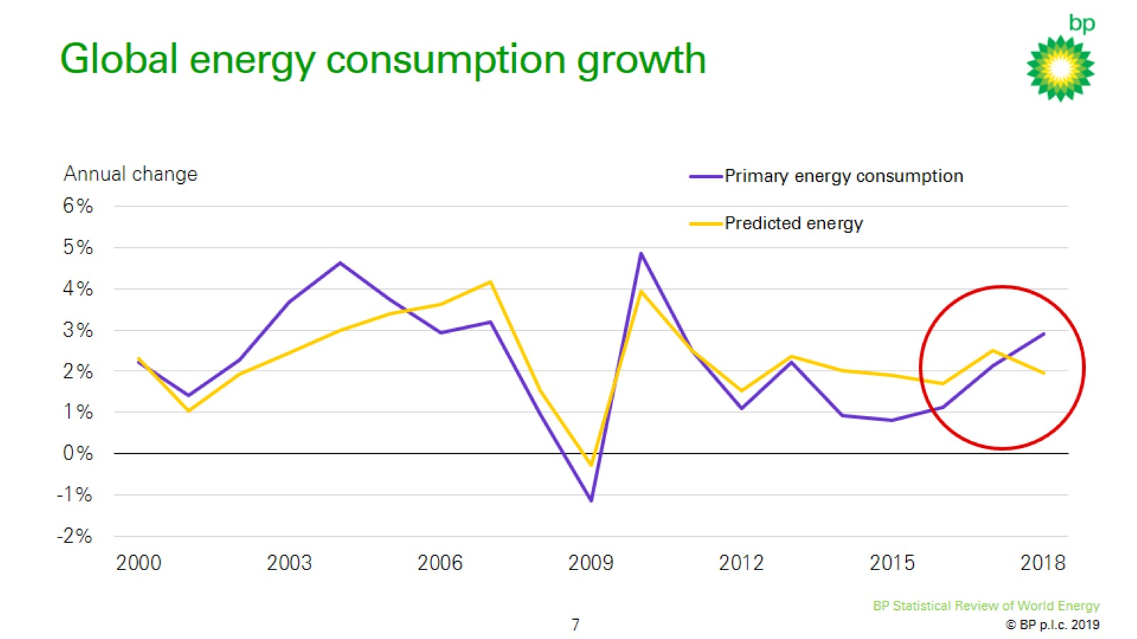
Global energy consumption growth

Slide 8
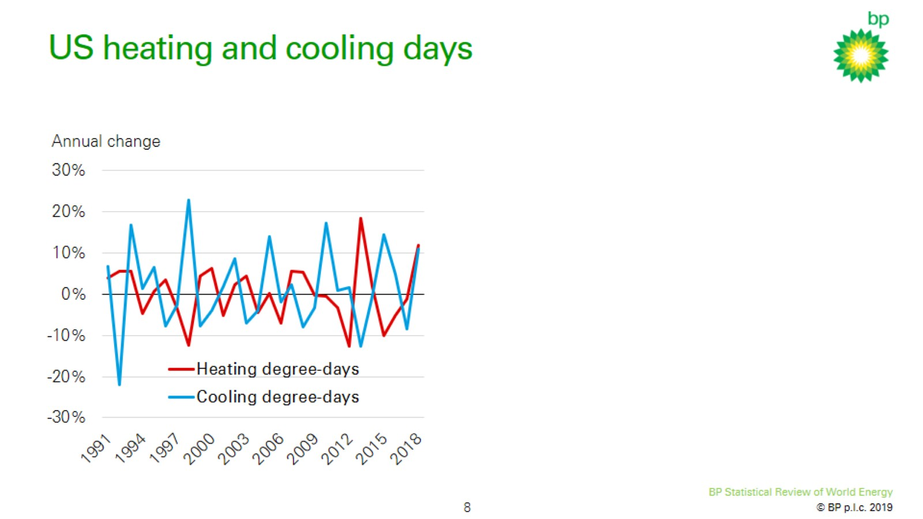
US heating and cooling days

Slide 9
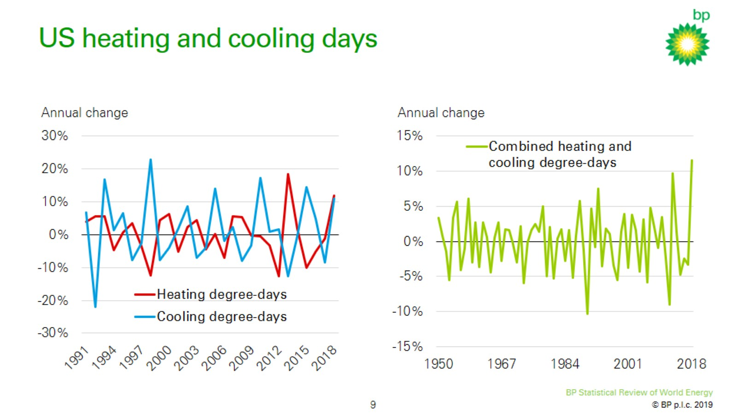
US heating and cooling days

Slide 10
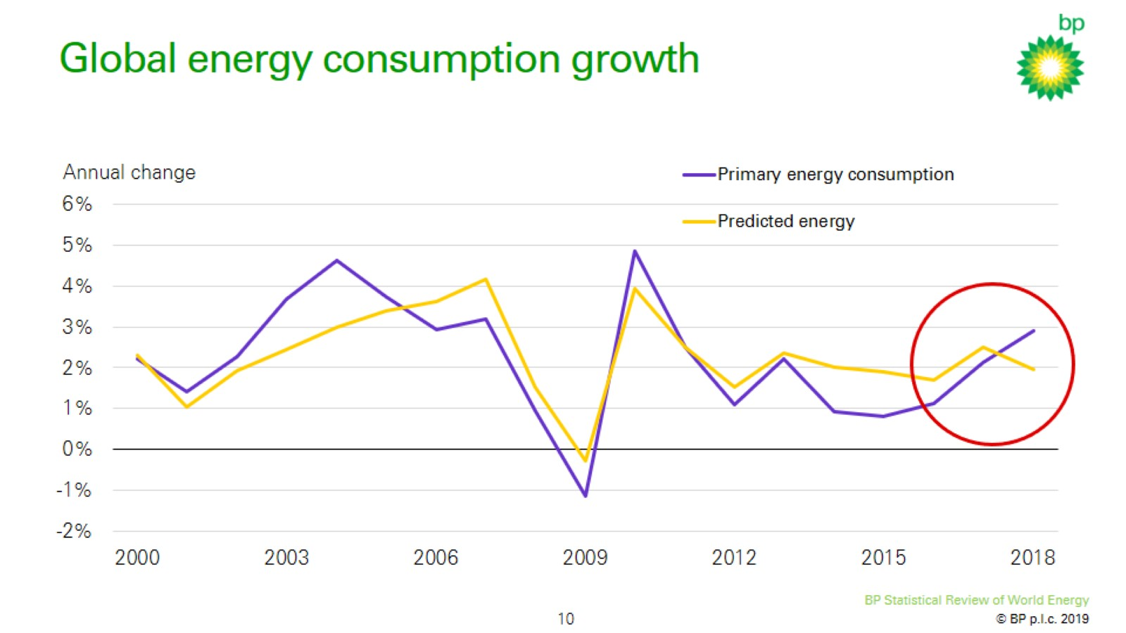
Global energy consumption growth

Slide 11
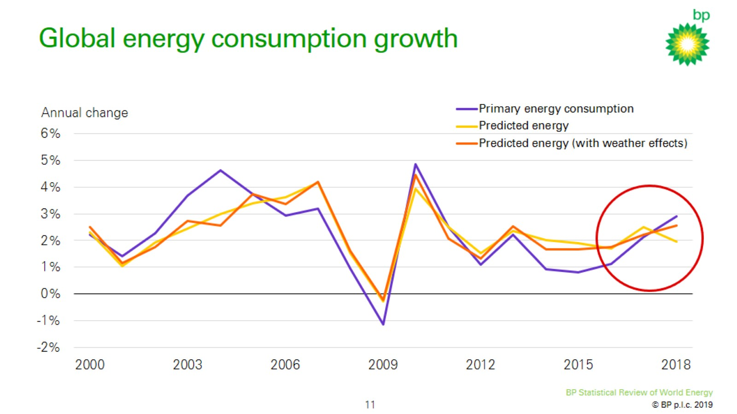
Global energy consumption growth

Slide 12
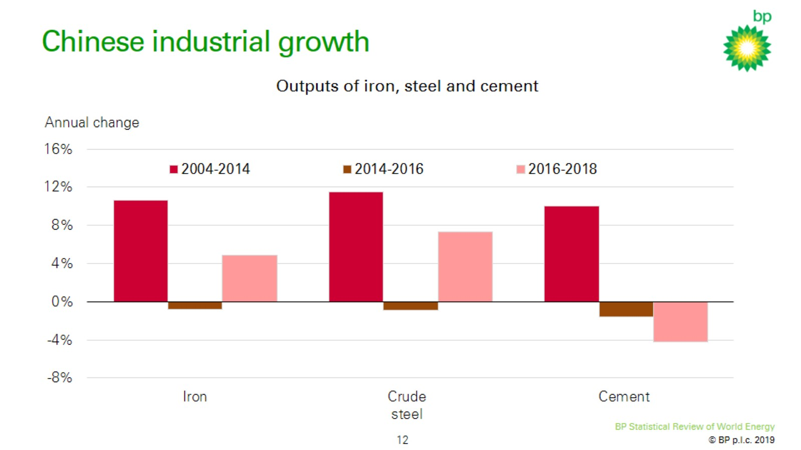
Chinese industrial growth

Slide 13
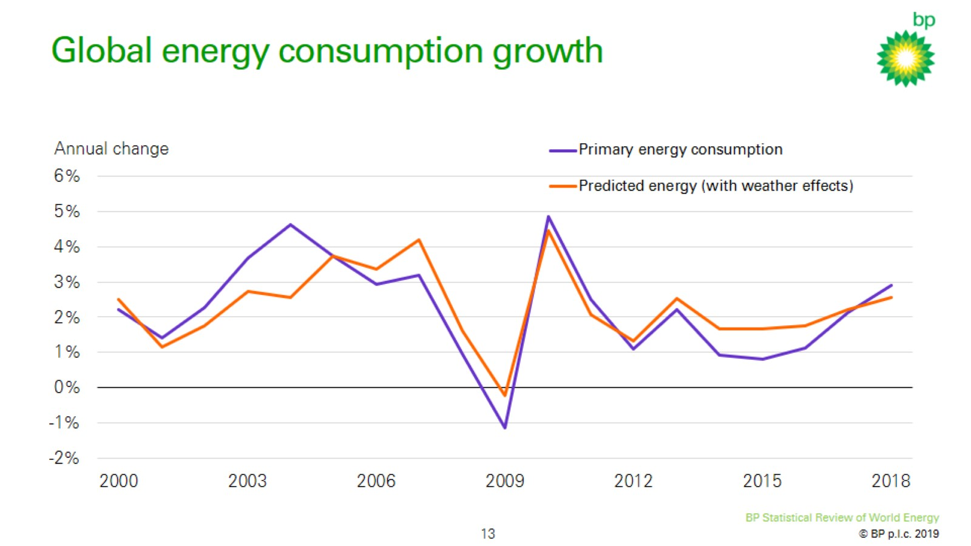
Global energy consumption growth

Slide 14
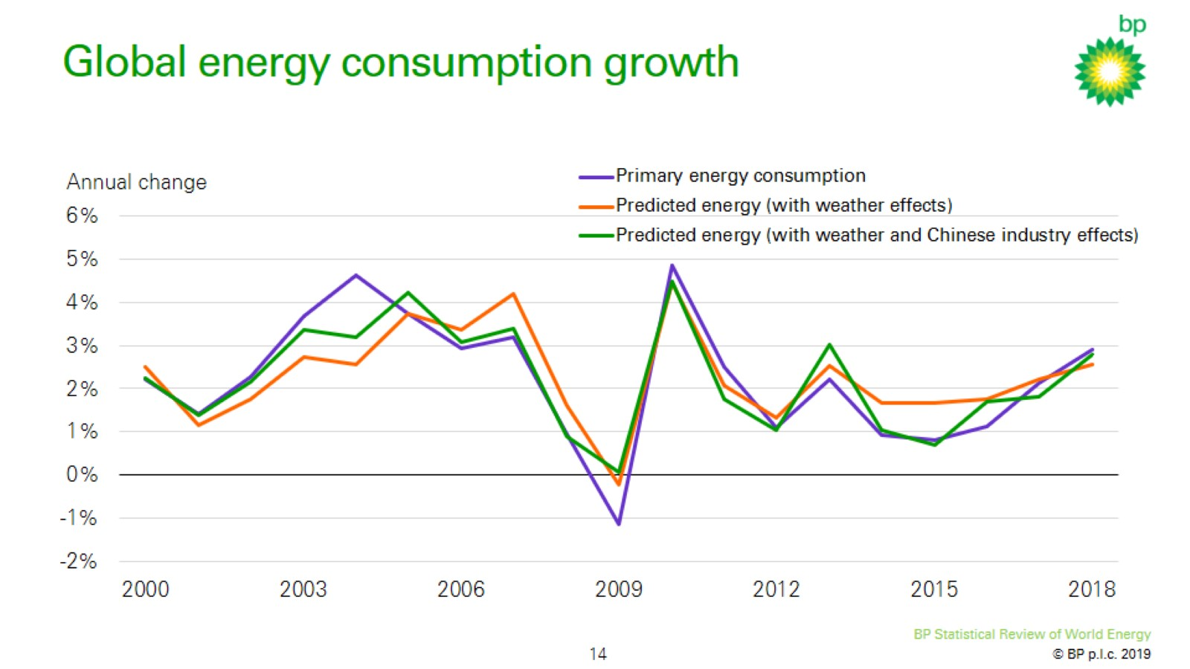
Global energy consumption growth

Slide 15
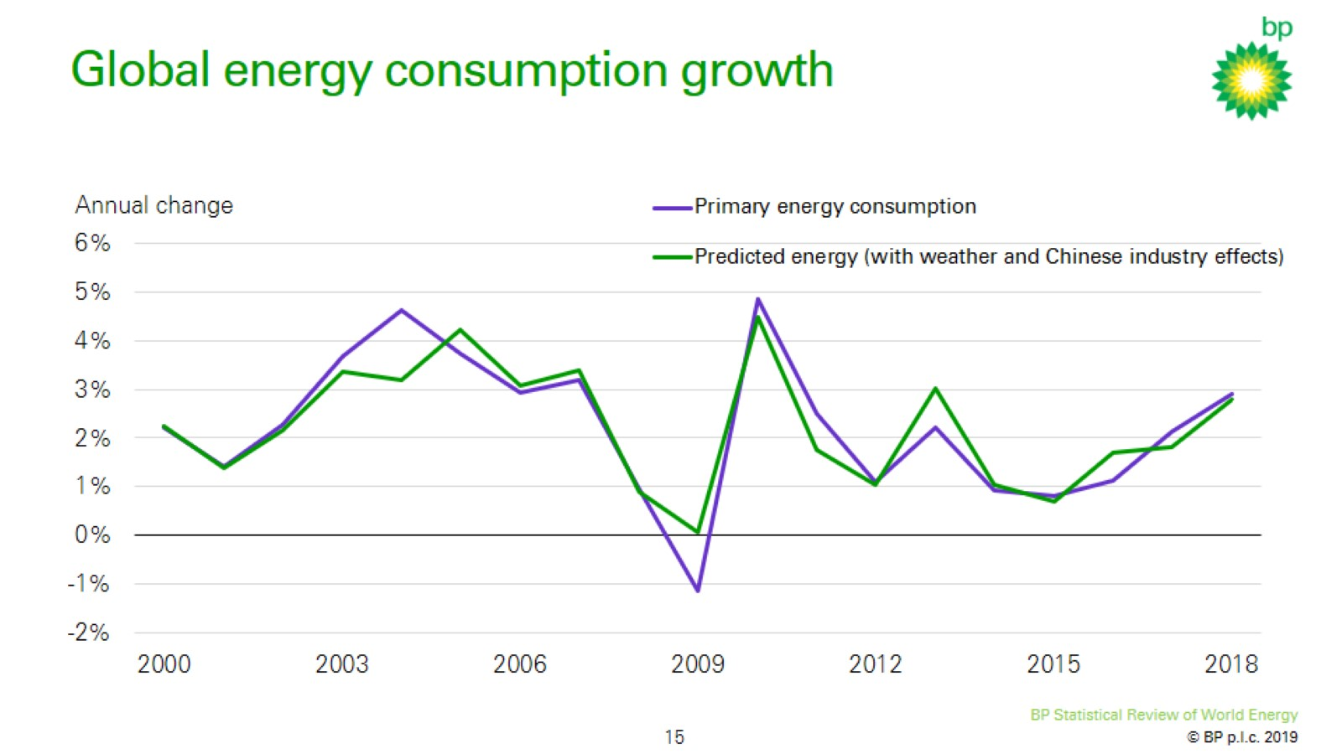
Global energy consumption growth

Slide 16
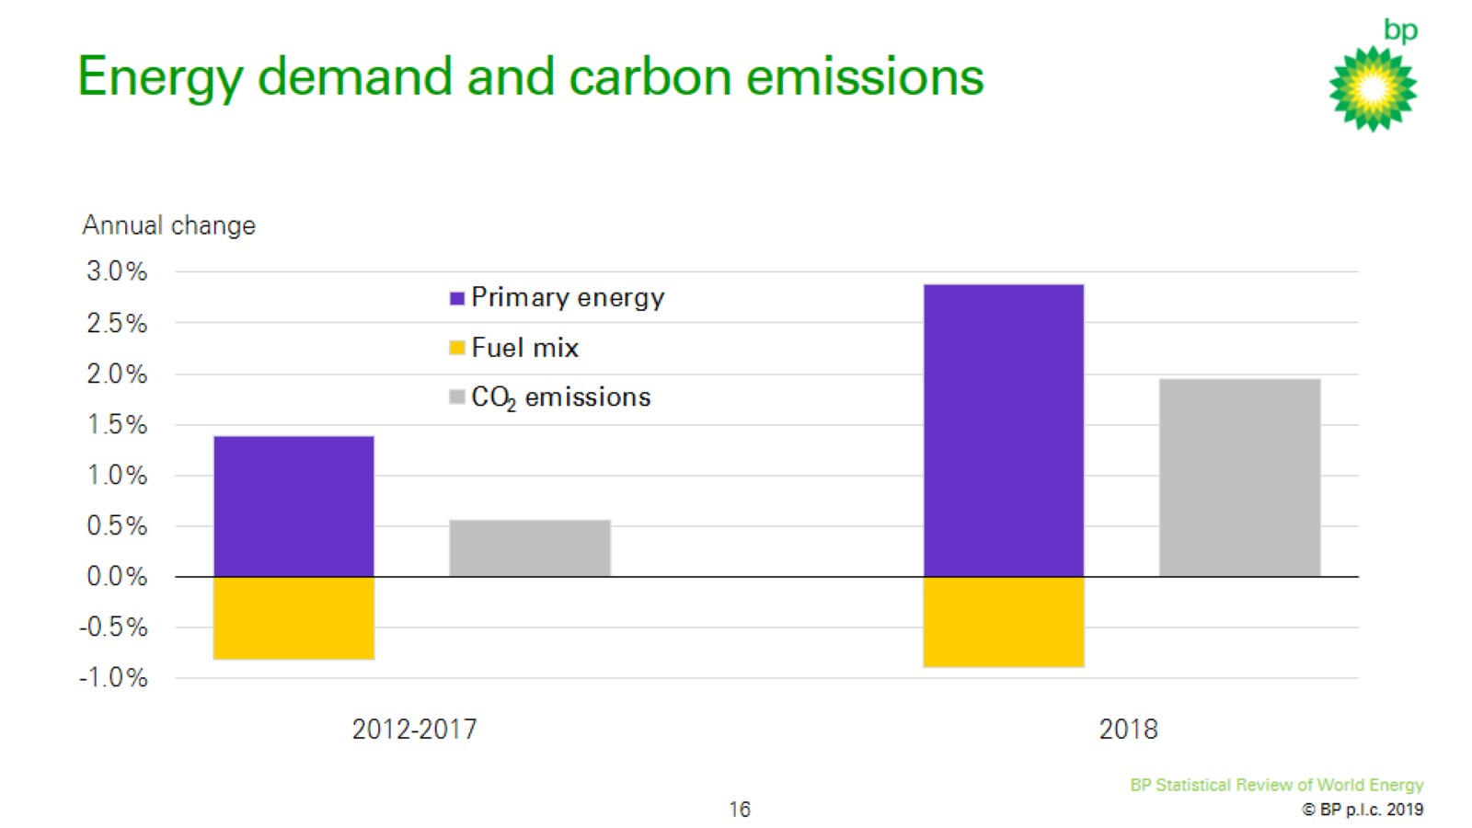
Energy demand and carbon emissions

Slide 17


Slide 18
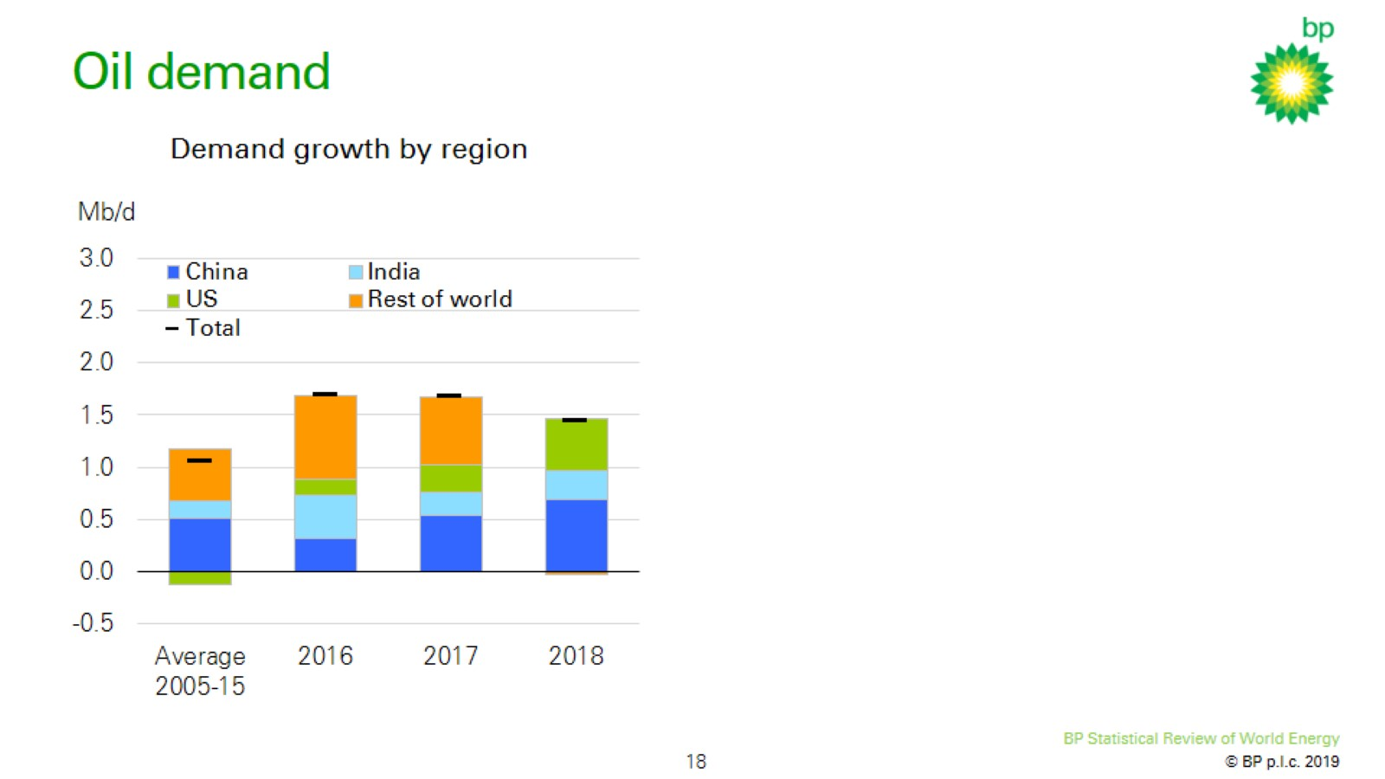
Oil demand

Slide 19
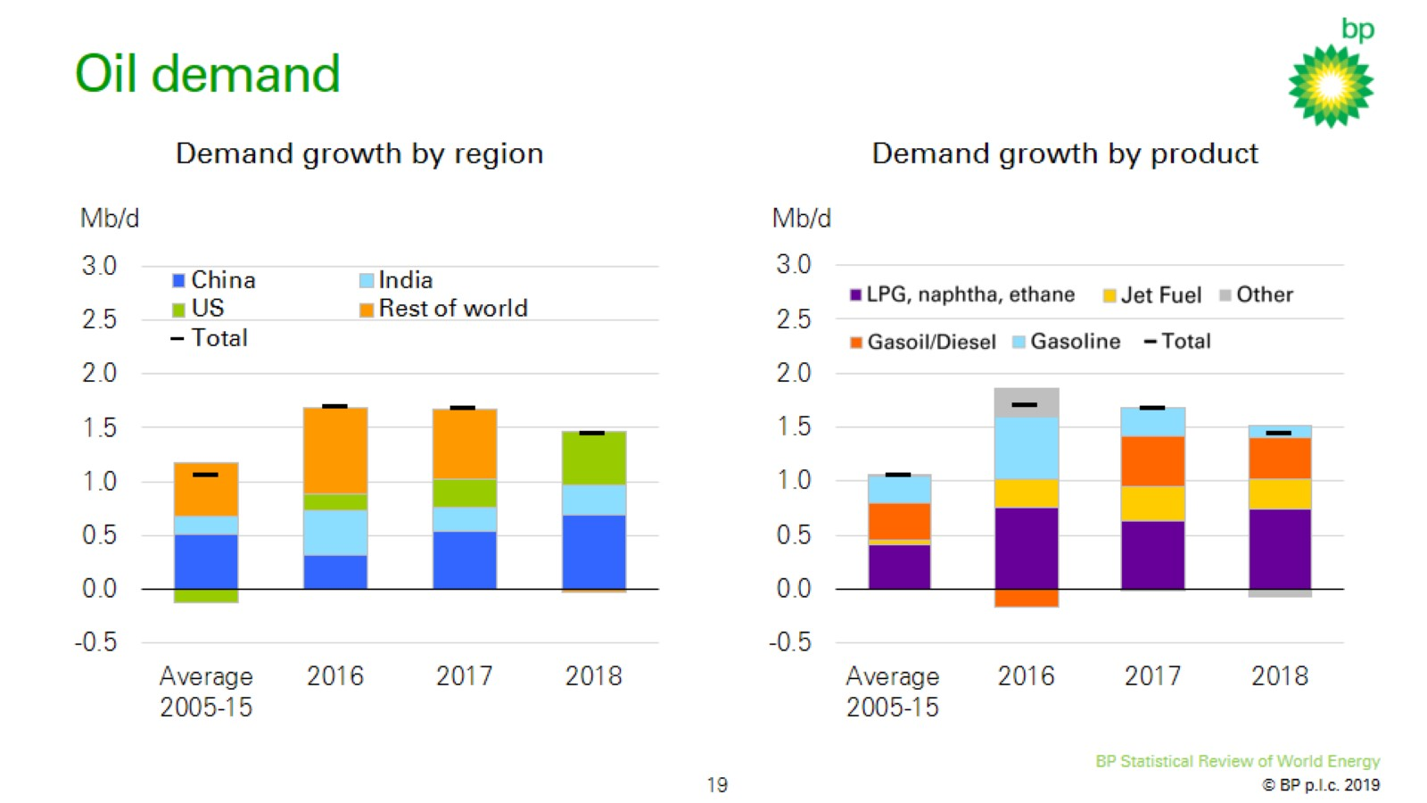
Oil demand

Slide 20
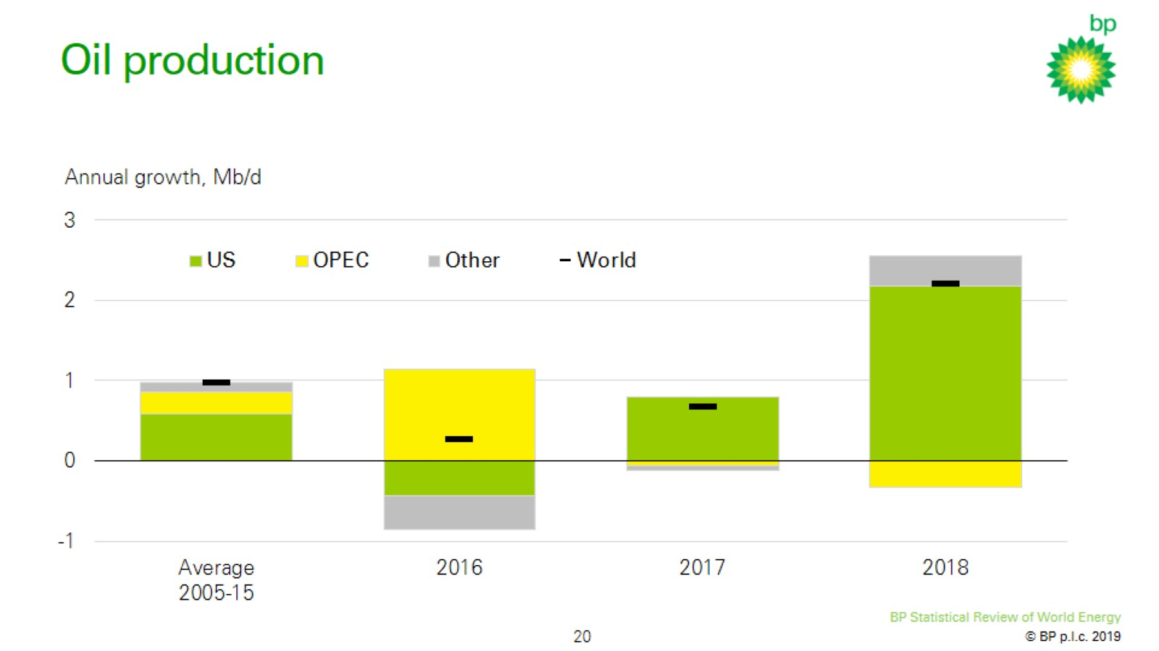
Oil production

Slide 21
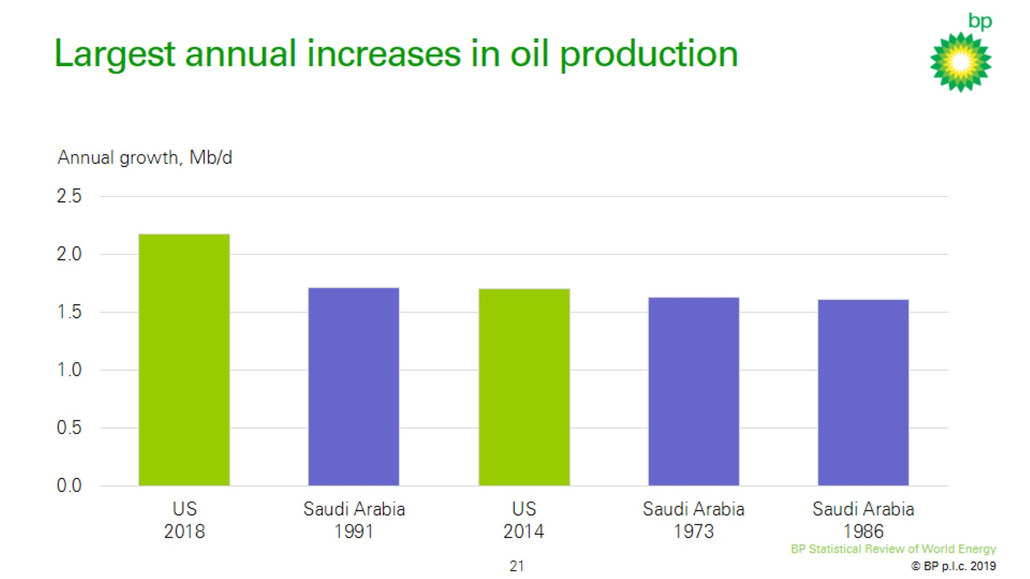
Largest annual increases in oil production

Slide 22
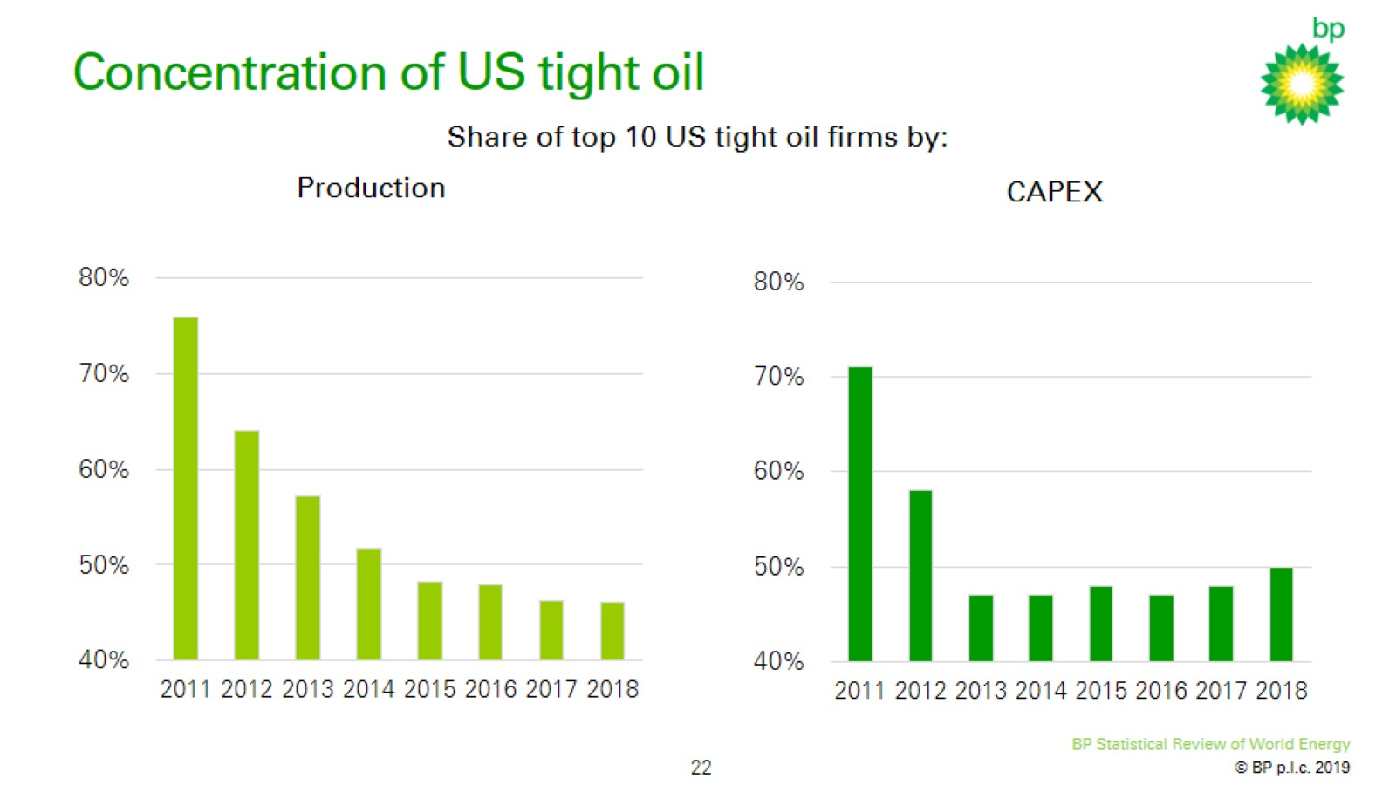
Concentration of US tight oil

Slide 23

Oil production

Slide 24
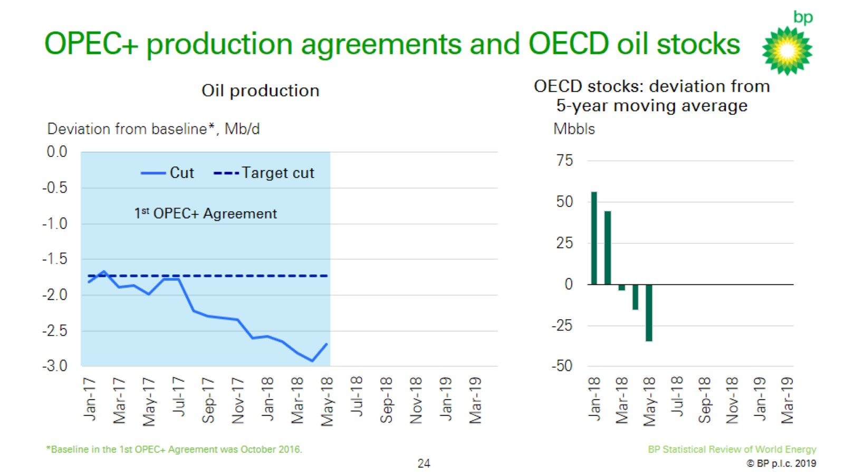
OPEC+ production agreements and OECD oil stocks

Slide 25
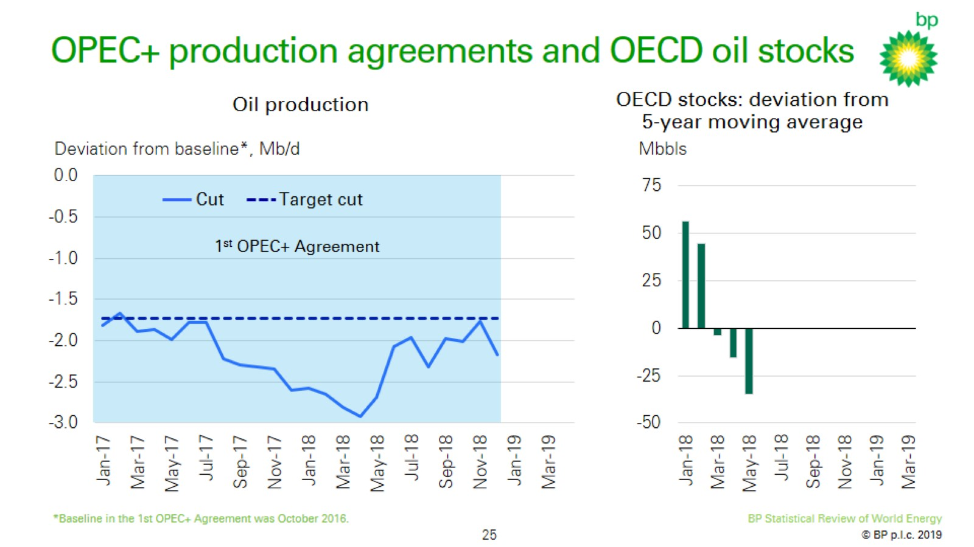
OPEC+ production agreements and OECD oil stocks

Slide 26
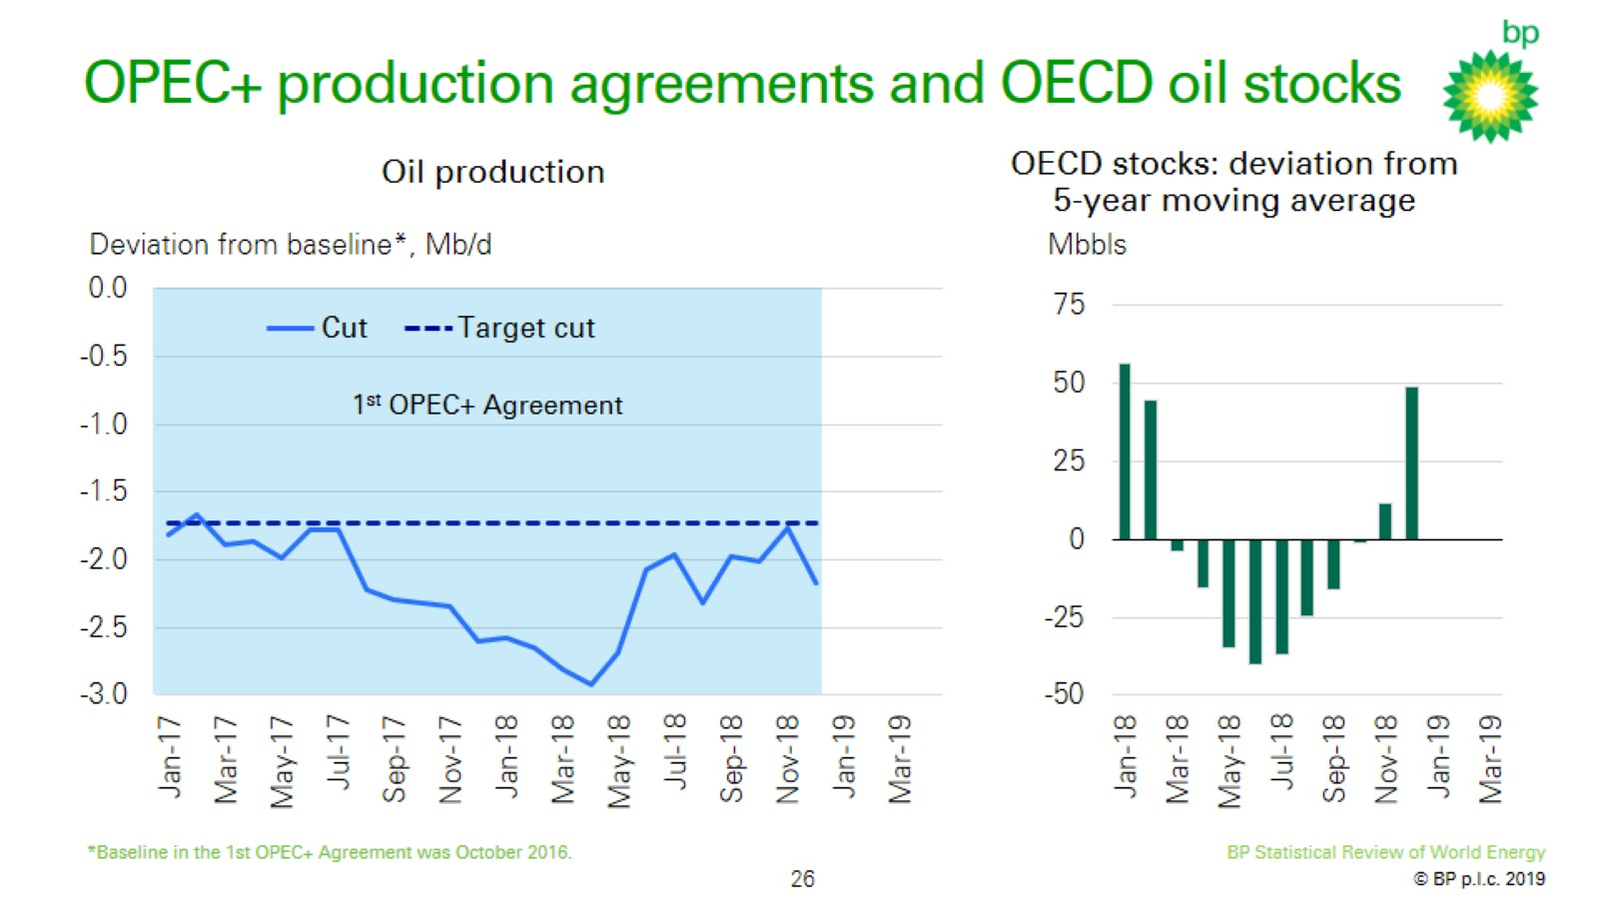
OPEC+ production agreements and OECD oil stocks

Slide 27
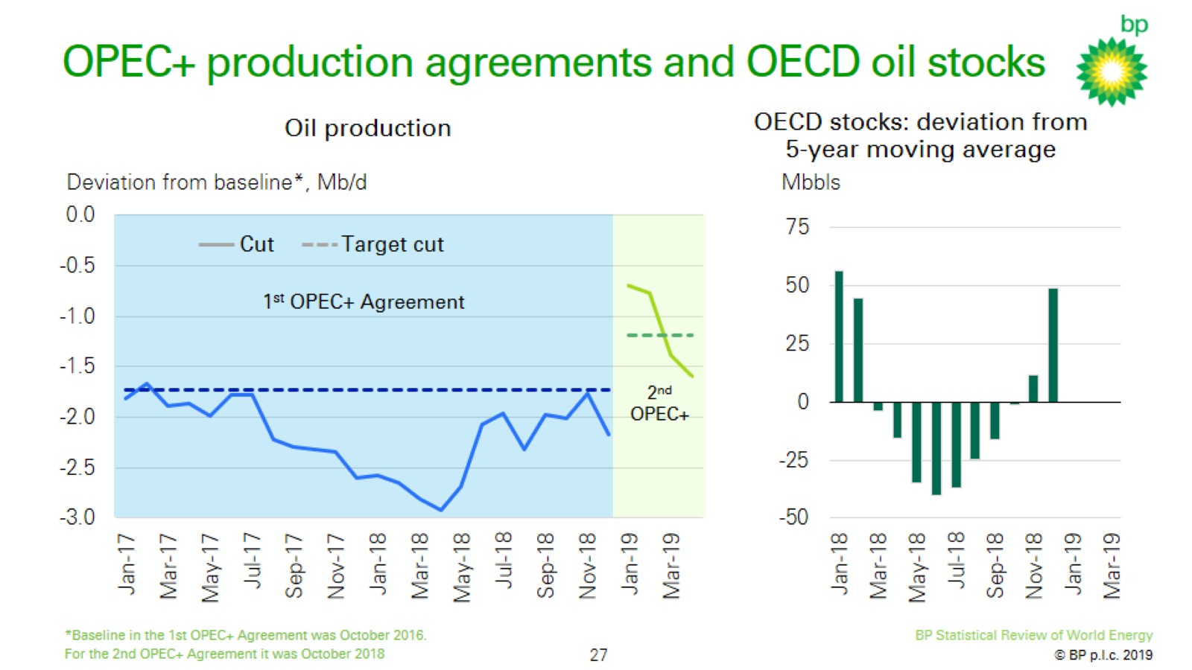
OPEC+ production agreements and OECD oil stocks

Slide 28
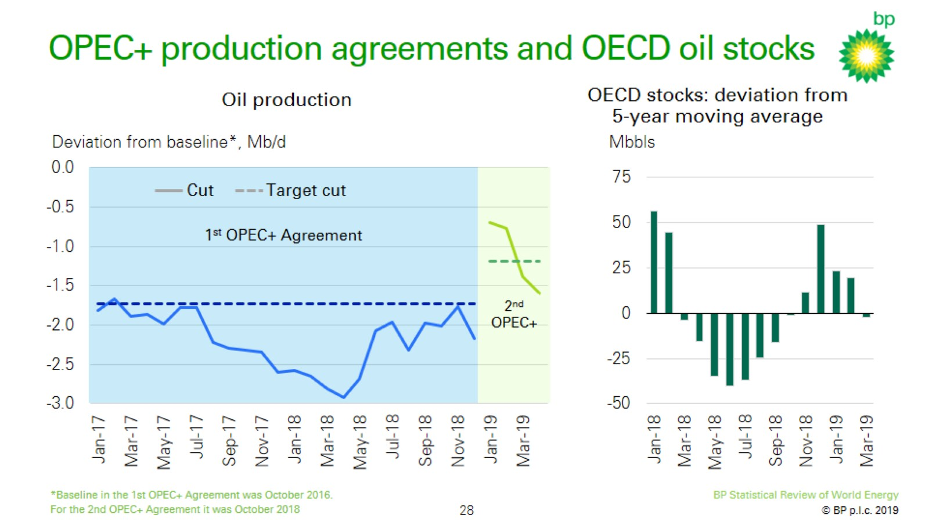
OPEC+ production agreements and OECD oil stocks

Slide 29


Slide 30
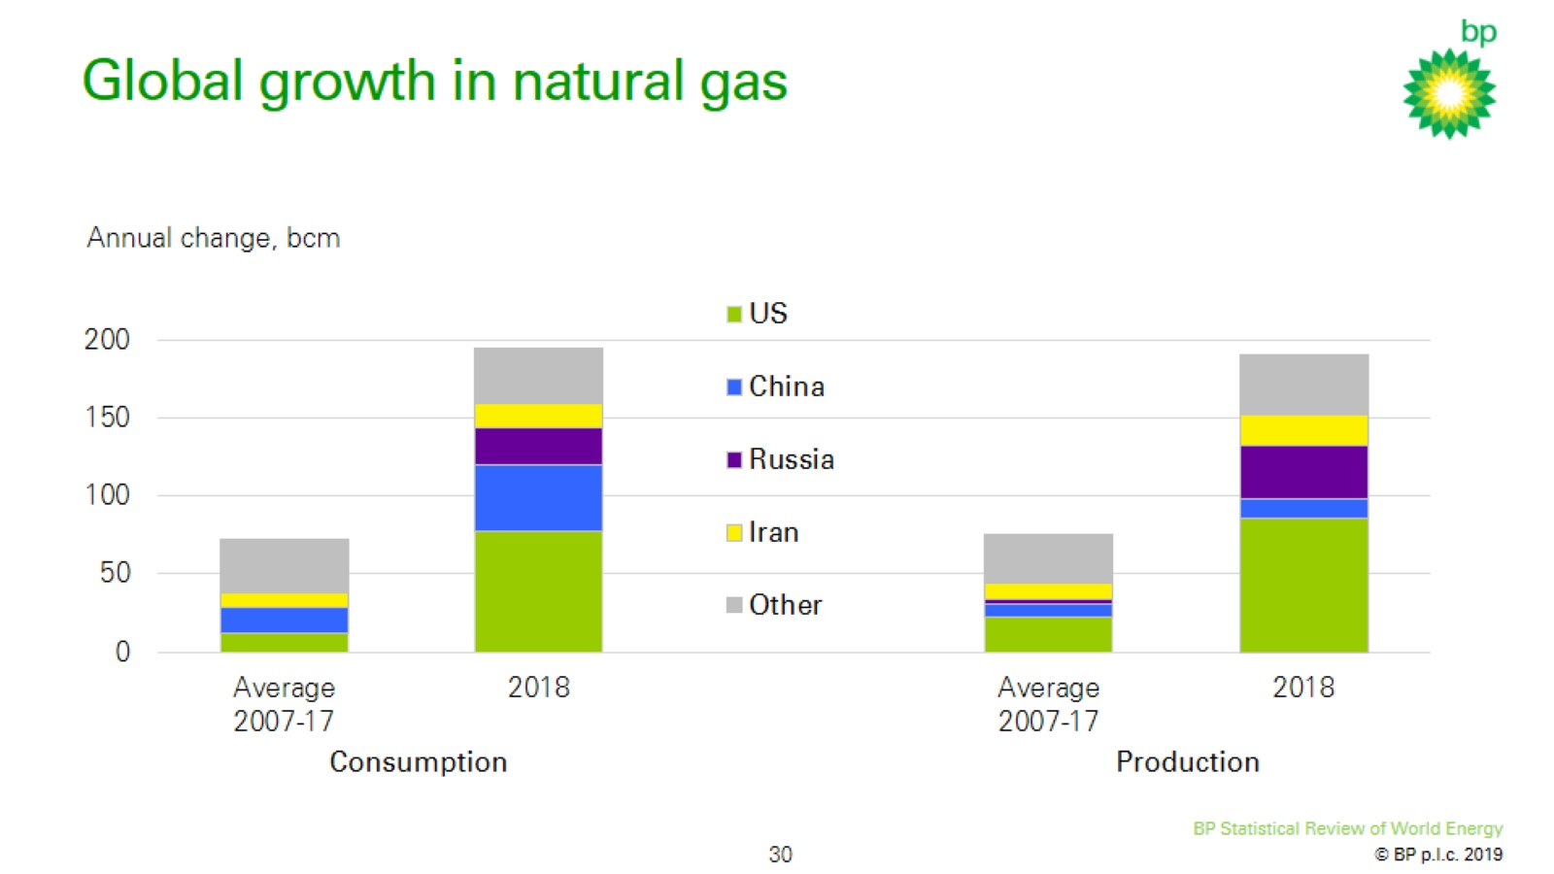
Global growth in natural gas

Slide 31
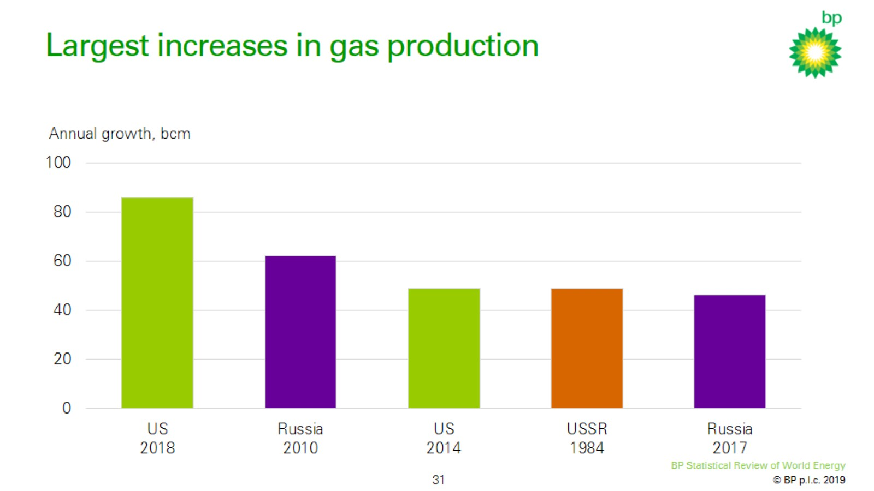
Largest increases in gas production

Slide 32
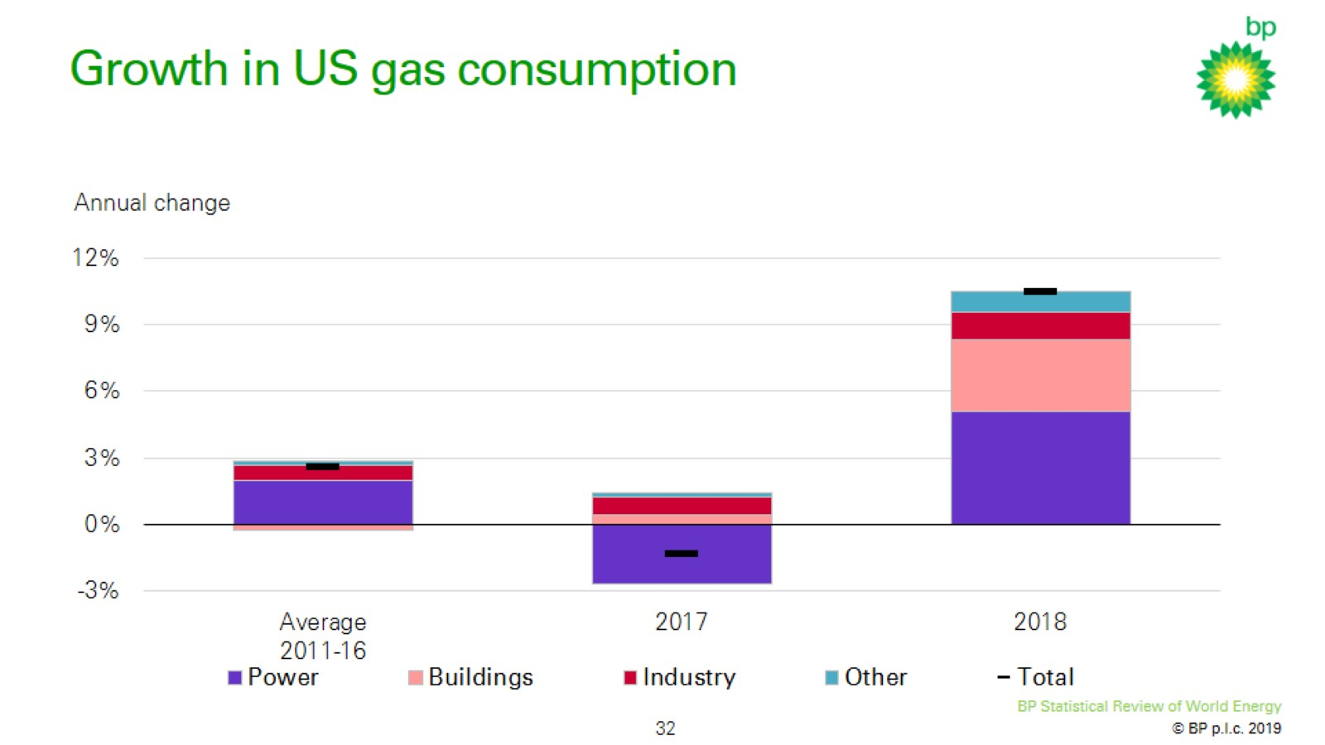
Growth in US gas consumption

Slide 33
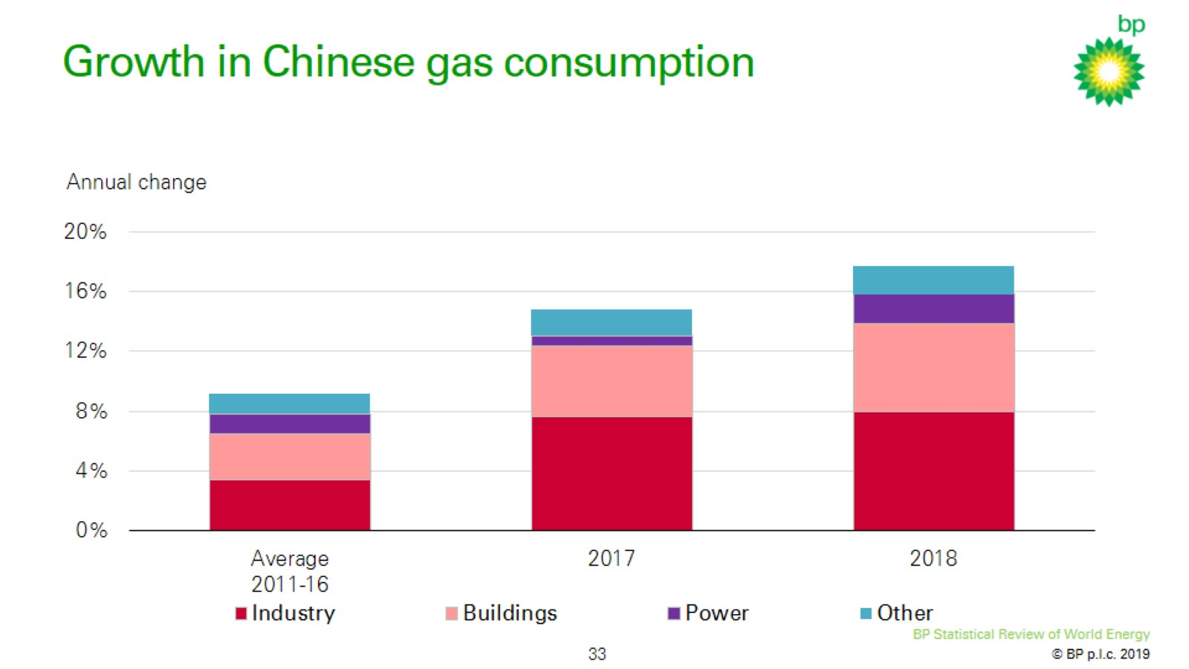
Growth in Chinese gas consumption

Slide 34
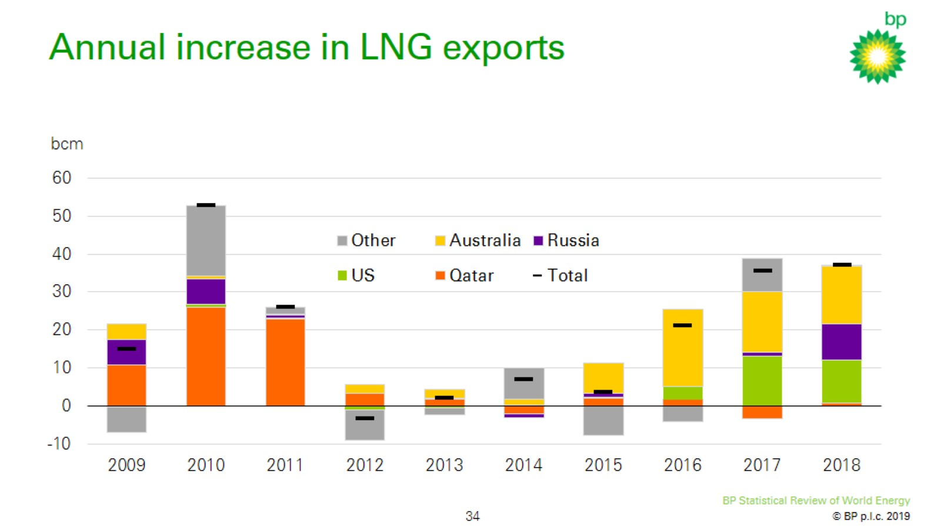
Annual increase in LNG exports

Slide 35
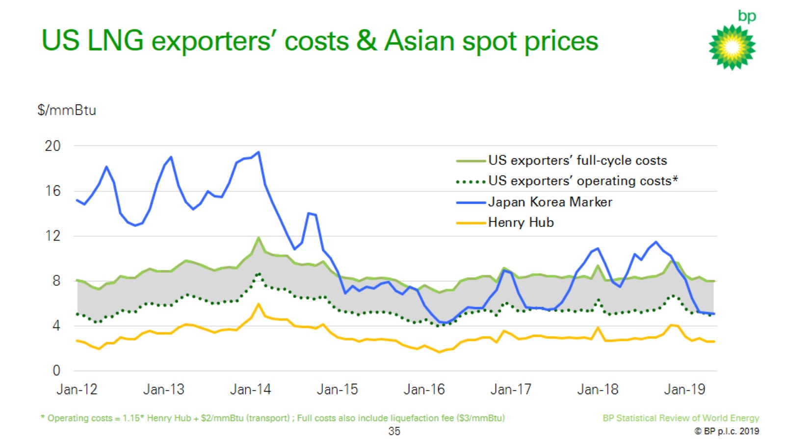
US LNG exporters’ costs & Asian spot prices

Slide 36


Slide 37
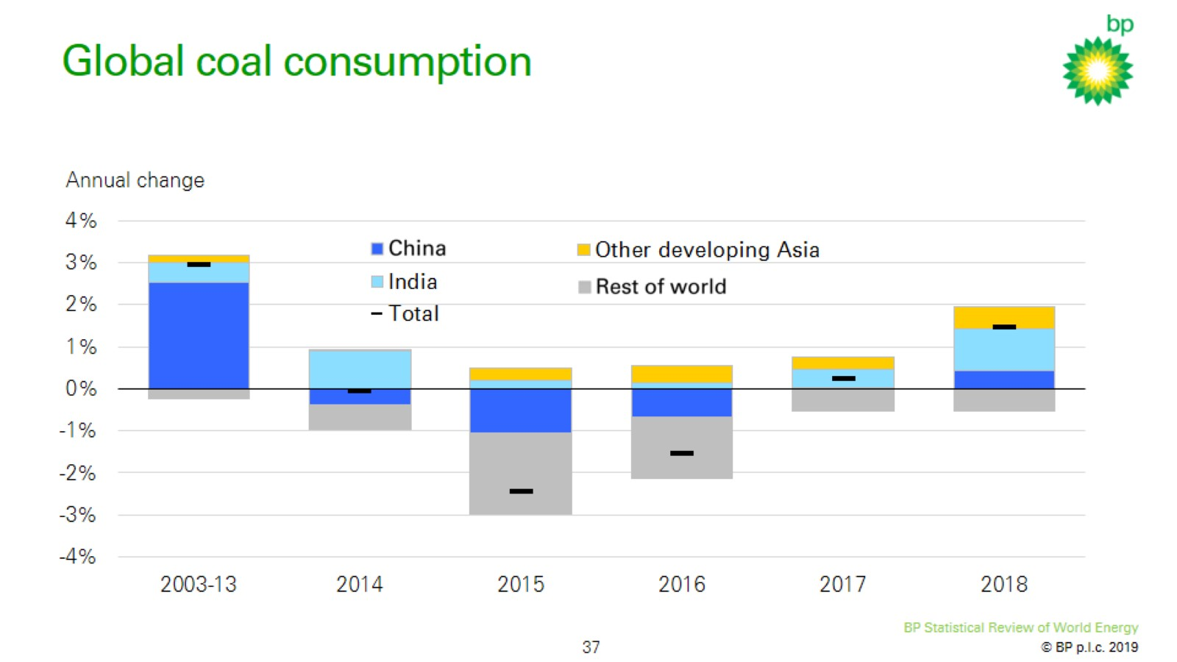
Global coal consumption

Slide 38


Slide 39
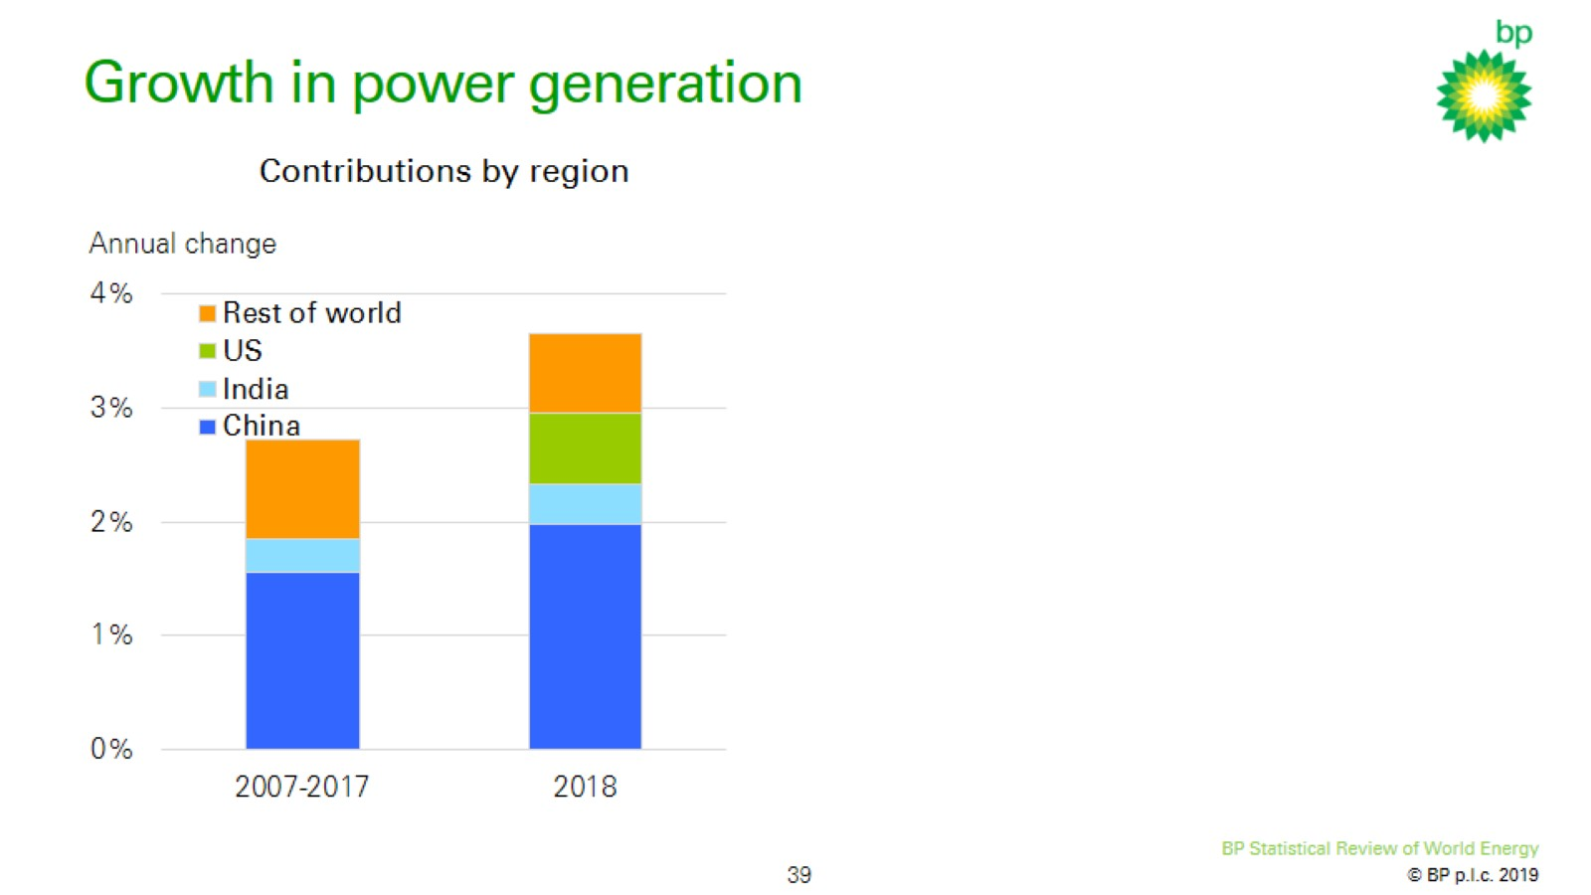
Growth in power generation

Slide 40
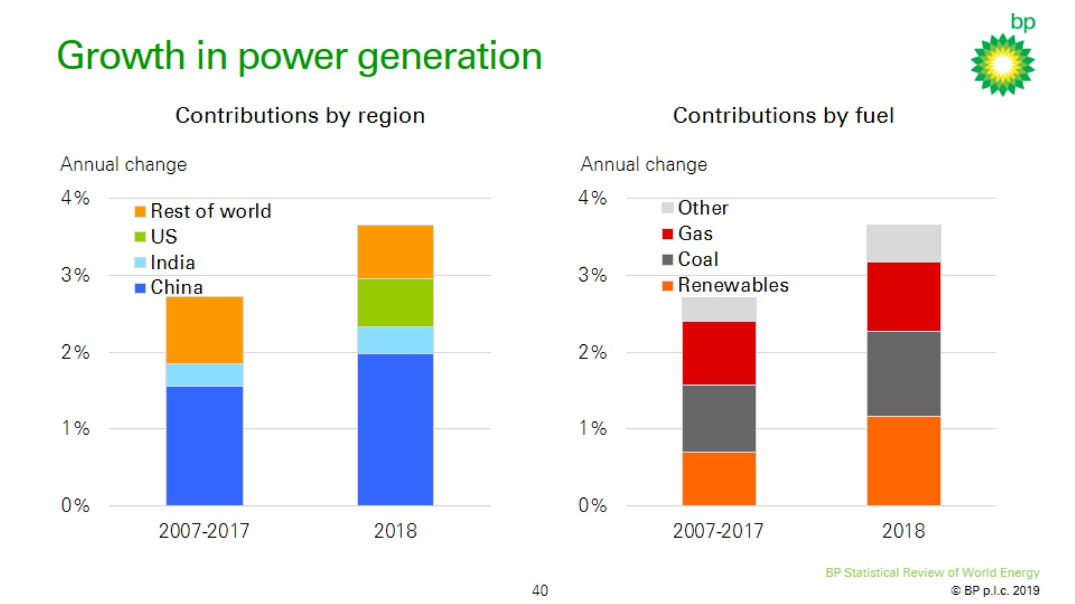
Growth in power generation

Slide 41
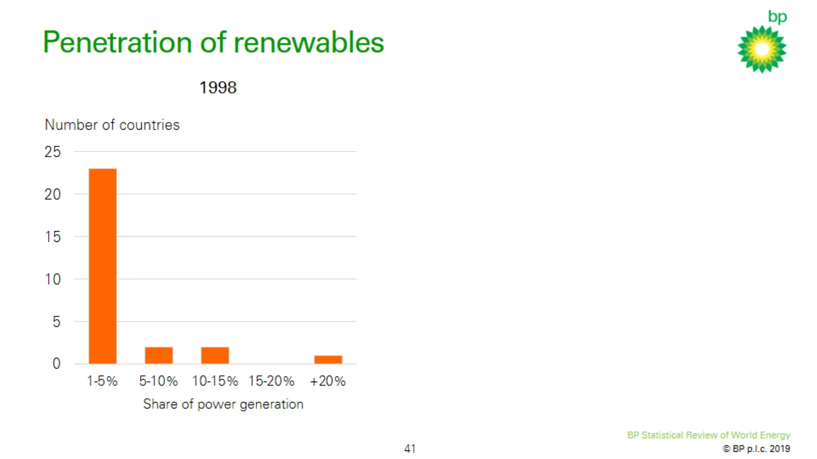
Penetration of renewables

Slide 42
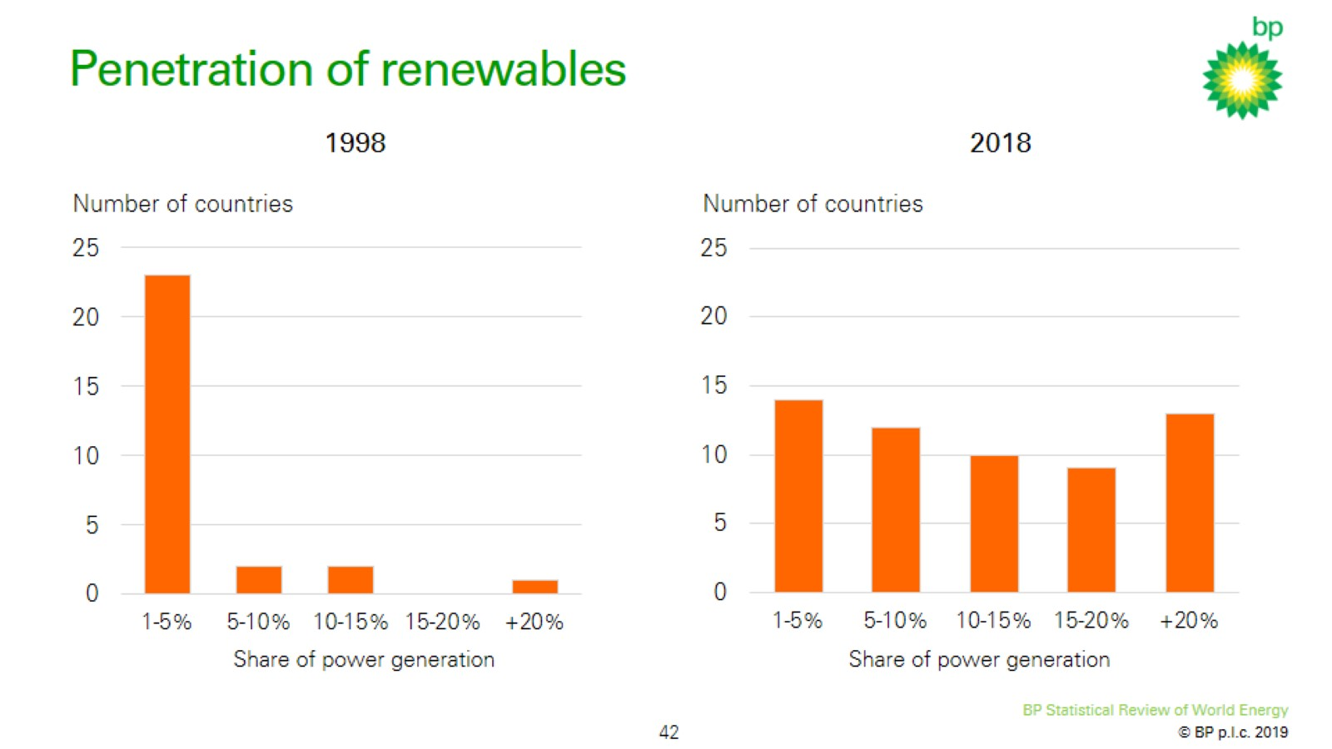
Penetration of renewables

Slide 43
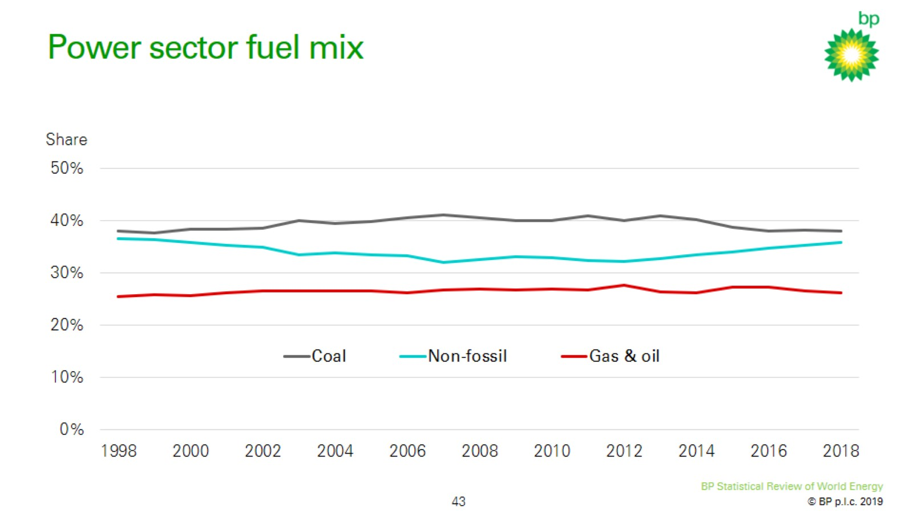
Power sector fuel mix

Slide 44
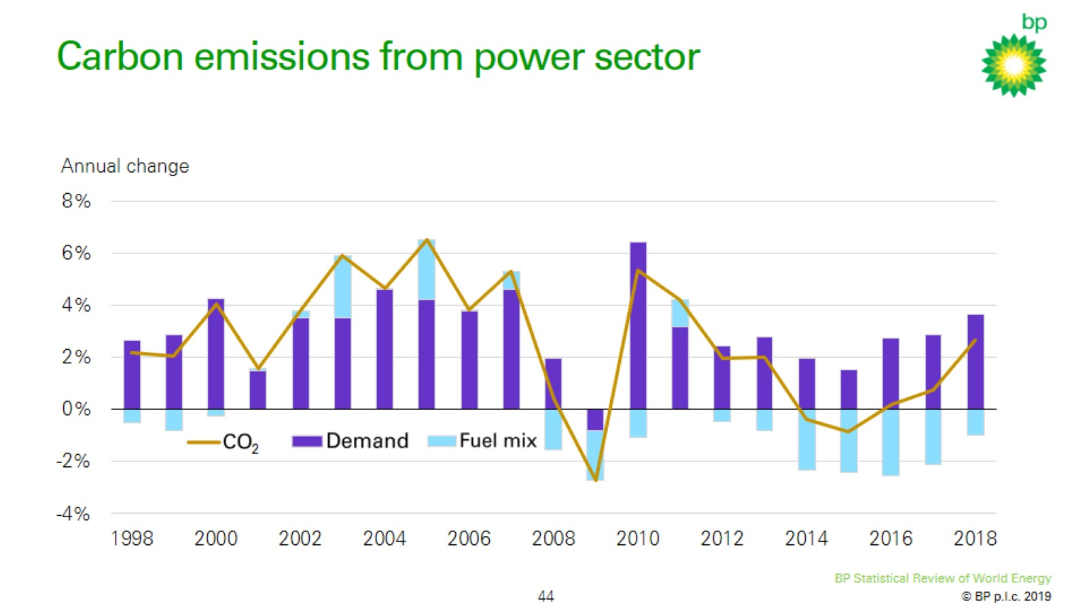
Carbon emissions from power sector

Slide 45
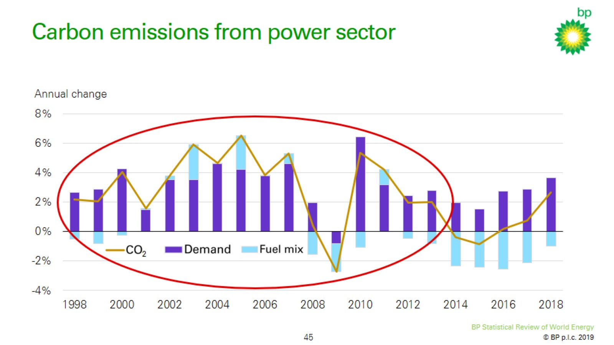
Carbon emissions from power sector

Slide 46
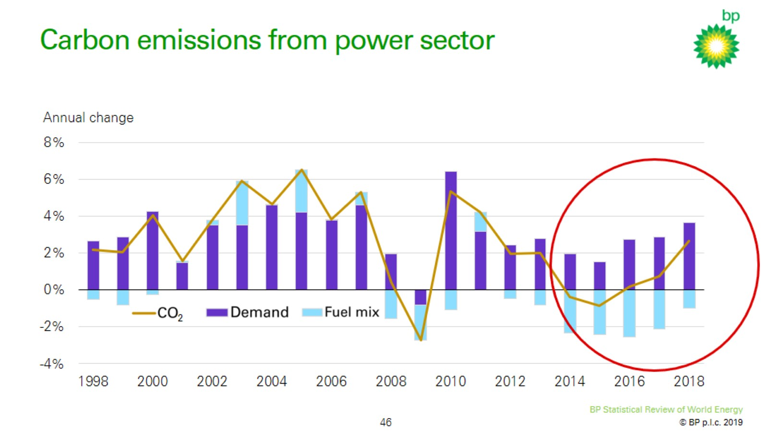
Carbon emissions from power sector

Slide 47
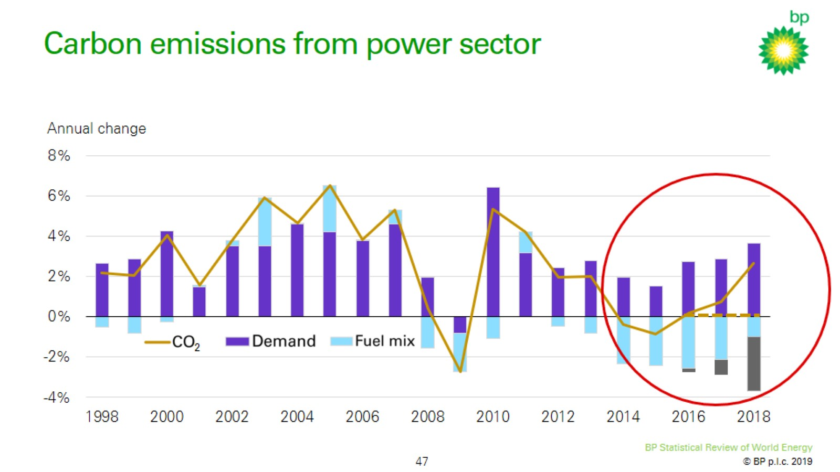
Carbon emissions from power sector

Slide 48
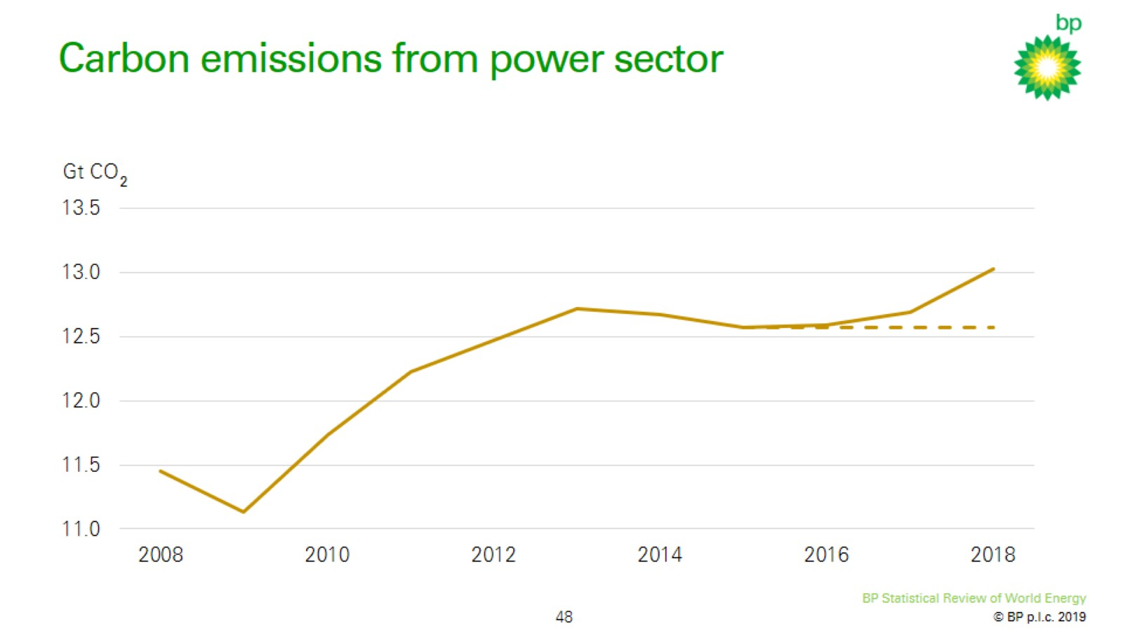
Carbon emissions from power sector

Slide 49
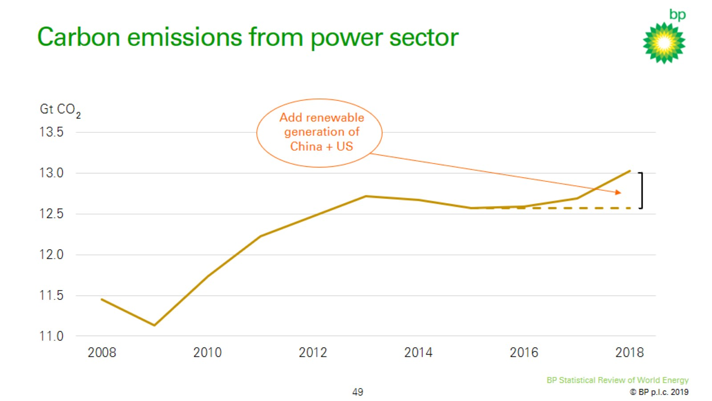
Carbon emissions from power sector

Slide 50
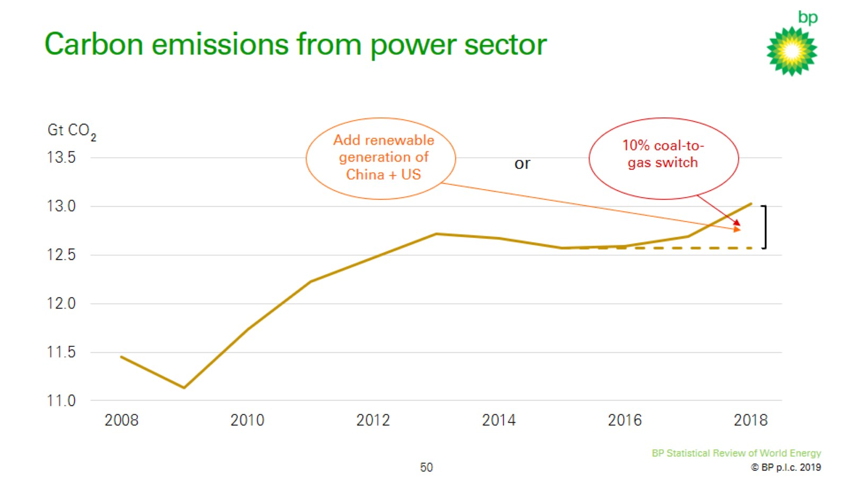
Carbon emissions from power sector

Slide 51


Slide 53
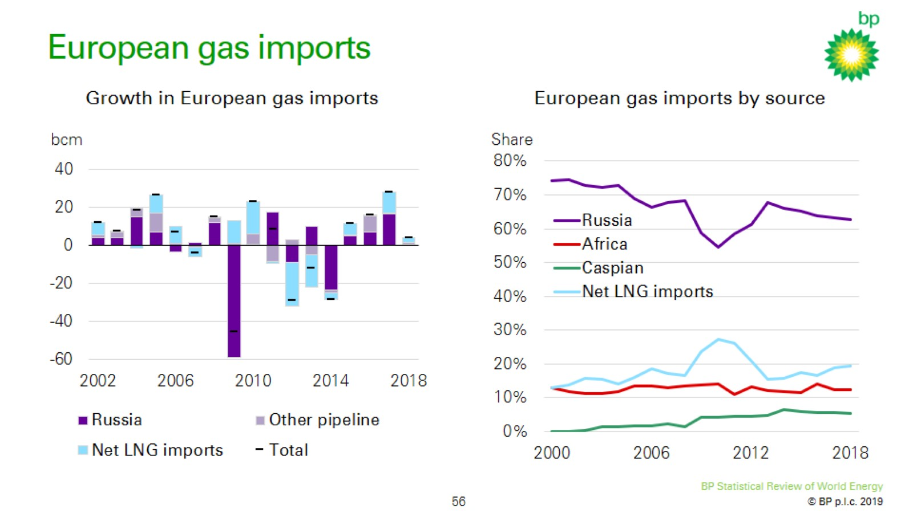
European gas imports

Slide 54
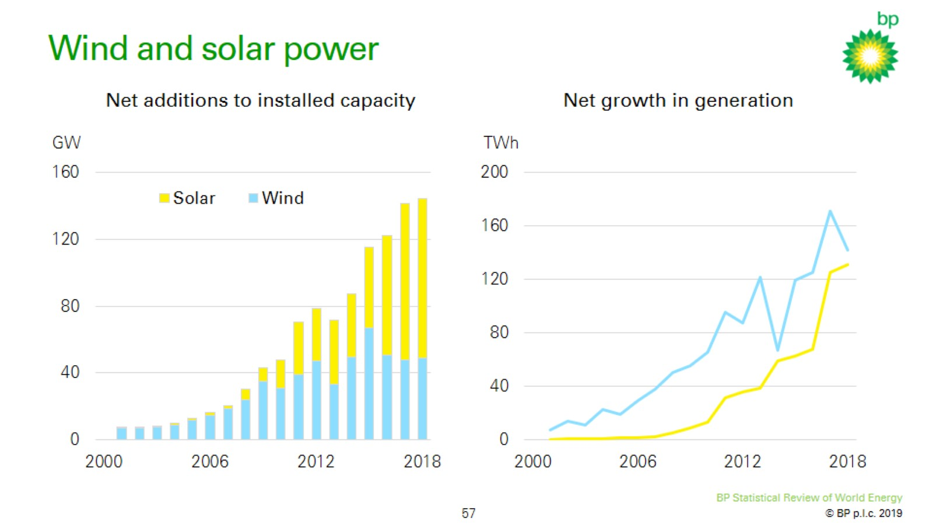
Wind and solar power

Slide 55


